Slide 1

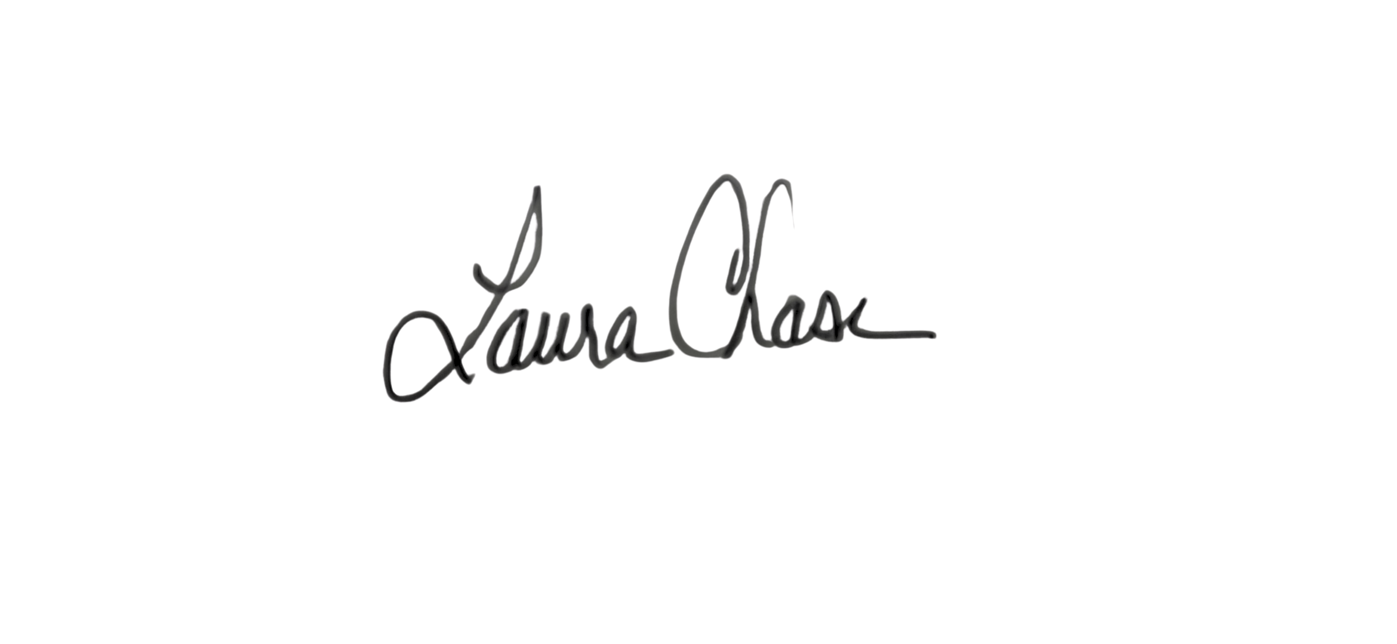




CERTIFICATE
of ACHIEVEMENT
SCHOLARSHIP AWARD
AWARDED TO
STUDENT NAME
on this Date of Graduation, in recognition of outstanding participation in the Bridge to Employment (BTE) Program and YEAR scholarship recipient
Laura Chase
Talent Access Leader, Global Talent Management
Johnson & Johnson
Lisa Johnson
Director, NIWL
FHI 360
Amanda McMahon
Director, Learning & Workforce Development
FHI 360

