Slide 1



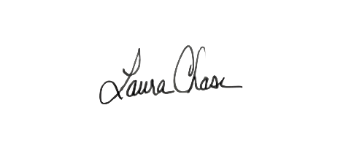





CERTIFICATE
of ACHIEVEMENT
CLASS OF
2026
AWARDED TO
STUDENT NAME
on this Date of Graduation, for successfully completing the Global Bridge to Employment (BTE) Program in [Program Location].
Laura Chase
Talent Access Leader, Global Talent Management
Johnson & Johnson
Lisa Johnson
Director, NIWL
FHI 360
Amanda McMahon
Director, Learning & Workforce Development
FHI 360

