Slide 1



COTTON BALL CATAPULT
Alliance Building & Training Session (ABTS) 2021
Teshell Ponteen Greene, Ph.D.
STEM²D Instructional Coach
FHI 360
October 26, 2021

Slide 2
STEM²D
About
“STEM” or Science, Technology, Engineering, and Mathematics, refers to an increasingly important sector of studies and careers. In 2015, Johnson & Johnson added ²D to its women in STEM initiative (WiSTEM²D) to recognize and elevate the manufacturing and design disciplines, which are directly aligned with the other STEM subjects.
WiSTEM²D addresses gender disparities within STEM²D fields and engages young girls and women through four pillars:
Youth Programs
University Programs
Professional Programs
Partnership Programs
Sparking enchantment with stem²d subjects for young women and girls through creative problem solving and play
- Johnson & Johnson youth pillar programs

Slide 3
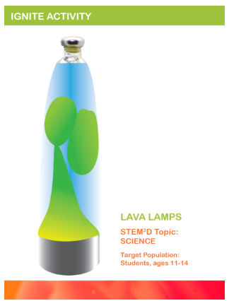
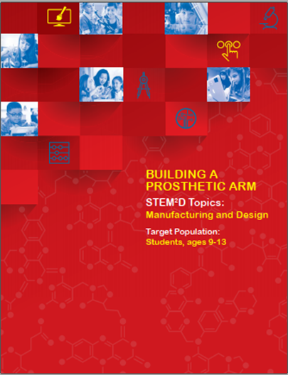



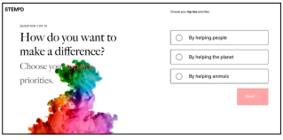
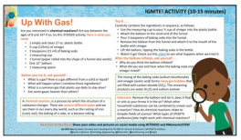
STEM²D Student Activities
Ignite! activities
A suite of activities for educators, parents, and volunteers to use as they engage youth with STEM²D. They incorporate a comprehensive approach to student-centered learning.
Interactive, hands-on, minds on learning
Collaboration & teamwork
Inquiry-based investigations
Project based with real-life application
Build confidence for student
Exposure to diverse role models
Activity Listing
Ignite! (10+)
Activities at Home (6)
Student Classroom Activities (26+)
STEM²D Career Quiz
STEM²D Recorded Events
CLASSROOM activities
CAREER QUIZ
Activities at Home
For more details, visit stem2d.org for the WiSTEM²D resources and ExploreSTEM2D.fhi360.org to learn more about the STEM²D Quiz

Slide 4
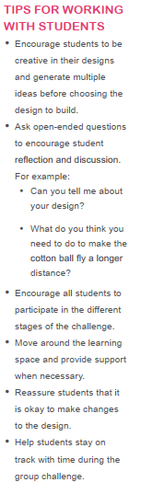
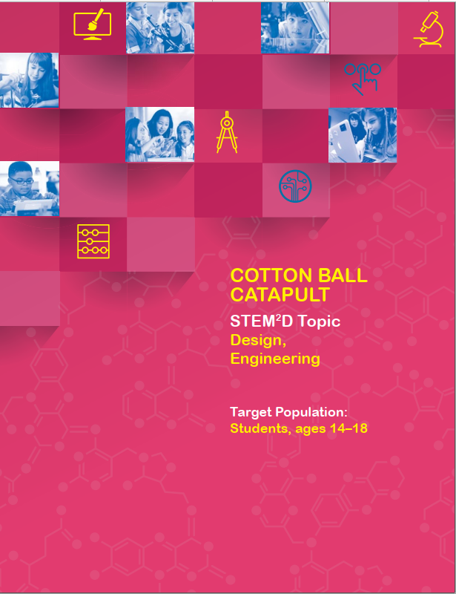
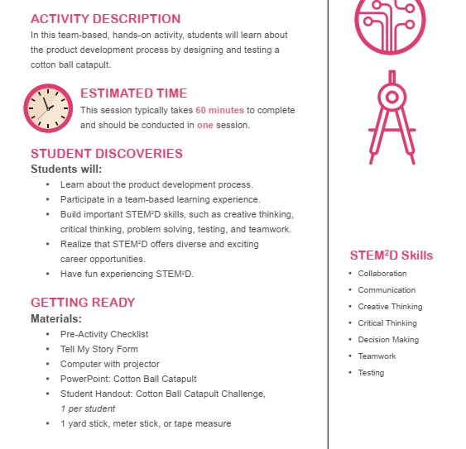
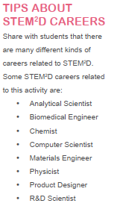
Classroom Activities
A series of fun, interactive hands-on activities in the STEM²D subjects for elementary and secondary school students. (26+)
  An activity guide, which includes educator and student materials with extended learning activities.
  The guide has structured time, questions and tips to engage students, skills addressed, and a list of careers related to the activity.
  An associated PowerPoint with the background content for the activity.
Photo Source: STEM²D Student Activity, Cotton Ball Catapult
For more details, visit stem2d.org

Slide 5
Activities Inventory
Activity Name | Description | Target Age | STEM²D Focus | Length (mins)
A Day in the Life of a Person with Diabetes | Measure the “blood-glucose levels” of a person with diabetes and explore how diet, exercise, medication, and new technologies may affect those levels. | 12-16 | S, M | 210
Backpack Challenge | Students will design a new backpack that they can use. | 12-16 | D | 90
Biomimicry in Design and Engineering | Students learn how nature and the living world provide inspiration for addressing the world’s challenges. They will design a structure or product inspired by nature. | 14-18 | D, E | 60
Build a Scientific Research Vessel | Design and build a seaworthy vessel that floats in water and can hold a specific amount of weight. | 14-18 | E, D | 60
Building a Medical Device | Students design, build, and test a medical device that meets a customer’s needs. | 12-18 | E, D | 150
Building a Prosthetic Arm | Design, build, and test a prosthetic arm that meets a customer’s needs. | 9-13 | M, D | 180
Building with Wonderful Junk | In this construction activity, young people have fun as they work in teams to plan and build large structures using recyclable materials brought from home. | 11-14 | D, E, S, M | 60
Change It, Create It, Solve It, Engineer It | Students practice engineering design. They begin to recognize that technologies and new innovations result when engineers apply science and math principles to design and develop products, structures, machines, tools, or systems that improve everyday life. | 11-14 | E, T, D | 45-60
Cleanser Challenge | Students explore science by creating their own facial products that meet specific consumer needs. | 11-14 | S, D | 90
Cotton Ball Catapult | In this team-based, hands-on activity, students learn about the product development process by designing and testing a cotton ball catapult. | 14-18 | D, E | 60
Create It, Try It, Manufacture It | Students identify the importance of personal experiences to making career choices and recognize opportunities in manufacturing for people with STEM²D skills and training. | 11-14 | M | 45-60
Egg Drop Challenge | Students explore design and manufacturing concepts by designing, building, testing, improving, and executing a device to protect an egg from breaking when dropped from a minimum height. | 12-16 | D, M | 90
Exploring Research & Development | Students will take on the role of a biomedical scientist and conduct laboratory research to examine the impact of different drug formulations | 11-14 | S, M | 60
From Innovation to the Patient: The Pharmaceutical R&D Process | This activity introduces students to pharmaceutical research and development—the process of developing new medicines that improve and save patients’ lives. | 11-14 | S | 60
Great Bones | Students learn about research and development (R&D) and how engineers use this process to design different technologies and medical devices to help doctors successfully treat patients. | 12-16 | D, E | 60
Ouch! Need a Band-Aid: Designing, Constructing, and Packaging as BAND-AID | In this engineering design activity, young students have fun working in teams to construct and package an adhesive bandage for a specific injury using everyday materials provided for them. | 7-10 | D, E, S, M, M | 90
Pollution Solution | Learn how pollution affects the environment and brainstorm solutions to pollution in the world. | 12-14 | S | 60
Putting Wind Energy to Work | Students learn how wind is used to generate energy and will learn about the design process by designing a wind turbine. | 10-15 | D | 140
Soapy Mathematics | Students will apply basic mathematics principles and skills to analyze the performance and determine corrective actions, if needed, of a production line. | 14-18 | M, E, M | 60-90
Strawberry Squish | Extract DNA from smashed strawberries and learn how DNA and genes play an important role in human development. | 14-18 | S | 60
Technology Everywhere | Use circuits to make an alarm. Students will learn about switches and use this new information and the engineering design process to complete a challenge. | 11-14 | T, E | 45-60
The Design Challenge | Students learn about human-centered design principles and complete a design challenge around oral hygiene. | 11-14 | D, E, T | 270
The Supply Chain and Lean Manufacturing | Students learn about the manufacturing process, use their critical thinking and problem-solving skills to evaluate a supply chain, and apply “lean principles” to make it work more efficiently. | 11-14 | M | 75
What's the Code? Coding Robot Movements using Sound | In this coding design activity, young students have fun working in teams to design and execute a code for specific robot movements using everyday materials provided for them. | 7-10 | D, E, S, M | 60
Where Does the Water Go? Calculating a Neighborhood Water Footprint | Students calculate the water usage of households in an imaginary neighborhood. They determine if there is enough water to meet demand or if restrictions need to be put in place. Students design and build a pumping station to move water from the reservoir to their house. | 10-14 | D, E, S, M | 60

Slide 6


Cotton Ball Catapult

Slide 7
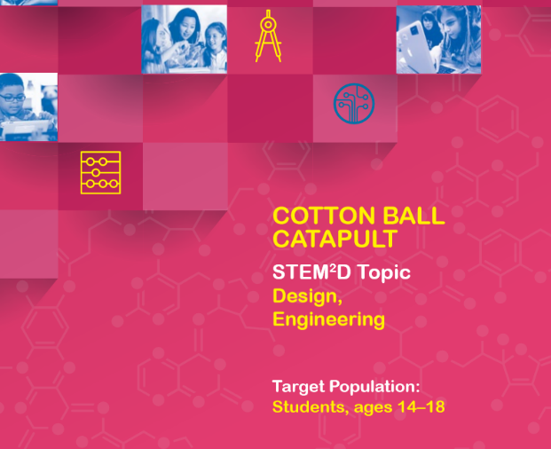
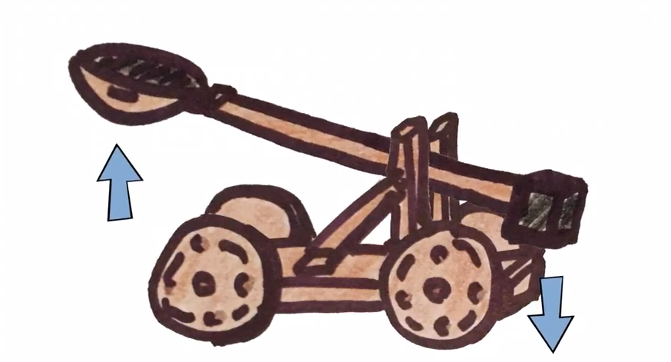
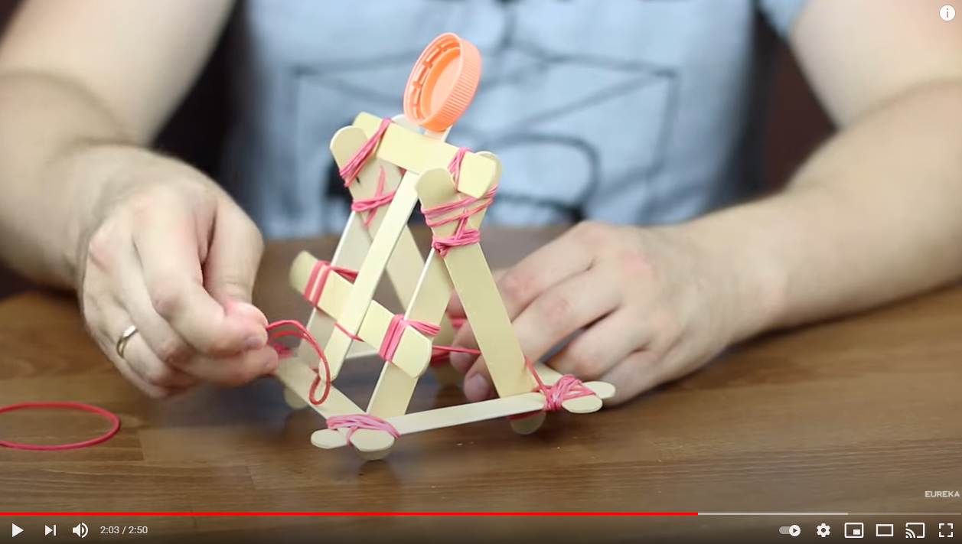
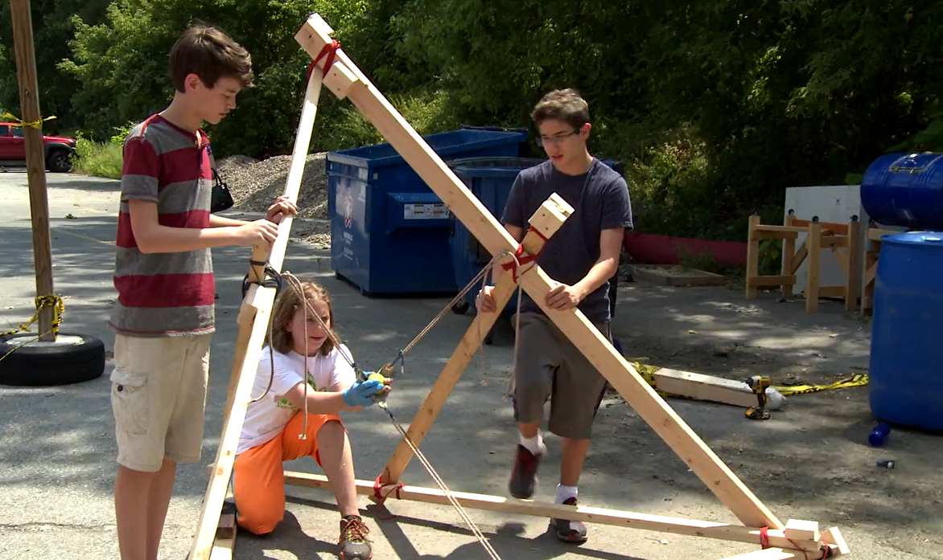
Cotton Ball Catapult
60-minute classroom and team-based, hands-on activity.
Students learn about the product development process by designing and testing a cotton ball catapult.
  Design, Engineering, Physics
  Intro to STEM²D or a particular area of STEM²D, half day or one day session activity or multiple day activity.
  Student and Facilitator Guide, example video demonstrations
Build a Catapult | Background Information
Creating Catapults Using Popsicle Sticks - Demonstration
For more details, visit https://www.stem2d.org/design-catapult to learn more about Cotton Ball Catapult

Slide 8
Review the Activity Background – Product Development
The overall process of strategy, organization, concept generation, product and marketing plan creation and evaluation, and commercialization of a new product.
The five (5) stages of Product Development
  Generating Ideas – brainstorm and concept generation
  Evaluating and Screening Ideas – assess idea for invention and innovation
  Protecting Ideas – patents and trade secrecy (e.g., Coca-Cola formula)
  Research and Development (R&D) – obtain new knowledge that can help create goods and services.
  Marketing, Promotion, and Distribution – TV, radio, commercials etc. to make product available to consumers for purchase.
Generate Ideas
Evaluate and Screen Ideas
Protect Idea
Research & Development
Market

Slide 9
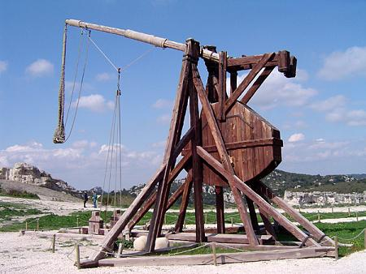
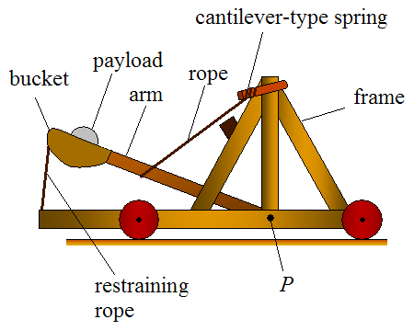
Describe the Challenge
About the Cotton Ball Catapult Challenge:
Each student will work with a partner to perform three of the five stages of the product development
  Generating Ideas
  Evaluating and Screening Ideas
  Research and Development (R&D)
The product the team is developing is a cotton ball catapult!
  A device that hurls an object some distance
    Medieval times – stones, spears etc.
    Modern day – aircraft, missiles
Goal - Design and test a catapult to get the cotton ball to fly as far as possible!
Notes:
Explain that a catapult is a device that is used to hurl an object some distance. Point out the parts of the catapult.

Slide 10
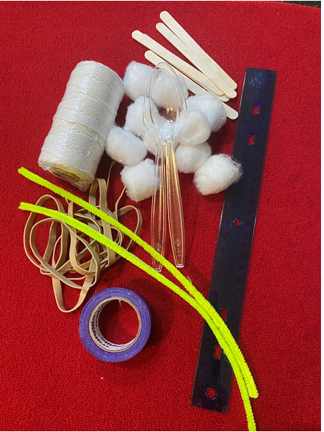
Discuss the Materials & Instructions
Cotton Ball Catapult
  Step 1: Generate Ideas! As a team of two (2), sketch possible designs for a cotton ball catapult. Keep in mind you may only use the materials provided when building your design.
  Step 2: Choose a Design. With your teammate, choose one design to build.
  Step 3: Build the Catapult. You have 15 minutes to build your catapult as a team. Use only the materials provided to build your catapult based on your design. Keep an eye on the time.
  Step 4: Test. Test the catapult and make changes as needed in order to get the cotton ball to fly as far as possible. Do not launch the cotton ball at other students or teams
  Step 5: Determine the Winning Team. Once all catapults are built, we will test each team’s design as a large group to see which design works the best.
Materials
10 cotton balls
1 ruler
5 popsicle sticks / wooden sticks
1 roll masking tape
10 rubber bands
2 plastic teaspoons
2 pipe cleaners
6’6” (2 meters) of string
For more details, visit stem2d.org

Slide 11

Cotton Ball Catapult
Demonstration

Slide 12
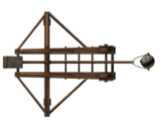
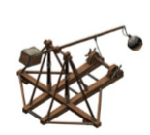
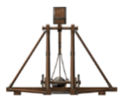
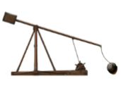
Catapult in a Bag - Tip Sheet
In your Catapult in a Bag, you will find the following
10 cotton balls
1 ruler
5 popsicle sticks / wooden sticks
1 roll masking tape
10 rubber bands
2 plastic teaspoons
2 pipe cleaners
6’6” (2 meters) of string
Activity Challenge (Do not start until the session)
Design and test a catapult to get the cotton ball to fly as far as possible!
Pre-Session Preparation
Review the contents of your Catapult in a Bag.
Think about how you can use the materials to design a catapult (see sample images).
Create a sketch of your design. You will need it for the virtual session.
Think of items around the house you may be able to substitute for materials in your kit.
  Write them down. You will share some of your ideas during the session.
Bring your excitement and inquisitiveness to the live demonstration.
Have fun during the session, ask questions, and share your insights!
For more details, visit stem2d.org

Slide 13
Let's Get STARTED!
Share in the chat or use the raise your hand feature to comment on some of the ideas/approaches you came up with for how to create your catapult.
Review the sketch you created and share one strategy you will use to make your catapult.
  Keep in mind the goal is to launch the cotton as far as you can.
Type in the chat, items from around the house you can easily substitute for materials in your kit. (virtual session or extension activity)
Let’s go ahead and make our catapults!
Now let’s test our catapults! (Example)
  Line up your students and give them 3 tries to launch their catapults.
  Have them record each launch distance using the 2-meter string and/or ruler.
  Take the average of the three launches, determine the winning team.
  Each team shares their experience.
For more details, visit stem2d.org

Slide 14
Review - Student Reflection Questions
Think about the following questions…
What did you learn about product design?
What would you do differently if you were to repeat this activity?
How do you think this activity relates to a career in design and engineering?
Can you see yourself as a STEM²D professional? In what role? Why or why not?
What would you need to do to make that happen?

Slide 15
Activity Extension Ideas
Have the students test how many cotton balls they can launch at once.
Have the student teams swap their design idea and create the catapult of that design.
  Share about their experience, what was challenging etc.
Add one or two additional materials for the students to use as they build their catapults.
  Cup, paper, binder clips, paper clips etc.
  Example substituted items: dry beans, coin, drinking straws, pieces wood/tree, pencils, clothe pins
Add another variable for the students to test their launch.
  Combine the weight of the cotton ball using the masking tape or pipe cleaners.
  Add a cup for them to try and catch the cotton ball.
Add an associated cost to each of the materials and give students a budget to work within.
  Can purchase materials but need to stay within budget.

Slide 16
Q&A / Share Thoughts

Slide 17
Thank You!

Slide 18
!
Teshell Ponteen Greene, PhD
STEM²D Instructional Coach, FHI 360
National Institute for Work and Learning
tgreene@fhi360.org
LinkedIn: Teshell Ponteen Greene

