Slide 1
Pathway to Success
Fall 2020 Online Forum
Saturday, November 7, 2020

Slide 2
DUE TOMORROW
Resume
Bio
Headshot
Maida Ahmad
Sarah Costa
Eric Gonzalez
Katherine Gonzalez
Will Green
Gianni Hodges
Dulce Javier
Jennifer Marroquin
Andy Reyes
Raisa Sabiha
Lizbeth Sanchez-Andrade
Ama Smith

Slide 3
EFFECTIVE STUDY STRATEGIES FOR
FINAL EXAMS

Slide 4
HOW DO YOU STUDY?
Walk us through your real-life study routine… and be honest ☺

Slide 5
Open Sharing

Slide 6
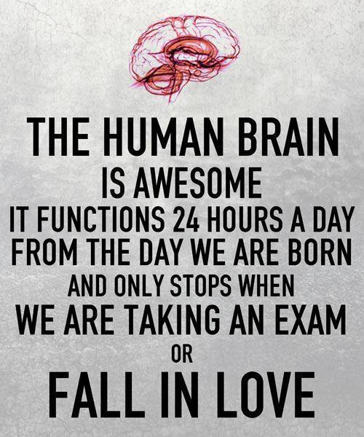
Think back to the exams you’ve taken already…
Do you feel that the grade you got on your exam is not representative based on how much you studied or what you got on your practice exams?
Did you freak out during the exam when you saw a question type that you haven't seen previously?
Did you read a question and have no idea how to go about solving it?
Looking back, were you overconfident based on how you did on practice exams?

Slide 7
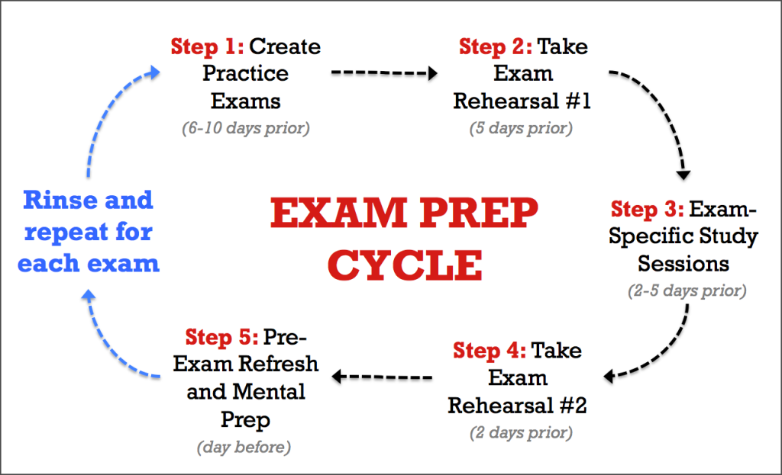

Slide 8
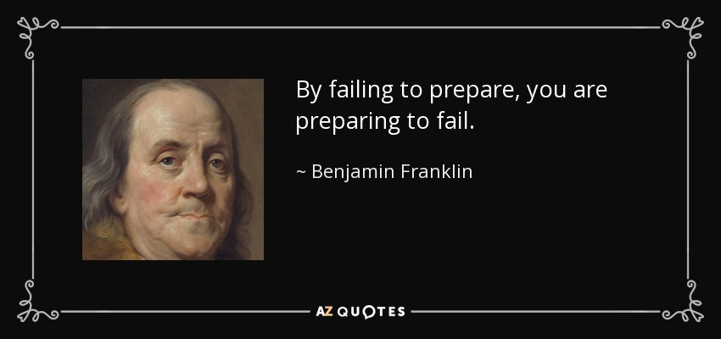

Slide 9
Final Exam Study Schedule

Slide 10
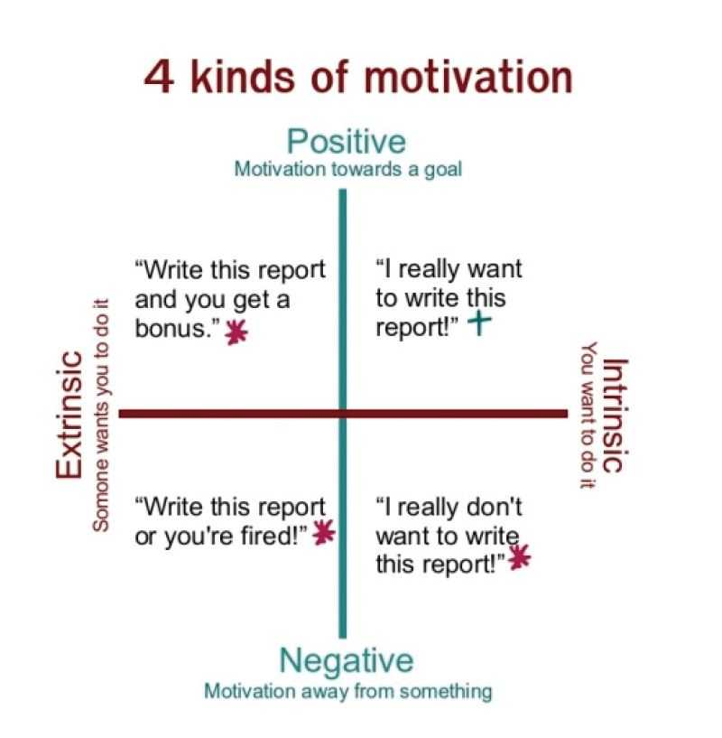
Find Your Motivation!
Be clear about why you want to get good grades:
I want to get into a good school/program
I want to have a meaningful career
I want to know that I gave it my best shot
“Do this assignment for extra credit.”
“I really want to do well on this assignment.”
If you have time to procrastinate, study!
You have limited time to study before your exams.
You have plenty of time after the exam to make excuses.
“Do this assignment or you will fail.”
“I really want to don’t want to do this assignment.”

Slide 11
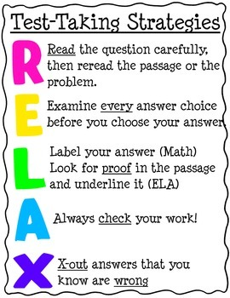
Attack the Questions: General Approach
Read the question WORD FOR WORD
Note any key words in the question: ex. LEAST, EXCEPT, NOT Qs
Reword the question in your own words – Make sure you know what the question is actually asking
What concept is this question testing? What do you know about this concept?
POE = Process of elimination
Ball-parking answers
Does the answer actually answer the question?
Label your units! And watch your exponents!

Slide 12
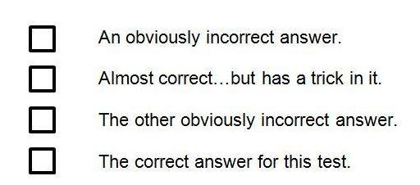
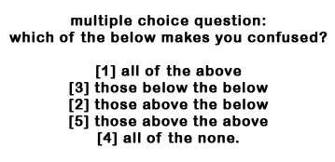
Anatomy of Multiple Choice Answer Choices
Typically:
Sometimes:
Don’t look for the “correct answer”
Look for the “least wrong answer”
Use process of elimination

Slide 13
Attack the Questions: Warm-up Qs
If you choose an answer to this question at random, what is the chance you will be correct?
25%
50%
0%
25%
If I were to say 25% of the answers are correct, I can't be correct because the answers saying 25% make up 50% of the answers.
If I were to say 50% of the answers are correct, I'd be wrong since it only makes up 25% of the answers.
If I were to say 0%, I'd claim that none of the answers are correct, including the one I gave, making this answer wrong. Since the other answers are wrong as well, this means that 0% is correct, though, but if it's correct, it invalidates itself again, leading to an endless cycle.

Slide 14
General Biology 101 & 102: General Tips
Don’t just memorize terms and definitions
On exam day, you will be expected to APPLY the concepts
Generate your own application questions (you should already be doing this)
Get into the mindset of the test writer. If you had to test this concept, how would you go about doing so?
Recognition vs. Recall vs. Application questions
There are very few recognition and recall questions on most exams
Most of the questions are application questions

Slide 15
Sample Exam Problem: GB101
Mitochondria are the “power plants” of eukaryotic cells. If you were to compare mitochondria to prokaryotic cells, what would you expect to find?
The inner membranes of mitochondria contain enzymes that transport mechanisms that are similar to those found in prokaryotes
Mitochondria contain DNA molecules that are structurally similar to those found in prokaryotes
Mitochondria provide energy to prokaryotic cells
The ribosomes found in prokaryotes are more similar to those found in eukaryotic cells than they are to those found in mitochondria
I and II
II only
I only
I, II, and IV
All of the above

Slide 16
Sample Exam Problem: GC161
Ultraviolet radiation and radiation of shorter wavelengths can damage biological molecules because they carry enough energy to break bonds within molecules. A typical carbon-carbon bond requires 348 kJ/mol to break. What is the longest wavelength of radiation with enough energy to break the carbon-carbon bond?
237 nm
344 nm
364 nm
387 nm
311 nm
What are you asked to solve?
Wavelength
What information are you given?
Energy/mol
How do we get there?
$E= \frac{hc}{λ}$

Slide 17
Sample Exam Problem: GB102
Which of the following features is/are characteristic of ALL prokaryotes, eukaryotes, and viruses?
Ribosomes
Nucleoid
Genetic material
Plasma membrane
Proteins
III and V
III only
I, II, and V
III, IV, and V
None of the features are characteristic of all three groups

Slide 18
Sample Exam Problem: GC162
The reaction 2 H₂O₂ → 2 H₂O + O₂ has the following mechanism
H₂O₂ + I⁻ → H₂O + IO⁻
H₂O₂ + IO⁻ → H₂O + O₂ + I⁻
The catalyst in the reaction is
IO⁻
H₂O
I⁻
H₂O₂
There is no catalyst
What concept are the testing?
Catalysts
What else could the question have asked?
What is the intermediate?
*Can you explain what each of the other answer choices are?

Slide 19
Don’t be a trend seeker!
If you are having trouble on exams despite all of your hard work and hours studying, you might fall in the category of students described as a "trend seeker."
Trend seeker (noun)
A student who instinctively matches a new question to a previous question they have seen and they approach the problem in a manner similar to how they approached a problem previously and can generally get to the correct answer (which is great for answering questions in general, but its not a good approach since you don't know what type of questions the exam will give you.. and it is unrealistic for you to have seen all possible question types prior to the exam). Consequently, trend seekers get the false impression that they have mastered a concept since they can answer many similar questions correctly, without actually mastering the content.
If you suspect that you are a trend seeker, you need to break out of that habit to succeed in future courses. It may get you thru 100 level courses, but not upper level.

Slide 20
How do I know if I am a trend seeker?
Look at any question you have done and ask yourself why you solved the question the way that you did. If your answers go something along the lines of:
Well, in lecture the professor started this problem by…
In a similar question, I first…
For all ______ types of questions, I start by…
I just knew I had to use this equation…
I got the answer right last time (previous attempt) by…
I remembered by TA/SI instructor do…
This is the only equation for _____ so…
…without you following it up with “because _____” and an explanation of the concept, then you might be a trend seeker

Slide 21
How Do I Overcome Being a Trend Seeker?
If you have identified yourself to be a trend seeker, you are probably doing well on practice questions and practice exams. To overcome being a trend seeker:
Study in groups
Explain the solutions of the problems to each other
Not just HOW to solve the problem but explain WHY you take those particular steps
Try the challenge questions at the end of the chapter. These questions really test your understanding of the concepts.

Slide 22
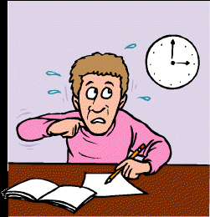
Time Management during the Exam
“I knew the concepts but I ran out of time!”
“I got the easy questions in the end wrong because I got stuck at an early problem and had to rush towards the end.”
STRATEGIZE YOUR TIME!
Do a 1st run through the exam and do the “easy” questions first
If you find yourself stuck on a problem, give yourself another 30 seconds, pick an answer, and move on

Slide 23
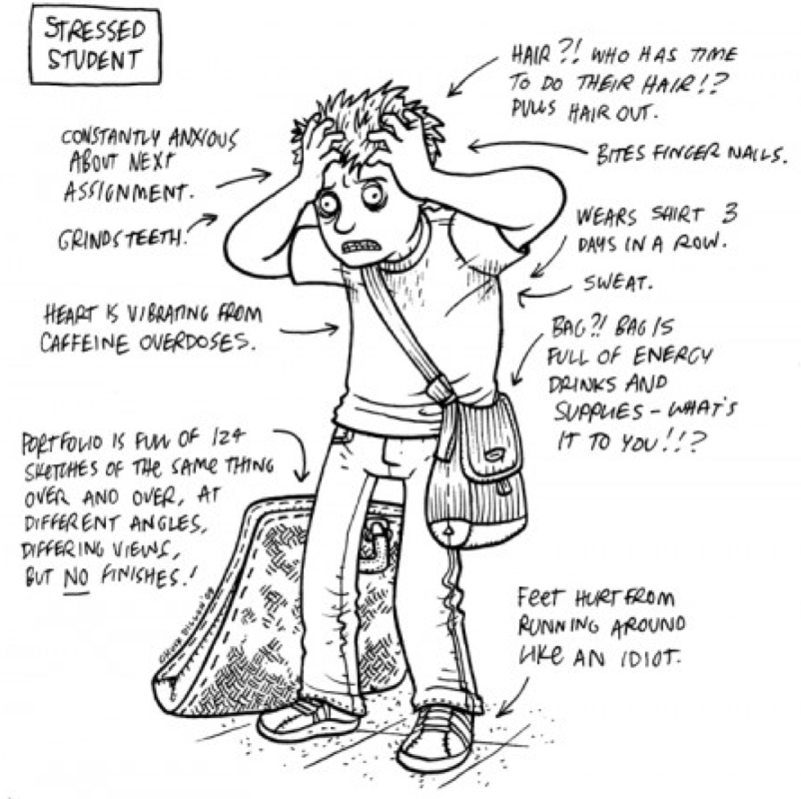
Oh but my anxiety!!!
Test anxiety is a vicious cycle:
Test as a threatening event
Anxiety lowers performance
Poor outcome confirms the perception of threat
Lack of confidence in ability
Stronger feeling that the test is threatening

Slide 24
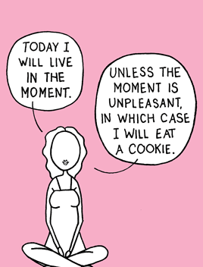
How to Reduce Test Anxiety BEFORE a Test
Manage time
Organize materials
Tutoring
Homework
Study groups
Arrive early
Eat healthy – light, nutritious
Well rested
Positive self-talk
Don’t discuss exam with anyone beforehand
Do something relaxing 1 hour before exam
The best way to reduce test anxiety is to BE PREPARED!

Slide 25
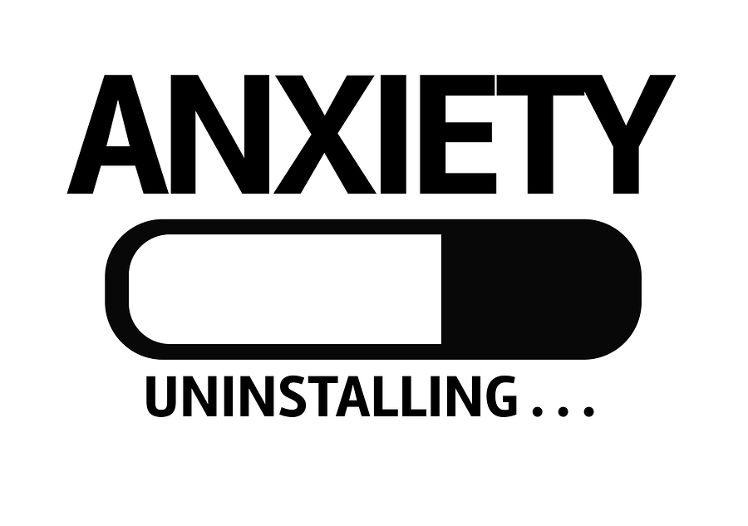
How to Reduce Test Anxiety DURING a Test
Breathe
Do what you can do first to gain confidence
Replace negative thoughts with positive thoughts
Brain dump
Read directions carefully
Write down what you know
Information may come to you
Partial credit
Use same pen/pencil/eraser
Stop when you are done
Don’t leave anything blank

Slide 26
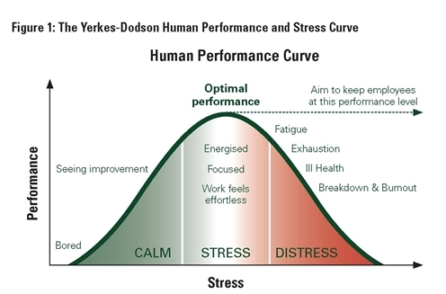
If you believe your anxiety is seriously hindering your performance, you might want to consider speaking to CAPS or the mental health support service at your school.

Slide 27
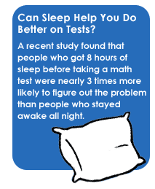
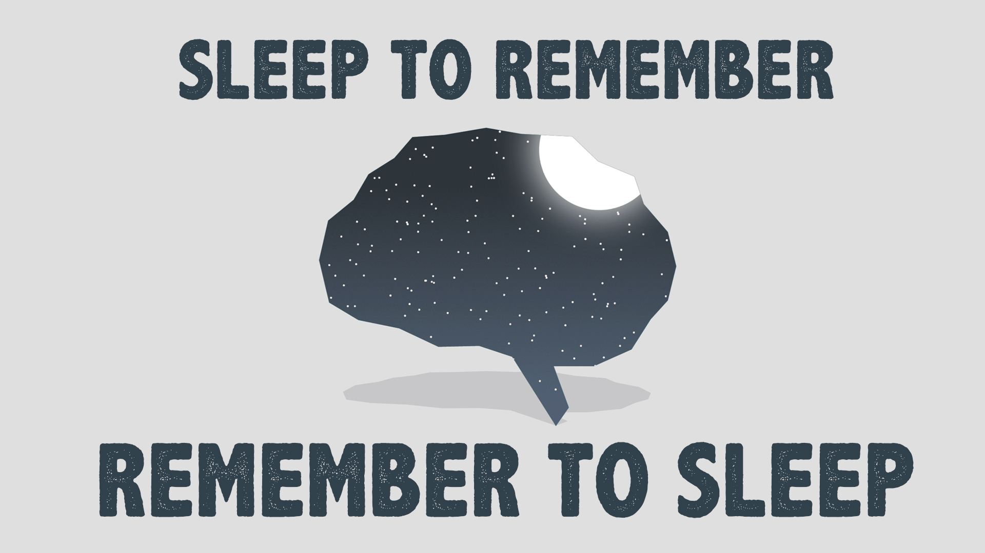
To Sleep or Not to Sleep?
Get a good night of sleep!
Prepare your tools beforehand (pens, calculators, etc.)

Slide 28
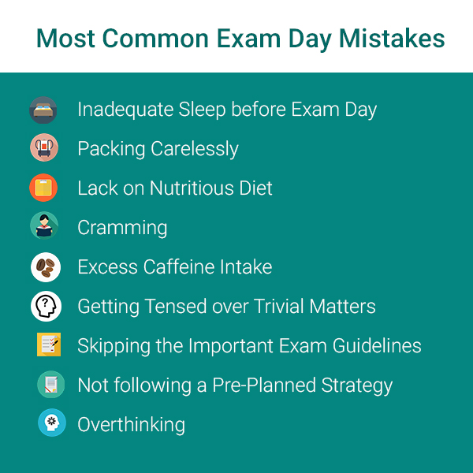
Your mindset plays a large part in how you perform on your exams

Slide 29
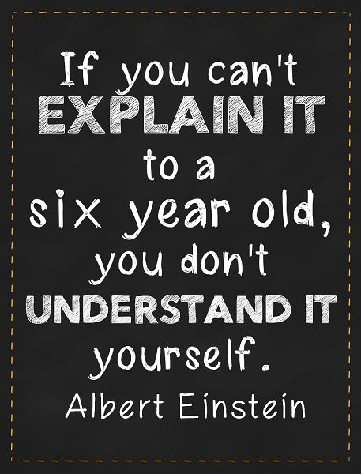
Exams: Are you ready?
How do you know you are ready for an exam?
Can you explain the concept?
Can you explain the answers to application questions?
Can you explain each step required to generate the correct answer?
Utilize the syllabus, homework questions, quiz questions, and practice exams

Slide 30
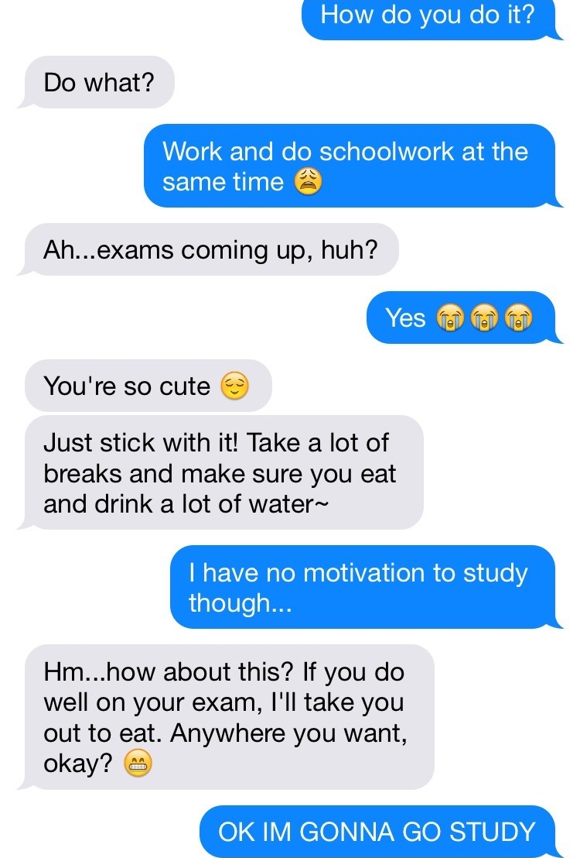
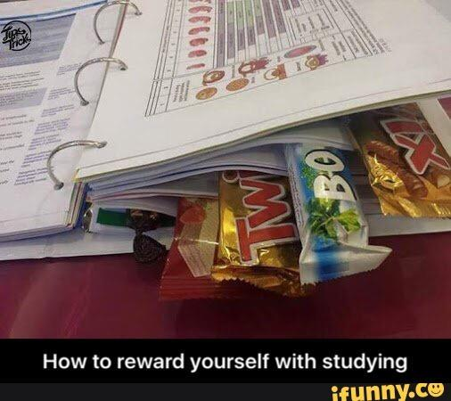
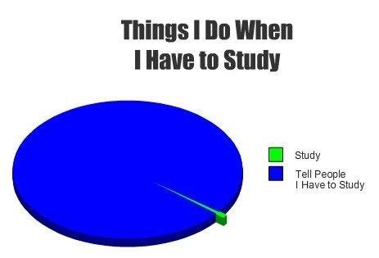
Reward Yourself!
Find what motivates you!
You know the rewards you are willing to work for.

Slide 31
Time to SHINE!
The exam is when you can finally show off the new knowledge you have acquired!
You have studied hard, mastered concepts, so go show off your skills!
Remember:
No matter how strangely a question is worded or presented, it can only be testing a concept that you have studied.
If you have been studying properly, you have all the tools you need to tackle any exam question.

Slide 32
Winter Seminar
2-Day Virtual Experience
Day 1: Energy for Performance 2.0
Day 2: Professional Portfolio
Do you prefer a particular week in January?

