Slide 1


Building Your LinkedIn Profile
December 2022

Slide 2
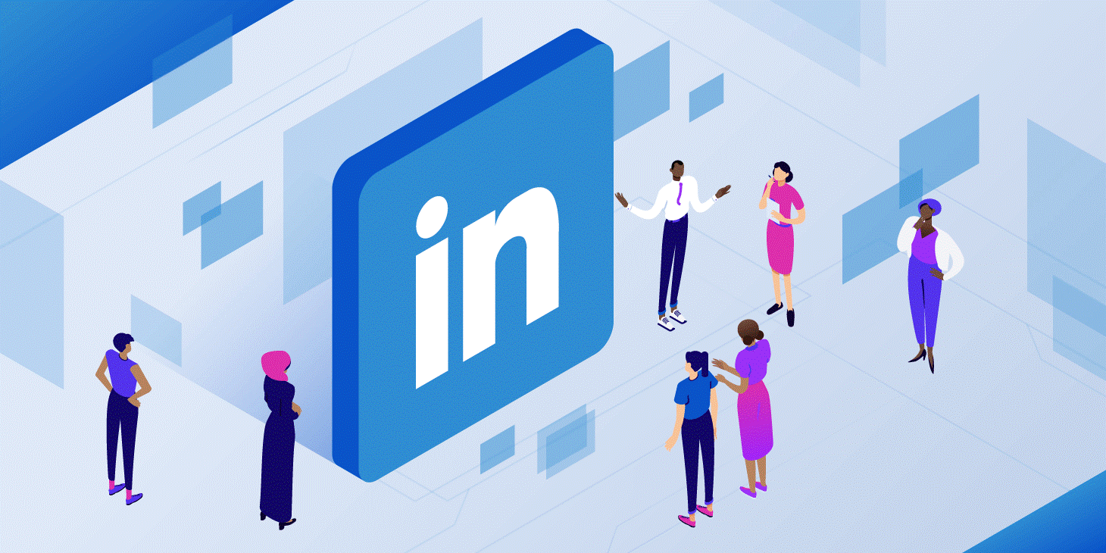


LinkedIn Overview
1

Slide 3


LinkedIn for Students
Notes:
Source: https://www.youtube.com/watch?v=YWp6AN00D_c&feature=emb_logo

Slide 4

LinkedIn
Overview
1
2
Linkedin is an online network for business professionals
It is designed specifically for professional networking: finding a job, connecting with potential business partners, and maintaining a professional network.
A top resource for recruiters
93% of recruiters are using LinkedIn to identify future employees.
Almost 100% use it to initially screen applicants.

Slide 5
LinkedIn
What it is
Is…
Is Not…
A place to share your professional profile.
A place to connect with and learn about other professionals.
A place to learn about companies, jobs, industries, and trends.
A place to remain connected to the BTE alumni, Johnson & Johnson volunteers, and other program partners from around the world.
A place to post social pictures, share music, share politics, etc.
A duplicate of Facebook, Instagram, TikTok, or Twitter.

Slide 6
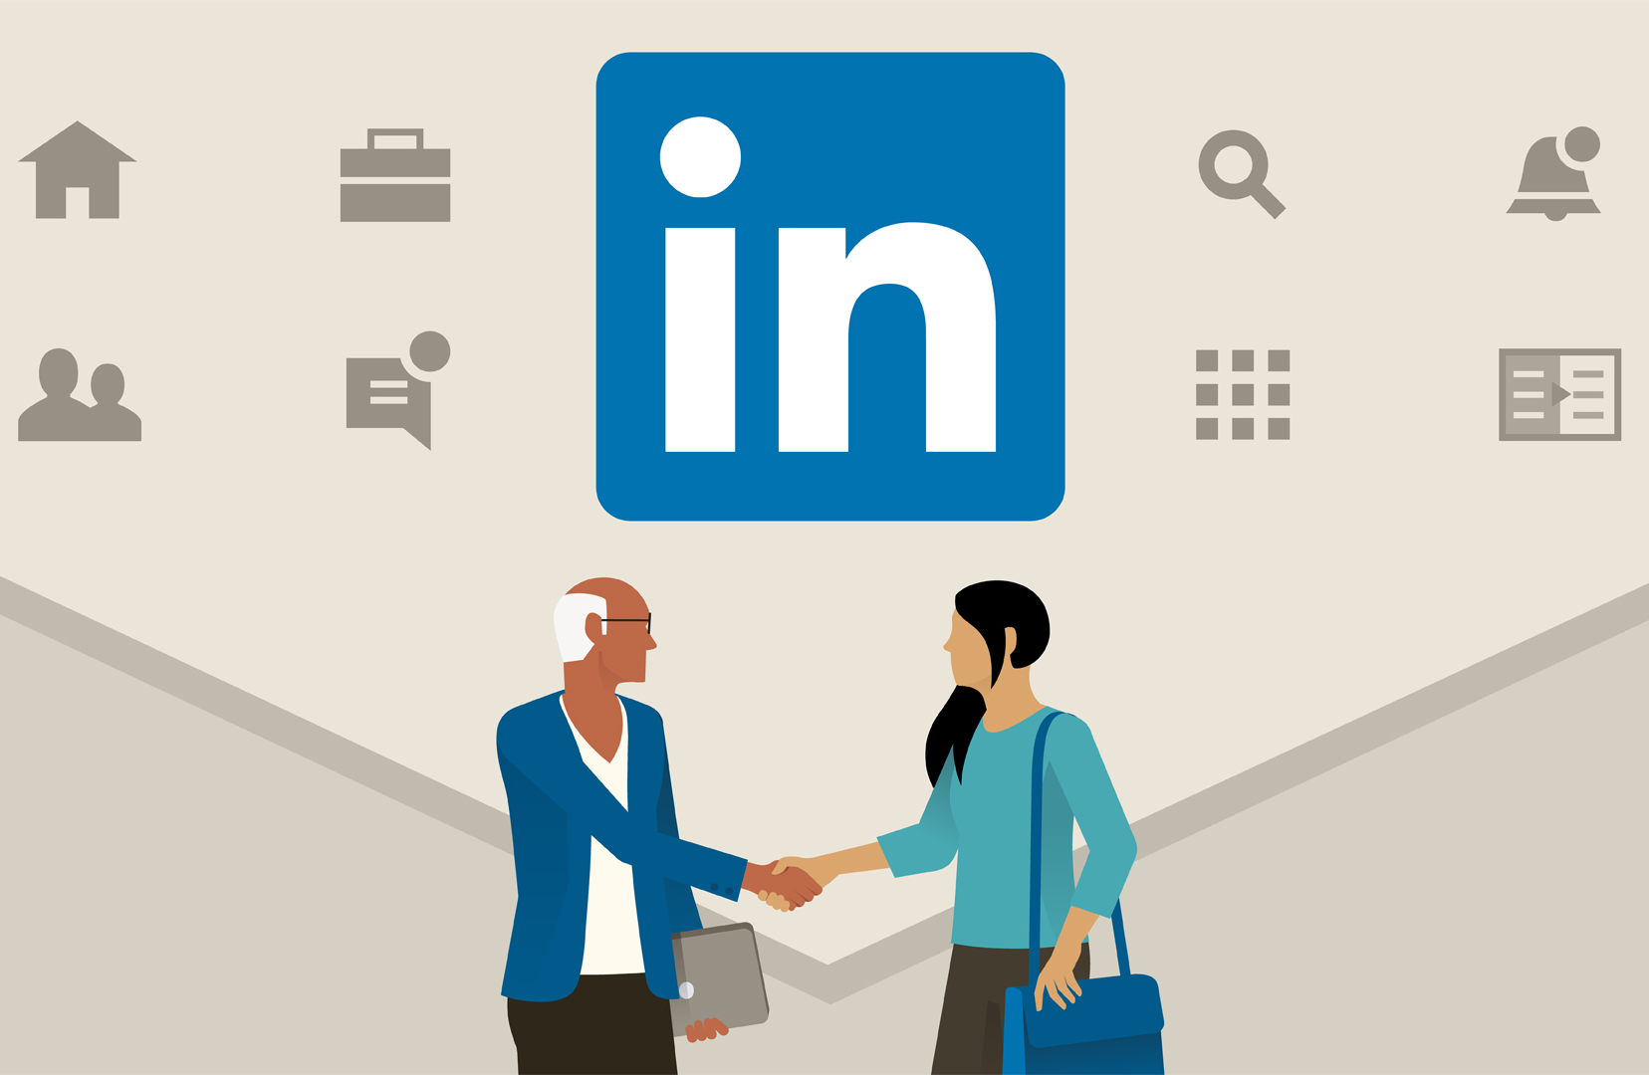
Why Should You Be On LinkedIn?
Advice for future professionals
1
To get a job! Make it easy for employers to pick you. LinkedIn provides a platform for you to tell employers how well you can do the work they need you to do and to show off the characteristics of their ideal employee.
LinkedIn also helps you grow your professional network, stay connected with mentors and coworkers, and maintain a positive online presence that may help you in your future work or job search.
2
Notes:
You can talk with people about their career journey, background, company, or ask for advice and tips. It’s all about establishing professional relationships.
Follow people and organizations of interest, post articles, and comment on other people’s posts.
At the high school/secondary school level, LinkedIn is a great way to connect with Johnson & Johnson professionals and BTE alumni from around the globe.
You can also use the job search feature on LinkedIn to see if there are BTE alumni, existing contacts that you already know, or information on the individual who posted a job description or professional opportunity.
Using LinkedIn effectively is about being proactive rather than passive. If you have a great profile and connect with a recruiter who posted a position, they may ask to see your resume. Now you’ve jumped out of the virtual resume pile and landed at the front of the line. That’s the power of networking.
Online networking can be great for those who are more reserved or hesitant with face-to-face networking. You can also reach a broader audience. For those who are comfortable and skilled at interpersonal networking, look to do both in-person and online networking. Like anything else, practice helps to improve performance.
Developing a solid LinkedIn profile, and connecting with current and former colleagues, other alumni, individuals working in your field, HR recruiters, and organizations of interests is a straightforward way to start reaching out.
When you send connection requests always include a short, personalized message that speaks to an inherent interest in making the connection—not just a message about seeking help finding a job.

Slide 7

Learn About Careers
explore
Search for companies or organizations by name or industry
Review the statistics available through LinkedIn
  Number of employees
    Where did they go to school?
    What other companies did they work for?
    How many years of experience do they have?
  What specific job titles are there?
Review job postings and possible connections
  Do you have any contacts there? If yes, are you connected on LinkedIn?

Slide 8
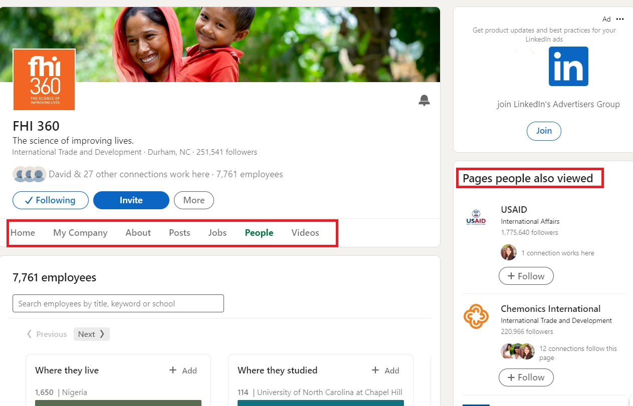
Conduct a Scan
Look at profile commonalities
1
Location
Where are the job opportunities located?
3
education
What type of degrees or certifications do most employees have?
2
Skills
What skills are required for the job?
4
Connections
What other common LinkedIn connections do they have?

Slide 9

Building your profile
2

Slide 10
LinkedIn is Your Online First Impression
Priorities
Top fold
Experience
Summary
Notes:
The top fold is your headline. It should describe who you are and include your specialties; include a professional photo.

Slide 11

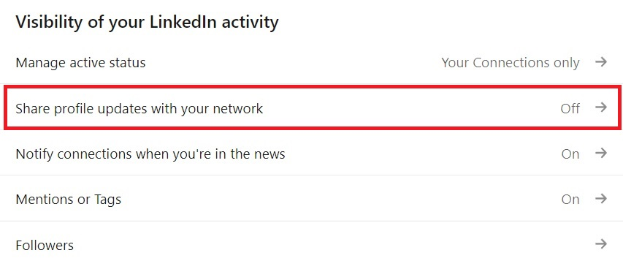
Creating or Editing Your Profile
Turn Off your notifications
If you plan to make edits to your LinkedIn profile, the first step you want to ensure is that you turn off your notifications until you are ready to launch your profile.
If you keep your notifications on, your connections will be notified about every little change you make.
To turn off notifications, go to Settings > Visibility. Under “Visibility of your LinkedIn activity,” turn off “Share profile updates with your network.”

Slide 12

Begin With a Professional Photo
This is your first impression
1
While a photo is not required, your photo is your first impression
3
Research shows that profiles with pictures are 7 times more likely to be viewed
Use a professional headshot whenever possible
If you don’t have a professional photo, use one that is recent, has good lighting, your face takes up most of it, you’re professionally dressed, and smile!
2
4
Notes:
If you don’t have the opportunity for a professional photo, best practice is for you to stand up against a white or very light covered wall.
Smile and wear professional clothing
The photo should be from the bottom of your shoulders, up.

Slide 13






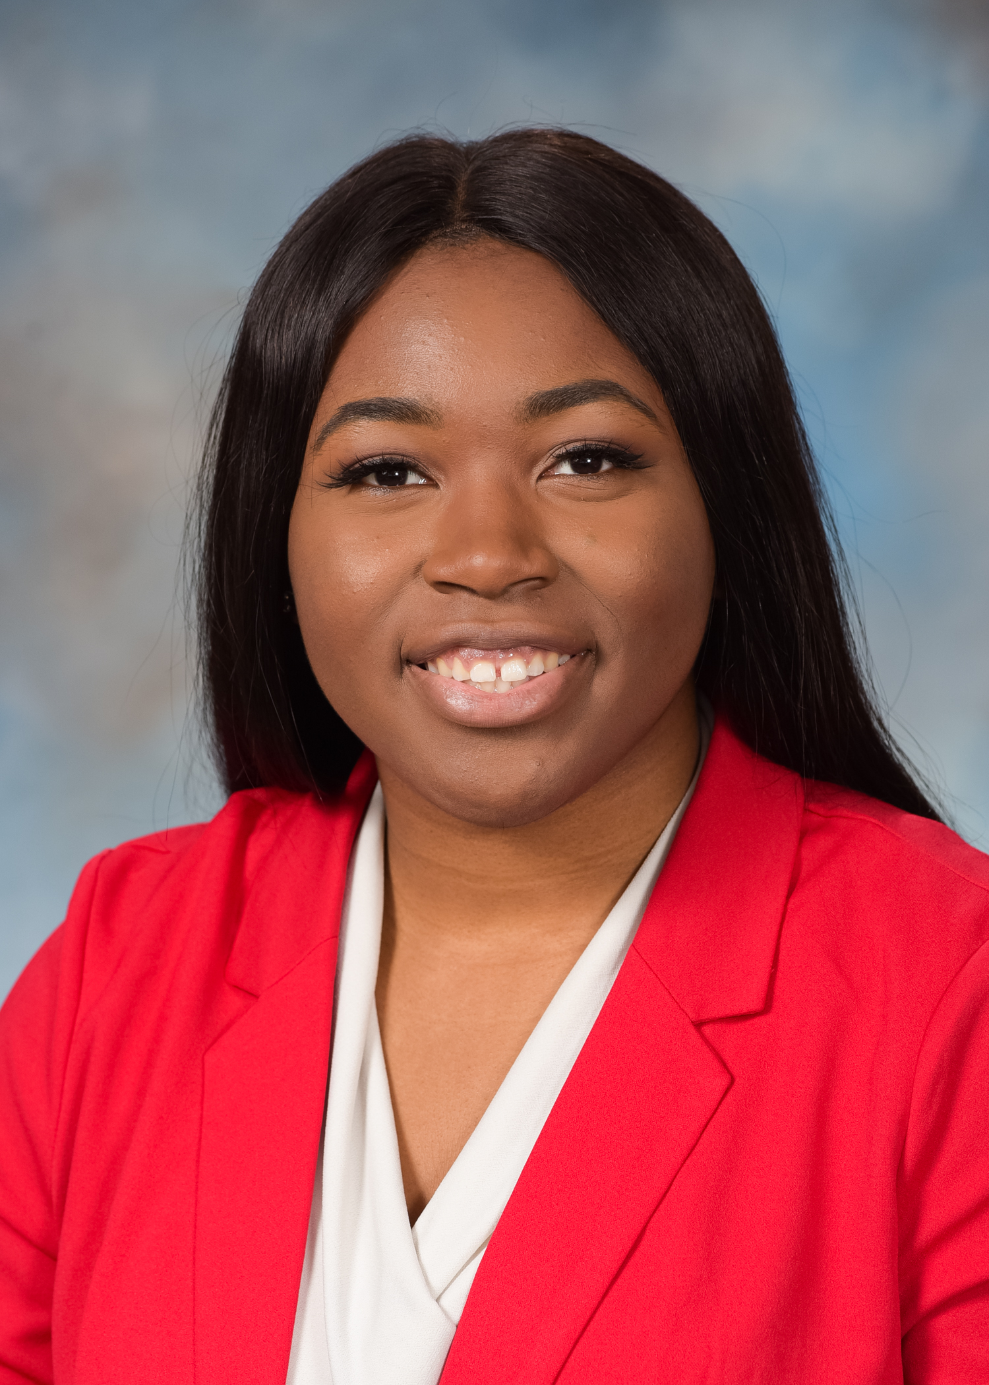

Professional Photos
To Use
Not To Use
X
To use or not to use
Up close, smiling, and a light or outdoor background are key elements for your LinkedIn profile pic! Look through some of your connections’ photos to get a sense of what’s popular and what you like best.
Bonus: Add a background banner photo to make your profile even more eye-catching!
X
X
Notes:
Photo Source: https://unsplash.com/s/photos/selfie-youth

Slide 14
Your LinkedIn Headline
Showcase your specialty
A detailed LinkedIn headline increases your “findability,” helping recruiters identify your potential and motivating your audience to keep reading the rest of your profile.
While viewing your profile, hover over your current headline, click on the pencil, and update accordingly.
Use key words that effectively identify your expertise, focus, and experience.
Jane Student
BS Mechanical Engineering | Michigan Tech | Manufacturing | New Product Design | Mechatronics
John Student
Dining Services Supervisor at Michigan Technological University
VS
Jane’s headline contains more keywords about what she does and is interested in. This increases the likelihood she will come up in relevant searches.

Slide 15
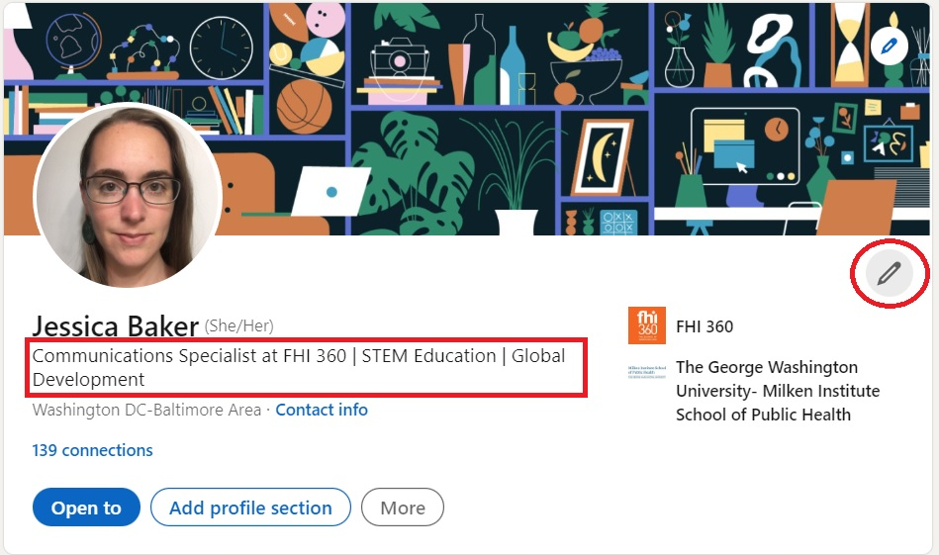
Your LinkedIn Headline
Showcase your specialty
While viewing your profile, click on the pencil at the right of your intro. Then, change your headline, save, and check to see how it looks in each line.

Slide 16
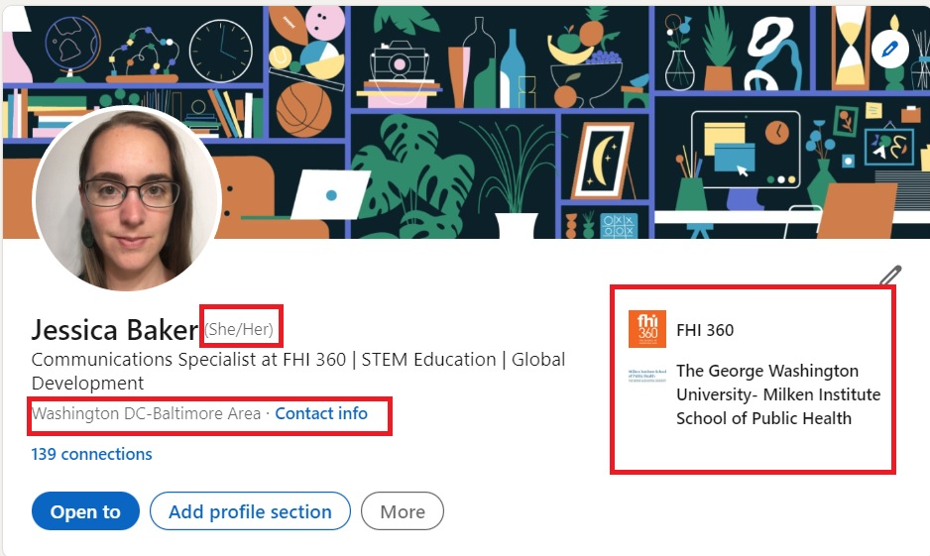
Your LinkedIn Intro
Showcase your specialty
While editing the intro, you can also add pronouns, your current position, most recent education, and location.

Slide 17
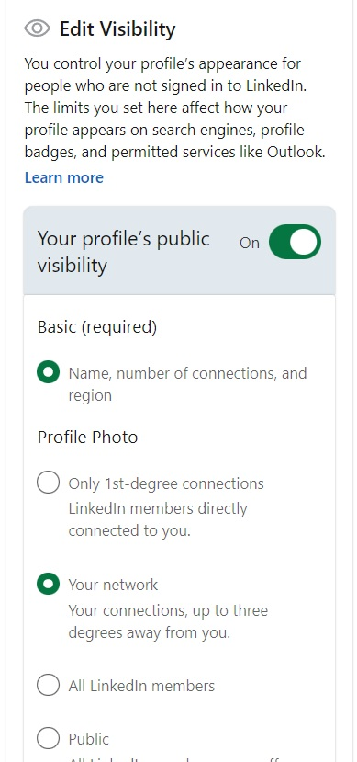
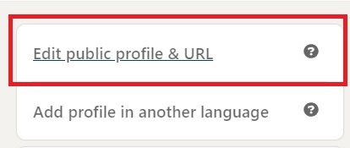
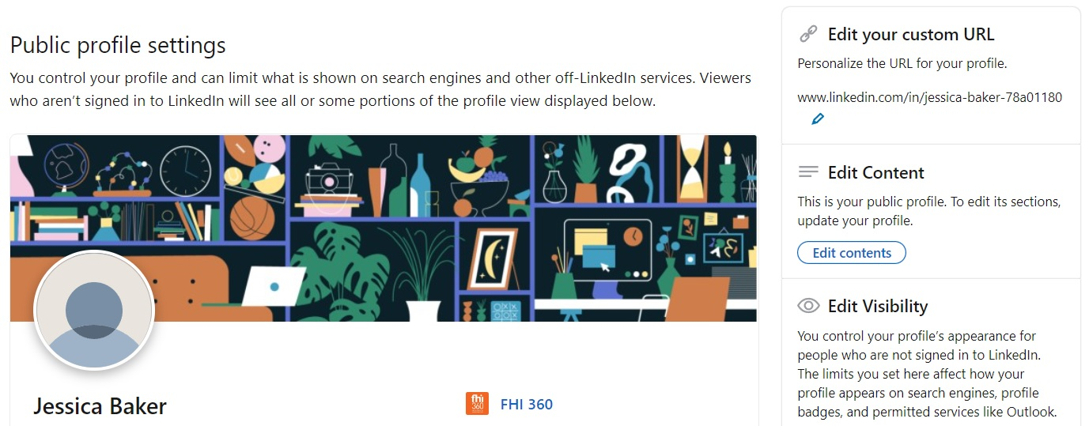
Edit Your Public Profile and Customize Your URL
Keep it clean & Professional
To the right of your intro, you’ll find an option to “Edit public profile & URL.” This button will allow you to see what’s visible to a public audience and allow you to edit this visibility to protect your privacy.
This page also allows you to personalize your URL, giving it a simple, clean look.

Slide 18

Drafting a Compelling Summary
Your virtual handshake
The summary is your virtual handshake and personal introduction.
You want to use a genuine but polished tone that you would use if you were meeting an advisor or mentor over coffee – be personal but professional, descriptive but to the point.
You want to tell your reader what you do and why, and you want to do it before they scroll away.
Notes:
When you read the sentences back to yourself, are those words that you would use in a conversation? Even though people think they are being genuine in conversational voice, you might not say out loud what you would think to write. Most people write more formally than they speak.

Slide 19

Drafting a Compelling Summary
Your first Draft
Your summary should be between 2-5 sentences. The text box will allow you to say much more, but people are unlikely to click the “Show more” button on your profile. Think of how often you just scroll quickly through a webpage. While writing your summary, make sure all the important information stays above the “Show more” button.
Everyone’s summary is unique, so you may want to read several other people’s summaries to get some ideas for your own. You should include the following information:
What you do
What field you work in (or want to work in)
Most recent job or education
Why your work matters to you (what motivates you)

Slide 20

Drafting a Compelling Summary
Your Second Draft
Getting your summary just right may take several revisions. Once you’ve written your first draft, consider the following questions:
Does it sound like you? Read it out loud a few times.
Does it capture your past experience and what you’re looking for in your career?
Are you being confident and positive about yourself? This can be difficult sometimes. Try to imagine what your friends or family might say about you, or imagine the most awesome version of yourself – what does that look like, and can you channel that self in this summary?

Slide 21
Drafting a Compelling Summary
Your Third Draft
You might be getting tired of looking at your summary by this point. Share your new draft with a friend, mentor, or career counselor to get some outside input.
Do they think it describes you accurately?
Do they think it’s compelling?
Did they find any typos??

Slide 22

Drafting a Compelling Summary
Posting Your Summary
Post your finalized personal summary under the “About” section on your LinkedIn profile.
A summary will be something you return to throughout your career. You may even include a version of it on your resume. It can help you stay focused when writing your resume, the rest of your LinkedIn bio, or elevator pitches. Feel free to edit your summary at any time.

Slide 23
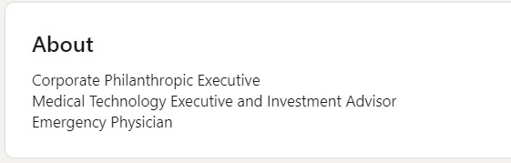
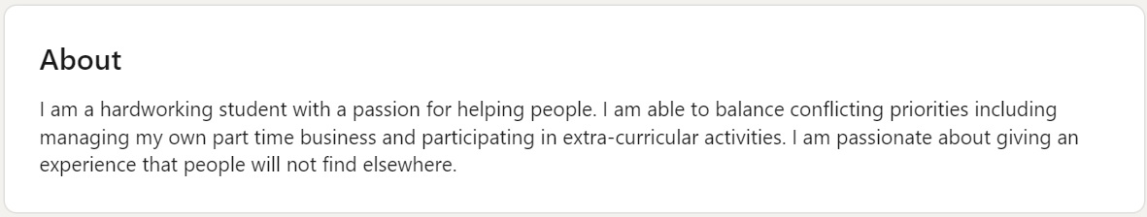
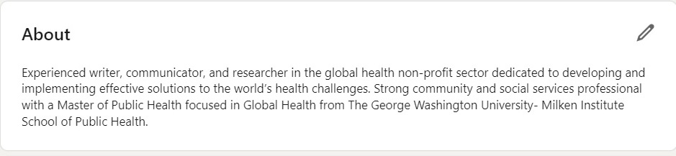
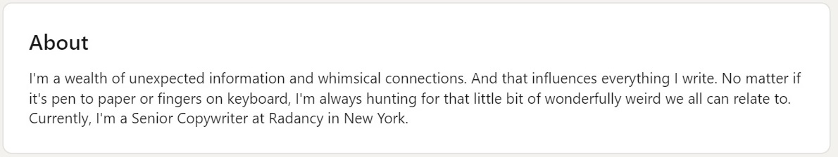
Summary Examples

Slide 24
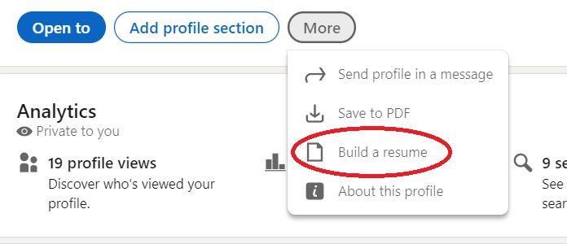
Add Your Resume & Media
Enhance your Summary Section
Most readers can’t spend the time reading your full profile initially.
Once they’re intrigued by your profile, they may want to download your resume before returning to read more of your profile. You want to make it easy for them to find it.

Slide 25

Experience
List relevant experience
This section is where you can list your current and past work experience.
Company Name:
Job, Internship, or Co-op company
Independent projects
Description:
Include start and end dates
You do not have to list every work experience. Highlight your experiences relevant to your career path
You can copy from your resume or create a more streamlined summary of your work, highlighting only the most important facts about your role and responsibilities
Add more:
LinkedIn allows you to add additional details like:
Media: Technical reports, images of posters, video, etc.
Skills: Computer Programming, Social Media Communications, Crisis Management, Writing, etc.

Slide 26

Education
List relevant education
This section is where you can list your current and past school experience.
Your current school program
Your expected graduation year
Your past school programs and the degree(s) or diploma your earned
Field of study
  Add your minor or concentration, if applicable
Grade Level
  Class status or rank
You can also add your co-curricular involvement, including leadership
Description
  You can use the Description field to highlight industry-relevant coursework or special projects you completed
  Include your GPA & field/industry related coursework

Slide 27
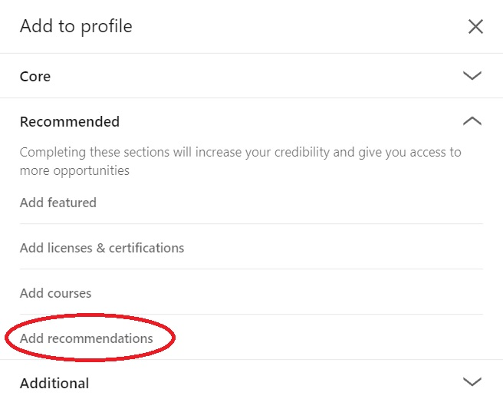

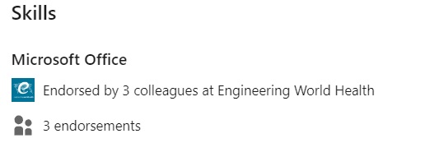
Recommendations & Endorsements
Add credibility
You can request recommendations from your LinkedIn network, including coworkers, classmates, teachers, etc. (Sundquist 2017).
  Whenever you excel in a class or position, or form a solid connection, always ask for a brief recommendation.
Ask for endorsements
  Your connections can endorse your skills – invite them!
Recommendations and endorsements add credibility to your profile, as it shows other people believe you can do what you claim to do.
Notes:
Source: Sundquist (2017). How to Use LinkedIn in High School. Retrieved from https://blog.collegevine.com/how-to-use-linkedin-in-high-school/.

Slide 28

Additional Sections to Consider
Presenting your full self
Fill in the fields that describe more about you to create a fuller picture.
Share your volunteer passions, causes, and organizations you belong to. These might be commonalities between you and a potential employer and a great way to make your initial connection (you can mention it in your personal invitation to connect).
You don’t need to list everything, but you can create a carefully curated profile that highlights your experiences, motivations, and goals.
Volunteering Experience Organizations | Honors and Awards Test Scores | Publications Languages
Notes:
These are non-academic co-curricular involvement

Slide 29
Remember Your Profile Priorities
Topfold
Ensure your headline describes exactly who you are, including your specialties, and that you have a professional photo
Piecing it all together
Summary
Tell your reader what you do and why and do it before they scroll away.
Experience
Include relevant work, education, skills, and projects that describe your hands-on experience that shows you can do the work!

Slide 30
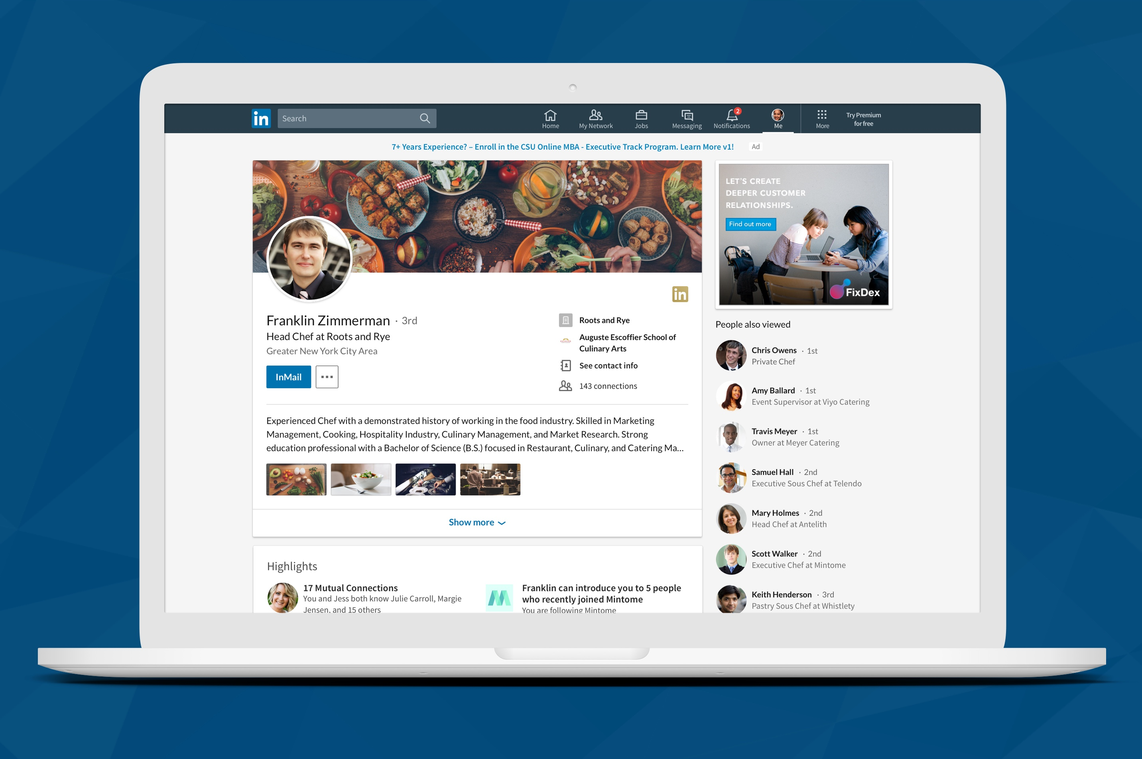
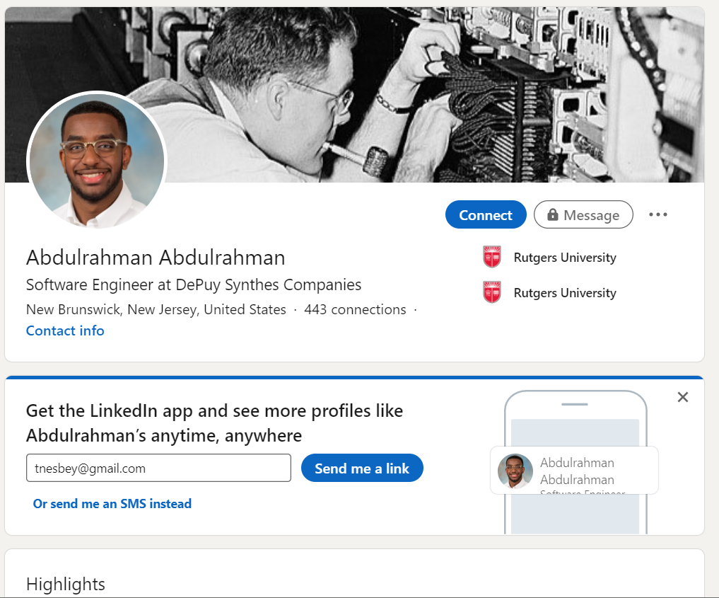
3
Managing your profile

Slide 31

Privacy Controls & Settings
Essentials to remember
Even though it is for professionals, LinkedIn is a social media network. The more you use it, the better its algorithm will do at providing you the results you need.
  Update your profile at least quarterly, but check in more often to engage with your connections.
Always remember: the information you post is publicly visible.
  Be careful about sharing personal information, especially with people you do not know.
  If you plan to make edits to your LinkedIn profile, remember to turn off your notifications until you are ready to launch your profile.
  If you keep your notifications on your connections will be notified about every little change you make.
Always proofread and check for grammar or spelling mistakes.
Be selective of what information you choose to include.
  Connecting to your personal social media accounts may not be the best idea, depending on the content you typically share through those platforms.
  Remember, LinkedIn is for professional use, not personal.

Slide 32
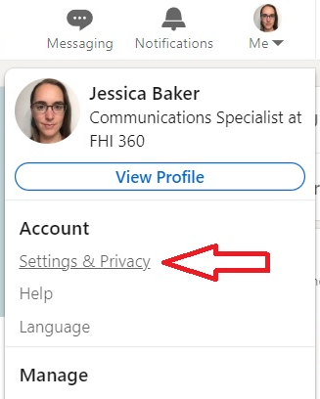
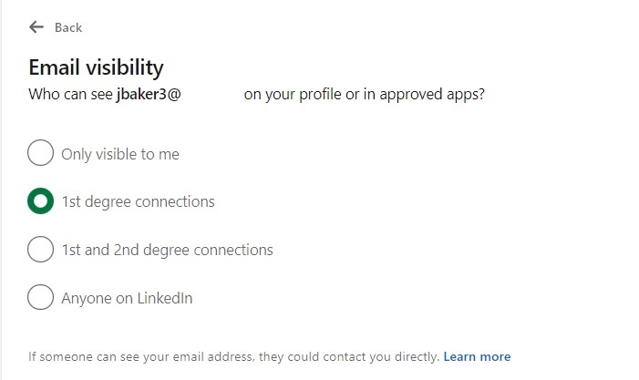
Privacy Controls
What your audience can see
Your privacy is important.
LinkedIn provides you with extensive options for controlling what you share with your audiences. Many of the settings have at least 3 levels of privacy: totally public, totally private, or somewhere in the middle. Take the time to go through these settings to make sure you’re sharing what you want with who you want.

Slide 33
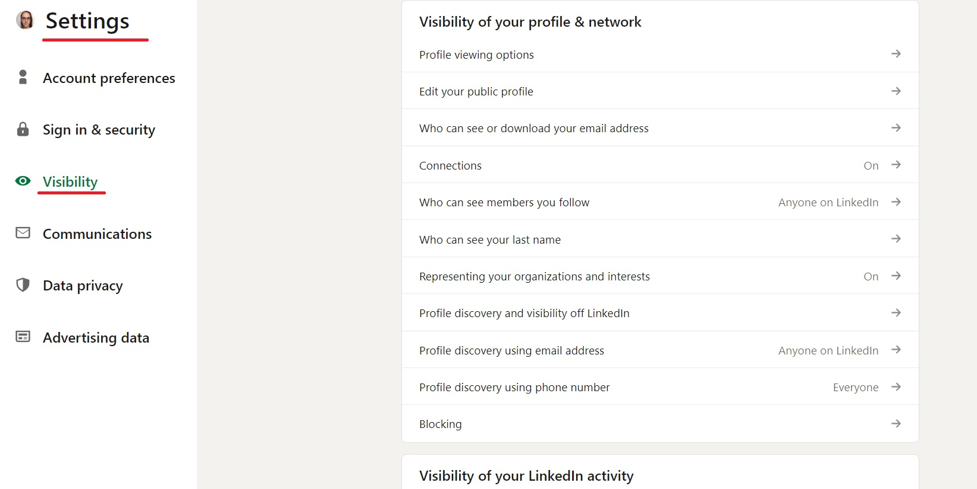
Privacy Controls

Slide 34
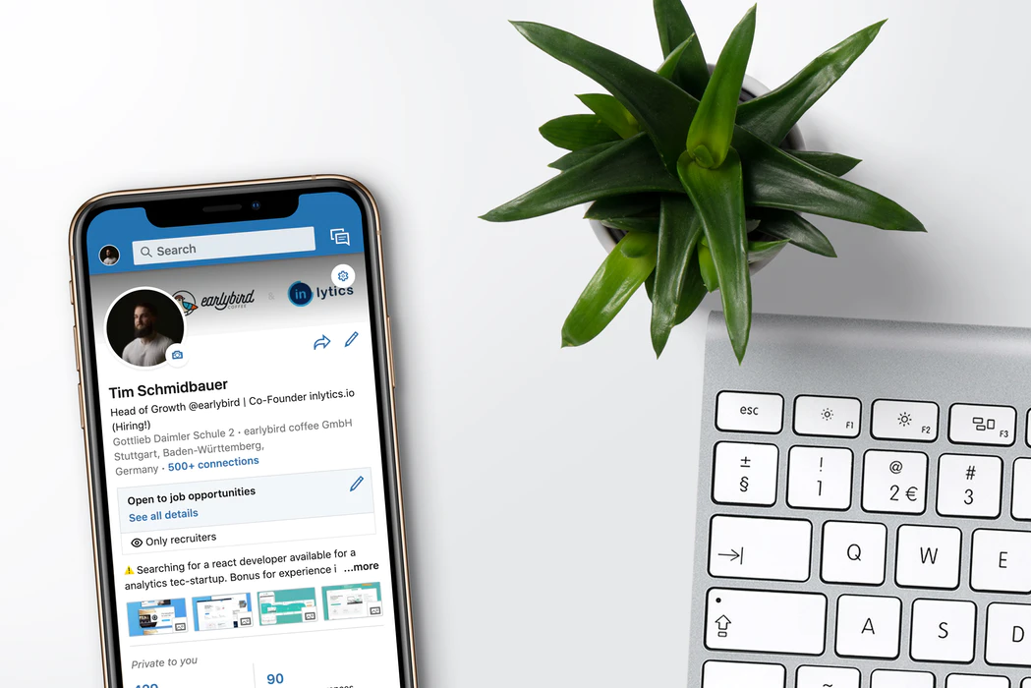
Connect on Linkedin
4
Notes:
Photo Source: https://unsplash.com/photos/RJT2EWPR0d0

Slide 35

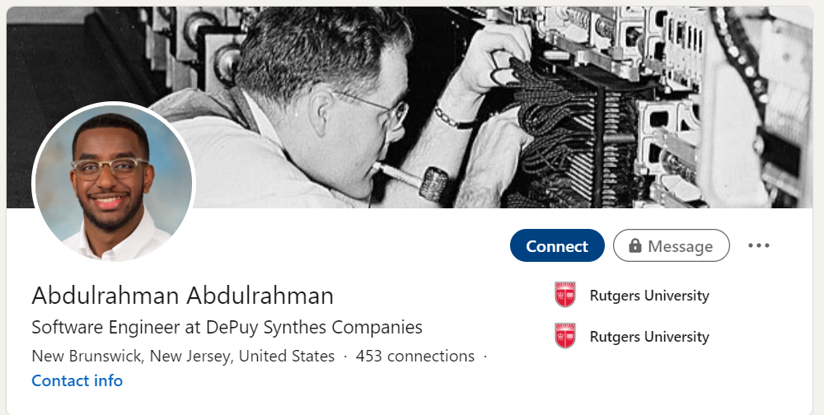


Online Networking
Start with who you know
Reflect on the individual professionals you already know…
Teachers
Advisors
Coaches
High School Alumni
College Faculty or Staff
School Presenters
Summer Job Managers
CONNECT ON LINKEDIN
Remember, LinkedIn is for professional connections.
TikTok, Instagram, etc. are for personal connections.

Slide 36
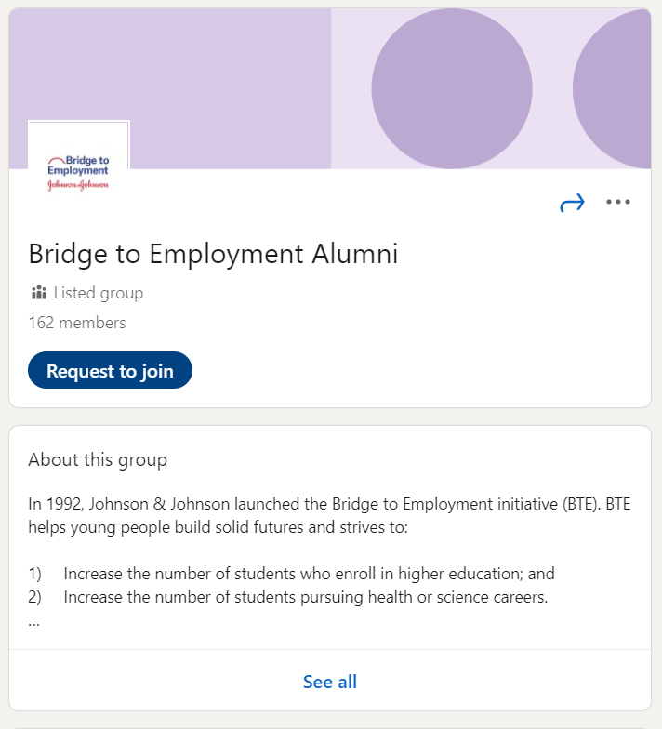
Staying Connected
Don’t forget your bte family
BTE Alumni Group
Johnson & Johnson Volunteers
Site Coordinators
School Principal(s)
School Counselor(s)
Community Partners
FHI 360
BTE Alumni
  Join the BTE Alumni Group on LinkedIn! Request to join at www.linkedin.com/groups/8497105

Slide 37
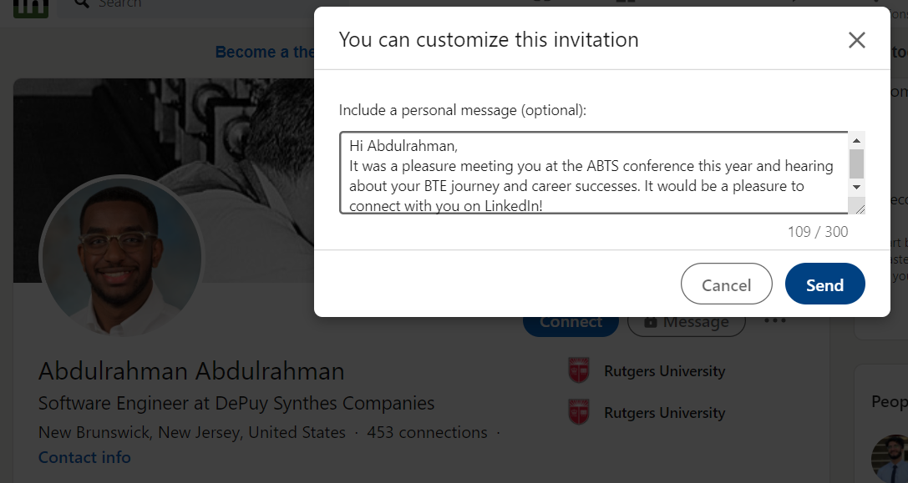
Connecting on LinkedIn
Tips for success
Sample invitation message
When you meet a professional contact, follow up within the next day or two with an invitation to connect via LinkedIn.
Always include a message when sending an invite to connect.
  Keep it brief.
  Indicate where you met them.
  Identify the program or affiliation you have that led to your initial meeting or introduction.
  Sign your name
Remember: One of the best uses of LinkedIn is for keeping in touch with contacts who might be able to create valuable connections for you when you look for a job, apply to scholarships, or apply to college (Sundquist 2017).
Notes:
Source: Sundquist (2017). How to Use LinkedIn in High School. Retrieved from https://blog.collegevine.com/how-to-use-linkedin-in-high-school/.

Slide 38

Piecing it all together
5
Notes:
Photo Source: https://unsplash.com/photos/kn-UmDZQDjM

Slide 39

From Recruiter to Employer
Getting the right attention
Career in STEM (2019) states,
“LinkedIn is the biggest social network for professionals across the world. LinkedIn now has more than 500 million users registered worldwide. If you join now, especially at a youthful age, you will be giving yourself the best chance to further your career faster. It’s a great introduction to the working world.
Due to the massive amount of prospective employees that are active on the platform, recruiters – individuals who work on behalf of companies to scout the best employees – are another big part of LinkedIn. Like millions before you, if you’ve joined LinkedIn to help start your career and find yourself the perfect role, then impressing a curious recruiter is highly valuable to any professional.”
Notes:
Source: Career in STEM (2019). LinkedIn for Teens. Retrieved from https://www.careerinstem.com/linkedin-for-teens/

Slide 40
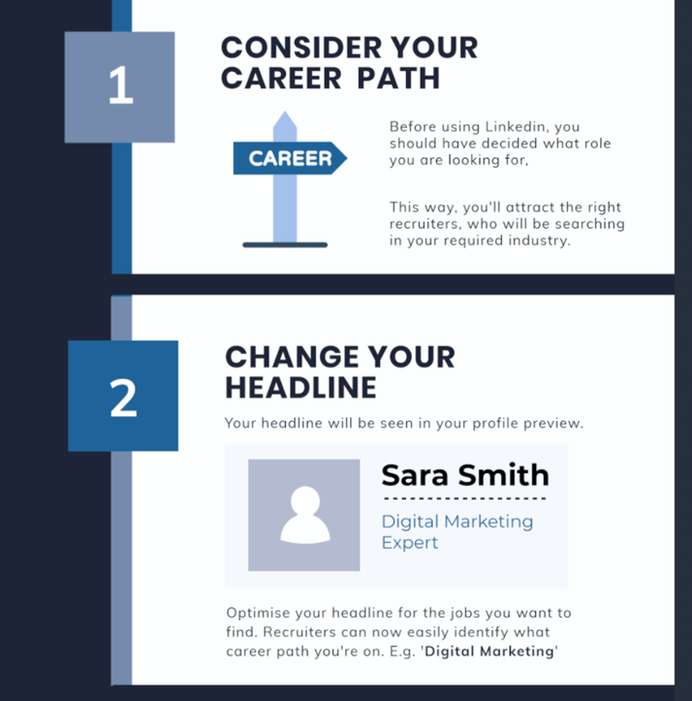
10-Step Guide to Attract Recruiters
Career in STEM
Notes:
Source: Career in STEM (2019). LinkedIn for Teens. Retrieved from https://www.careerinstem.com/linkedin-for-teens/

Slide 41
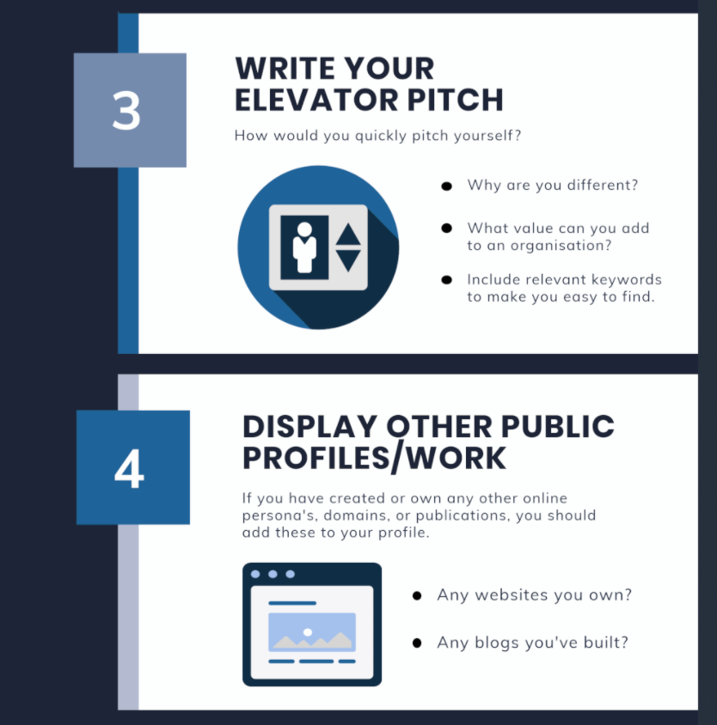
10-Step Guide to Attract Recruiters
Career in STEM
Notes:
Source: Career in STEM (2019). LinkedIn for Teens. Retrieved from https://www.careerinstem.com/linkedin-for-teens/

Slide 42
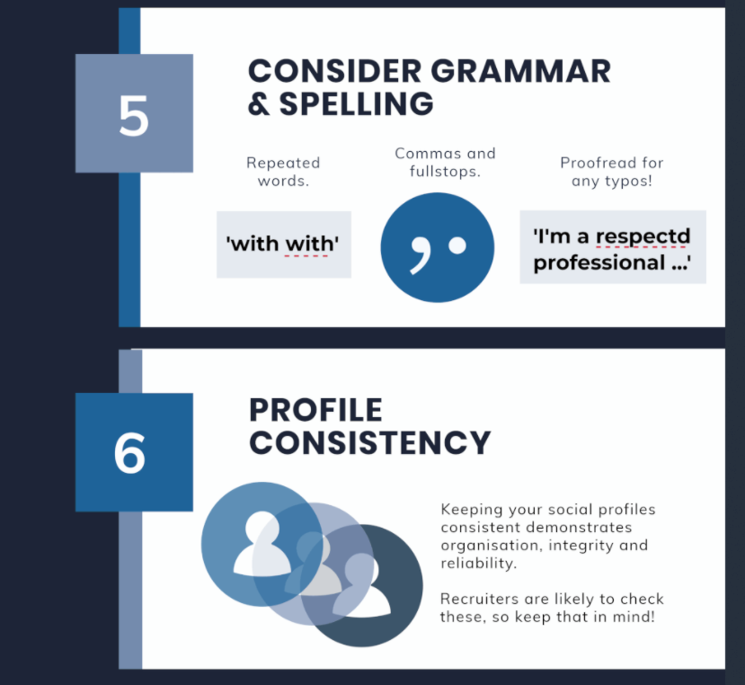
10-Step Guide to Attract Recruiters
Career in STEM
Notes:
Source: Career in STEM (2019). LinkedIn for Teens. Retrieved from https://www.careerinstem.com/linkedin-for-teens/

Slide 43
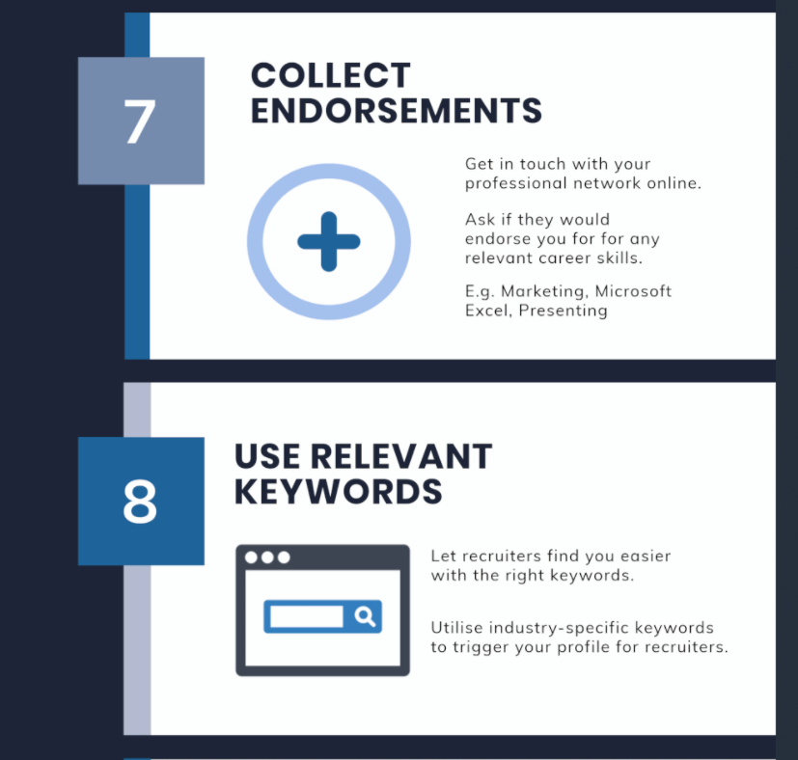
10-Step Guide to Attract Recruiters
Career in STEM
Notes:
Source: Career in STEM (2019). LinkedIn for Teens. Retrieved from https://www.careerinstem.com/linkedin-for-teens/

Slide 44
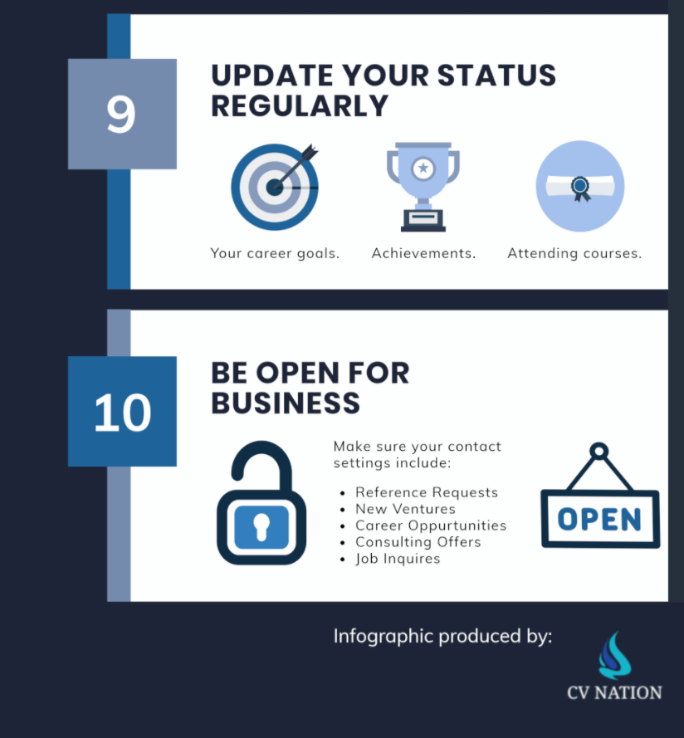
10-Step Guide to Attract Recruiters
Career in STEM
Notes:
Source: Career in STEM (2019). LinkedIn for Teens. Retrieved from https://www.careerinstem.com/linkedin-for-teens/

Slide 45
Let’s Put This All to Practice
Notes:
Facilitator should have participants build their LinkedIn profile using the LinkedIn Profile Checklist for High School Students PDF handout (or the LinkedIn Profile Checklist for College Students depending on your age group).
The facilitator can recommend participants to refer to their most recent resume for content to pull (they will want to post their resume on LinkedIn anyway, so it is great to have ready any available anyway).
Once each participant has built their profile, have them connect with:
Your BTE Leadership Team (i.e., Site Coordinator, BTE Champion(s), school partners, higher ed partners, etc.)
BTE Volunteer(s)
At least 3 BTE participants
If your site conducted cross-site sessions, have them connect with at least 2 participants from that site
Their favorite teacher (have students request a recommendation or endorsement)
One new connection outside of their social network that they identified thru a common connection (i.e., high school alumni, CEO, etc.)

Slide 46
Questions
or
Final Reflections?

