Slide 1


VIRTUAL COMMUNICATION
DIGITAL BADGE
Part Two: Creating the foundation
OCTOBER 2020

Slide 2

Virtual Communication Model
1
Sub-competency 1: virtual platforms & interactions
- Blackboard Collaborate
- Zoom
- Adobe Premier Rush
3
Sub-competency 3: Incorporatingg diverse perspectives
- Site Video Showcase
- Adversity
- Taking Responsibility for
Communication
2
Sub-competency 2: Active Listening
- Active v. Passive
- Empathetic Listening for
Leaders
- Conducting Successful Digital
Interviews
4
Sub-competency 4: Telling stories to express ideas
- Storytelling that Moves
- Lunch & Learn
- Virtual Production Showcase

Slide 3

Active vS. passive listening
1

Slide 4
Define & Describe Active Listening
DEFINE:
DESCRIBE:
Notes:
- Using the BBC interactive whiteboard, have participants type their initial thoughts in the corresponding boxes above.

Slide 5
Active Listening
Defined & Described
Two-way communication
with the listener responding
Listener asks questions, clarifies ideas, and comments on key points
1
3
The listener is fully engaged and reacts to the ideas presented by the speaker.
2
Non-verbal cues
Smiling, nodding, facial expressions, eye contact, etc.
4
Analytical listening
Listener analyzes the ideas, evaluates, and assesses them while listening

Slide 6
Define & Describe Passive Listening
DEFINE:
DESCRIBE:
Notes:
- Using the Blackboard Collaborate (BBC) interactive whiteboard, have participants type their initial thoughts in the corresponding boxes above.

Slide 7
Passive Listening
The listener does not react to the ideas of the speaker but merely listens.
Defined & Described
1
2
3
Listener does not ask questions or share ideas
One-way communication
Listener does not need to make eye contact
Notes:
Facilitator should follow up the definition and description with the following prompt, “Is passive listening positive or negative? Why?”
Many young people perceive passive listening as “bad.” After fielding responses to the positive/negative prompt, the facilitator should ask the group, “Can you describe an example of passive listening that would not be perceived as negative?” Potential responses may include during a presentation or class lecture. During a presentation or class lecture, the audience may make eye contact (which is typically viewed as positive), however, the eye contact itself is not required, nor considered “bad” if not made.

Slide 8
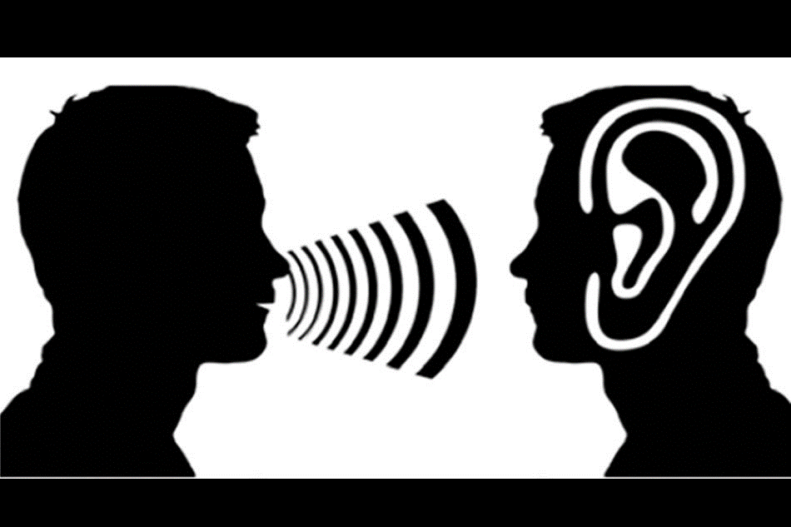
Test Yourselves
Which is active (A)? Which is passive (P)?
A P
Definition:
The listener is fully engaged and reacts to the ideas the speaker presents.
Definition:
The listener does not react to the ideas of the speaker but merely listens.
Communication:
One-way communication.
Communication:
Two-way communication.
Effort:
Does not require effort.
Effort:
Requires effort.
A P
A P
Reactions of the listener:
The listener reacts using nonverbal cues, comments, and questions.
Reactions of the listener:
The listener does not react.
Other actions involved:
The listener analyzes, evaluates, and summarizes.
Other actions involved:
Simply listens.
A P
A P
A P
A P
A P
A P
A P
Notes:
- Using the BBC writing tool, have participants circle either “A” or “P” to indicate if that line reflects Active (A) or Passive (P) listening.

Slide 9



Differences Between Active & Passive Listening
Active Listening
Passive Listening
Comparisons
Definition
Definition
The listener is fully engaged and reacts to the ideas the speaker presents.
The listener does not react to the ideas of the speaker but merely listens.
Communication
Communication
Two-way communication.
One-way communication.
Reactions of the listener
Reactions of the listener
The listener reacts using nonverbal cues, comments, and questions.
The listener does not react.
Effort
Effort
Requires effort.
Does not require effort.
Other Actions Involved
Other actions involved
The listener analyzes, evaluates, and summarizes.
Simply listens.

Slide 10
7 Effective Habits That Will Make You A Better Listener
1-3
1
2
3
focus
Most people focus on what they are going to say next, so they don’t hear what is actually being said. Words come through, but the meaning is lost.
Control your thoughts.
Put away your phone
When you commit to a conversation, invest all of your energy into that, not your phone or other devices.
Ask good questions
Asking questions or asking for clarification not only shows you are listening, but you also care about what the person is saying.
Whenever possible, ask probing questions like, “What I hear you saying is…” or “Why do you think that happened?”
Notes:
Source: https://www.themuse.com/advice/7-habits-thatll-make-you-a-better-listener-and-not-the-person-who-always-needs-everything-repeated

Slide 11
7 Effective Habits That Will Make You A Better Listener
4-7
4
Practice reflective listening
5
Use Positive body Language
  Psychologist Carl Rogers coined the term reflective listening, which is a strategy of paraphrasing what is being said to make certain you have interpreted the speaker’s words correctly.
  Provides an opportunity for the speaker to clarify statements.
  Provides the listener an opportunity to absorb the information.
  Be aware of gestures, expressions, tone of voice, and body position.
  An enthusiastic tone, uncrossing your arms and legs, maintaining eye contact, and leaning toward the speaker are all signs of positive body language.
6
Do Not pass judgment
7
Think before you speak
  A good listener always has an open mind, making them approachable and interesting to others.
  Having an open mind is crucial in the workplace; it provides opportunities to share ideas and collaborate as a unit.
  If you are not asking a probing question or asking for clarification, you should remain quiet and listen.
  Avoid hijacking a conversation, which shows that you think what you have to say is more important than the speaker does.

Slide 12

Empathetic listening for leaders
2

Slide 13
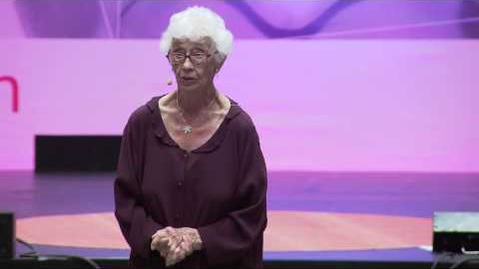
Empathetic Listening for Leaders
Notes:
YouTube Link: https://www.youtube.com/watch?v=ESqfW_kyZq8

Slide 14

Practice!
Notes:
Distribute the “Active Empathetic Listening” handout.
Have participants form pairs to practice active empathetic listening, following the instructions in the handout.
Assess using the “Active Listening Assessment” PDF handout.

Slide 15

Thoughts & Reflections

Slide 16

Taking responsibility for your communication
3

Slide 17

Taking responsibility for your communication
Notes:
YouTube Link: https://www.youtube.com/watch?v=gIXD351YJyE

Slide 18

What are some ways you can take responsibility for your communication?

Slide 19
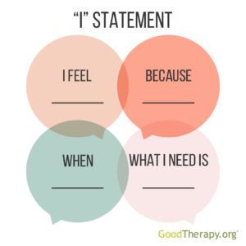
Communicating respectfully
I-messages
Source: Overcoming Obstacles. Respect It’s Up to All of Us
Notes:
Distribute the “Communicating Respectfully:_I–Messages” PDF handout to participants and complete the activity.
Source: Overcoming Obstacles. Respect It’s Up to All of Us. Retrieved from file:///C:/Users/TNesbey/OneDrive%20-%20Family%20Health%20International/Digital%20Badges/Empathy/SC%202/Communicating%20Respectfully_I-Messages.pdf

Slide 20
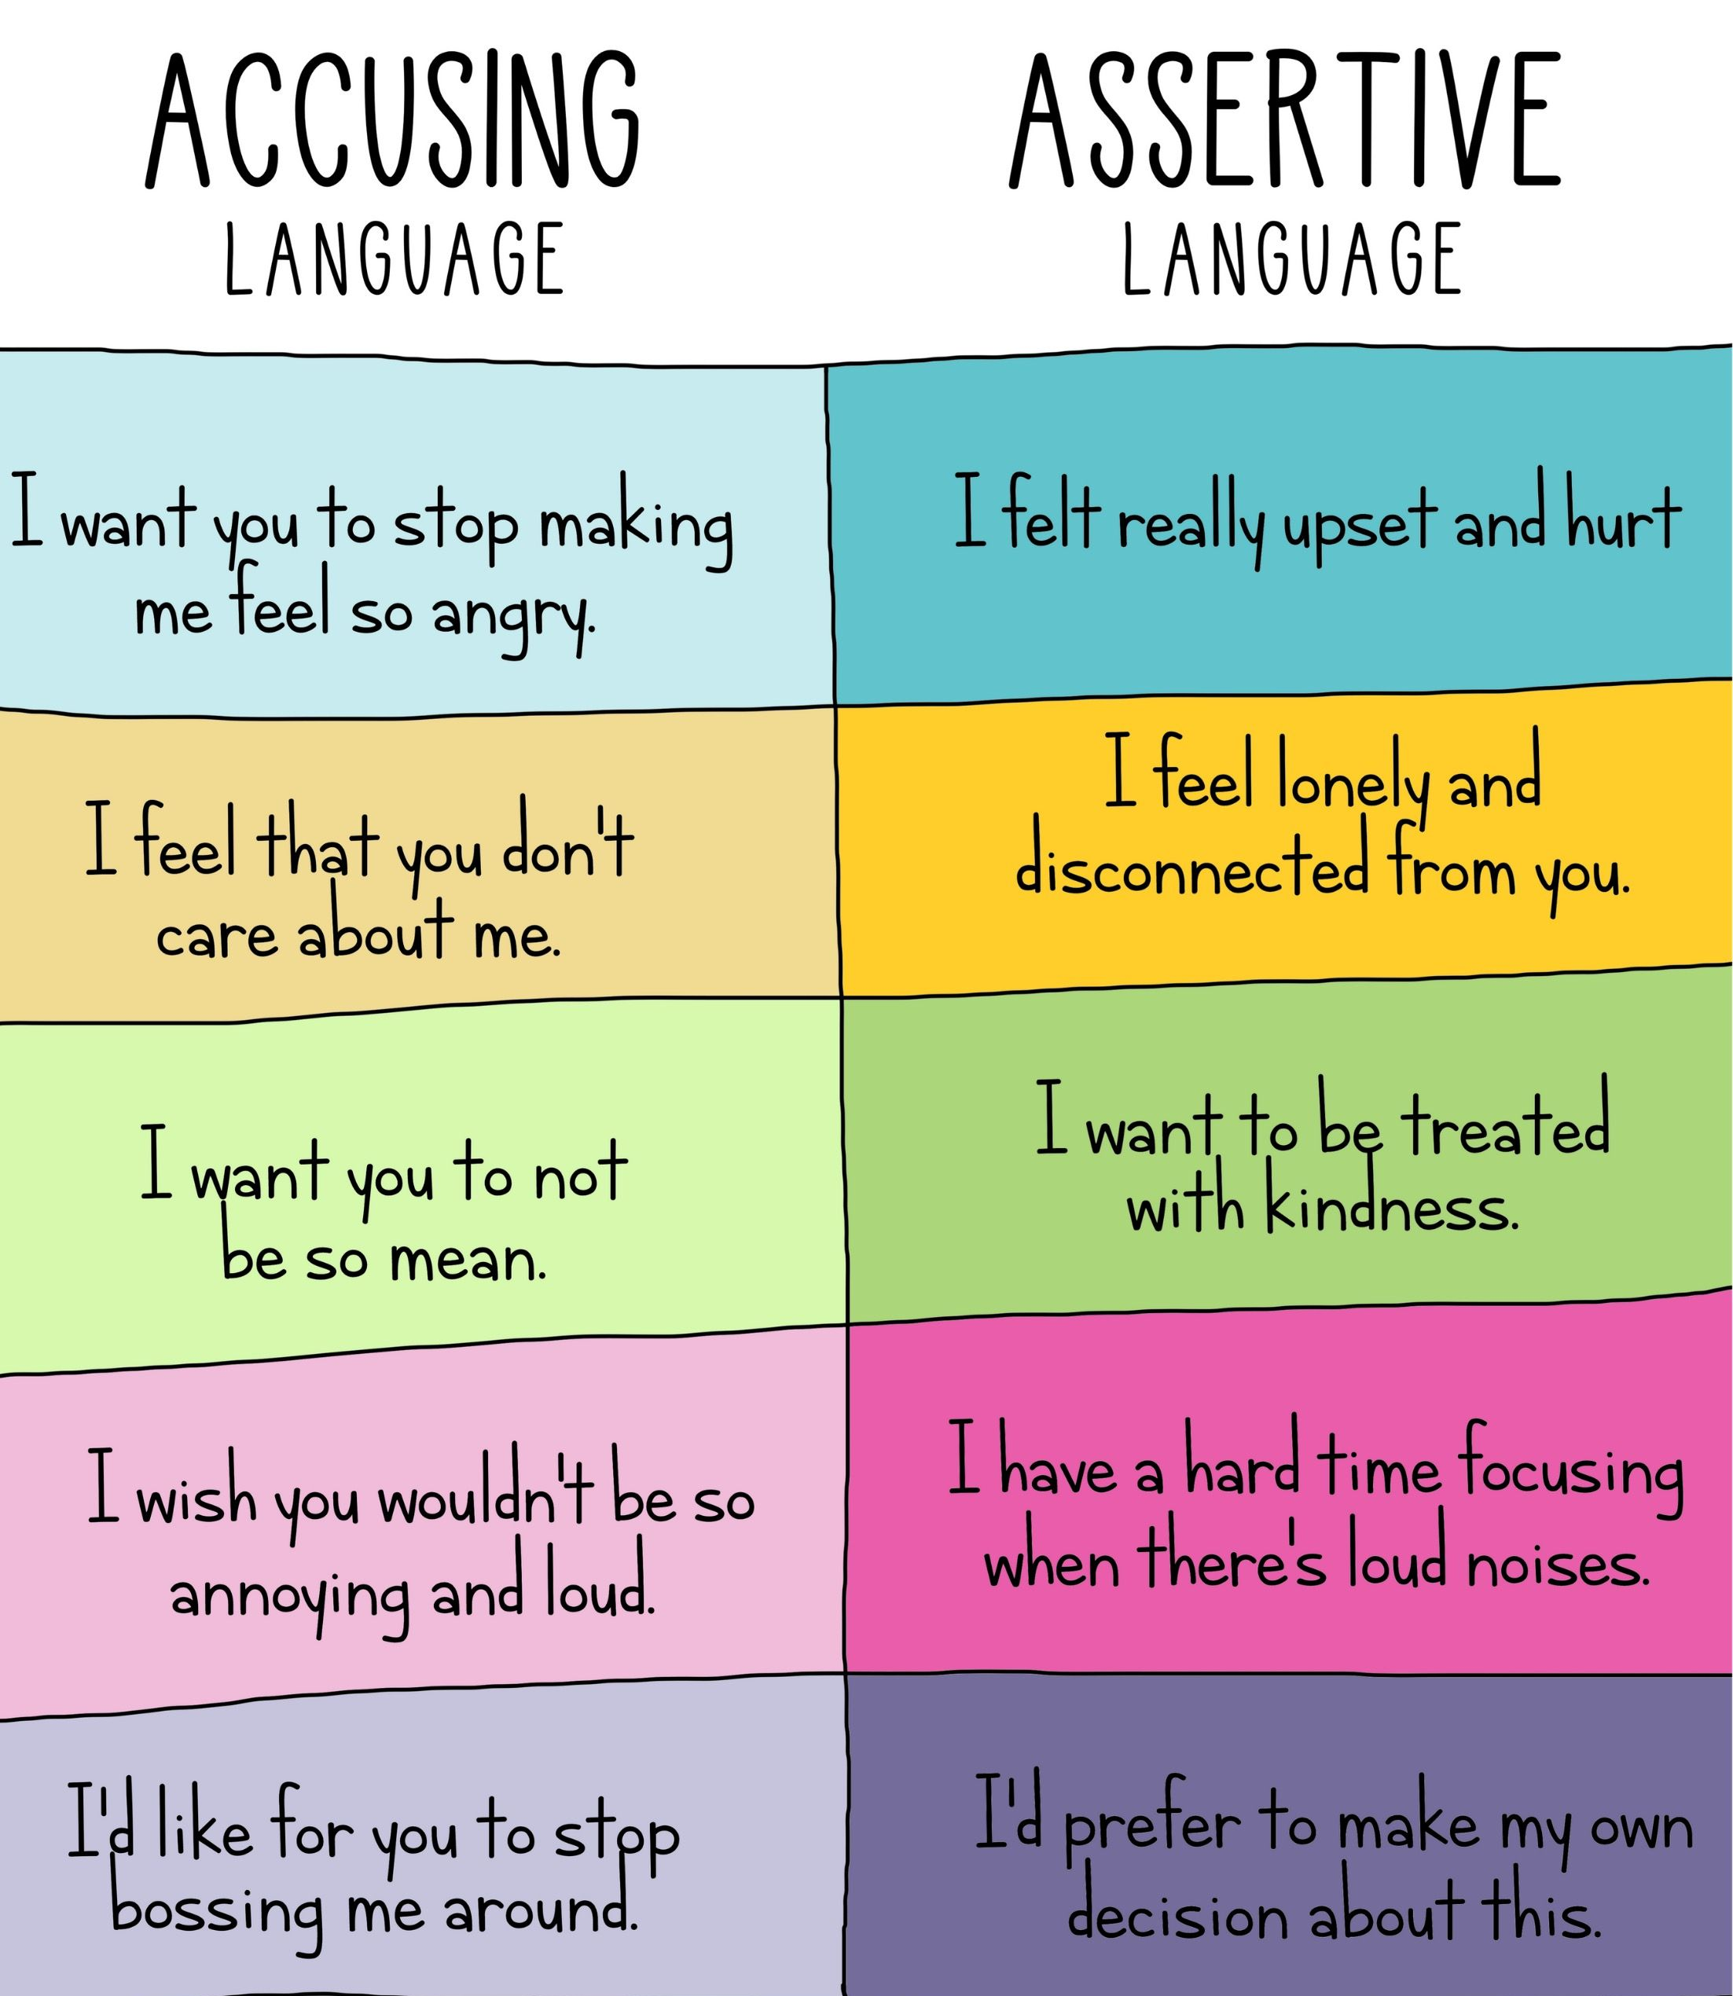
I-MESSAGE ACTIVITY
Putting it into practice

Slide 21
Thoughts & Reflections

Slide 22

Adversity
4

Slide 23
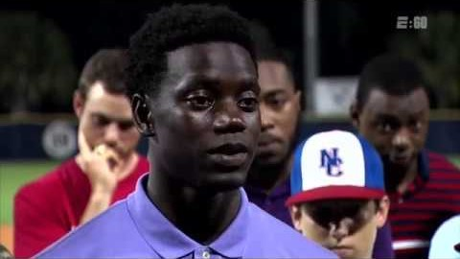
Love overcomes hate
Notes:
YouTube Link: https://www.youtube.com/watch?v=cQqbTzLqvRY
- *Note: At 19 minutes and 50 seconds, Chris begins introducing an example with content that some audiences may find sensitive. Facilitators should preview this video and get appropriate approval before sharing. Alternatively, facilitators can end the video before the example.

Slide 24
ADVERSITY: THOUGHTS & REFLECTION
Chris Singleton
1
2
3
4
What does adversity mean to you?
What are your thoughts on the quote, “Life is 10% about what happens to you and 90% How you react to it”?
How does forgiveness connect to adversity? Or doesn’t it?
How can you address adversity in today’s world? How can you do so using empathy?

Slide 25
Thoughts & Reflections

