Slide 1
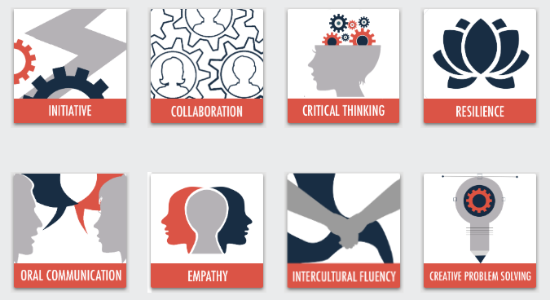
21st Century Skills
© 2020

Slide 2
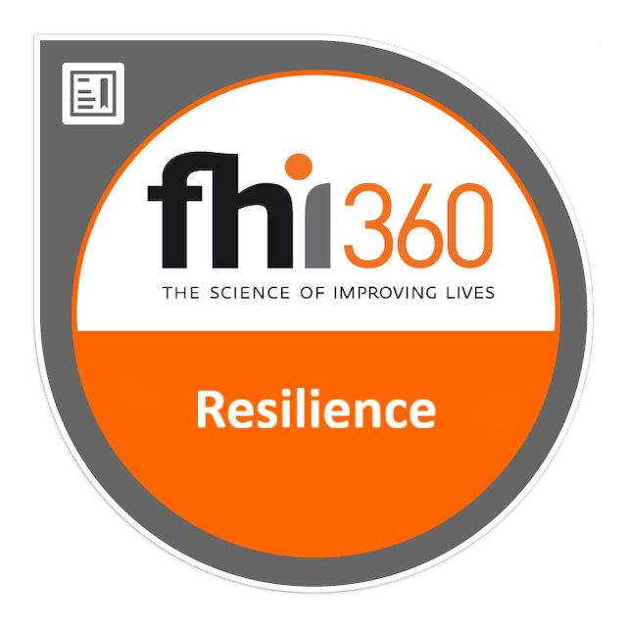
Resilience Model
Sub-Competency 1: Demonstrate Self-Awareness
Self-Awareness Exercises | Identifying Strengths & Weaknesses | Mind Mapping
Sub-Competency 2: Learn from Experience
Mistakes | Celebrating Failure | Life Stress
Sub-Competency 3: Focus on Solutions
Reframing Problems | SMART Goals | Biomimicry Challenge
Sub-Competency 4: Exhibit Flexibility
Adaptability | Training for Change | Gumby Approach

Slide 3
Reframing problems
Sub-Competency 3: Focus on Solutions

Slide 4
Why should we be solution oriented?
Notes:
- Using a flipchart, record participant responses to the question posed.

Slide 5
Becoming solution oriented
It all begins with our attitude.
Be objective.
Have a plan.
Employ creativity to surface solutions.
Be flexible.
Be accountable.
Take action.
Notes:
Distribute the “Why We Must All Be Solution-Oriented” handout.
Read and discuss.
Source: Jaynes, Leslie (2018). Why We Must All Be Solution-Oriented. Retrieved from https://www.linkedin.com/pulse/why-we-must-all-solution-oriented-leslie-jaynes/.

Slide 6
How do you know you’re solution-oriented?
You look at a problem and see the possible outcomes.
You think systematically and strategically.
You have little time for excuses.
You resist problem oriented questions.
You take a collaborative approach.
Notes:
Source: Jaynes, Leslie (2018). Why We Must All Be Solution-Oriented. Retrieved from https://www.linkedin.com/pulse/why-we-must-all-solution-oriented-leslie-jaynes/.

Slide 7
Adversity & solutions
Notes:
Distribute the “Focus on Solutions, Not More Problems” PDF article.
Read and discuss as a class.
Source: Mayberry, Matt (2015). When Faced With Adversity, Focus on Solutions, Not More Problems. Retrieved from https://www.entrepreneur.com/article/249129.

Slide 8
Observe how the group attempts to solve the problem
Notes:
https://www.youtube.com/watch?v=lm9gOxnX5XM

Slide 9
Reframing the problem
Write one sentence that defines the problem the Big Bang Theory group is trying to solve.
Circle any words in your sentence that describe the signs and symptoms of the problem (i.e., what is wrong).
Underline any words you used to define the problem in terms of the outcome (i.e., what success would look like).
Notes:
Source: Reframing Problems in Terms of Solutions. Retrieved from https://ntyyvuebz51lkxul3puxw5nw-wpengine.netdna-ssl.com/wp-content/uploads/2018/03/Reframing-Problems-as-Solutions.pdf.

Slide 10
Think about problem again and try to define it only in terms of the commonly desired positive outcome
Watch the clip again.
Reframe the problem.
Notes:
https://www.youtube.com/watch?v=lm9gOxnX5XM
Source: Reframing Problems in Terms of Solutions. Retrieved from https://ntyyvuebz51lkxul3puxw5nw-wpengine.netdna-ssl.com/wp-content/uploads/2018/03/Reframing-Problems-as-Solutions.pdf.

Slide 11
SMART Goals
Sub-Competency 3: Focus on Solutions

Slide 12
S.M.A.R.T. Goals
A GOAL WITHOUT A PLAN IS ONLY A DREAM

Slide 13
S.M.A.R.T. goals are…
Specific
Measurable
Attainable/ Action-oriented
Realistic
Timely/Tangible

Slide 14
Specific
Specific goals answer the following questions:
Who: Who is involved?
What: What do I want to accomplish?
When: Establish a time frame.
Where: Identify a location.
Which: Identify requirements and/or constraints.
Why: Identify a specific purpose or benefit of accomplishing the goal.

Slide 15
Measurable
To determine if your goal is measurable, ask questions such as
How much?
How many?
How will I know when it is accomplished?
Think numbers
Think quantifiable

Slide 16
Attainable
The goal is “do-able.”
It is action oriented.
It is “within reach” of mortals!
A may also stand for Action oriented, and that requires action verbs in the goal!

Slide 17
Realistic
The goal must be something you are both willing and able to do.
People must believe it can be accomplished.

Slide 18
Timely
You should establish a timeframe.
The timeframe must be realistic.
Everyone needs to know the timeframe…make it public.
T may also represent Tangible, in that you can experience it with one of your senses!

Slide 19
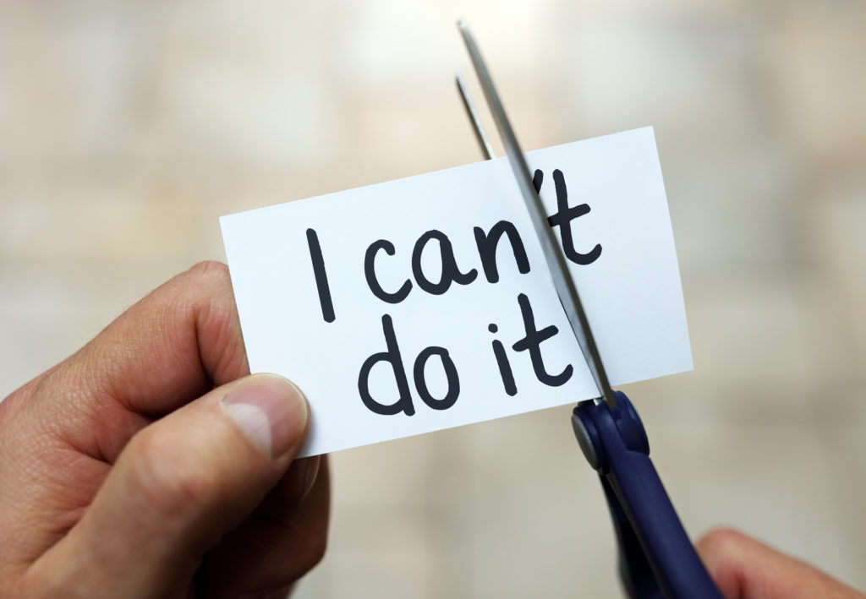
S.M.A.R.T. + C
Specific
Measurable
Attainable/ Action-oriented
Realistic
Timely/Tangible
Challenging

Slide 20
Let’s Think About Your GOALS
Using the S.M.A.R.T. +C goal techniques to:
Develop a personal goal you’d like to accomplish before this program is over
Develop a professional goal you’d like to accomplish before this program is over

Slide 21
Create your smart goal plan
If you ink it, you think it
Notes:
Distribute the “My SMART Goals” Microsoft Word worksheet.
Ask participants to complete the worksheet.

Slide 22
Biomimicry challenge
Sub-Competency 3: Focus on Solutions

Slide 23
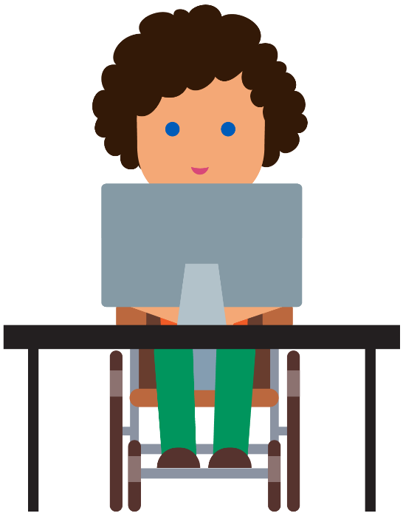
Biomimicry in Design and Engineering Stem²D Topics: Design and Engineering

Slide 24
What is STEM²D?
Science
Technology
Engineering
Mathematics
Manufacturing
Design
S
T
E
M
M
D

Slide 25
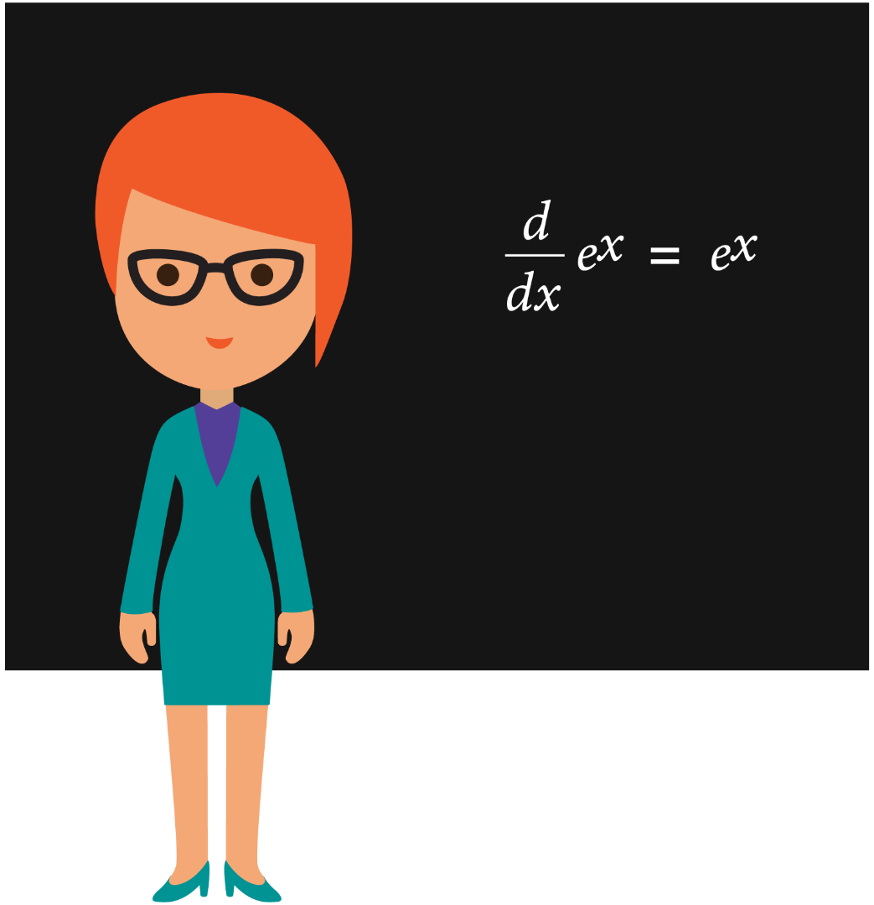
What is Biomimicry?
An approach to innovation that seeks sustainable solutions to human challenges by imitating nature’s patterns and strategies.
Notes:
Definition:
Biomimicry: an approach to innovation that seeks sustainable solutions to human challenges by imitating nature’s patterns and strategies.
Sustainable: capable of being maintained at a steady level without exhausting natural resources or causing severe ecological damage
Source: Biomimicry Institute

Slide 26
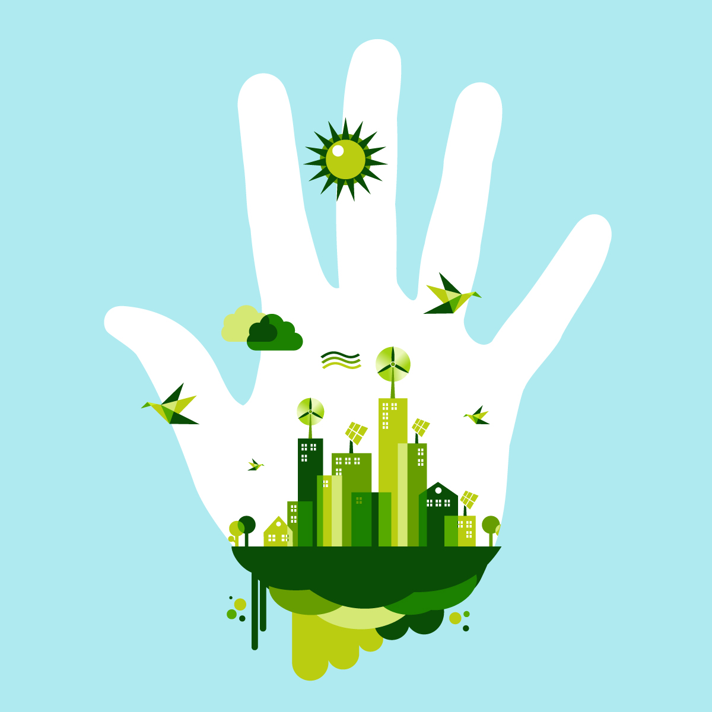
What is Sustainability?
Capable of being maintained at a steady level without exhausting natural resources or causing severe ecological damage.

Slide 27
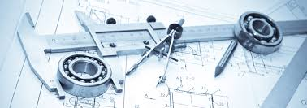
Why Biomimicry?
Why might engineers and designers use biomimicry?
Notes:
Explain that biomimicry can help solve problems to challenges faced by humans.
Consider referencing a famous quote by Albert Einstein: “Look deep into nature, and then you will understand everything better.”

Slide 28
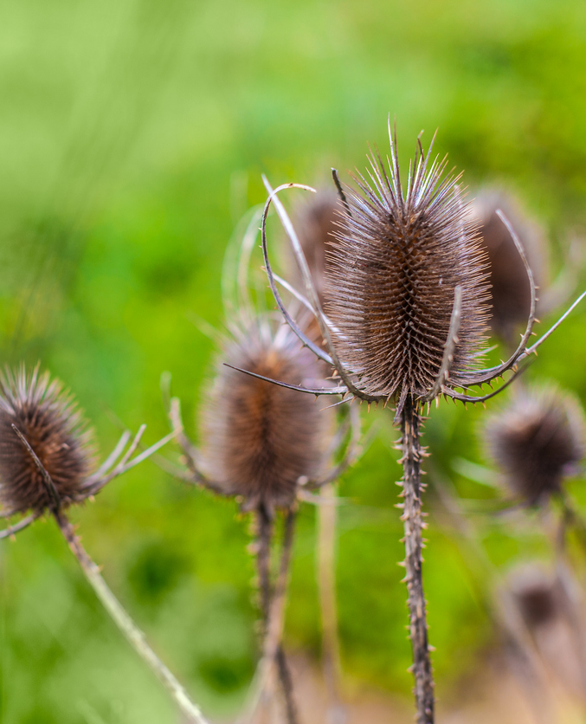
Biomimicry in Consumer Products
Velcro
Invented by Swiss engineer, George de Mestrel, in 1941.
He removed burrs from his dog and took a closer look at them to see how they worked.
The small hooks at the end of the needles inspired him to make Velcro.
Photo credit: iStock
Notes:
Velcro was invented by Swiss engineer George de Mestral in 1941 after he removed burrs from his dog and decided to take a closer look at how they worked.
The small hooks at the end of the burr needles inspired him to create Velcro.

Slide 29
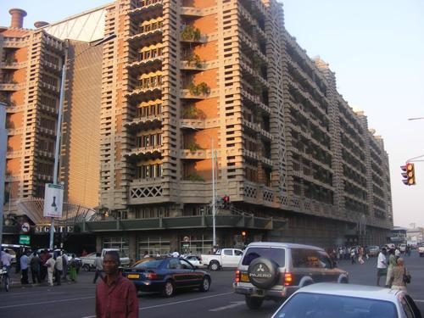
Biomimicry in Architecture
Photo credit: The Pinsta
Photo credit: iStock
Eastgate Centre, Harare, Zimbabwe
Has an internal climate control system originally inspired by the structure of termite mounds.
The architecture designed uses 90% less energy for ventilation than conventional buildings its size and has already saved over $3.5 million dollars in air conditioning costs.
Notes:
From Biomimicry Institute:
We generally think of termites as destroying buildings, not helping design them. But the Eastgate Building, an office complex in Harare, Zimbabwe, has an internal climate control system originally inspired by the structure of termite mounds.
The operation of buildings represents 40% of all the energy used by humanity, so learning how to design them to be more sustainable is vitally important.
The architect collaborated with engineers to design Eastgate, which uses 90% percent less energy for ventilation than conventional buildings its size, and has already saved the building owners over $3.5 million dollars in air conditioning costs.

Slide 30
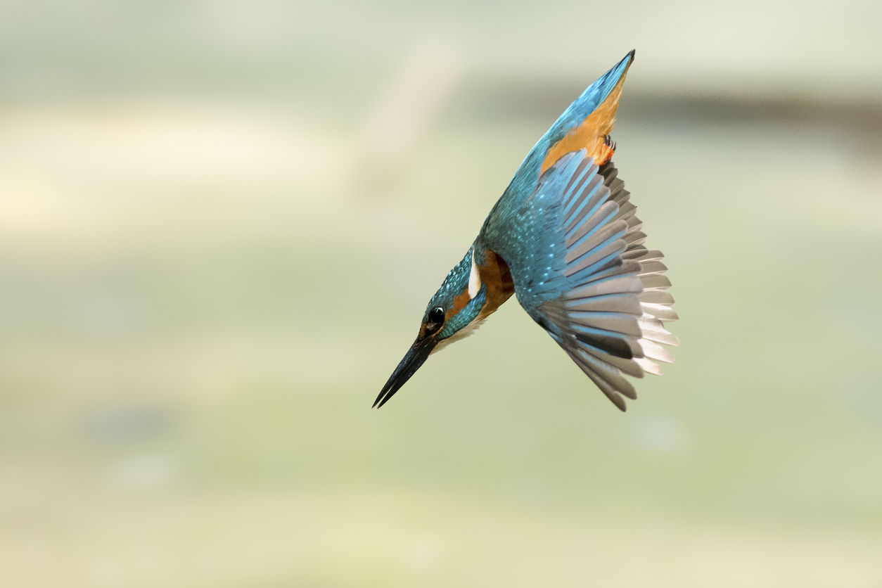
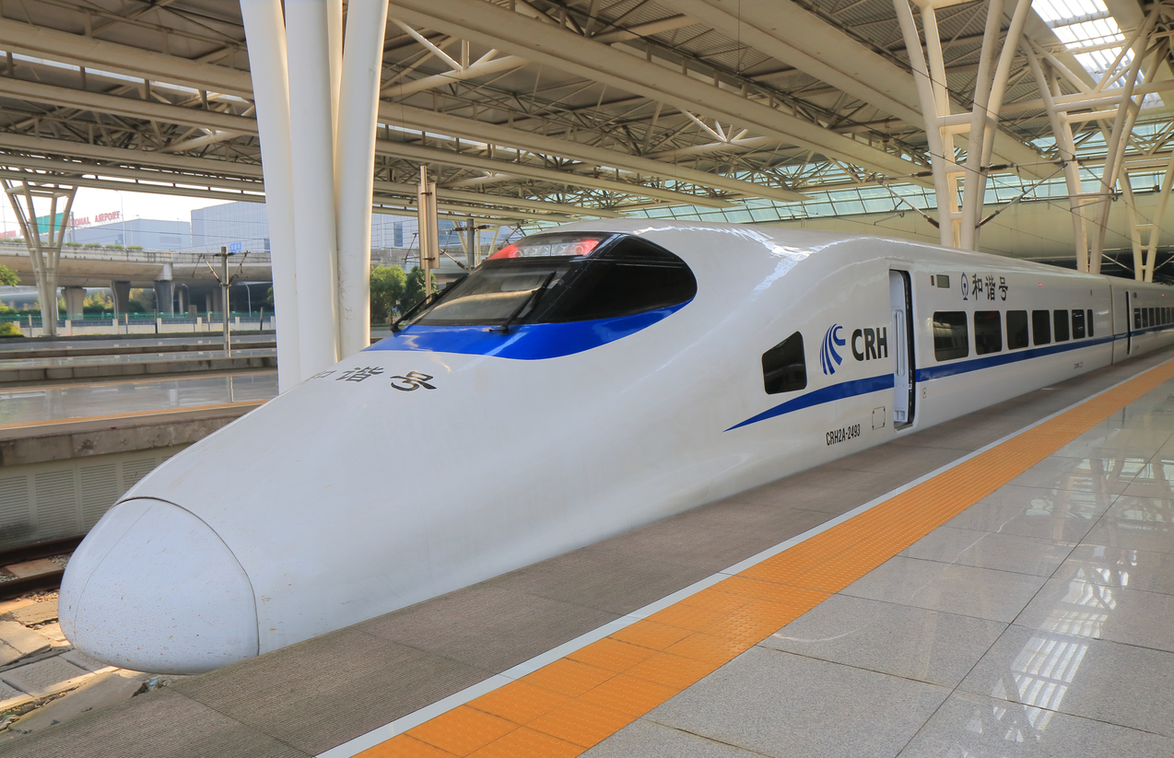
Biomimicry in Transportation
Shinkansen Bullet Train
Bullet train traveled over 200 mph, but it made A LOT of noise—even residents ¼ of a mile away complained!
The train’s engineer was a bird watcher.
Re-modeled the front end after the beak of kingfishers, which resulted in a quieter … AND FASTER … train!
It also ended up using 15% less electricity.
Photo credit: iStock
Photo credit: iStock
Notes:
From Biomimicry Institute:
The Shinkansen Bullet Train was the fastest train in the world, traveling 200 miles per hour. The problem? Noise.
Air pressure changes produced large thunder claps every time the train emerged from a tunnel, causing residents one-quarter a mile away to complain. The train’s chief engineer (and an avid bird watcher) asked himself, “Is there something in Nature that travels quickly and smoothly between two very different mediums?”
Modeling the front end of the train after the beak of kingfishers (which dive from the air into bodies of water with very little splash to catch fish) resulted not only in a quieter train, but 15% less electricity use—even while the train travels 10% faster.

Slide 31
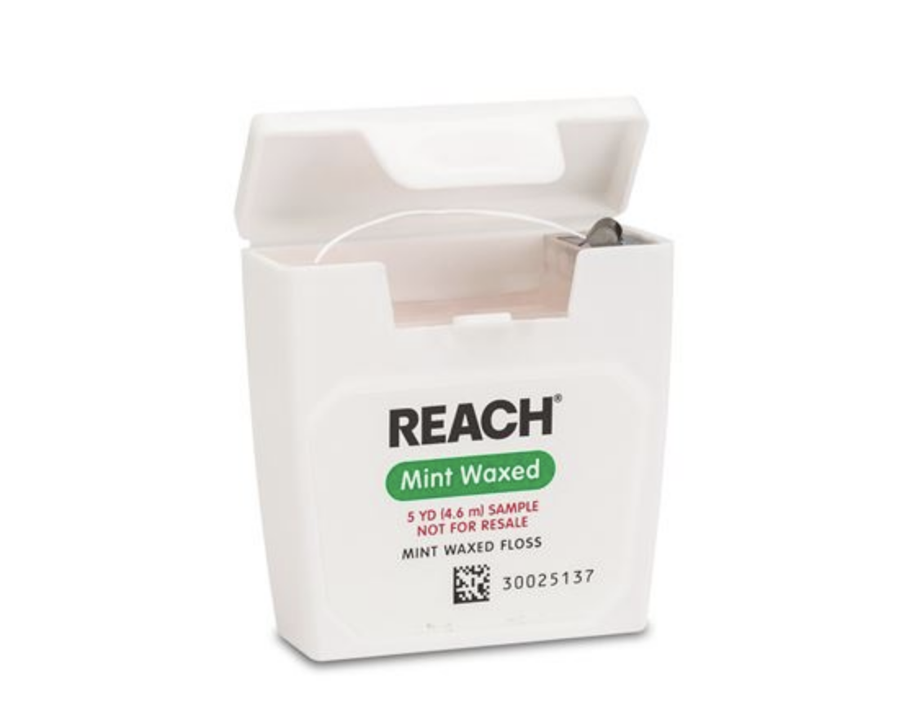
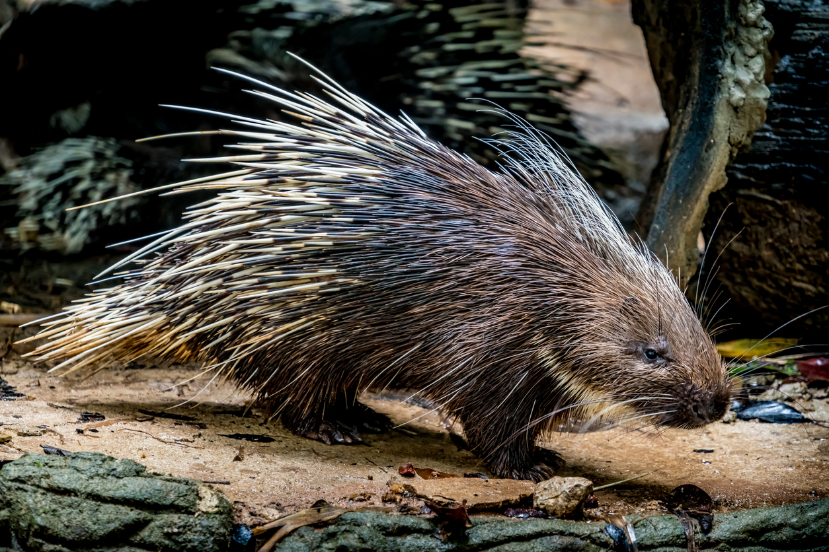
Biomimicry in Healthcare
Dental Floss
In the 1800s, people used sharp slivers of wood to clean between their teeth because silk was too expensive.
J&J used the excess silk left over from its suture manufacturing business to make more affordable floss.
Porcupine quills also served as a model for injection and suture needles.
Notes:
From Biomimicry Institute and Johnson & Johnson “Our Story”:
In the late 1800s, people were apt to use the sharpened ends of porcupine quills, writing quills, or slivers of wood to clean between their teeth because silk dental floss was too pricey. Johnson & Johnson decided to use the excess silk left over from its suture-manufacturing business to make a more affordable version of floss for the average consumer. It is interesting to note that porcupine quills, with their ease of entry, also serve as a model for injection needles and suture needles.
Mussels possess the unique ability to attach to wet, solid surfaces such as rocks, fish, and boats and are able to withstand strong wind and even waves. The remarkable adhesive powers of the mussels inspired medical adhesives. In 1998, Ethicon Inc., introduced a breakthrough alternative to traditional stitches. Dermabond® became the first FDA-cleared topical skin adhesive used to close up cuts that would otherwise require sutures or staples.

Slide 32
Biomimicry Challenge
Challenge
Design a structure, mode of transportation, or consumer product that is based on something in nature and solves a human challenge.
Instructions
Get inspired! Use the photos on the next slide as inspirations for the design. Alternately, use the Internet to perform research; websites are listed on the Biomimicry Resources handout.
Brainstorm different designs. Sketch potential ideas.
As a team, select one design to present to the large group.
Draw your group’s final design on the flip chart paper using the materials provided.
One person from each team will share the group’s design and give an explanation of why the design is a sustainable solution to a human challenge.

Slide 33
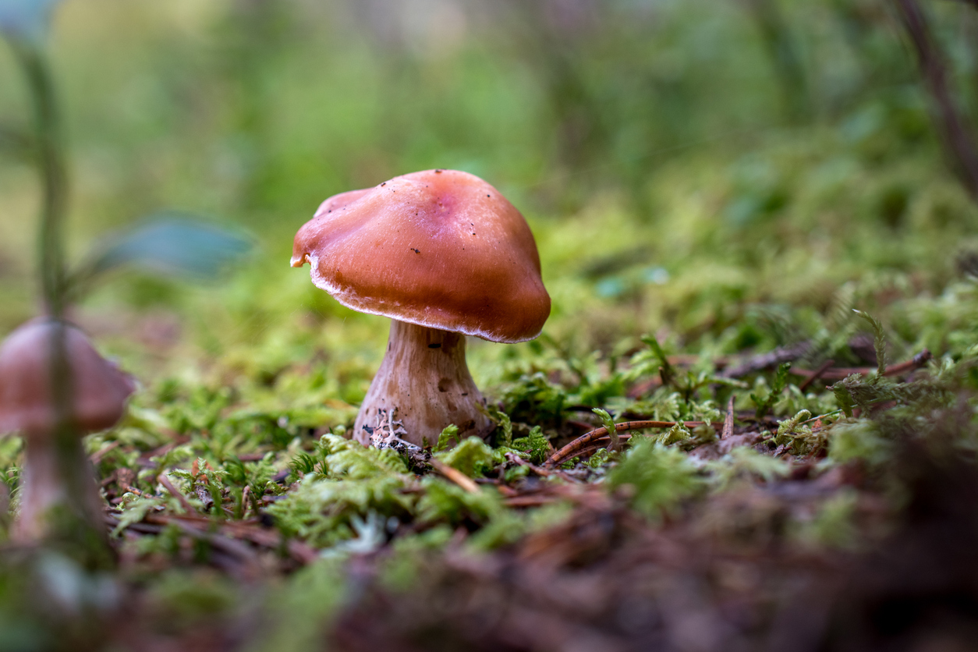
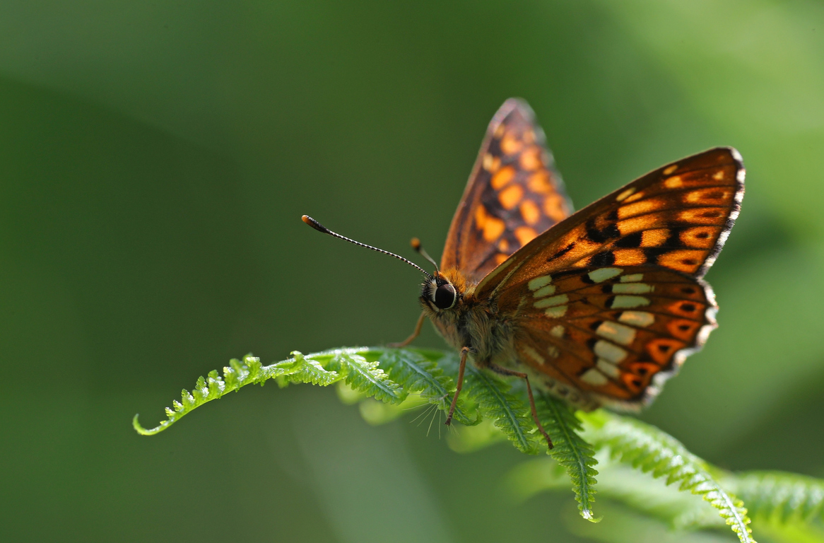
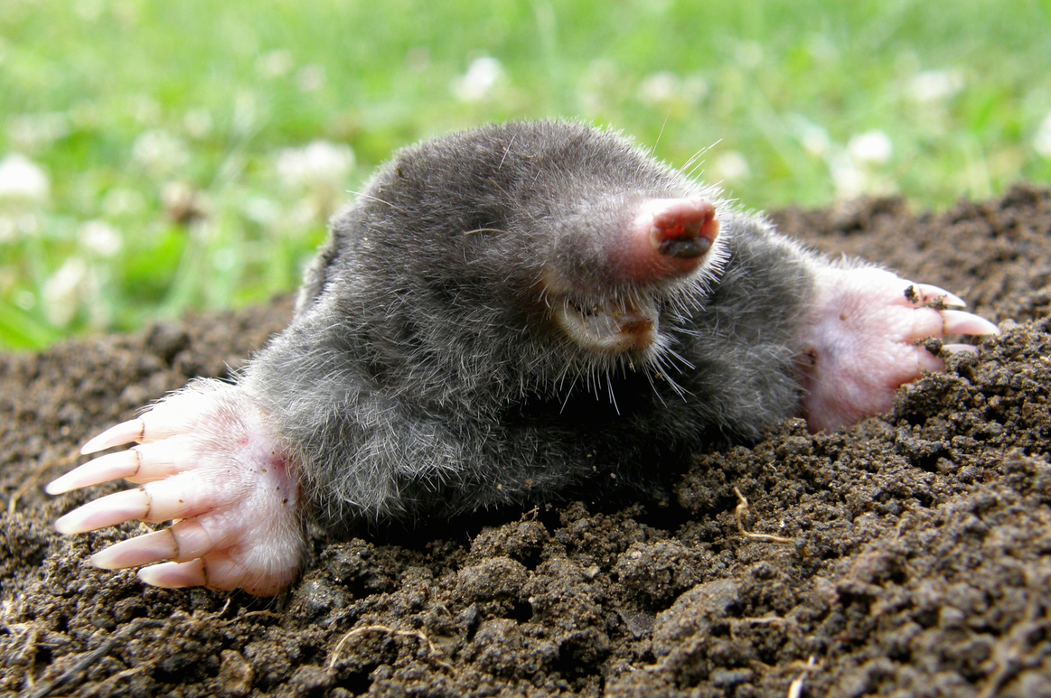
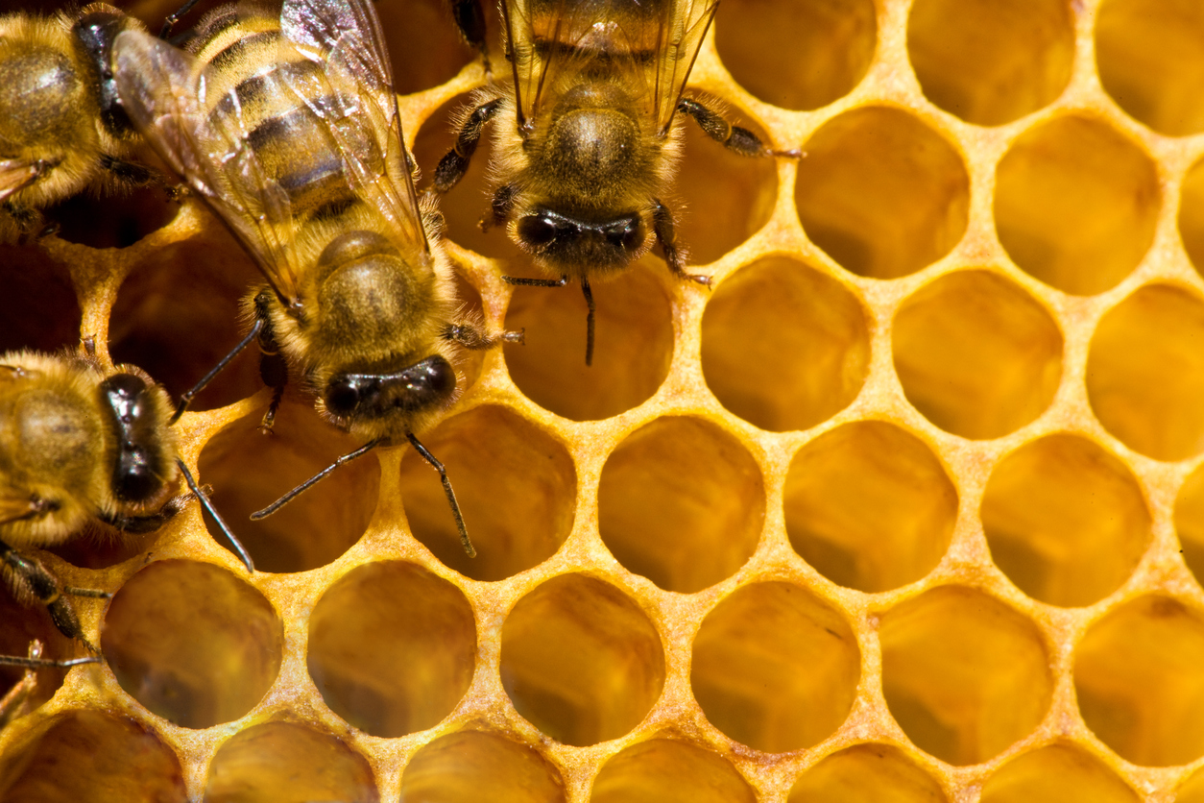
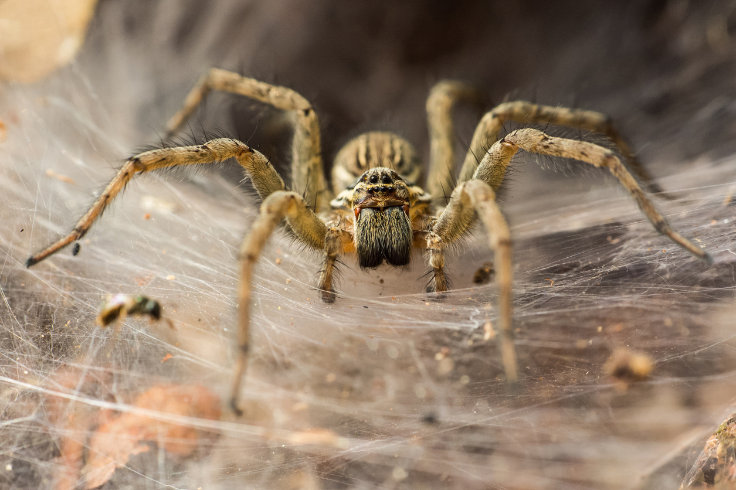
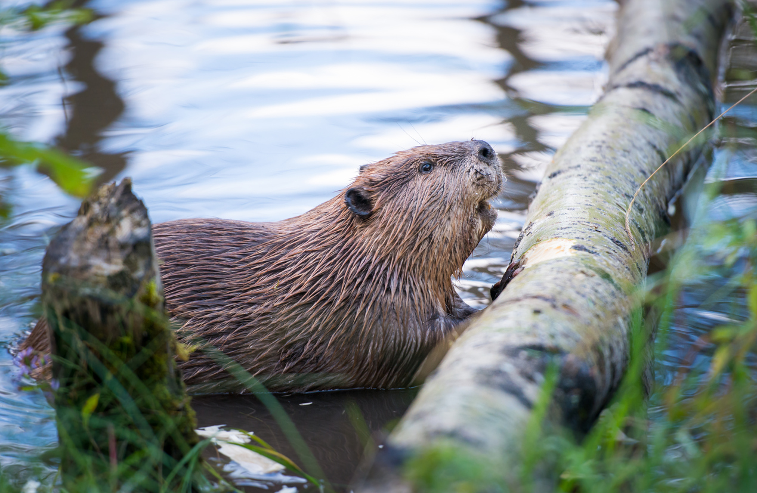
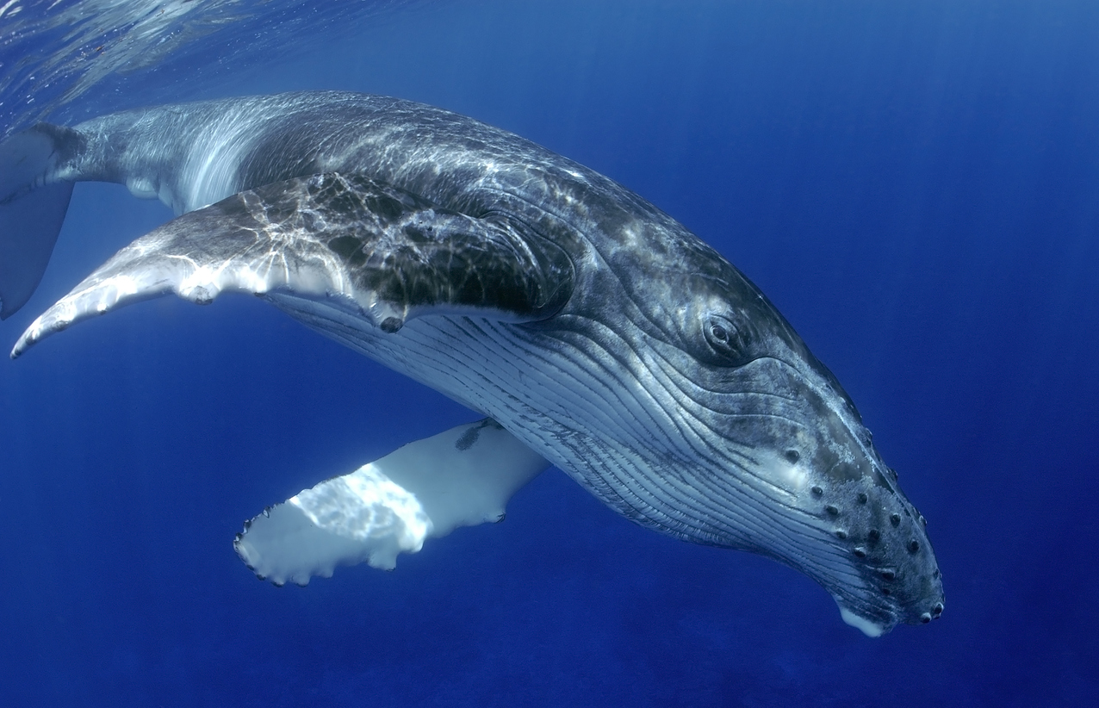
Inspirations in Nature
Photo credits: iStock
Notes:
ROW 1
Images from left to right:
Mushrooms can be used as inspiration for housing—the shape of the mushroom cap allows it to absorb a large amount of sunlight to convert to energy.
The butterfly is lightweight, can fly long distances, and can maneuver easily. Its design can be used as inspiration for airplanes.
A shark’s skin is made up of countless overlapping scales. The scales have grooves that allow water to pass by faster. The sharkskin has been used as inspiration to help design swimsuits.
A mole is known for its tunnel building. Tunnel building is a solution being explored in cities with severe traffic problems. In Los Angeles, California, Elon Musk, the co-founder of Tesla, is currently building a network of tunnels under the city that will some day transport people from one place to another.
ROW 2
Images from left to right:
The cells in beehives are already being used as inspiration for capsule hotels in which people sleep in small adjacent capsules instead of hotel rooms.
Spiders have the ability to travel vertically and horizontally and also travel long distances. The hairs on their feet help grip the surface, and they create silk parachutes using techniques similar to those used in creating a web. These characteristics may one day change how humans move around the earth.
Beavers have a thick layer of blubber that keeps them warm while they're diving and swimming in their water environments. Their fur is so dense that it traps warm pockets of air in between the layers, keeping these aquatic mammals not only warm, but dry. Engineers are using these features to help design wetsuits for surfing—when an athlete moves frequently between air and water environments.
The front edge of a whale fin has bumps that greatly increase its efficiency, reducing drag and increasing lift. Companies are applying the idea to wind turbine blades, cooling fans, airplane wings, and propellers.

Slide 34
Reflection
Think about the following questions:
What did you learn about biomimicry in design and engineering?
What role do you think biomimicry will have in how we may live in the future?
How was focusing on solutions key to success for this challenge?

Slide 35
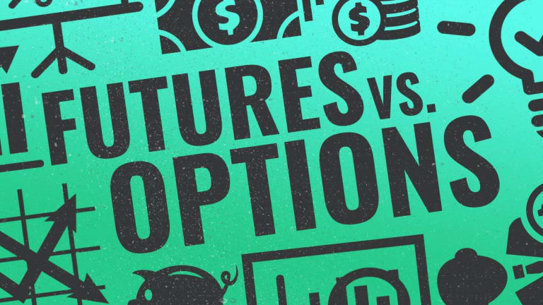
Preferred futures
Notes:
Distribute the “Preferred Futures” PDF handout.
Have each participant complete the activity within the handout.
This activity will be used to assess competency for this unit.
Source: Education Design Lab (2020). Proving Ground: Preferred Futures. Retrieved from https://ntyyvuebz51lkxul3puxw5nw-wpengine.netdna-ssl.com/wp-content/uploads/2018/03/Focus-on-Solutions.pdf

Slide 36
Thoughts and Reflections?

