Slide 1
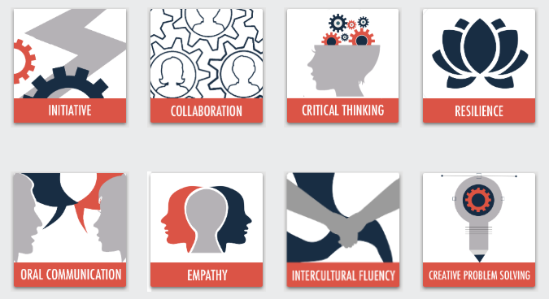
21st Century Skills
© 2020

Slide 2
Creative problem solving Model
Sub-Competency 1: Convergent & Divergent Thinking
Divergent & Convergent Thinking | Divergent & Convergent Questions | Creative Problem Solving Process
Sub-Competency 2: Manage Ambiguity
IDEO| Improv Exercises | Microsoft Ambiguity
Sub-Competency 3: Apply An Iterative Process
Design Thinking | Iterative Design | Sparring
Sub-Competency 4: Identify Patterns
Pattern Recognition | Affinity Diagrams | Remote Associates Test

Slide 3
Design thinking
Sub-Competency 3: Apply An Iterative Process

Slide 4
What is design thinking?
Notes:
https://www.youtube.com/watch?v=_WI3B54m6SU

Slide 5
How to solve problems like a designer
“The mission of design thinking is to translate observation into insights and insights into products and services that will improve lives.”
- Tim Brown, IDEO President & CEO
Notes:
Source: Janie Kliever (2020). Design Thinking: Learn How to Solve Problems Like a Designer. Retrieved from https://www.canva.com/learn/design-thinking/

Slide 6
5 principles of design thinking
Notes:
Distribute the “Learn How to Solve Problems Like a Designer” PDF article.
Read and discuss.
Source: Janie Kliever (2020). Design Thinking: Learn How to Solve Problems Like a Designer. Retrieved from https://www.canva.com/learn/design-thinking/

Slide 7
Qualitative research for design thinking
When conducting qualitative research for design thinking, the research itself can be conducted in a variety of ways:
 | Active | Passive
Individual | Interviews (semi-structured; explores experiences) | Observations (individuals)
Group | Focus Groups (semi-structured; explores a set of issues) | Observations (environments)
Notes:
Source: Qualitative Research for Design Thinking. Retrieved from https://ntyyvuebz51lkxul3puxw5nw-wpengine.netdna-ssl.com/wp-content/uploads/2018/03/Qual-Research-Methods.pptx.pdf

Slide 8
active interviews, focus group discussions
Strengths
Weaknesses
Can explore almost anything:
Questions
Thoughts
Wants/Needs
Ideas
Can be general or specific
Can be surface level or a deep dive
For design-driven innovation, the key is learning about their experiences, not answering the question
Tend to give the answer people are looking for
Not always truthful or transparent responses
Recommendation: Conduct 3 focus groups of 6–10 people OR 10–12 individual interviews.
Notes:
Source: Qualitative Research for Design Thinking. Retrieved from https://ntyyvuebz51lkxul3puxw5nw-wpengine.netdna-ssl.com/wp-content/uploads/2018/03/Qual-Research-Methods.pptx.pdf

Slide 9
Passive Observations: Individuals, Groups, Environments
Strengths
Weaknesses
Can demonstrate major and minor activities without prompting
Can offer insight into a larger narrative
Often a good place to start research
People change their behavior when they are being observed
An observation is just that—an observation.
Recommendation: Conduct at least 3–5 observations with multiple observers (limits bias and helps ensure accuracy)
Notes:
Source: Qualitative Research for Design Thinking. Retrieved from https://ntyyvuebz51lkxul3puxw5nw-wpengine.netdna-ssl.com/wp-content/uploads/2018/03/Qual-Research-Methods.pptx.pdf

Slide 10
Iterative design
Sub-Competency 3: Apply An Iterative Process

Slide 11
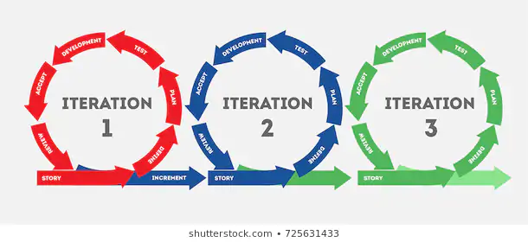
iteration
What does it mean?
Iteration is the repetition of a process in order to generate a sequence of outcomes.
The sequence will approach some end point or end value.
Each repetition of the process is a single iteration, and the outcome of each iteration is then the starting point of the next iteration.
It can be the new version of computer software or the repetition of some word or process.
Version 2.0 of a piece of computer software is an example of a new iteration.
Notes:
Source: Wikipedia

Slide 12
Iterative design in action
Notes:
https://www.youtube.com/watch?v=Rnsk5lA52ps&feature=youtu.be

Slide 13
Iteration: rules of engagement
Fail often and fail fast.
It’s kind of liberating. You actually have permission to mess up. In fact, it’s encouraged. The thought behind this is to not spend too much time developing things before getting it out to be tested. Get concepts (as rough as they may seem) into the hands of the user. Their course correction or validation is invaluable.
Be able to kill your ideas.
It’s hardly as gruesome as it sounds. You know that really good idea you have that you swear is the next best thing? You know, the idea that turned out not to be that great, but you still think it is? Yep. That’s this. If that wonderful idea that you feel personally dedicated to just isn’t working out, you have to be ready to kill it and leave it behind. There’s no dwelling in iteration.
Once an idea is out, everyone owns it.
Coming from the world of grant funding and research—where everyone is out to validate their own idea—this concept is particularly appealing. If I toss out a decent nugget of an idea and then three people add to it, expand upon it, and enhance it, everyone gets credit. There is no point in clinging onto who did what.
Less talking, more making.
Some conversation is okay, but in order to be able to test things, you have to make things. This doesn’t mean you have to create a masterpiece. You just need to put something down in writing or drawing or whatever. It will allow you to see holes in your concepts and gaps in your story.
Notes:
Source: Lussetto, Amy (2014). 4 keys to mastering 'design thinking' and the iteration process. Retrieved from https://www.bdcnetwork.com/blog/4-keys-mastering-design-thinking-and-iteration-process

Slide 14
Let’s practice iterative design!
Notes:
Facilitator should refer to the “Marshmallow Challenge_Facilitaor Lesson Plan.”
Source: Common Sense Education (ND). The Marshmallow Challenge. Retrieved from https://www.commonsense.org/education/lesson-plans/the-marshmallow-challenge.

Slide 15
sparring
Sub-Competency 3: Apply An Iterative Process

Slide 16
sparring
Sparring is a structured way to get peer feedback from teammates and stakeholders.
A fruitful sparring session can also help you reach specific decisions that will take the project forward.
Notes:
Source: Atlassian (2020). Sparring. Retrieved from https://www.atlassian.com/team-playbook/plays/sparring.

Slide 17
Uses of sparring
Let peers challenge your own ideas and inspire new ones.
Take advantage of others' knowledge and experience from outside your own discipline.
If you're struggling with velocity or team cohesiveness, sparring might help.
Notes:
Source: Atlassian (2020). Sparring. Retrieved from https://www.atlassian.com/team-playbook/plays/sparring.

Slide 18
Sparring assessment
Notes:
Distribute “Sparring Assessment” PDF handout.
Have participants complete the activity.
This activity will serve as the competency assessment for this unit.
Source: Education Design Lab (2020). Proving Ground: Sparring. Retrieved from https://www.atlassian.com/team-playbook/plays/sparring

Slide 19
Thoughts and Reflections?

