Slide 1
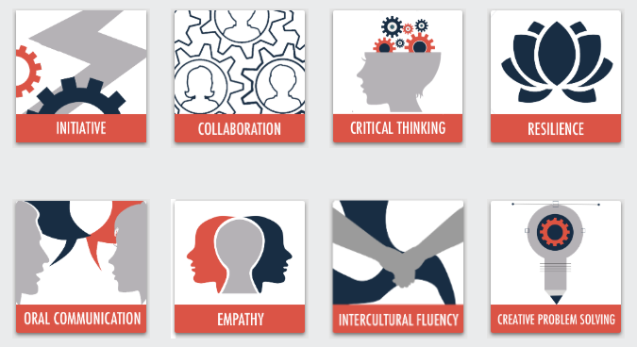
21st Century Skills
© 2020

Slide 2
Intercultural Fluency Model
Sub-Competency 1: Incorporating Diverse Perspectives
Intercultural Index | Communicating Respectfully | Circles of Self | The Choice
Sub-Competency 2: Show Curiosity
Importance of Being Curious | Bridging Cultural Differences | Building Connections
Sub-Competency 3: Demonstrate Self-Awareness
Self-Awareness Exercises | Identifying Strengths & Weaknesses | Mind Mapping
Sub-Competency 4: Challenge One’s Own Biases
Detecting Bias | The Implicit Bias Test | The Platinum Rule

Slide 3
Detecting bias
Sub-Competency 4: challenge one’s own biases

Slide 4
What is bias?
Understanding its meaning & Exploring its impact

Slide 5
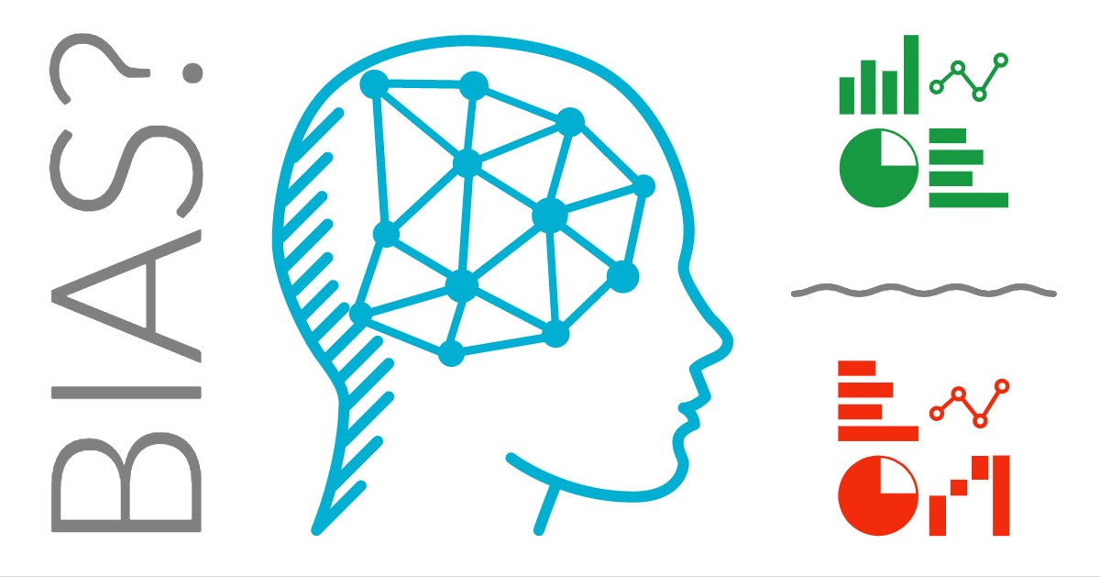
Defining bias
Disproportionate weight in favor of or against something
Can be innate or learned
Can be against an individual, group, or belief
Notes:
Source: Oxford Dictionary.

Slide 6
WHAT THE RESEARCH SHOWS
Most of us believe that we are ethical and unbiased.
We imagine we are good decision makers, think objectively, and reach fair and rational conclusions.
BUT …
More than two decades of research confirms that in reality most of us fall short of our inflated self-perception.
Source: Cultural Competency
Notes:
Source: Cultural Competency. Retrieved from http://cahra.net/downloads/updated_cultural_competency_presentation_for_cahra.pptx

Slide 7
What is unconscious bias?
The inclinations, attitudes, or stereotypes that affect our understanding, actions, and decisions that form outside our own conscious awareness.
Source: Cultural Competency
Notes:
Source: Cultural Competency. Retrieved from http://cahra.net/downloads/updated_cultural_competency_presentation_for_cahra.pptx

Slide 8
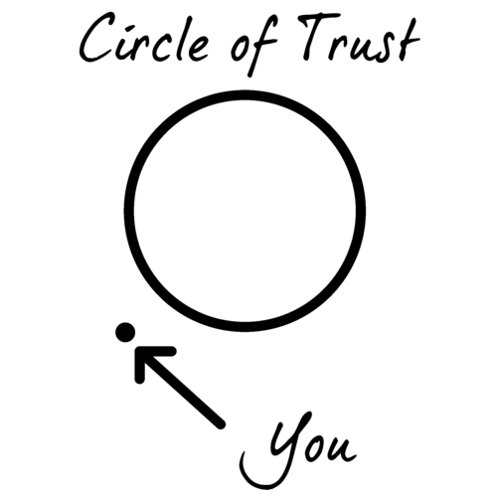
Your Circle of trust
Take out a blank sheet of paper.
On the left-hand side, make a column and write down the initials of 5-10 people you trust the most who are not family members.
This is your circle of trust
Listen to the following prompts and record accordingly.
Notes:
After participants have completed the aforementioned steps, the facilitator should do the following:
Read out some diversity dimensions (e.g., gender, nationality, native language, accent, age, race/ethnicity, professional background, religion) that participants identify with.
Have participants look at their list of five to ten trusted individuals and place a check mark next to those who have the same dimensions as them (i.e., female participant will put a check mark next to each female in their trusted circle list, etc.).
Ask participants if they noticed anything about the dimensions/diversity of their trusted circle.
Participants typically discover that their trusted circle often displays minimal diversity – for most participants, their inner circle includes people with backgrounds similar to their own. This is an example of affinity bias.
Source: Include-Empower. A-Ha Activities for Unconscious Bias Training. Retrieved from https://cultureplusconsulting.com/2018/08/16/a-ha-activities-for-unconscious-bias-training/

Slide 9
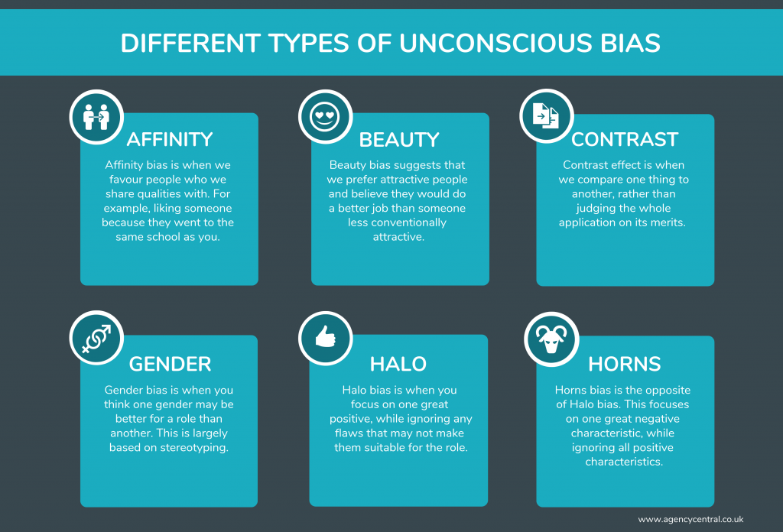
Types of Unconscious Bias
Affinity
Beauty
Contrast
Gender
Halo
Horns
Confirmation

Slide 10
Bias and Our Actions
Perception – how we see people and perceive reality
Attitude – how we react toward certain people
Behaviors – how receptive or friendly we are toward certain people
Attention – which aspects of a person we pay most attention to
Listening skills – how much we actively listen to what certain people say

Slide 11
How to outsmart your own unconscious bias
Notes:
https://www.youtube.com/watch?v=GP-cqFLS8Q4

Slide 12
What is Cultural Competence?
The integration and transformation of knowledge about individuals and groups of people into specific standards, policies, practices, and attitudes used in appropriate cultural settings to increase the quality of services, thereby producing better outcomes.
The ability to think, feel, and act in ways that acknowledge, respect, and build upon ethnic, socio-cultural, and linguistic diversity.
Notes:
Source: Cultural Competency. Retrieved from http://cahra.net/downloads/updated_cultural_competency_presentation_for_cahra.pptx

Slide 13
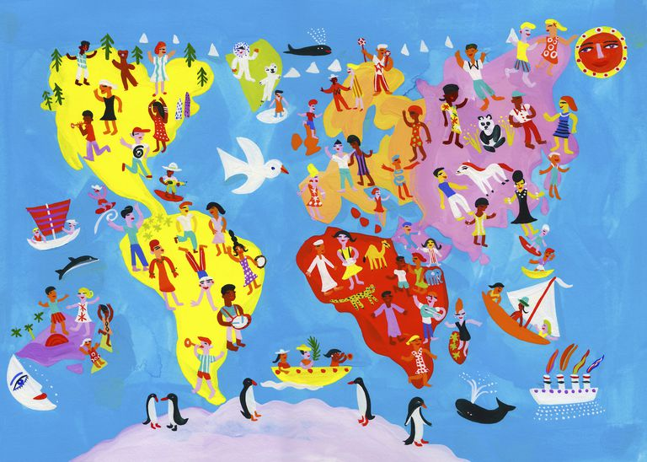
Culture helps Gives Context and Meaning
It is a filter through which people process their experiences and events of their lives.
It influences people’s values, actions, and expectations of themselves.
It impacts people’s perceptions and expectations of others.
Source: Cultural Competency
Notes:
Source: Cultural Competency. Retrieved from http://cahra.net/downloads/updated_cultural_competency_presentation_for_cahra.pptx

Slide 14
Bias example
Imagine you plan to go to college.
Think about the websites and media you will view to use for research.

Slide 15
Bias example
Bias can be presenting the best possible image, aiming to persuade a particular viewpoint.
Describe what you see in the following campus photo that was posted on a school website.
What does the campus environment look like?
Do you think this is in an urban or suburban setting?
How do you feel when looking at this picture and imagining yourself there as a student?

Slide 16
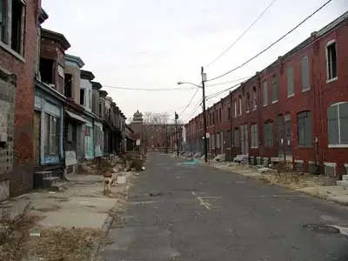
Describe what you see and how you feel based on these photos.

Slide 17
What if we told you these pictures were taken within one block of each other?
Have your thoughts or feelings about this campus changed?
What role may bias play in the way this information is presented?

Slide 18
Exploring bias
In the previous example, you saw how bias could play a role in what you experience in something as simple as exploring a college campus online.
What are some ways in which the impact of bias can be prevented when exploring a college campus?
Notes:
- Using a flipchart, record participant responses.

Slide 19
Exploring bias
What are some ways in which the impact of bias can be prevented when exploring a college campus?
Take a personal campus visit.
Speak to students who attend the college.
Research using objective sources (e.g., College Board)

Slide 20
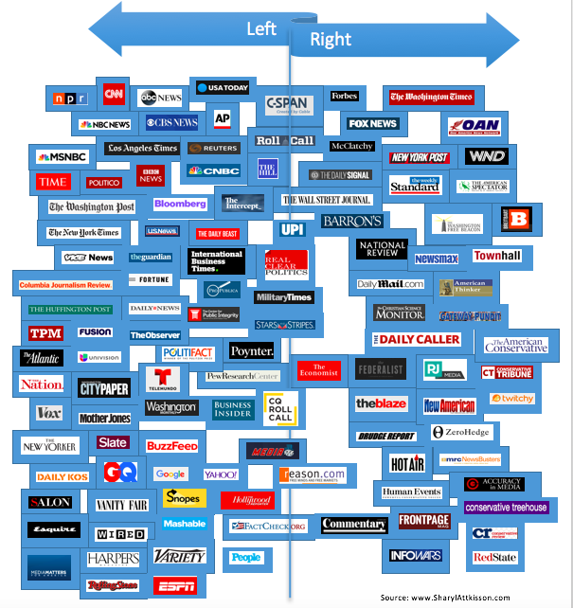
How to detect bias in media
Media has power in shaping many points of view, including cultural, social, and even political.
News media & institutions are challenged to be fair and accurate….
BUT HOW?
Notes:
Source: Fairness & Accuracy in Reporting (2012). How To Detect Bias in News Media. Retrieved from https://fair.org/take-action-now/media-activism-kit/how-to-detect-bias-in-news-media/.

Slide 21
How to detect bias in media
Sources:
Be aware of political perspectives (i.e., government, corporate, progressive, public interest, etc.).
Count the number of corporate and government sources vs. the number of progressive, female, and minority voices.
Diversity:
Look at the race, gender, and sexual diversity in the news outlet (i.e., producers, writers, editors, etc.).
Nightline and PBS’s NewsHour guests are 92% white and 89% male.
Point of View:
Political coverage often focuses on how issues affect politicians and corporations, not the people affected by the issues.
Economic coverage usually looks at how events impact stakeholders, not the workers or consumers.
Double Standards:
Youth of color who commit crimes are referred to as “predators,” whereas adult white criminals are portrayed as having a tragic past.
Expose double standards by citing parallel stories or examples.
Source: Fairness & Accuracy in Reporting (2012). How to Detect Bias in News Media
Notes:
Source: Fairness & Accuracy in Reporting (2012). How to Detect Bias in News Media. Retrieved from https://fair.org/take-action-now/media-activism-kit/how-to-detect-bias-in-news-media/.

Slide 22
How to overcome our Biases? Walk boldly toward them
Notes:
https://www.youtube.com/watch?v=uYyvbgINZkQ

Slide 23
The implicit bias test
Sub-Competency 4: challenge one’s own biases

Slide 24
Explicit vs. implicit bias

Slide 25
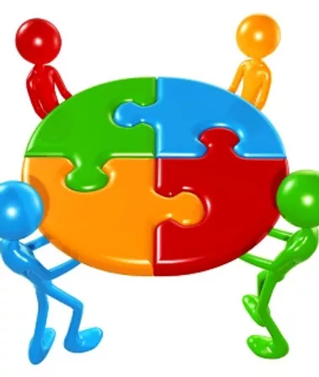
Exploring implicit bias
With a small group, define implicit bias and provide at least three examples.
Notes:
Facilitator should break participants up into small groups.
Using either a flipchart or notebook paper, have each group come up with their own definition of “implicit bias,” along with three examples. Instruct participants not to use the Internet or smartphones.
Have each group share their definitions and examples.

Slide 26
Implicit bias explained
The perception institute
Notes:
Distribute the “Implicit Bias Explained” PDF handout.
As a class, read and discuss implicit bias. Suggested prompts:
What impact can implicit bias have in the world?
What impact can implicit bias have in the workplace?
Source: The Perception Institute (2020). Implicit Bias Explained. Retrieved from https://perception.org/research/implicit-bias/.

Slide 27
Understanding Unconscious Bias
Notes:
https://www.youtube.com/watch?v=dVp9Z5k0dEE
Source: https://dramatictrainingsolutions.com/unconscious-bias-3-great-exercises-to-use-in-your-training/

Slide 28
What is the harm caused?
We are all biased, after all.
Notes:
Source: Cultural Competency. Retrieved from http://cahra.net/downloads/updated_cultural_competency_presentation_for_cahra.pptx

Slide 29
Unconscious bias is a fact of life
You are NOT alone. Everyone has unconscious biases and has taken them into the workplace.
We all suffer from prejudice. Prejudices are simply mental shortcuts based on social norms and stereotypes.
If you can name it, there is probably an unconscious bias for or against it.
It is all in the brain.
Mental grouping is part of the survival mechanism hard-wired into our brains.
There are more than 150 identified unconscious biases.
What is unconscious to some is in fact quite conscious to others.
Source: Cultural Competency
Notes:
Source: Cultural Competency. Retrieved from http://cahra.net/downloads/updated_cultural_competency_presentation_for_cahra.pptx

Slide 30
Implicit bias test
Explore your implicit associations
https://implicit.harvard.edu/implicit/
Notes:
- Using a computer or laptop, have participants go to the link provided to complete the implicit bias test. Note, there are multiple options. The facilitator should use discretion about which to use based on their group.

Slide 31
Implicit bias: What can we do about it?
Notes:
https://www.youtube.com/watch?v=kKHSJHkPeLY

Slide 32
Implicit Bias Recognition & Challenge
Notes:
Distribute the “Implicit Bias Recognition & Challenge” PDF handout. Using the results from their Implicit Bias Test (slide 21), have the participants complete the activity.
Instruct participants that this activity will be used to assess competency for this unit.

Slide 33
The platinum rule
Sub-Competency 4: challenge one’s own biases

Slide 34
Platinum vs golden rule
Notes:
Ask participants to explain the difference between the golden vs. platinum rules and provide an example.
Ask participants to reflect on the 21st century skills (i.e., critical thinking, empathy, resilience, etc.) presented in the digital badge series (slide 1). Which skill is most needed to execute the platinum rule? Answer: Empathy

Slide 35
Empathy versus sympathy

Slide 36
Empathy in the 21st century
Ability to understand others’ viewpoints and feelings
Use this understanding to improve the quality of:
Personal and professional relationships
Behaviors
Teambuilding
Performance

Slide 37
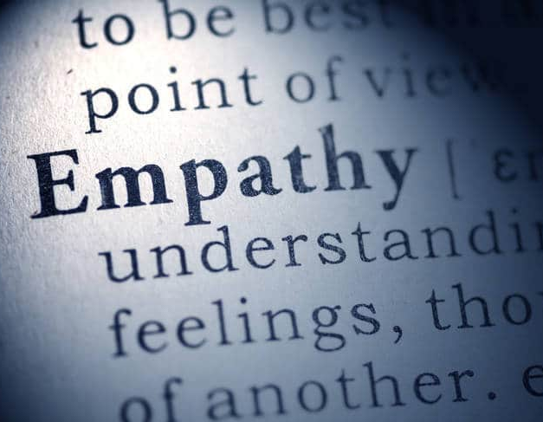
Power of empathy through employees
Notes:
Using the “Unleashing the Power of Employees Through Empathy” PDF, have participants reflect on the importance of empathy in leaders.
Using a flipchart, have participants make a list of qualities that make up an empathetic leader.
Source: TruScore. Unleashing the Power of Empathy Through Employees. Retrieved from https://www.truscore.com/resources/unleashing-power-employees-empathy/

Slide 38
Empathy map
Source: Education Design Lab. Recognizing Others
Needs & Values: Empathy Map.
Notes:
Using the “Empathy Map” PDF, have participants complete the empathy map activity.
If looking to add a professional scope to this activity, ask participants to repeat this activity with a former boss or supervisor in mind.
Source: Education Design Lab. Recognizing Others Needs & Values: Empathy Map. Retrieved from https://ntyyvuebz51lkxul3puxw5nw-wpengine.netdna-ssl.com/wp-content/uploads/2018/03/Recognize-others-Needs-Values_-Empathy-Map.pdf

Slide 39
The platinum rule
Notes:
https://www.youtube.com/watch?v=xcdiDnQ9-DQ

Slide 40
The platinum rule challenge
Notes:
Distribute the “Platinum Rule Challenge” PDF handout. Instruct participants to complete the activity.
This assessment will be used to demonstrate competency for this unit.
Source: Education Design Lab (2020). Recognize and Challenge One’s Own Cultural Bias Part II: The Platinum Rule. Retrieved from https://ntyyvuebz51lkxul3puxw5nw-wpengine.netdna-ssl.com/wp-content/uploads/2018/03/Recognize-and-Challenge-One_s-own-Cultural-Bias-Part-II.pdf.

Slide 41
Thoughts and Reflections?

