Slide 1
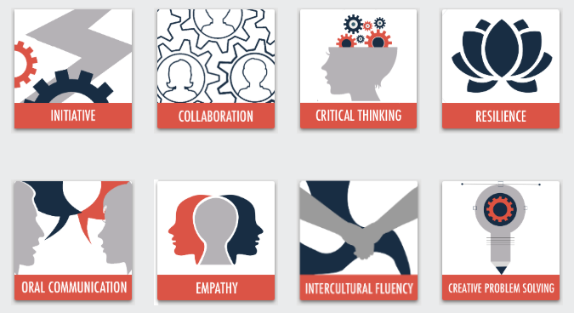
21st Century Skills
© 2020

Slide 2
Initiative Model
Sub-Competency 1: Lead Without Title
Motivating Others | Effective Leading | Sway Your Colleagues
Sub-Competency 2: Act as Catalyst
Proactive | Growth Mindset | Petition
Sub-Competency 3: Demonstrate Self-Awareness
Self-Awareness Exercises | Identifying Strengths & Weaknesses | Mind Mapping
Sub-Competency 4: Learn from Experience
Mistakes | Celebrating Failure | Grit

Slide 3
mistakes
Sub-Competency 2: Learn From Experience

Slide 4
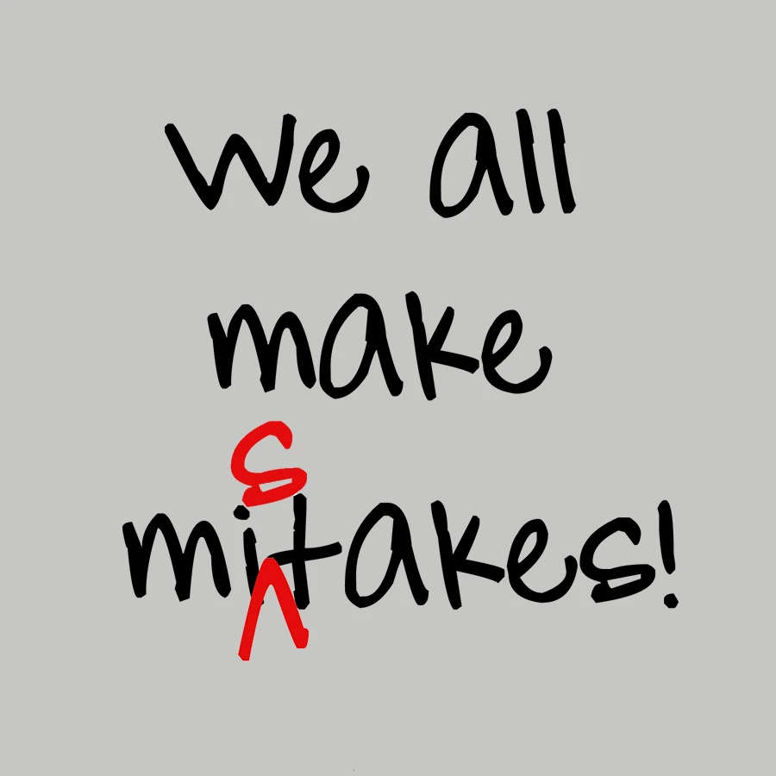
How do you identify your mistakes?
What constitutes a mistake?
What kinds of mistakes can you make?
How do you address your mistakes?
Do you own your mistakes?

Slide 5
How to learn & identify from your mistakes The Four kinds of mistakes
Stupid
Simple
Involved
Complex
Notes:
Distribute the “How to Learn and Identify from Your Mistakes” PDF article.
Read and discuss.
Source: Berkun, Scott (2011). How to Identify and Learn from Your Mistakes. Retrieved from https://lifehacker.com/how-to-identify-and-learn-from-your-mistakes-5863490.

Slide 6
Learning from mistakes checklist
Accepting responsibility makes learning possible.
Don't equate making mistakes with being a mistake.
You can't change mistakes, but you can choose how to respond to them.
Growth starts when you can see room for improvement.
Work to understand why it happened and what the factors were.
What information could have helped avoid the mistake?
What small mistakes, in sequence, contributed to the bigger mistake?
Are there alternatives you should have considered but did not?
What kinds of changes are required to avoid making this mistake again? What kinds of change are difficult for you?
How do you think your behavior should/would change if you were in a similar situation again?
Work to understand the mistake until you can make fun of it (or not want to kill others that make fun).
Don't over-compensate: the next situation won't be the same as the last.

Slide 7
The failure toss
Notes:
Facilitator should refer to the “Failure Toss Facilitator Lesson Plan.”
Implement activity with participants.
Source: Downing, Skip. On Course Facilitator’s Manual: The Failure Toss. Retrieved from https://oncourseworkshop.com/life-long-learning/failure-toss/.

Slide 8
Celebrating failure
Sub-Competency 4: Learn From Experience

Slide 9
The unexpected benefit of celebrating failure
Notes:
https://www.youtube.com/watch?v=2t13Rq4oc7A

Slide 10
The failure lab
FAILURE LAB is a raw and intimate evening showcasing personal stories of failure.
With a refreshing vibe of openness, it helps pave the way for change by crushing the isolation and stigma around failure.
FAILURE LAB empowers audience members to persevere by exploring the space between people who fail and quit, and those who get back up again.
By talking about failure, the audience can begin a dialogue about how the local community can help foster success.
Failure then takes its rightful place as the crucial first step to the next big thing.

Slide 11
The failure lab
You can subscribe to the FAILURE LAB to learn more and hear stories of those celebrating their failure.
Notes:
https://www.youtube.com/watch?v=hWO9s_xgYm0

Slide 12
Famous failures
Many success stories of famous people have only occurred through great persistence, after many setbacks and failures.
Albert Einstein
The failure: His teachers called him ‘slow.’ He didn’t learn to speak English until he was seven years old.
The success: He won the Nobel Prize for physics.
Colonel Sanders
The failure: Now a famous KFC fried chicken recipe, Sanders’ recipe was rejected 1008 times before a restaurant accepted it and began making fried chicken.
The success: KFC is a worldwide brand, making billions of dollars a year.
Oprah Winfrey
The failure: Oprah was fired from her first TV job and told she was ‘unsuitable’ for television.
The success: She became a billionaire through her popular talk show and television network.
Notes:
Source: Reach Out (2020). Embracing the F Word: Using Failure to Build Resilience and Motivation. Retrieved from http://about.au.reachout.com/wp-content/uploads/2015/08/ReachOut_Embracing-the-F-Word_Web.pdf.

Slide 13
Famous failures
J.K. Rowling
The failure: Her Harry Potter books were rejected by 12 publishers.
The success: Rowling created Harry Potter, now estimated to be worth $15 billion.
Elvis Presley
The failure: After a performance, the concert manager told him he would be better off returning to his old job of driving trucks.
The success: Elvis is one of the most famous singers of all time.
Failure in science
Science and experimenting are all about trying something out. If something works, great. But we can probably do it even better.
Failing is a vital part of science. Scientists are constantly developing theories to explain how something happens or to try to solve a problem.
If a theory ‘fails,’ this can often be a good thing. So failures are not even considered as such. They are called experiments!
Notes:
Source: Reach Out (2020). Embracing the F Word: Using Failure to Build Resilience and Motivation. Retrieved from http://about.au.reachout.com/wp-content/uploads/2015/08/ReachOut_Embracing-the-F-Word_Web.pdf.

Slide 14
Embracing the f word
Celebrating my failures & moving forward
Notes:
Distribute the “Failure Worksheet” Microsoft Word handout.
Ask participants to complete the worksheet.
In small groups or as a class, have each students share his or identified failure and how it will make them more resilient.

Slide 15
GRIT
Sub-Competency 4: Learn From Experience

Slide 16
When you think of success, what is the one quality you think you need? Why?
Notes:
Using a flipchart, record the participants’ responses to the posed question.
Discuss and reflect.

Slide 17
The one quality you need to take initiative & Succeed
Notes:
Distribute “Why Grit Is More Important Than IQ When You're Trying To Become Successful” PDF article.
Read and discuss.
Source: Quast, Lisa (2017). Why Grit Is More Important Than IQ When You're Trying To Become Successful. Retrieved from https://www.forbes.com/sites/lisaquast/2017/03/06/why-grit-is-more-important-than-iq-when-youre-trying-to-become-successful/#69aadb187e45

Slide 18
The power of passion & perseverance
Notes:
https://www.youtube.com/watch?v=H14bBuluwB8

Slide 19
The grit scale
Notes:
Distribute the “Grit Scale” PDF worksheet.
Have participants complete the worksheet and score their responses.
Source: Ducksworth, A.L & Quinn, PD (2009). Development and Validation of the Short Grit Scale. Retrieved from http://www.sjdm.org/dmidi/files/Grit-8-item.pdf

Slide 21
Signs you have the grit you need to succeed
You’re comfortable being uncomfortable.
You stay on course until you succeed.
You maintain your commitment even when you’re knocked down.
You use your intuition when most would use their rational mind.
You put up a brave front even though you’re scared.
You keep going even when you’re not sure you will win.
You don’t allow anything to get in your way.
You’re strong-minded and mentally tough.
You don’t take embarrassment to heart.
You accept support but you don’t rely on it.
You learn as you go and stay flexible in your thinking.
You forego perfection for high standards.
You stay positive even when the situation is negative.
You care about your return on investment.
You will do anything, but not everything.
Notes:
Distribute the “15 Signs You Have the Grit You Need to Succeed” PDF article.
Read and discuss.
Source: Daskal, Lolly. 15 Signs You Have the Grit You Need to Succeed. Retrieved from https://www.inc.com/lolly-daskal/15-signs-you-have-the-grit-you-need-to-succeed.html

Slide 22
GRIT
Notes:
https://www.youtube.com/watch?v=vzle_Puyg5o&vl=en

Slide 23
The perseverance walk
Notes:
Distribute the “Grit: The Perseverance Walk” PDF handout.
Have each participant complete the activity in the handout.
This activity will be used to assess competency for this unit.
Source: Lyon, Amy (ND). A Bit of Grit. Retrieved from https://www.edutopia.org/sites/default/files/pdfs/rmr/edutopia-rsrchmaderelevant-grit-perseverance-walkworksheet.pdf

Slide 24
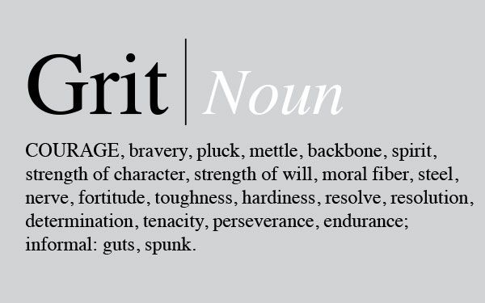

Slide 25
Thoughts and Reflections?

