Slide 1
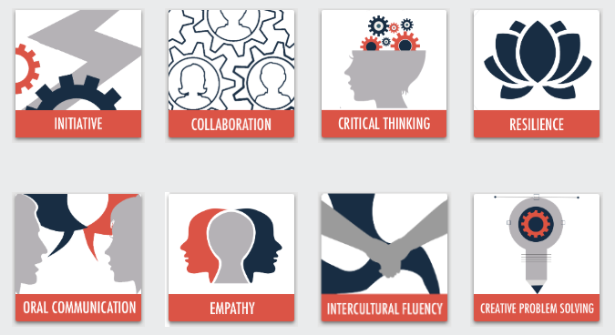
21st Century Skills
© 2020

Slide 2
initiative Model
Sub-Competency 1: Lead Without Title
Motivating Others | Effective Leading | Sway Your Colleagues
Sub-Competency 2: Act as Catalyst
Proactive | Growth Mindset | Petition
Sub-Competency 3: Demonstrate Self-Awareness
Self-Awareness Exercises | Identifying Strengths & Weaknesses | Mind Mapping
Sub-Competency 4: Learn from Experience
Mistakes | Celebrating Failure | Grit

Slide 3
Self-awareness exercises
Sub-Competency 3: Demonstrate Self-Awareness

Slide 4
What exactly is self-awareness?

Slide 5
How do you practice self-awareness?
Notes:
- Using a flipchart, record participants’ responses.

Slide 6
How to become more self-aware
Notes:
https://www.youtube.com/watch?v=R3kkqOzjrM4

Slide 7
12 Exercises For Greater Self-Awareness
The three why’s
Expand your emotional vocabulary
Practice saying no to yourself
Break visceral reactions
Be accountable for your flaws
Monitor your self-talk
Improve your body language awareness
Play devil’s advocate
Know your personality type
Practice self evaluation and reflection
Ask for constructive feedback regularly
Meditation
Notes:
Distribute the “12 Self-Awareness Exercises to Fuel Success” PDF article.
Read and discuss the article.
Source: Nguyen, Thai (2016). 12 Self-Awareness Exercises That Fuel Success. Retrieved from https://www.entrepreneur.com/article/254669.

Slide 8
The importance of self-awareness
Notes:
https://www.youtube.com/watch?v=LH12DmOwWRk

Slide 9
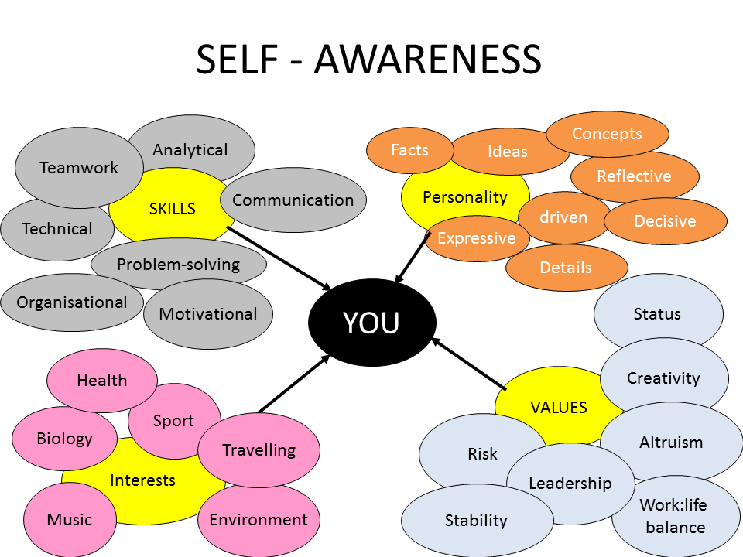
Create your own self-awareness game plan

Slide 10
Identifying strengths & weaknesses
Sub-Competency 3: Demonstrate Self-Awareness

Slide 11
How to identify your strengths & weaknesses
Understand your abilities
Perform a reflective best self exercise
List your actions
List your desires
Assess your strengths and weaknesses
Notes:
Distribute the “How to Identify Your Strengths and Weaknesses” PDF article.
Explore each of the 5 parts.
Source: Griffin, Trudi (2019). How to Identify Your Strengths and Weaknesses. Retrieved from https://www.wikihow.com/Identify-Your-Strengths-and-Weaknesses.

Slide 12
Reflective best self exercise (rbse)
Notes:
https://www.youtube.com/watch?v=KQ6GK5RRIIo

Slide 13
Complete step one of rbse
Notes:
Have participants complete step 1 of the reflective best self exercise (RBSE): write three stories of their strengths.
Facilitator should use their discretion if they would like to have participants complete the full RSBE exercise.

Slide 14
Mind mapping
Sub-Competency 3: Demonstrate Self-Awareness

Slide 15
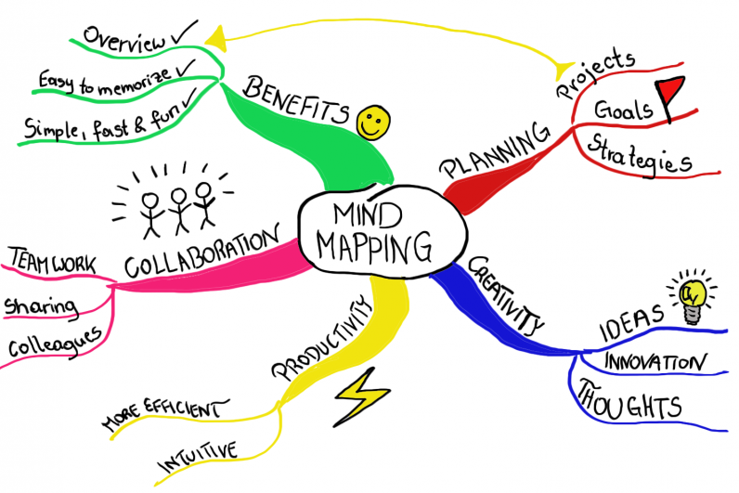
What is a mind map?
An easy way to brainstorm thoughts without worrying about order and structure.
Allows you to visually structure your ideas to help with analysis and recall.
A diagram for representing tasks, words, concepts, or items linked to and arranged around a central concept or subject using a layout that allows you to build an intuitive framework around a central concept.
It can turn a long list of info into a colorful, memorable, and highly organized diagram that works in line with your brain's natural way of doing things.
A mind map can be used as a simplified content management system (CMS).
It allows you to store all your data in a centralized location to stay organized.
With the various mind-mapping software programs out today, you can attach files to different branches for even more flexibility.
Notes:
Source: Mind Mapping (2020). What is a Mind Map. Retrieved from https://www.mindmapping.com/mind-map.php

Slide 16
Basic structure of a mind map

Slide 17
Sample mind map for essay planning

Slide 18
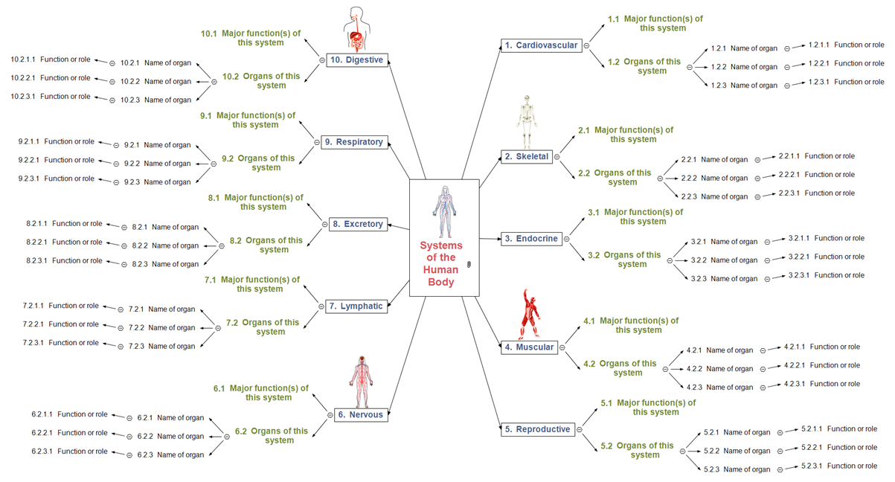
Sample mind map of the human body

Slide 19
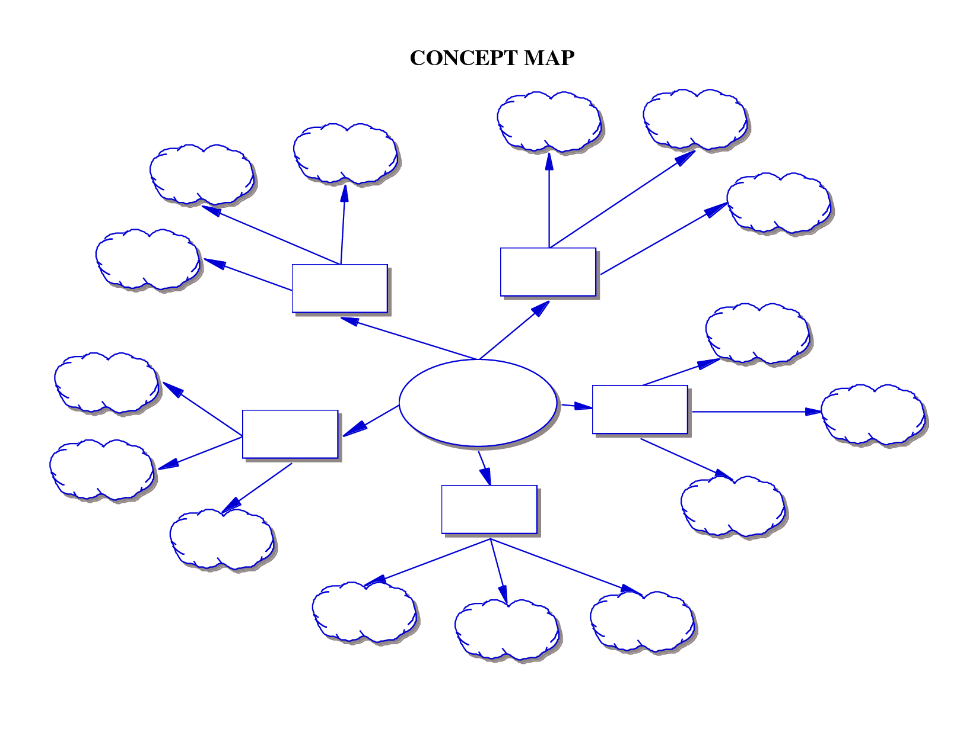
Create a mind map with you at the center
YOU
Notes:
Provide participants with the “Mind Map Template” handout.
Ask participants to share when they have completed.

Slide 20
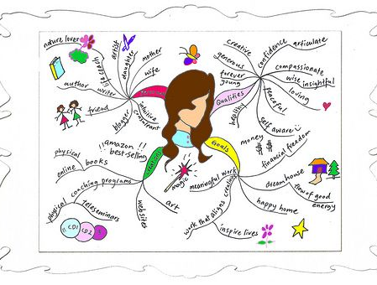
Drucker’s questions
Self-awareness questions
Notes:
Distribute the “Drucker’s Questions” PDF handout.
Have each participant complete the activity within the handout.
Source: Education Design Lab (2020). Demonstrate Self-Awareness: Drucker’s Questions. Retrieved from https://ntyyvuebz51lkxul3puxw5nw-wpengine.netdna-ssl.com/wp-content/uploads/2019/04/druckersquestions_selfawareness.pdf.

Slide 21
Self-awareness reflection
Notes:
Distribute the “Demonstrate Self-Awareness: Reflection” PDF handout.
Have each participant complete the activity within the handout.
This activity will be used to assess competency for this unit.
Source: Education Design Lab (2020). Demonstrate Self-Awareness: Reflection. Retrieved from https://ntyyvuebz51lkxul3puxw5nw-wpengine.netdna-ssl.com/wp-content/uploads/2018/03/Demonstrate-Self-Awareness.pdf

Slide 22
Thoughts and Reflections?

