Slide 1
Empathy digital badge Model
Sub-Competency 1: Listen Actively
Listening Habits | Walk & Stop | Active Empathetic Listening
Sub-Competency 2: Incorporate Diverse Perspectives
Circles of Self | Read the Room | NEAR Engagement |
Respect in the Workplace
Sub-Competency 3: Recognize Others’ Needs & Values
Stand in Someone Else’s Shoes | Emotional Intelligence |
Bias in the Workplace | Power of Empathy Through Employees
Sub-Competency 4: Validate Others’ Feelings & Perceptions
Communicate Acceptance | Validation Through Empathy | Values Across the Aisle
© 2020

Slide 2
Sub-competency 3: Recognize others’ needs & values
“It is not our differences that divide us. It is our inability to recognize, accept, and celebrate those differences.”
HealthyPlace.com

Slide 3
Stand in someone else’s shoes
Notes:
https://www.youtube.com/watch?v=zh55e6U_XPM

Slide 4
Thoughts and Reflections?

Slide 5
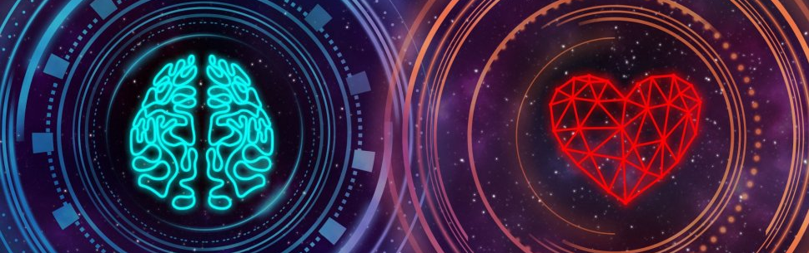
Emotional intelligence (EI)

Slide 6
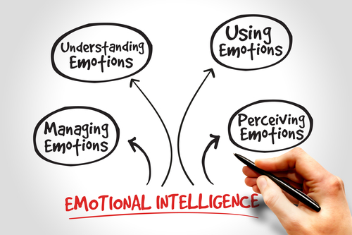
Emotional Intelligence (EI) Defined
Recognize, understand, and manage our own emotions
Recognize, understand, and influence the emotions of others
Notes:
Source: Emotional Intelligence. Retrieved from https://cdn.ymaws.com/www.naecp.net/resource/collection/E888E026-C04E-4F26-BC42-5A8484128A87/Emotional_Intelligence_Presentation.pptx

Slide 7
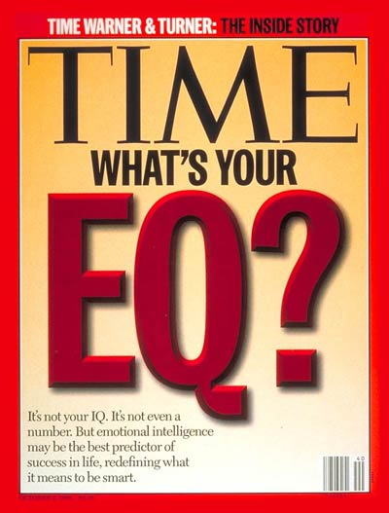
Was initially studied in the 1920s during the IQ movement and called social intelligence.
Researchers testing intelligence realized that IQ doesn’t capture all of a person’s potential for success.
Intellect only accounts for 20% of success in life. What makes up the rest?
Emotional intelligence
Social class
Luck
The 1990s research at Yale was conclusive that the EQ is a major indicator of achievement.
Explains why two people with the same IQ could attain drastically different levels of success in their work and personal lives.
90% of top performers have high EI.
Notes:
Source: Emotional Intelligence. Retrieved from https://cdn.ymaws.com/www.naecp.net/resource/collection/E888E026-C04E-4F26-BC42-5A8484128A87/Emotional_Intelligence_Presentation.pptx

Slide 8
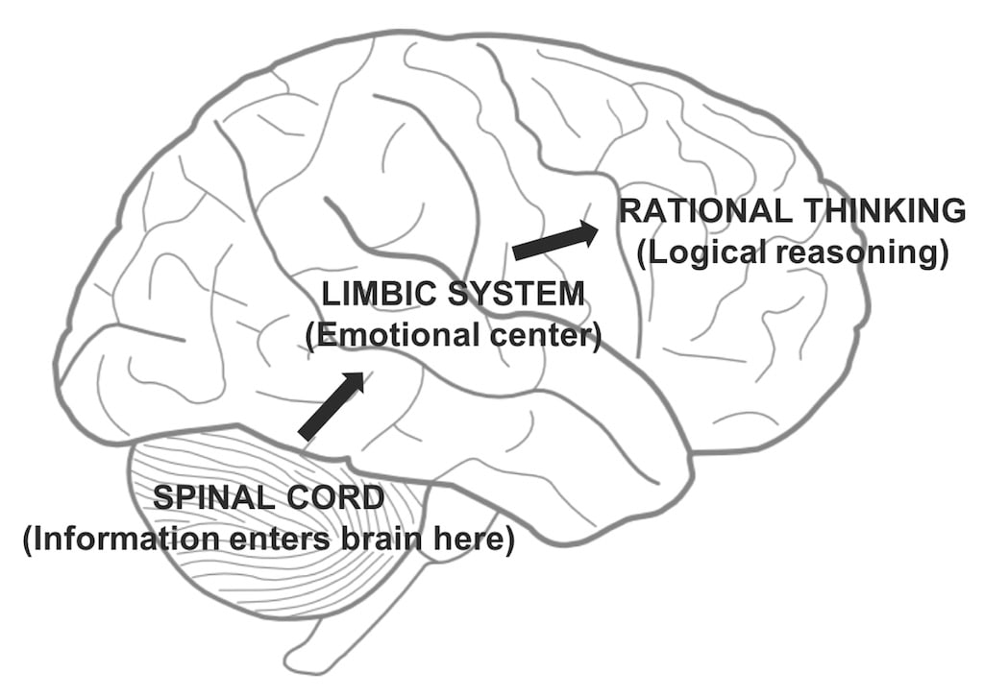
Physiological Science Behind EI
Humans are built to be emotional.
We experience an emotional response to an event before it reaches the part of the brain that thinks rationally and reacts to the emotion.
The more we think about what we are feeling – and do something productive with that feeling – the more developed this pathway becomes.
The more traffic in both directions the better.
If you typically yell when feeling angry, you have to learn to choose an alternative reaction.
You must practice this new reaction many times before it will replace your urge to yell.
Notes:
Source: Emotional Intelligence. Retrieved from https://cdn.ymaws.com/www.naecp.net/resource/collection/E888E026-C04E-4F26-BC42-5A8484128A87/Emotional_Intelligence_Presentation.pptx

Slide 9
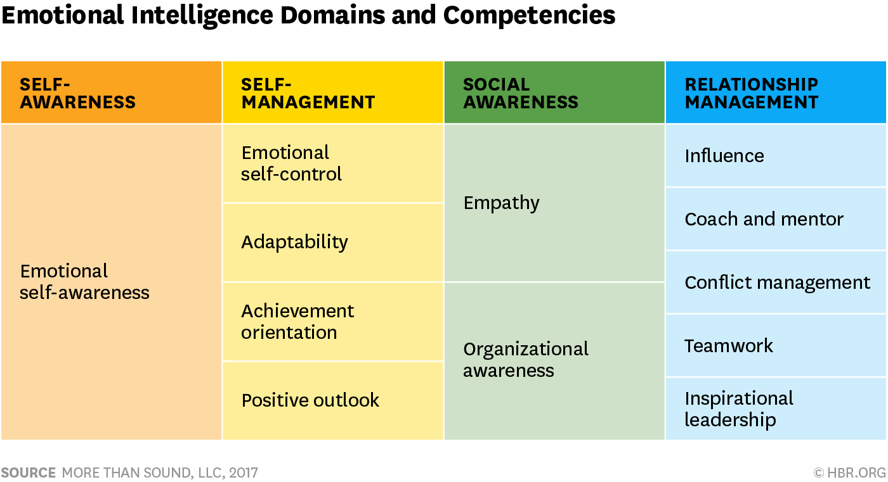
4 Skills of Emotional Intelligence
Emotional Intelligence
Self-Awareness
Self-Management
Social Awareness
Relationship Management
PERSONAL COMPETENCE
SOCIAL COMPETENCE

Slide 10
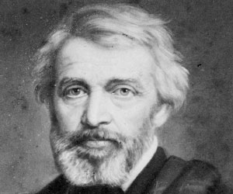
EI Starts with Self-Awareness
The greatest of faults is to be conscious of none
Self-awareness
Accurately perceive your own emotions.
Aware of your emotions as they happen.
Keep on top of how you tend to respond to specific situations and people.
Thomas Carlyle
Notes:
Source: Emotional Intelligence. Retrieved from https://cdn.ymaws.com/www.naecp.net/resource/collection/E888E026-C04E-4F26-BC42-5A8484128A87/Emotional_Intelligence_Presentation.pptx

Slide 11
How to Improve Self-Awareness
Know yourself.
See yourself for who you are (what do you think and feel).
Be cognizant of your emotions including physiological signs.
Mind goes blank.
Feel hot or numb.
Muscle tension.
Shaking.
Track and backtrack your emotions in difficult conversations.
Learn your tendencies in emotionally difficult situations.
Use paired sharing (peer or supervisor).
Own your actions – take full responsibility for what you say and do.
Notes:
Source: Emotional Intelligence. Retrieved from https://cdn.ymaws.com/www.naecp.net/resource/collection/E888E026-C04E-4F26-BC42-5A8484128A87/Emotional_Intelligence_Presentation.pptx

Slide 12
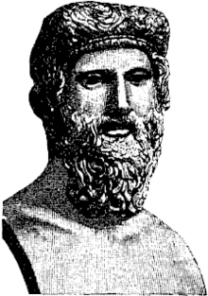
Use Awareness to Self-Manage
The first and best victory is to conquer self
Self-management
Use the awareness of your emotions to stay flexible and positively direct your behavior.
Manage your emotional reactions to all situations and people.
Plato
Notes:
Source: Emotional Intelligence. Retrieved from https://cdn.ymaws.com/www.naecp.net/resource/collection/E888E026-C04E-4F26-BC42-5A8484128A87/Emotional_Intelligence_Presentation.pptx

Slide 13
What are your Emotional Triggers?
What is an emotional trigger?
What are your emotional triggers?
Think about your future profession — what emotional triggers do you think might be linked to that career?
Notes:
Do you know the emotional triggers of your stakeholders?
Source: Emotional Intelligence. Retrieved from https://cdn.ymaws.com/www.naecp.net/resource/collection/E888E026-C04E-4F26-BC42-5A8484128A87/Emotional_Intelligence_Presentation.pptx

Slide 14
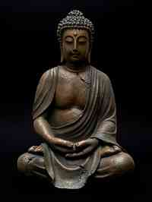
Becoming Socially Aware
Resolve to be tender with the young, compassionate with the aged, sympathetic with the striving and tolerant with the weak and wrong. Sometime in your life, you will have been all of these.
Social awareness
Accurately pick up on emotions in other people.
Understand what is really going on.
Understand what other people are thinking and feeling, even if you do not feel the same way.
Gautama Buddha
Notes:
Source: Emotional Intelligence. Retrieved from https://cdn.ymaws.com/www.naecp.net/resource/collection/E888E026-C04E-4F26-BC42-5A8484128A87/Emotional_Intelligence_Presentation.pptx

Slide 15
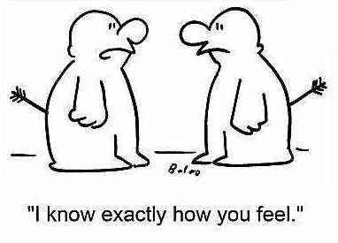
Social Awareness Requires Empathy
Empathy is the ability to see the world from another’s point of view and to identify and understand another’s situation, feelings, and motives
Notes:
Source: Emotional Intelligence. Retrieved from https://cdn.ymaws.com/www.naecp.net/resource/collection/E888E026-C04E-4F26-BC42-5A8484128A87/Emotional_Intelligence_Presentation.pptx

Slide 16
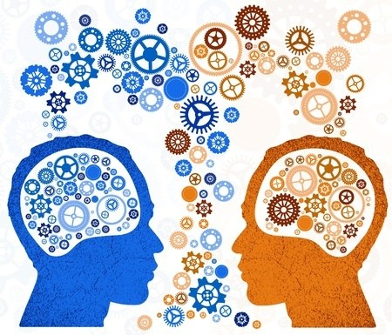
Improving Social Awareness
Be open-minded
Spend extra time observing, asking and listening.
Maintain eye contact.
Give a speaker your full attention.
Playback and summarize.
Imagine yourself in the person’s shoes.
Suspend your judgment.
Read body language.
Recognize emotions in speech tone.
Think before you speak.
Recognize indicators of potential problems or conflicts.
Notes:
Source: Emotional Intelligence. Retrieved from https://cdn.ymaws.com/www.naecp.net/resource/collection/E888E026-C04E-4F26-BC42-5A8484128A87/Emotional_Intelligence_Presentation.pptx

Slide 17
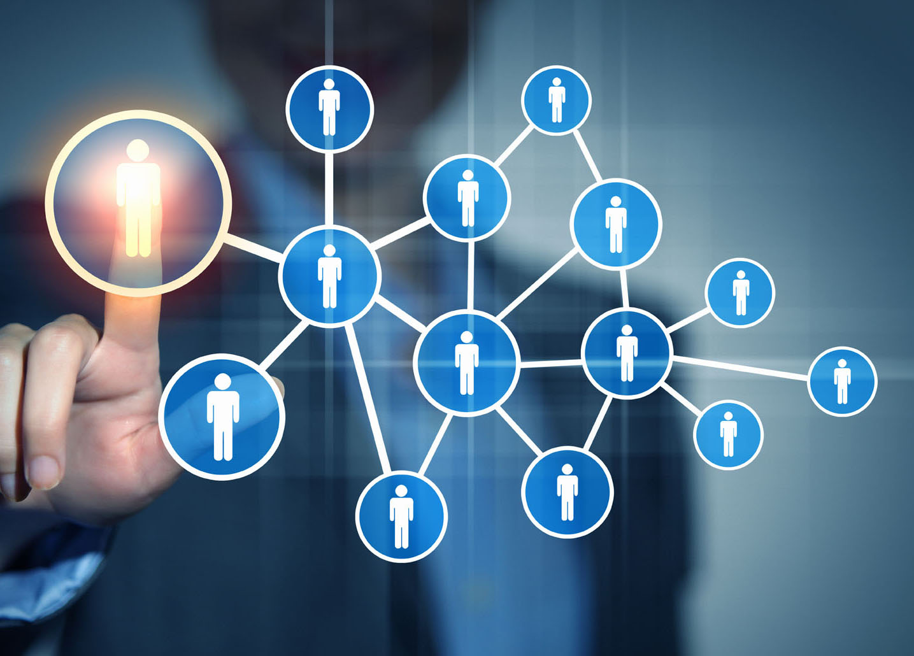
Use Awareness to Manage Relationships
People aren’t either wicked or noble. They’re like chef salads with good things and bad things chopped up and mixed together in a vinaigrette of confusion and conflict.
Relationship management
Awareness of your emotions and the emotions of others to manage interactions successfully.
Ensure clear communication and effective handling of conflict.
Anonymous
Notes:
Source: Emotional Intelligence. Retrieved from https://cdn.ymaws.com/www.naecp.net/resource/collection/E888E026-C04E-4F26-BC42-5A8484128A87/Emotional_Intelligence_Presentation.pptx

Slide 18
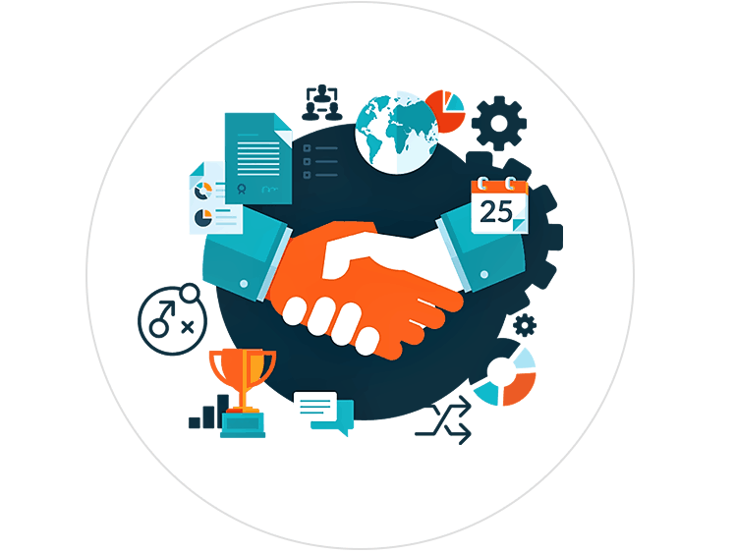
Improving Relationship Management
Seek to build high quality, high trusting relationships.
Try to discover what role emotions are playing in your interactions with others.
If you sense tension or other emotional reactions in a person’s body language or speech, ask questions to seek to understand.
Be quick to settle disputes, differences of opinion and misunderstandings.
Notes:
Source: Emotional Intelligence. Retrieved from https://cdn.ymaws.com/www.naecp.net/resource/collection/E888E026-C04E-4F26-BC42-5A8484128A87/Emotional_Intelligence_Presentation.pptx

Slide 19
What does EI have to do with professional development?
WHAT I SEE
WHAT I DO
Self-awareness
Accurately perceive your own emotions.
Aware of your emotions as they happen.
Keep on top of how you tend to respond to specific situations and people.
Self-management
Awareness of your emotions to stay flexible and positively direct your behavior.
Manage your emotional reactions to all situations and people.
Personal Competence
Social awareness
Accurately pick up on emotions in other people.
Understand what is really going on.
Understanding what other people are thinking and feeling even if you don’t feel the same way.
Relationship management
Awareness of your emotions and the emotions of others to manage interactions successfully.
Ensure clear communication and effective handling of conflict.
Social Competence
Notes:
Reviewing each box, discuss the Importance of empathy and how it applies. Potential prompts can include:
What is fundamental to any relationship, which low EI could compromise? Trust
Do you think low EI in supervisors, managers or others could be correlated to employee concerns? (many of the issues we receive are because of what someone said or did and how it was perceived)
Source: Emotional Intelligence. Retrieved from https://cdn.ymaws.com/www.naecp.net/resource/collection/E888E026-C04E-4F26-BC42-5A8484128A87/Emotional_Intelligence_Presentation.pptx

Slide 20
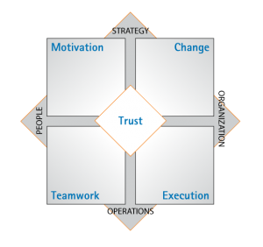
What does EI have to do with the workplace?
Trust: People have a sense of safety and assurance to share and go beyond their comfort zones.
Motivation: People feel energized and committed to doing more than the minimum.
Change: Employees and institutions are adaptable and innovative.
Teamwork: People collaborate and communicate to take on challenges.
Execution: Individuals are both focused and accountable.
Fariselli, L., Freedman, J., & Ghini, M. (2013). White Paper: Linking bottom line performance to emotional intelligence and organizational climate. Retrieved September 18, 2014 from 6seconds.org.
Notes:
Source: Emotional Intelligence. Retrieved from https://cdn.ymaws.com/www.naecp.net/resource/collection/E888E026-C04E-4F26-BC42-5A8484128A87/Emotional_Intelligence_Presentation.pptx

Slide 21
Key Takeaways of ei

Slide 22
What behaviors do emotionally intelligent people display?
Robust emotional vocabulary.
Curious about people.
Embrace change.
Know their strengths and weaknesses.
Good judge of character.
Difficult to offend.
Knows how to say no.
Let go of mistakes.
Give and expect nothing in return.
Do not hold grudges.
Neutralize toxic people.
Do not seek perfection.
Appreciate what they have.
Disconnect.
Limit caffeine intake.
Get enough sleep.
Stop negative self-talk.
Does not let anyone limit their joy.
Notes:
Source: Time. 18 Behaviors of Emotionally Intelligent People. Retrieved from https://time.com/3838524/emotional-intelligence-signs/

Slide 23
Thoughts and Reflections?

Slide 24
Pendry, Driscoll, and Field’s (2007) Father/Son activity
Imagine the following:
A father and son were involved in a car accident in which the father was killed and the son was seriously injured. The father was pronounced dead at the scene of the accident and his body was taken to a local morgue. The son was taken by ambulance to a nearby hospital and was immediately wheeled into an emergency operating room. A surgeon was called. Upon arrival and seeing the patient, the attending surgeon exclaimed “Oh my God, it’s my son!’
On a sheet of paper, can you explain how this is possible?
Notes:
This activity will lead into a discussion about bias.
Source: Include-Empower. A-Ha Activities for Unconscious Bias Training. Retrieved from https://cultureplusconsulting.com/2018/08/16/a-ha-activities-for-unconscious-bias-training/

Slide 25
Exploring bias
Around 40% of participants who are faced with the Father/Son challenge do not think of the most plausible answer — the surgeon is the boy’s mother.
Most readers invent elaborate stories such as the boy was adopted and the surgeon was his natural father or the father in the car was a priest.
This exercise illustrates the powerful pull of automatic, stereotyped associations.
For some individuals, the association between surgeon and men is so strong that it interferes with problem-solving and making accurate judgments.
Notes:
Source: Include-Empower. A-Ha Activities for Unconscious Bias Training. Retrieved from https://cultureplusconsulting.com/2018/08/16/a-ha-activities-for-unconscious-bias-training/

Slide 26
Bias in the workplace

Slide 27
What is bias?
Notes:
Using a flipchart, ask participants to record their definitions of bias.

Slide 28
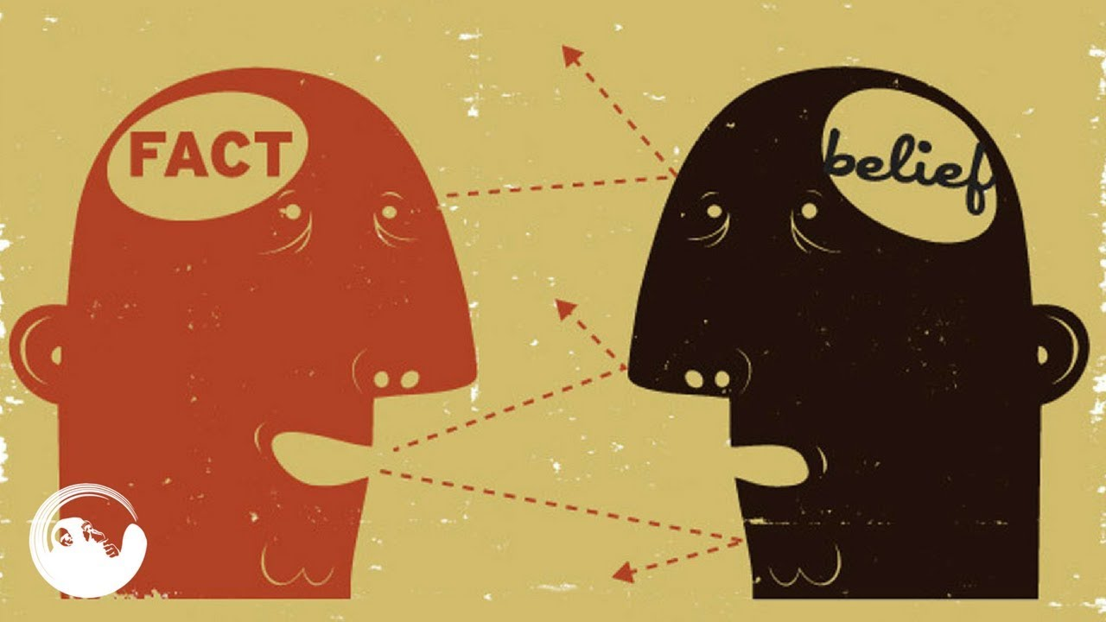
Bias defined
Prejudice in favor of or against one thing, person, or group compared with another, usually in a way considered to be unfair.
Ask yourself:
Is bias always intentional?

Slide 30
WHAT THE RESEARCH SHOWS
Most of us believe that we are ethical and unbiased.
We imagine we are good decision makers, think objectively, and reach fair and rational conclusions.
BUT …
More than two decades of research confirms that in reality most of us fall short of our inflated self-perception.
Notes:
Source: Cultural Competency. Retrieved from http://cahra.net/downloads/updated_cultural_competency_presentation_for_cahra.pptx

Slide 31
Bias and Our Actions
Perception – how we see people and perceive reality.
Attitude – how we react toward certain people.
Behaviors – how receptive or friendly we are toward certain people.
Attention – which aspects of a person we pay most attention to.
Listening skills – how much we actively listen to what certain people say.

Slide 32
What is Cultural Competence?
The integration and transformation of knowledge about individuals and groups of people into specific standards, policies, practices and, attitudes used in appropriate cultural settings to increase the quality of services, thereby producing better outcomes.
The ability to think, feel, and act in ways that acknowledge, respect, and build upon ethnic, socio-cultural, and linguistic diversity.
Notes:
Source: Cultural Competency. Retrieved from http://cahra.net/downloads/updated_cultural_competency_presentation_for_cahra.pptx

Slide 33
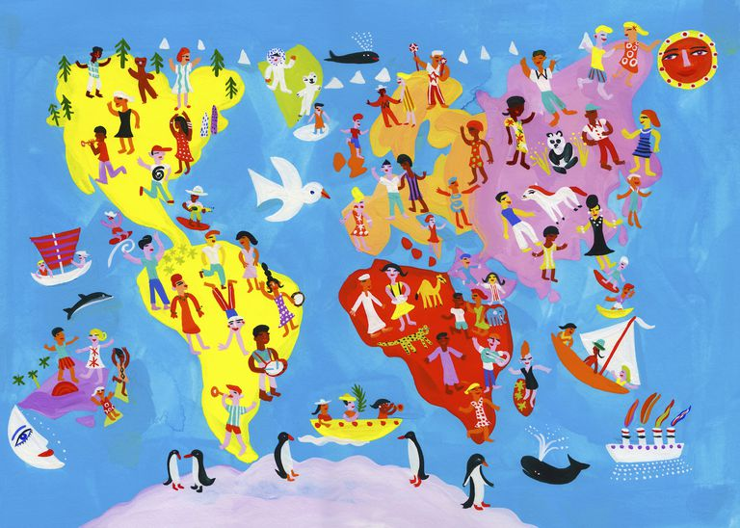
Culture helps Gives Context and Meaning
It is a filter through which people process their experiences and events of their lives.
It influences people’s values, actions, and expectations of themselves.
It impacts people’s perceptions and expectations of others.
Notes:
Source: Cultural Competency. Retrieved from http://cahra.net/downloads/updated_cultural_competency_presentation_for_cahra.pptx

Slide 34
What is unconscious bias?
The inclinations, attitudes or stereotypes that affect our understanding, actions, and decisions that form outside our own conscious awareness.
Notes:
Source: Cultural Competency. Retrieved from http://cahra.net/downloads/updated_cultural_competency_presentation_for_cahra.pptx

Slide 35
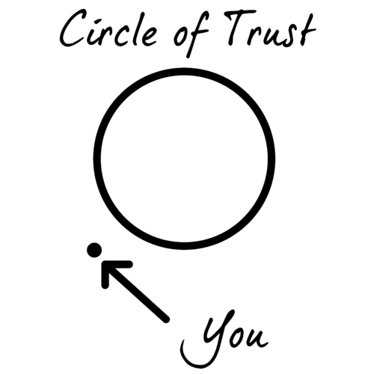
Your Circle of trust
Take out a blank sheet of paper.
On the left-hand side, make a column and write down the initials of 5-10 people you trust the most who are not family members.
This is your circle of trust
Listen to the following prompts and record accordingly.
Notes:
After participants have completed the aforementioned steps, the facilitator should do the following:
Read out some diversity dimensions (i.e. gender, nationality, native language, accent, age, race/ ethnicity, professional background, religion, etc.) that participants identify with.
Have participants look at their list of 5-10 trusted individuals and place a check mark next to those that have the same dimensions as them (i.e. female participant will put a check mark next to each female in their trusted circle list, etc.).
Ask participants if they noticed anything about the dimensions/diversity of their trusted circle.
Participants typically discover that their trusted circle often displays minimal diversity – for most participants, their inner circle includes people with backgrounds similar to their own. This is an example of affinity bias.
Source: Include-Empower. A-Ha Activities for Unconscious Bias Training. Retrieved from https://cultureplusconsulting.com/2018/08/16/a-ha-activities-for-unconscious-bias-training/

Slide 36
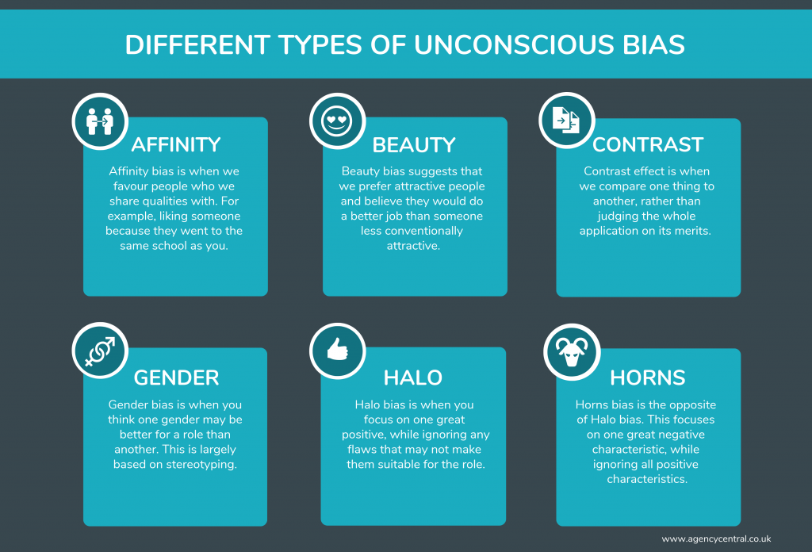
Types of Unconscious Bias
Affinity
Beauty
Contrast
Gender
Halo
Horns
Confirmation

Slide 37
Explicit vs. implicit bias

Slide 38
Understanding Unconscious Bias
Notes:
https://www.youtube.com/watch?v=dVp9Z5k0dEE
Source: https://dramatictrainingsolutions.com/unconscious-bias-3-great-exercises-to-use-in-your-training/

Slide 39
What is the harm caused?
We are all biased after all.
Notes:
Source: Cultural Competency. Retrieved from http://cahra.net/downloads/updated_cultural_competency_presentation_for_cahra.pptx

Slide 40
Unconscious bias is a fact of life
You are NOT alone. Everyone has them and taken them into the workplace.
We all suffer from prejudice. They are simply mental shortcuts based on social norms and stereotypes.
If you can name it, there is probably an unconscious bias for it.
It is all in the brain.
Mental grouping is part of the survival mechanism hard-wired into our brains.
There are more than 150 identified unconscious biases.
What is unconscious to some is in fact quite conscious to others.
Notes:
Source: Cultural Competency. Retrieved from http://cahra.net/downloads/updated_cultural_competency_presentation_for_cahra.pptx

Slide 41
Thoughts and Reflections?

Slide 42
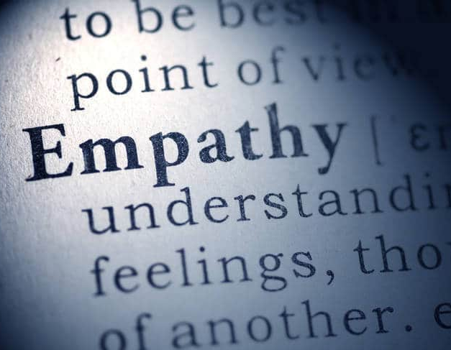
Power of empathy through employees
Notes:
Using the “Unleashing the Power of Employees Through Empathy” PDF, have participants reflect on the importance of empathy in leaders.
Using a flipchart, have participants make a list of qualities that make up an empathetic leader.
Source: TruScore. Unleashing the Power of Empathy Through Employees. Retrieved from https://www.truscore.com/resources/unleashing-power-employees-empathy/

Slide 43
Empathy map
Notes:
Using the “Empathy Map” PDF, have participants complete the empathy map activity.
If looking to add a professional scope to this activity, ask participants to repeat this activity with a former boss or supervisor in mind.
Source: Education Design Lab. Recognizing Others Needs & Values: Empathy Map. Retrieved from https://ntyyvuebz51lkxul3puxw5nw-wpengine.netdna-ssl.com/wp-content/uploads/2018/03/Recognize-others-Needs-Values_-Empathy-Map.pdf

Slide 44
Thoughts and Reflections?

