Slide 1
Let’s talk about it
WHAT DOES Empathy MEAN TO YOU?
© 2020

Slide 2
Empathy versus sympathy

Slide 3
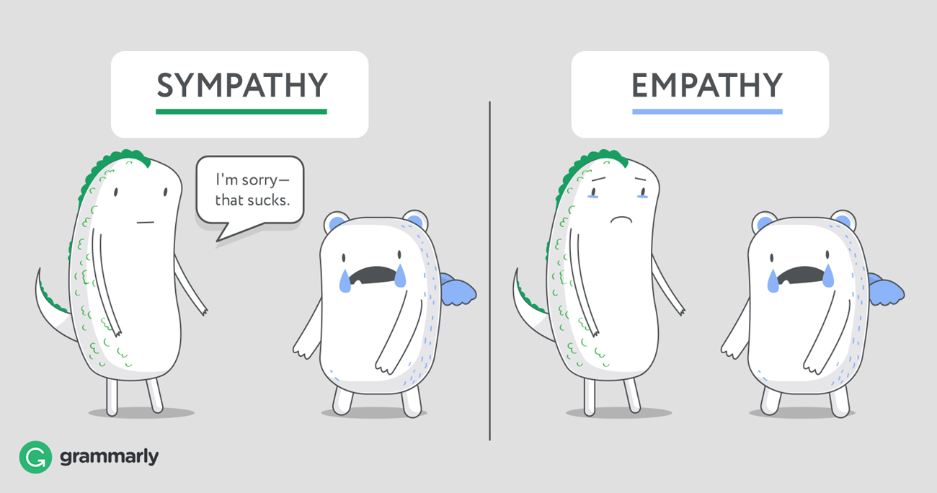
Definitions
Sympathy
The ability to feel sorry or pity for someone else’s misfortune.
Empathy
The ability to understand other people’s feelings as if we are having them ourselves.

Slide 4
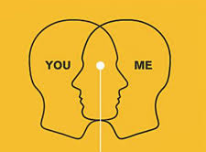
Empathy in the circle of life
It is essential to recognize the importance of empathy in the:
Workplace
School
Community
Home
Social relationships

Slide 5
Empathy in the 21st century
Ability to understand others’ viewpoints and feelings.
Use this understanding to improve the quality of:
Personal and professional relationships
Behaviors
Teambuilding
Performance

Slide 6
Empathy digital badge Model
Sub-Competency 1: Listen Actively
Listening Habits | Walk & Stop | Active Empathetic Listening
Sub-Competency 2: Incorporate Diverse Perspectives
Circles of Self | Read the Room | NEAR Engagement |
Respect in the Workplace
Sub-Competency 3: Recognize Others’ Needs & Values
Stand in Someone Else’s Shoes | Emotional Intelligence |
Bias in the Workplace | Power of Empathy Through Employees
Sub-Competency 4: Validate Others’ Feelings & Perceptions
Communicate Acceptance | Validation Through Empathy | Values Across the Aisle

Slide 7
Sub-competency 1: listen actively
The word ‘listen’ contains the same letters as the word ‘silent.’
- Alfred Brendel

Slide 8
Effective listening habits
A recent study conducted at George Washington University showed that listening can influence up to ___ % of a leader’s job performance.
True or False: Most people believe their listening skills are where they need to be, when in fact they are not.
True or False: Effective listening is something that can be learned and mastered.
Notes:
40%
True
True

Slide 9
7 Effective habits that will make you a better listener
Focus
Most people focus on what they are going to say next that they fail to hear what is actually being said now; words come through, but the meaning is lost.
Control your thoughts.
Put away your phone
When you commit to a conversation, invest all of your energy into it, not your phone or other devices.
Ask good questions
Asking questions or for clarifications not only shows you are listening, but care about what the person is saying.
Whenever possible, ask probing questions like “What I hear you saying is ….” or “Why do you think that happened?”

Slide 10
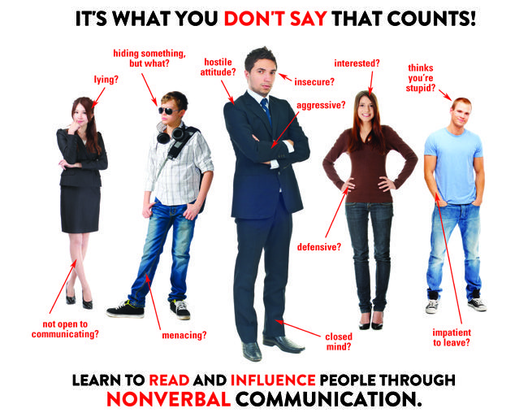
7 Effective habits that will make you a better listener
Practice reflective listening
Psychologist Carl Rogers coined the term reflective listening, which is a strategy of paraphrasing the meaning of what is being said to make certain you have interpreted the speaker’s words correctly.
Provides an opportunity for the speaker to clarify statements.
Provides the listener an opportunity to absorb the information.
Use positive body language
Be cognizant of gestures, expressions, tone of voice, and body position.
An enthusiastic tone, uncrossing your arms and legs, maintaining eye contact, and leaning toward the speaker are all signs of positive body language.
Do not pass judgement
A good listener always has an open-mind, making them approachable and interesting to others.
Having an open-mind is crucial in the workplace; it provides opportunities to share ideas and collaborate as a unit.
Think before you speak
If you are not asking a probing question or for clarification, you should remain quiet and listen.
Hijacking a conversation shows that you think you have something more important to say.
Notes:
https://www.themuse.com/advice/7-habits-thatll-make-you-a-better-listener-and-not-the-person-who-always-needs-everything-repeated

Slide 11
Time for some practice — a quick exercise!
Walk & Stop
Notes:
https://www.youtube.com/watch?v=JmcmffiXgFY&t=2s

Slide 12
Walk & Stop exercise reflections
What did we learn about effective listening and what we just experienced?
How important was it to focus during this exercise?
Could you have successfully completed this activity while on your phone? Would it have been as effective?
Was there a need to ask questions? Why or why not?
What role, if any, did body language play in this exercise?
Was it important to have an open mind? Why or why not?

Slide 13
LISTENING
Active and passive

Slide 14
ACTIVE LISTENING
The listener is fully engaged and reacts to the ideas presented by the speaker:
Two-way communication, listener responding.
Non-verbal cues (smiling, nodding, facial expressions, and eye contact).
Listener asks questions, clarifies ideas, and comments on key points.
Analytical listening — listener analyzes the ideas, evaluates, and assesses them while listening.

Slide 15
PASSIVE LISTENING
The listener does not reaction to the ideas of the speaker, but merely listens:
Listener does not ask questions or share ideas.
One-way communication.
Listener does not make eye contact.
Notes:
Follow-up question: Is passive listening a negative or bad form of listening?
Answer: No- example, a college lecture. The professor stands and speaks to a room full of hundreds of students but not every single student is participating in conversation, but they are learning.

Slide 16
Differences Between Active and Passive
Active Listening
Passive Listening
Definition:
The listener is fully engaged and reacts to the ideas presented by the speaker.
Communication:
Two-way communication.
Reactions of the listener:
The listener reacts using nonverbal cues, comments, and questioning.
Effort:
Requires effort.
Other activities involved:
The listener analyzes, evaluates, and summarizes.
Definition:
The listener does not react to the ideas of the speaker but merely listens.
Communication:
One-way communication.
Reactions of the listener:
The listener does not react.
Effort:
Does not require effort.
Other activities involved:
Simply listens.

Slide 17
Connecting all the dots
When empathy meets active listening.

Slide 18
Active empathetic listening
Notes:
https://www.youtube.com/watch?v=ESqfW_kyZq8

Slide 19
Practice!
Notes:
Active Listening Handout

Slide 20
Thoughts and Reflections?

