Slide 1
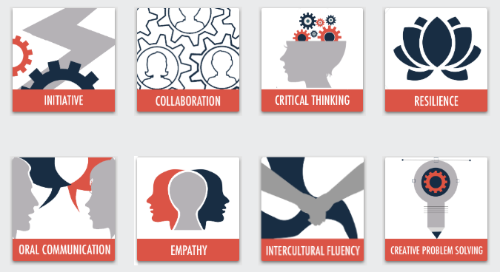
21st Century Skills
© 2020

Slide 2
Collaboration Model
Sub-Competency 1: Strengthening Relationships
Setting Expectations | Conflict Styles | Digital Badge Project Challenge
Sub-Competency 2: Incorporating Diverse Perspectives
Circles of Self | Visual Phone | Taking Responsibility for Communication
Sub-Competency 3: Active Listening
Walk & Stop Exercise | Informational Interviews | Role Reflections
Sub-Competency 4: Focusing on Solutions
Biomimicry Challenge | New Generation Prototype

Slide 3
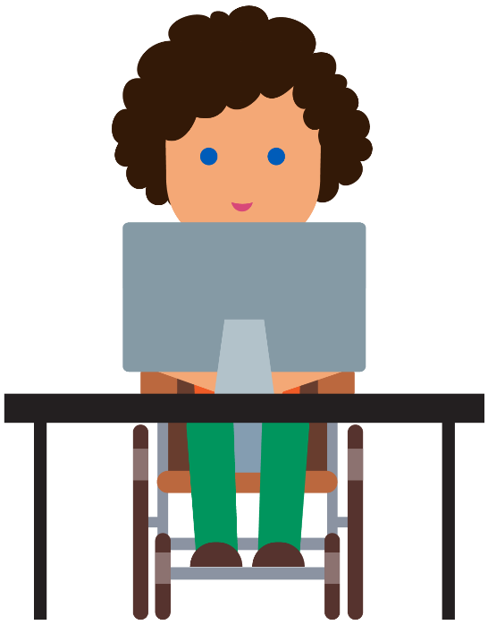
Biomimicry in Design and Engineering Stem²D Topics: Design and Engineering

Slide 4
What is STEM²D?
Science
Technology
Engineering
Mathematics
Manufacturing
Design

Slide 5
Today’s Plan
Biomimicry Challenge
Presentations
Reflection

Slide 6
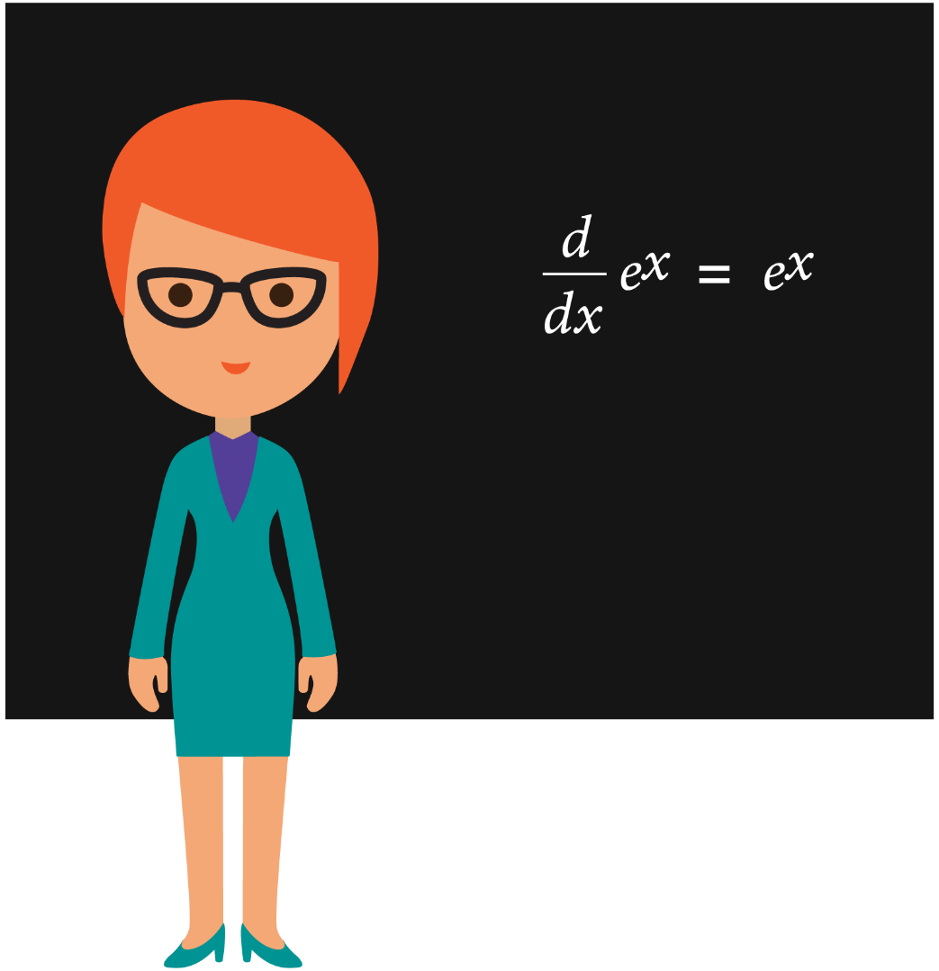
Biomimicry

Slide 7
What is Biomimicry?
An approach to innovation that seeks sustainable solutions to human challenges by imitating nature’s patterns and strategies.
Source: Biomimicry Institute
Notes:
Definition:
Biomimicry: an approach to innovation that seeks sustainable solutions to human challenges by imitating nature’s patterns and strategies.
Sustainable: capable of being maintained at a steady level without exhausting natural resources or causing severe ecological damage

Slide 8
What is Sustainability?
Capable of being maintained at a steady level without exhausting natural resources or causing severe ecological damage.

Slide 9
Why Biomimicry?
Why might engineers and designers use biomimicry?
+
Notes:
Explain that biomimicry can help solve problems to challenges faced by humans.
Consider referencing a famous quote by Albert Einstein: “Look deep into nature, and then you will understand everything better.”

Slide 10
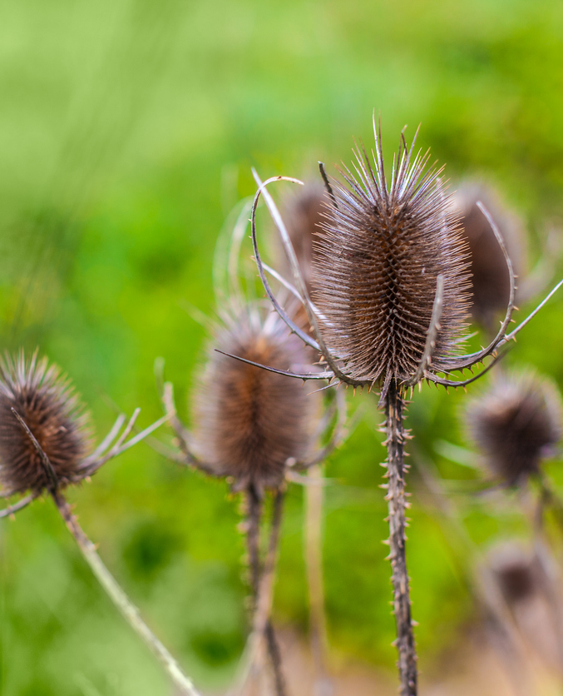
Biomimicry in Consumer Products
Velcro
Invented by Swiss engineer, George de Mestrel in 1941.
He removed burrs from his dog and took a closer look at them to see how they worked.
The small hooks at the end of the needles inspired him to make Velcro.
Photo credit: iStock
Notes:
Velcro was invented by Swiss engineer George de Mestral in 1941 after he removed burrs from his dog and decided to take a closer look at how they worked.
The small hooks found at the end of the burr needles inspired him to create Velcro.

Slide 11
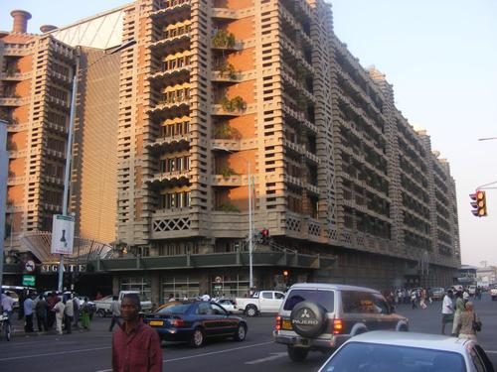
Biomimicry in Architecture
Eastgate Centre, Harare, Zimbabwe
Has an internal climate control system originally inspired by the structure of termite mounds.
The architecture designed uses 90% less energy for ventilation than conventional buildings its size and has already saved over $3.5 million dollars in air conditioning costs.
Photo credit: iStock
Photo credit: The Pinsta
Notes:
From Biomimicry Institute:
We generally think of termites as destroying buildings, not helping design them. But the Eastgate Building, an office complex in Harare, Zimbabwe, has an internal climate control system originally inspired by the structure of termite mounds.
The operation of buildings represents 40% of all the energy used by humanity, so learning how to design them to be more sustainable is vitally important.
The architect collaborated with engineers to design Eastgate, which uses 90% percent less energy for ventilation than conventional buildings its size, and has already saved the building owners over $3.5 million dollars in air conditioning costs.

Slide 12
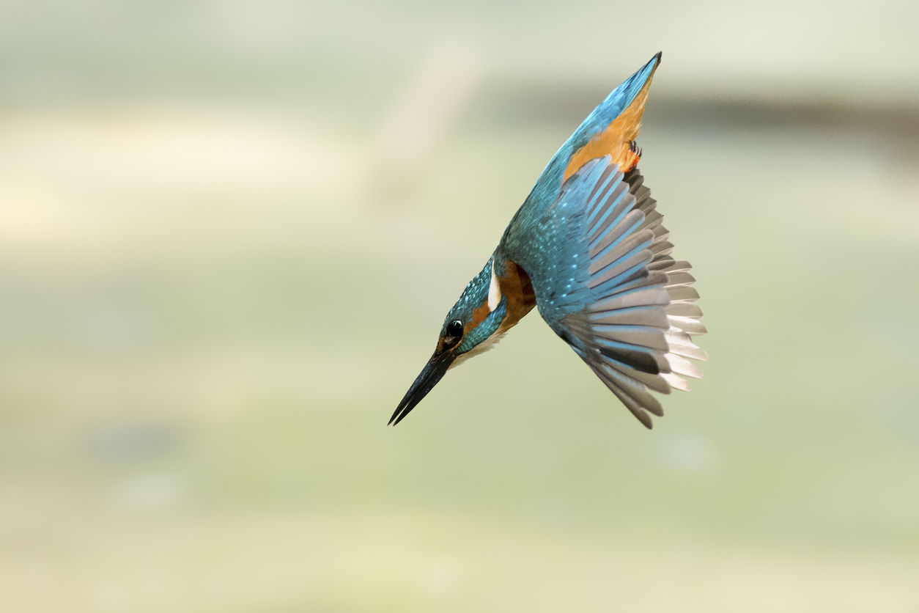
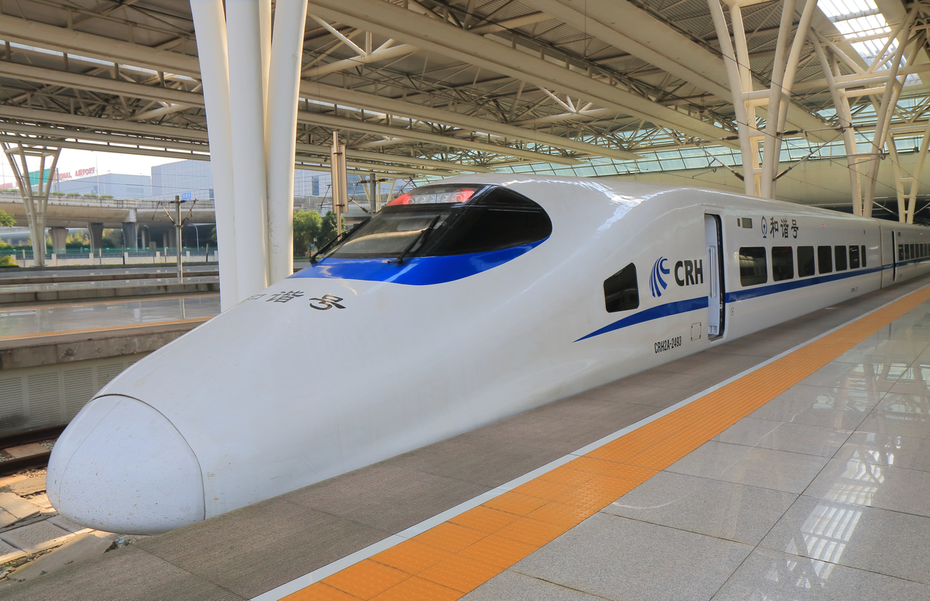
Biomimicry in Transportation
Shinkansen Bullet Train
Bullet train traveled over 200 mph, but it made A LOT of noise - even residents ¼ of a mile away complained!
The train’s engineer was a bird-watcher.
Re-modeled the front-end after the beak of kingfishers, which resulted in a quieter … AND FASTER … train!
It also ended up using 15% less electricity.
Photo credit: iStock
Photo credit: iStock
Notes:
From Biomimicry Institute:
The Shinkansen Bullet Train was the fastest train in the world, traveling 200 miles per hour. The problem? Noise.
Air pressure changes produced large thunder claps every time the train emerged from a tunnel, causing residents one-quarter a mile away to complain.The train’s chief engineer and an avid bird-watcher, asked himself, “Is there something in Nature that travels quickly and smoothly between two very different mediums?”
Modeling the front-end of the train after the beak of kingfishers, which dive from the air into bodies of water with very little splash to catch fish, resulted not only in a quieter train, but 15% less electricity use even while the train travels 10% faster.

Slide 13
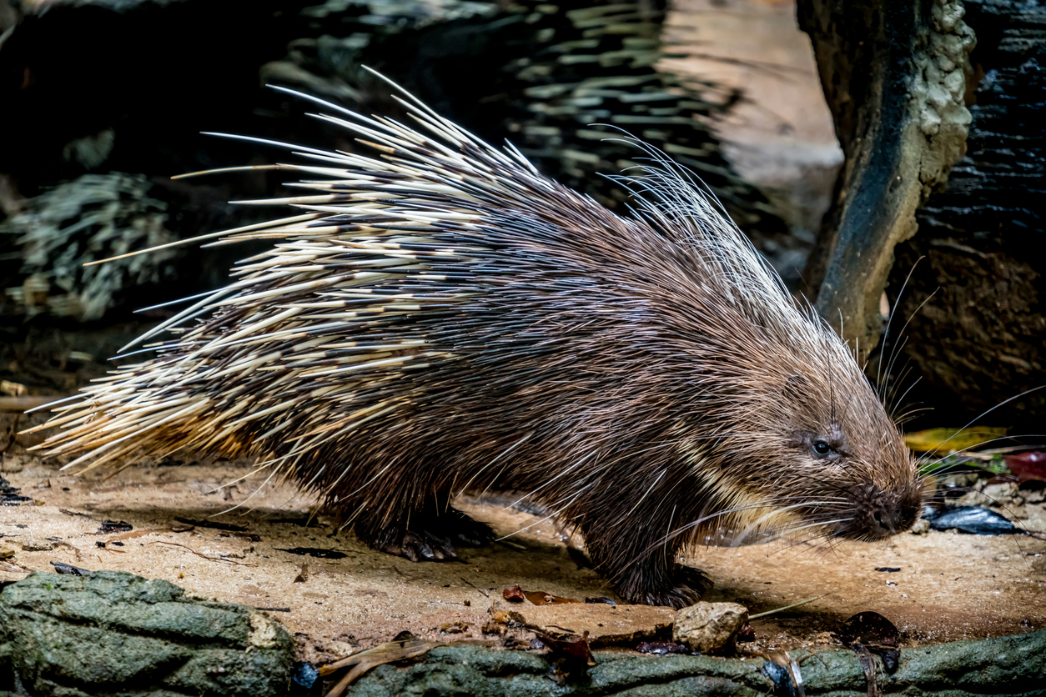
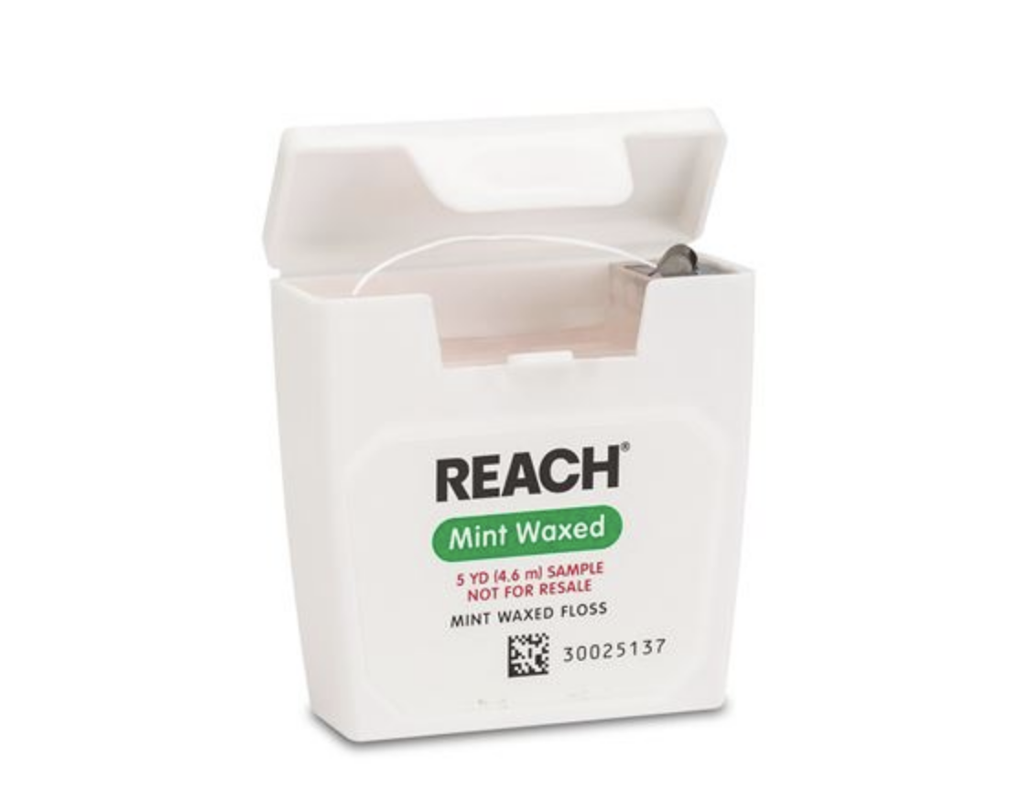
Biomimicry in Healthcare
Dental Floss
In the 1800’s people used sharp slivers of wood to clean between their teeth because silk was too expensive.
J&J used the excess silk leftover from its suture manufacturing business to make more affordable floss.
Porcupine quills also served as a model for injection and suture needles.
Notes:
From Biomimicry Institute and Johnson & Johnson “Our Story”:
In the late 1800’s people were apt to use the sharpened ends of porcupine quills, writing quills, or slivers of wood to clean between their teeth because silk dental floss was too pricey. Johnson & Johnson decided to use the excess silk left over from its suture-manufacturing business to make a more affordable version of floss for the average consumer. It is interesting to note that porcupine quills, with their ease of entry, also serve as a model for injection needles and suture needles.
Mussels possess the unique ability to attach to wet, solid surfaces such as rocks, fish, and boats and are able to withstand strong wind and even waves. The remarkable adhesive powers of the mussels inspired medical adhesives. In 1998 Ethicon Inc., introduced a breakthrough alternative to traditional stitches. Dermabond® became the first FDA-cleared topical skin adhesive used to close up cuts that would otherwise require sutures or staples.

Slide 14
Biomimicry Challenge
Challenge
Design a structure, mode of transportation, or consumer product that is based on something in nature and solves a human challenge.
Instructions
Get inspired! Use the photos on the next slide as inspirations for the design. Alternately, use the Internet to perform research; websites are listed on the Biomimicry Resources handout.
Brainstorm different designs. Sketch potential ideas.
As a team, select one design to present to the large group.
Draw your group’s final design on the flip chart paper using the materials provided.
One person from each team will share the group’s design and give an explanation of why the design is a sustainable solution to a human challenge.
Each group will have two minutes to present to the class.
Keep an eye on the time to make sure you leave enough time to draw your design to share with the whole group.

Slide 15
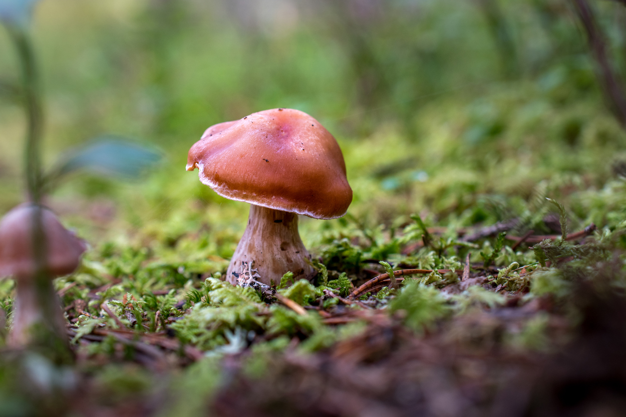
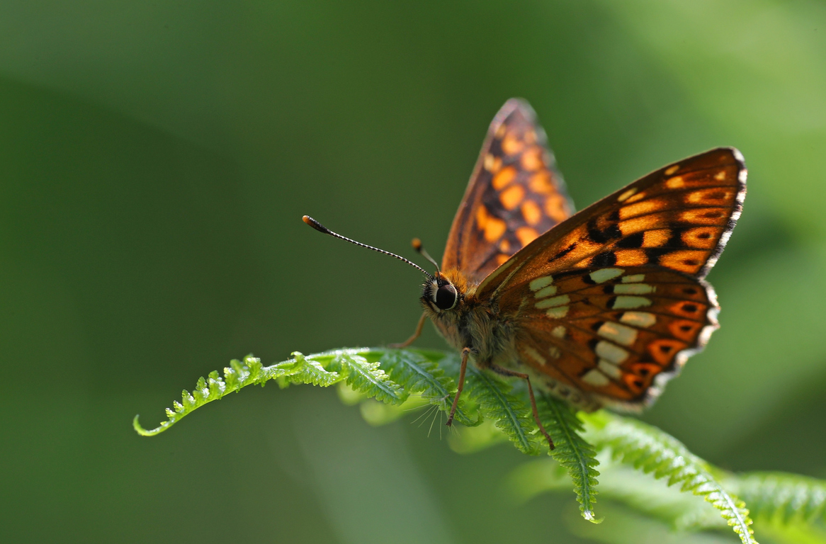
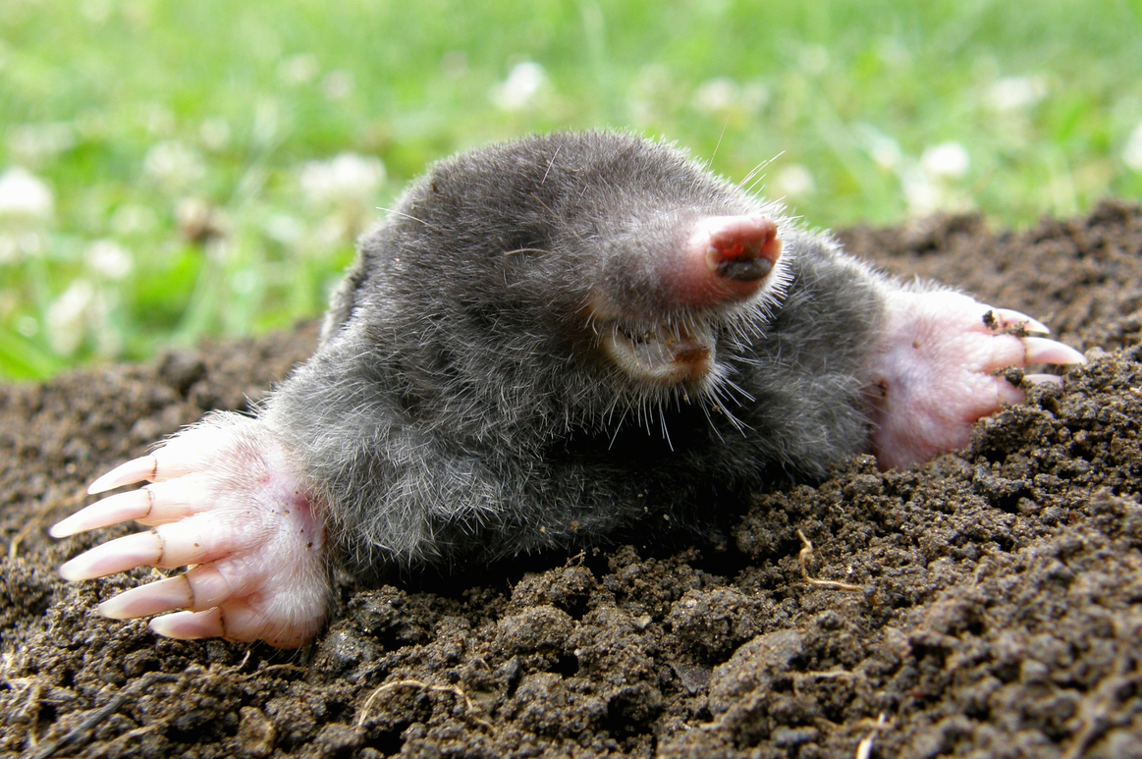
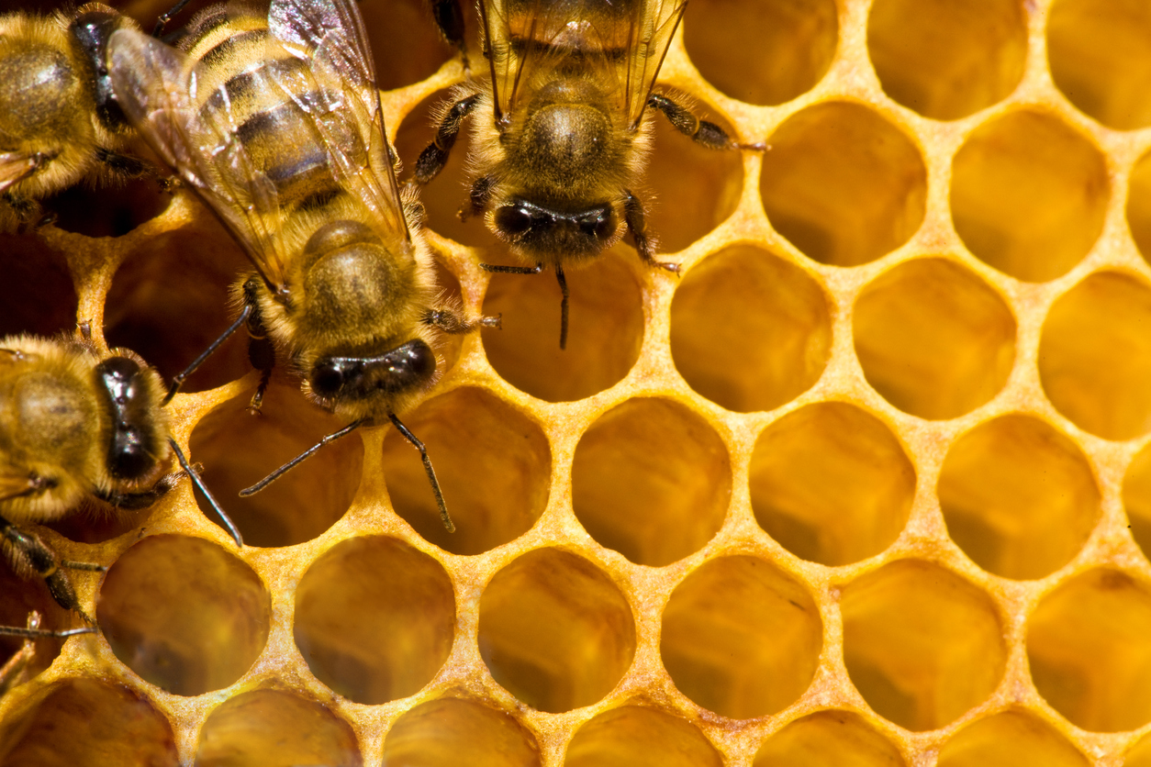
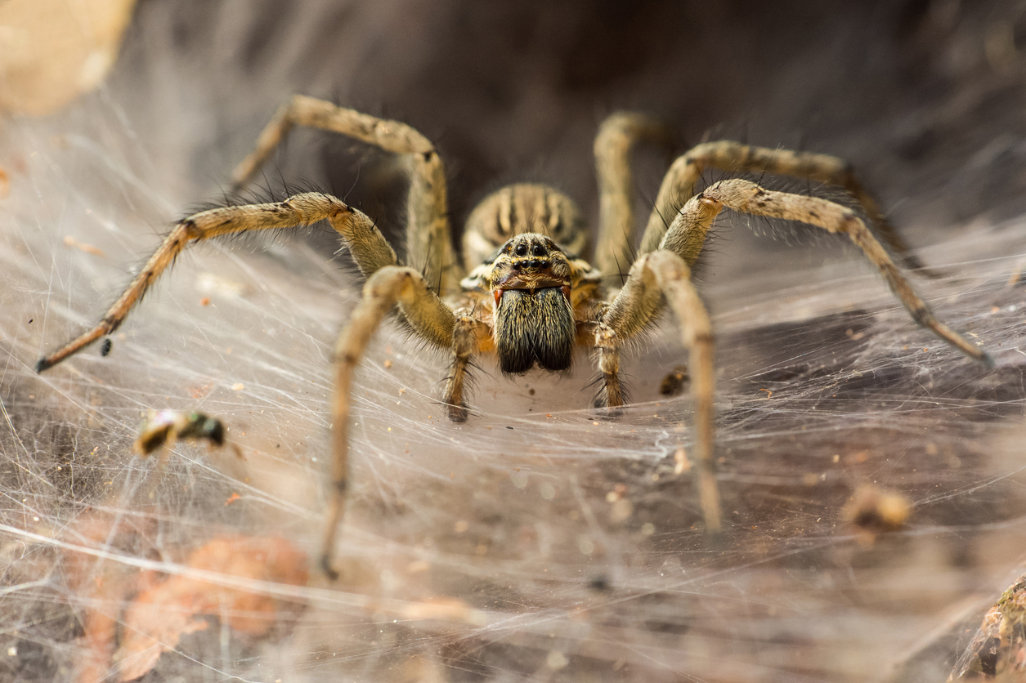
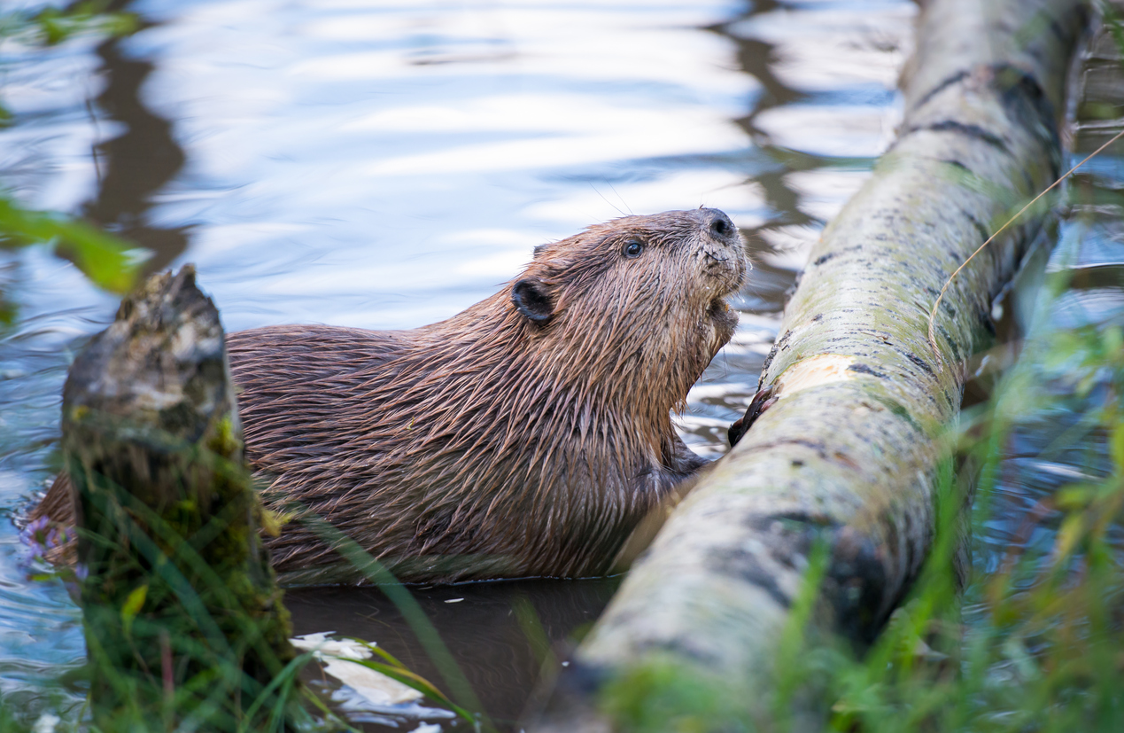
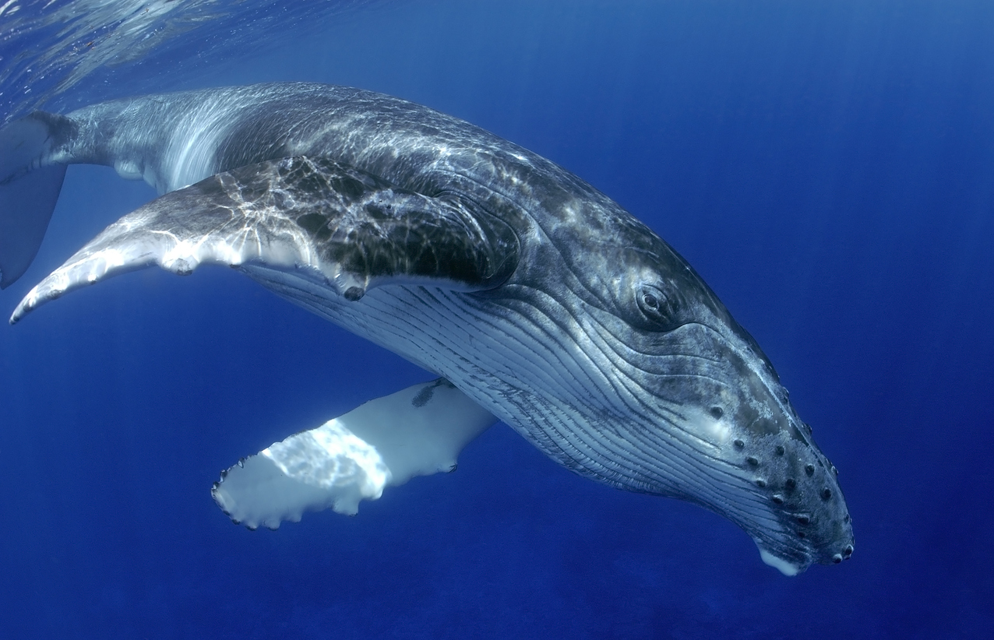
Inspirations in Nature
Photo credits: iStock
Notes:
ROW 1
Images from left to right:
Mushrooms can be used as inspiration for housing—the shape of the mushroom cap allows mushrooms to absorb a large amount of sunlight to convert to energy.
The butterfly is lightweight, can fly long distances, and can maneuver easily. Its design can be used as inspiration for airplanes.
A shark’s skin is made up of countless overlapping scales. The scales have grooves that allow water to pass by faster. The sharkskin has been used to help design swimsuits.
A mole is known for its tunnel building. Tunnel building is a solution being explored in cities with severe traffic problems. In Los Angeles, California, Elon Musk, the co-founder of Tesla, is currently building a network of tunnels under the city that will someday transport people from one place to another.
ROW 2
Images from left to right:
The cells in beehives are already being used as inspiration for capsule hotels where people sleep in small adjacent capsules instead of hotel rooms.
Spiders have the ability to travel vertically and horizontally and also travel long distances. The hairs on their feet help grip the surface, and they create silk parachutes using techniques similar to those used in creating a web. These characteristics may one day change how humans move around the earth.
Beavers have a thick layer of blubber that keeps them warm while they're diving and swimming in their water environments. Their fur is so dense that it traps warm pockets of air in between the layers, keeping these aquatic mammals not only warm, but dry. Engineers are using these features to help design wetsuits for surfing—when an athlete moves frequently between air and water environments.
The front edge of a whale fin has bumps that greatly increase its efficiency, reducing drag and increasing lift. Companies are applying the idea to wind turbine blades, cooling fans, airplane wings, and propellers.

Slide 16
Reflection
Think about the following questions
What did you learn about biomimicry in design and engineering?
What role do you think biomimicry will have for how we may live in the future?
Can you see yourself as a STEM²D professional? Why or why not?
How can you use this challenge with the development of your Digital Badge challenge?

Slide 17
New Generation prototype
Sub-Competency 4: Focusing on Solutions

Slide 18
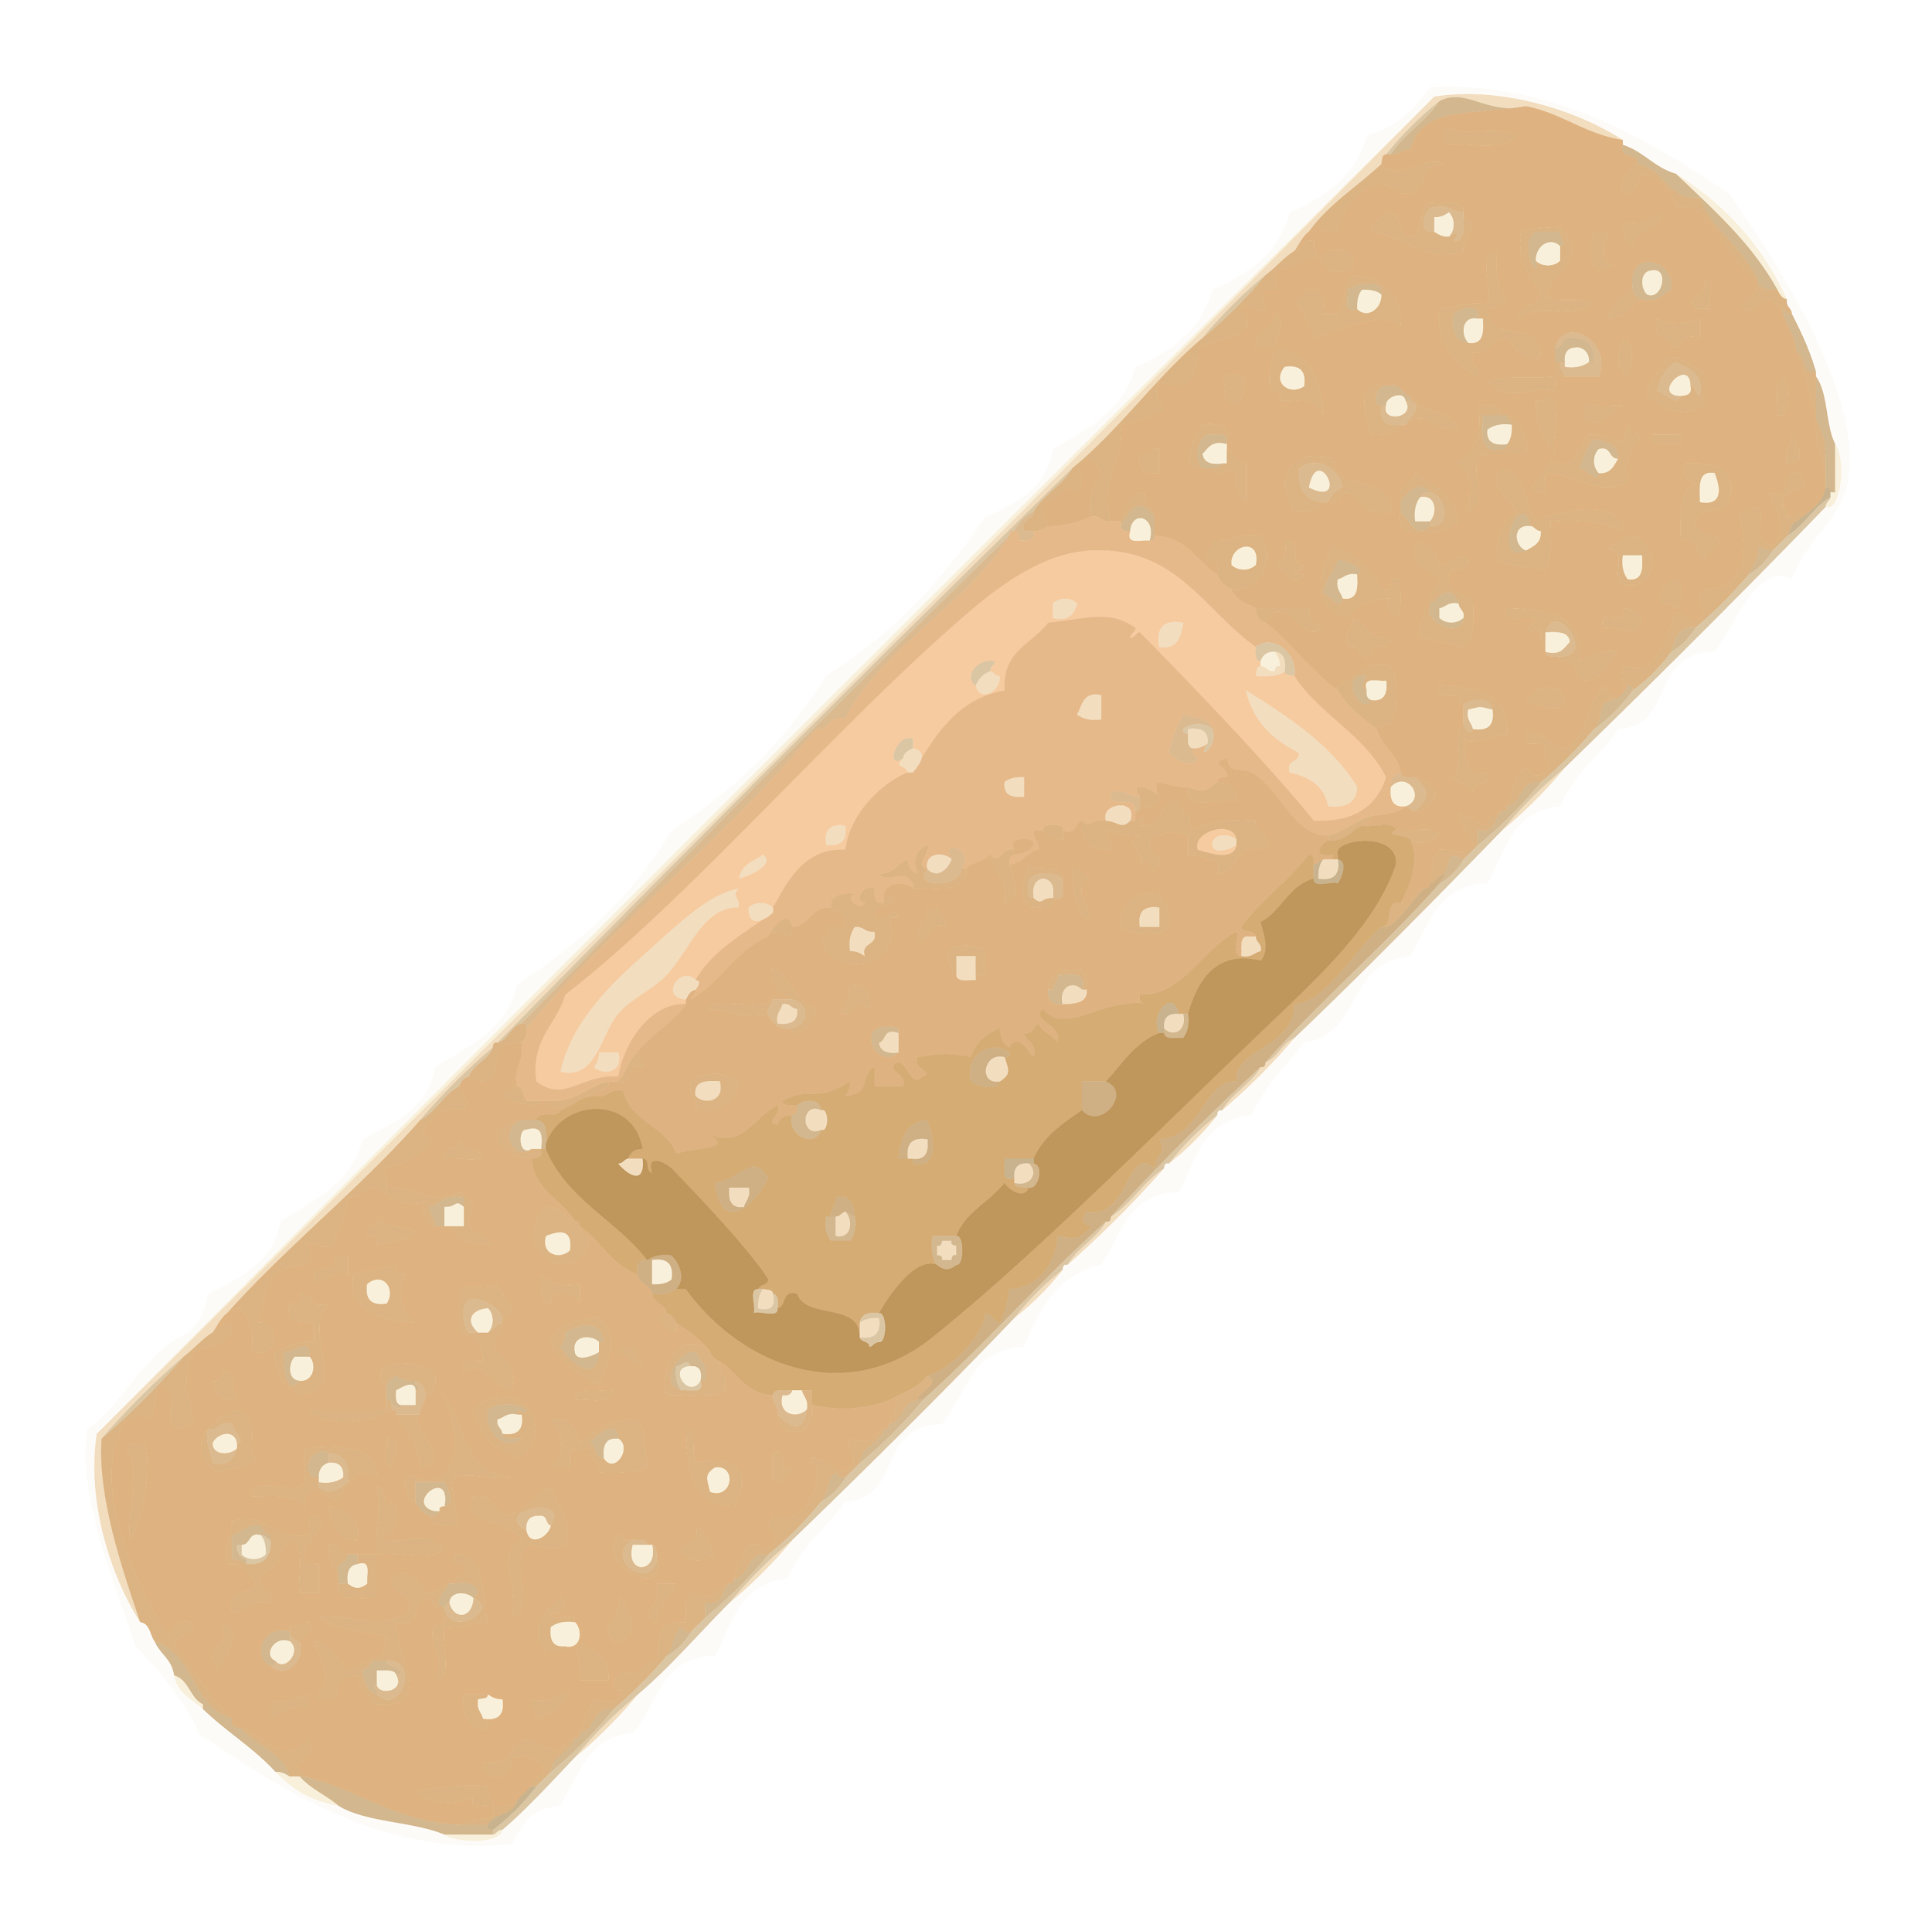
Band-Aid: Ultimate Defense
Feel better with a skin sweater!
By: Team Injury Excuse
Notes:
Introduce the next sequence of slides as sample New Generation Prototype deck- this is what an ideal final presentation could look like (summarizes roles clearly, clearly outlines details of New Generation Prototype, etc.).

Slide 19
Product Development
Main goal: Give customers a more efficient way to use Band-Aids.
How?
By decreasing the time of application while keeping the quality of the product in a portable size.

Slide 20
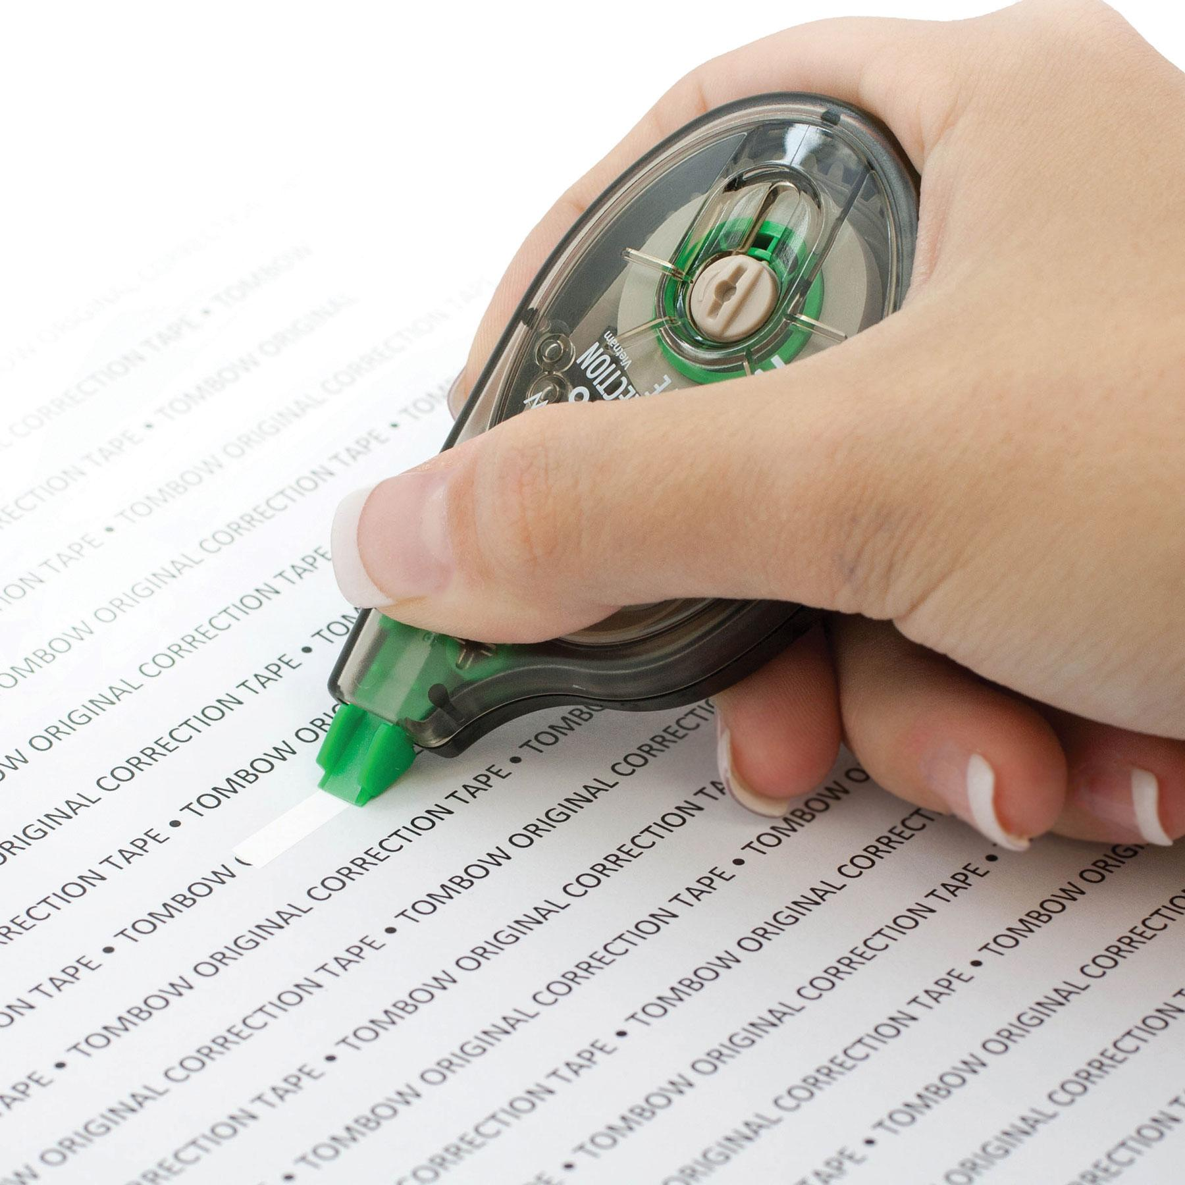
Product Development Continued
Very similar to white out - glides onto skin.
Saves time and effort Originally you’d pull it out of the bag, peel the covers off, and apply. Now peel one cover and apply.
This new product does not take more time than a few seconds.
Excellent for parents on the go with children prone to accidents.

Slide 21
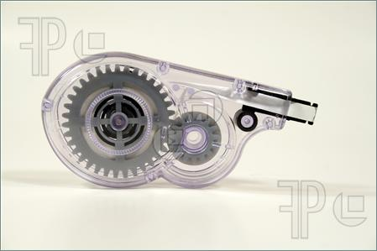
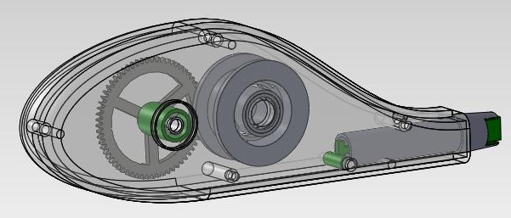
Packaging Engineer
The goal of the Packaging Engineer is to create an easy, convenient way to use the product.
20 bandages per package.
Bandages will be encased in a dispenser similar to whiteout tape.
A dispenser will be designed into the shape of the shell of Gary (i.e. Sponge Bob) themed for kids.

Slide 22
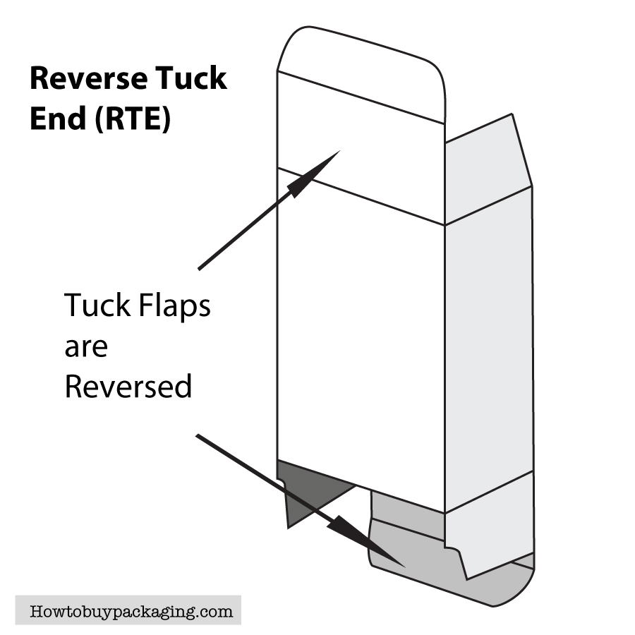
Packaging (boxing)
Reverse Tuck End (RTE)
Low cost.
Easy to assemble box.
Can be stored flat for excess packaging inventory.
Relatively quick to load product in the packaging.
Works well with our lightweight product.

Slide 23
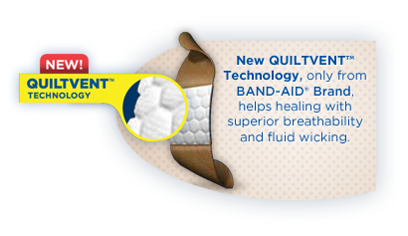
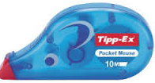
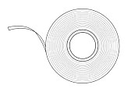
Our Product
Ultimate-Defense
Ultimate-Defense
Ultimate-Defense
Ultimate-Defense
For Medical Emergencies
seek professional help.
Caution: The packaging
of This Product Contains
Natural Rubber Latex,
Which May Cause Allergic
Reaction
DIRECTIONS:
For use on minor cuts and scrapes. For best results, apply bandage to clean, dry skin. Change bandage daily if needed.
Safe, Works, and Practical!
NEW!
20
regular size
STERILE
NEW!
Distributed by:
JOHNSON & JOHNSON
CONSUMER PRODUCTS COMPANY
Division of Johnson & Johnson
Consumer Companies, Inc.
Skillman, NJ 08558-9418
Patents pending.
www.band-aid.com
Tape Dispenser
Design
Feel better with a skin sweater!
Built in dispenser for easy use and accessibility,

Slide 24
Claims
The claims department’s goal is to prove our claims for each product inside the Band-Aid. In order to accomplish our goal, we will conduct clinical trials and a placebo study.

Slide 25
Claims
*Our product will consist of three products to satisfy our customers; Antibiotics, Moisturizer, and Scar Lotion.
The claims we’re putting on the box for the three products are
It's safe, it works, and it's practical (generic)
Clinically proven to heal faster and prevent infection (antibiotics)
Leaves skin looking healthy and smooth (moisturizer)
Prevents scarring and minimizes redness (scar lotion)
*We will not have issues getting permission to use the shape of the corrector since the company is not a competitor.

Slide 26
Claims
Why we conduct clinical trials
To prove our claims - by gathering a number of people to try out our product for a few days.
What kind of clinical trial do we do?
A placebo study will be held to receive feedback from people who used the real product and the product similar to our product (placebo product).

Slide 27
Claims
In addition, we will conduct tests on our device to make sure:
The device is easy and safe to use for our consumers.
Device works every time it’s used.
Band-aid will stick to the person.
The length of the band-aid is long enough to cover cuts.

Slide 28
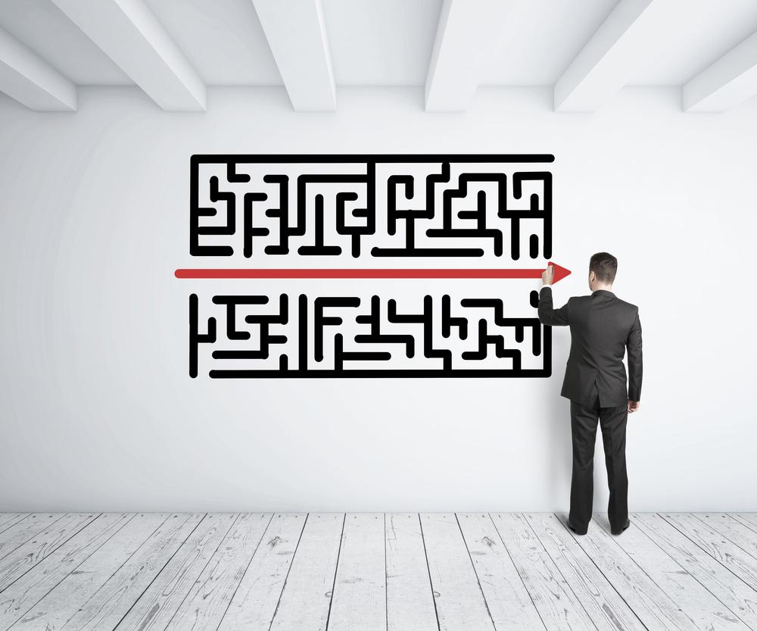
Marketing
What does Marketing do?
Identifies audience + stores
Base design + slogan on audience
Creates gameplan
Price
Promotion

Slide 29
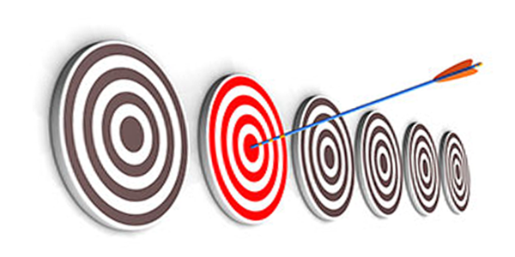
Marketing: Audience + Stores
Who?
Everyone in the U.S.
Who especially?
Parents - children’s products
Where?
Major pharmacies and department stores
Why?
Extensive reach of the U.S.

Slide 30
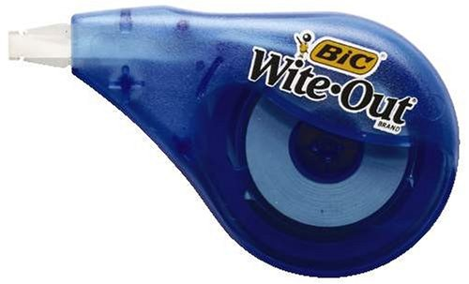
Marketing: Design + Slogan
The design of the product was based on
Consumer needs
Technological trends
Cultural issues
The slogan of the product was aimed to be
Friendly
Catchy
Feel better with a skin sweater!

Slide 31
Marketing: Gameplan
Gameplan: 4 releases
Fourth Release (2018-2019)
Band-Aid: Ultimate Defense- Anti-Scar Version
Third Release
(2017-2018)
Band-Aid: Ultimate Defense - Moisturizer Version
Second Release (2016-2017) Band-Aid: Ultimate Defense - Antibiotic Version
Initial Release (2015-2016) Band-Aid: Ultimate Defense + Children’s Version

Slide 32
Marketing: Pricing
How It Will Be Sold
1 box includes: Dispenser + 1 roll of Band-Aid tape($5-7)
Refill Includes:
1 roll of Band-Aid tape($2-3)
Premium Product
Public likes premium and revolutionary things

Slide 33
Marketing: Promotion
Commercial
1-2 minutes long featured on kids channel to grab their attention.
Will use amateur actors instead of celebrities.

Slide 34
Public Relations
Our main goal is to persuade customers into buying our product through earned publicity.
To promote the new product we will be giving products to the New Jersey boy scouts and four magazine companies: Healthcare, Sports Illustrated, Parenting, and Parents.

Slide 35
Public Relations (continued)
Boy Scouts
Public Relations will go on a trip with the boy scouts and commence a photo opportunity as well as media coverage on our “new leaf.”
Magazines
We hope at least 1/4 endorse and write an article in their magazine(s) about how this is a new “must-buy”product.

Slide 36
Sales
The sales department is in charge of choosing stores and racks to put the products on.
They plan on working with some important pharmacies like: RITEAID, Walgreens, CVS, and Duane Reade.

Slide 37
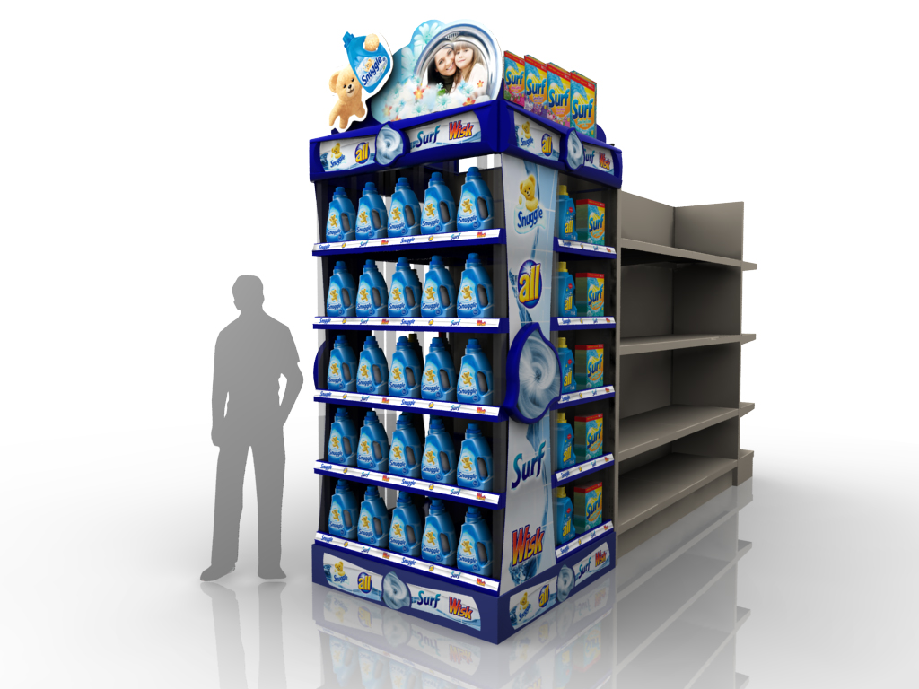
Sales Continued
We also plan on using an End Cap display which will need 75% of the sales budget to be able to get some shelves.

Slide 38
Finance Department Role
The Finance Department focuses on the distribution of money among all the departments to ensure the success of the new product.
Our Band-Aid: Ultimate Defense innovation has one million dollars to develop, prepare, advertise, and launch.

Slide 39
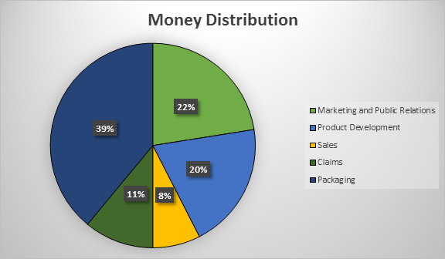
Finance
To the left is the agreed distribution of the million dollar budget.
It has been split
prioritizing the Packaging Department.
Marketing and Public Relations have been given a combined budget due to the similarities in goals.

Slide 40
Finance Continued
To reduce costs and save money we are planning to:
Use single ingredients instead of a full formula.
Have the claims made beforehand and tested during the creation of the product to save time and money.
Combine the budget for both the Marketing Department and Public Relations to decrease the misuse of money.
Use amateur actors and half a page of advertisement.
If money is still needed the total budget will increase from $1,000,000 to $1,200,000 or 20%.
The budget is subject to change depending on who needs what.

Slide 41
NEXT STEPS
Finalize your NGP
Provide Site Coordinator with a list of materials needed to create your NGP
Draft project plan slides (i.e. how each functional role will take part in the NGP)

