Slide 1
SAT Bowl

Slide 2
How to Play
One contestant from each team will come up to the stage. They will each appoint one person from their team to be their assistant (this person will not come up to the stage, but should be prepared to go up if their teammate calls for their help).
An SAT Bowl question will be displayed. The first person to raise their paddle and give the correct answer will win one point for their team. Each team can only give one answer! There are no second chances- Sorry ☹
If the contestant on the stage is having difficulty with the question, they may call for their assistant’s help.
Be prepared for random Bonus Questions. The first team to get this question right will receive 5 extra points for their team. All team members are allowed to answer these questions, BUT YOU MUST COME UP AND RAISE YOUR TEAM’S PADDLE.
The most important rule: HAVE FUN WHILE LEARNING ☺

Slide 3

What is the sum of the first 100 positive odd integers?
22500
10050
85496
  10000
10250

Slide 4
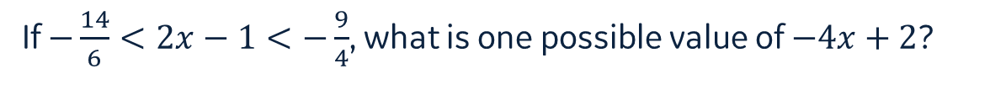
If $−\frac{14}{6}<2x−1<−\frac{9}{4}$, what is one possible value of $−4x+2$?
3.55
4.67
5.96
3.60
4.55

Slide 5
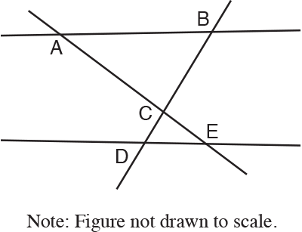
In the following figure , ABC~EDC. Which of the following must be true?
AB is parallel to DE
AE is perpendicular to BD
AC is parallel to DE
AB is perpendicular to DE
AE is parallel to AB

Slide 6
Pass or Play
Notes:
In a small bowl or cup, place scrap pieces of paper with +3, +2, +1, -1, -2, or -3 on them. Fold the scrap papers up so students cannot see what is written on them. Each contestant should pick one piece of paper but before opening decide if they want to “Pass” the paper off to another team or “Play” that paper and keep it for themselves. If passing off to another team, they must identify the team before opening the paper.

Slide 7
The nature trail is six feet wide and seven miles long. It slithers through the forest like a snake curving and bending along the banks of the river.
No change
snake, curving, and bending,
snake curving and bending
snake, curving and bending
Snake curving and bending,

Slide 8
Define the word irrefutable
Cannot be proven wrong
Always wrong
Argumentative
Agreeable
Unchanging

Slide 9
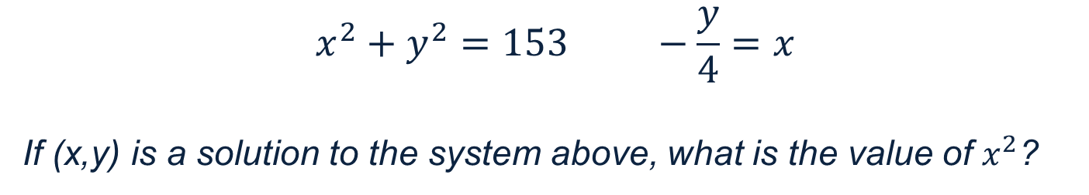
$$x^{2}+y^{2}=153 −\frac{y}{4}=x$$
If (x,y) is a solution to the system above, what is the value of $x^{2}$?
3
-51
9
144
What???!

Slide 10
Bonus Question:
What is Tiffany’s favorite summer drink at Starbucks?
Chai Tea
Cinnamon Dulce Latte
Peach Green Tea Lemonade
Peach Green Tea
Tiffany likes Dunkin better

Slide 11


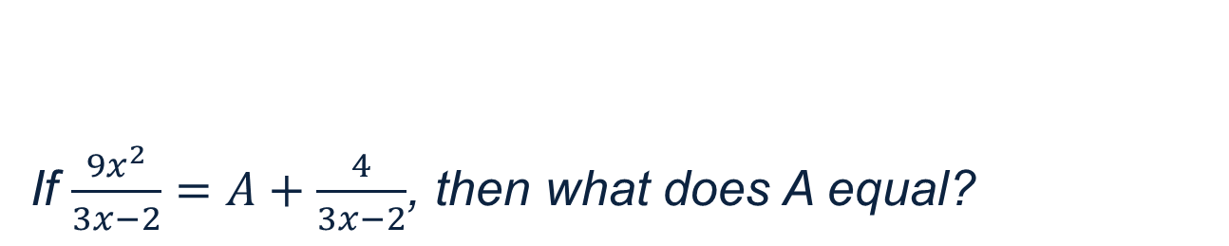
If $\frac{9x^{2}}{3x−2}=A+\frac{4}{3x−2}$, then what does A equal?
3x - 2
$$9x^{2}$$
3x + 2
$$9x^{2}−4$$
undefined

Slide 12
First contestant to do the following correctly IN ORDER gets 5 points
2 jumping jacks, 1 push-up, 1 squat, 1 push- up, 1 squat, 1 push-up, and 10 crunches

Slide 13
Define insolence
Stubborn
Charming
Pleasant scent
Polite
Rude

Slide 14
Define abase
To lessen
To humiliate or degrade
To support
To know
To joke

Slide 15
BONUS QUESTION:
Who is Gerizim’s favorite superhero
Batman
Captain America
Deadpool
Tiffany
His Mom

Slide 16
What does the root word “pan” mean?
related to cooking (don’t pick this one, it’s not right)
none
all
some
to know

Slide 17
Pass or Play

Slide 18
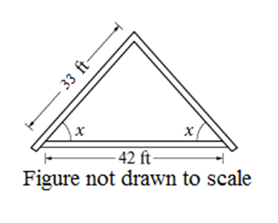
An architect drew the sketch below while designing a house roof. The dimensions shown are for the interior of the triangle. What is the value of cos(x)?
2/3
14/11
7/11
11/14
11/7

Slide 19
The impostor eluded detection for so long because she conducted herself as though she were a licensed practitioner.
as though she were a licensed practitioner.
as though she was a licensed practitioner.
like she was a licensed practitioner.
like as if she was a licensed practitioner.
as if she was a practitioner with a license.

Slide 20
First student to find the hidden Japanese “shi” symbol gets 5 bonus points

Slide 21
Bonus Question:
How many questions are in the reading section of the SAT?
50
52
54
56
35

Slide 22
The square root of a certain positive number is twice the number itself. What is the number?
1/8
1/2
1/16
1/6
1/4

Slide 23
At a students meeting, the ratio of athletes to non-athletes is 3:2, and among the athletes the ratio of males to females is 3:5. What percent of the students at this meeting are female athletes?
37.5%
22.5%
25%
27%
27.5%

Slide 24
My grandmother's legacy is substantial, especially if the value of the rare
(A) (B) stamps are taken into consideration. No error. (C) (D) (E)
A
B
C
D
E

Slide 25
Pass or Play

Slide 26
Two numbers have a difference of 4 and a sum of -7. What is their product?
8.25
-33
-10.25
10.25
-8.25

Slide 27
Bonus Question:
What is Rodney’s favorite MLB team?
Yankees
Mets
Giants
Red Sox
Cubs

Slide 28
Pass or Play

Slide 29
What is the greatest of three consecutive integers whose sum is 24?
6
7
8
9
10

Slide 30
Each team must come up with a BTE rap. Each rap should be at least 6 lines long and rhyme using at least 3 SAT vocab words.
Best rap wins 10 bonus points!
Instructors decide winner.

Slide 31
In writing an essay, what is the most important thing to keep in mind?
Length
Amount of rhetorical device you write about
Style (e.g. diction, syntax, etc.)
Writing in cursive
Establishing connection between author’s rhetoric and his/her argument

Slide 32
Bonus Question:
What is Bhavana’s major?
English
Cell Biology & Neuroscience
Psychology
Biology with a minor in Education
She doesn’t have one

Slide 33
When a certain number is increased by 4, the result is equal to that number divided by 7. What is the number?
-14/3
4/7
2/3
14/3
28

Slide 34
Artificial light sources are also costly aside from lowering worker productivity. They typically constitute anywhere from 25 to 50 percent of a building’s energy use. When a plant in Seattle, Washington, was redesigned for more natural light, the company was able to enjoy annual electricity cost reductions of $500,000 each year.
In context, which choice best combines the underlined sentences?
The cost of artificial light sources, aside from lowering worker productivity, typically constitutes anywhere from 25 to 50 percent of a building’s energy use.
Aside from lowering worker productivity, artificial light sources are also costly, typically constituting anywhere from 25 to 50 percent of a building’s energy use.
Typically constituting 25 to 50 percent of a building’s energy use, artificial light sources lower worker productivity and are costly.
Artificial lights, which lower worker productivity and are costly, typically constitute anywhere from 25 to 50 percent of a building’s energy use.
I don’t understand why Tiffany is making me read all of these words on this tiny little power point slide. I do, however, understand I will not be given credit if I select this answer choice.

Slide 35
Artificial light sources are also costly aside from lowering worker productivity. They typically constitute anywhere from 25 to 50 percent of a building’s energy use. When a plant in Seattle, Washington, was redesigned for more natural light, the company was able to enjoy annual electricity cost reductions of $500,000 each year.
No change
Delete the underlined portion and end the sentence with a period
every year
per year
Is she really making me read all of this again?

Slide 36
Bonus Question:
What is Gerzim’s major?
Biomathematics
English
Astrophysics
Japanese
Mathematics

Slide 37
The graph of g(x) = (3x-9)(x-1) is a parabola in the xy-plane. If the vertex of this parabola has coordinates (h,k), what is the value of h-k?
1
2
3
4
5

Slide 38
Pass or Play

Slide 39
More and more holidaymakers are choosing to fly to remote islands in search of the perfect beach; seeking sand, sun and palm trees, rather than centers of entertainment
; seeking sand, sun and palm trees, rather than centers of entertainment.
; seeking sad, sun, palm trees and not entertainment.
, they seek sand, sun and palm trees, rather than entertainment centers.
, with sand, sun, palm trees and no entertainment.
; they seek sand, sun and palm trees, rather than centers of entertainment.

Slide 40
You have 2 minutes to draw a picture of your favorite memory.
Juan decides the best picture.
Winner gets 4 points ☺

Slide 41
A piece of ribbon 4 yards long is used to make bows requiring 15 inches of ribbon for each. What is the maximum number of bows that can be made?
9
8
10
7
11

Slide 42
If a < –1 and –1< b < 0, what are all of the possible values of ab?
All positive numbers
All negative numbers
All positive numbers less than 1
All positive numbers greater than 1
All negative numbers between –1 and 0

Slide 43
Bonus Question:
What is the name of the pre-med program offered by ODASIS?
SERC
Medical Access
Access Med
NERA
SEEDS

Slide 44
Pass or Play

Slide 45
Bonus Question:
What song does Josette sing for karaoke?
See You Again
Gangsta’s Paradise
Work
Panda
Cake by the ocean

Slide 46
First contestant to draw the Starbucks Siren wins 5 extra points for their team

Slide 47
If y=2x+3 and x<2, which of the following represents all the possible values for y?
y>7
y<7
y<5
y>5
5<y<7

Slide 48
What is the maximum number of rectangular blocks measuring 3 inches by 2 inches by 1 inch that can be packed into a cube-shaped box whose interior measures 6 inches on an edge?
40
24
36
28
30

