Slide 1
ABTS 2018 Lisbon, Portugal
Michael Lawrence and Mel Thompson

Slide 2
Janssen Supply Chain
Malvern is home to 1200+ employees
These employees consist of Full-Time, Co-Ops and contractors
PDMS & Manufacturing
Remicade (used for 16 different treatments)
Mainly prescribed for Crohn’s Disease, Rheumatoid Arthritis
65-70 % of all Remicade is made here at Malvern
Remicade has treated 2.8 million patients since 1998

Slide 3
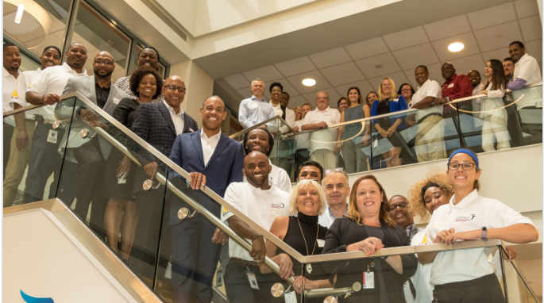
Our Credo
We are responsible to the communities in which we live and work and to the world community as well. We must be good citizens – support good works and charities.. We must encourage civic improvements and better health and education.
AALC (African American Leadership Council)
Bridge to Employment
Wissahickon High School/ Spring House site.

Slide 4
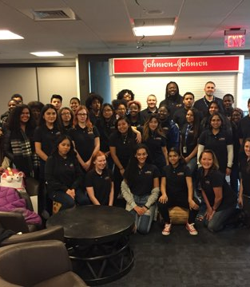
37 Students (started w/44)
NAHS (Secondary school)
Career and College Counselor
Guidance Counselor
District Liaison/ Lead Counselor
17 Career Coaches
Our site is a 24/7 365 process which allows us flexibility with coaching and Management Meetings.
Our coaches work in Manufacturing, R&D, Marketing and QC.

Slide 5
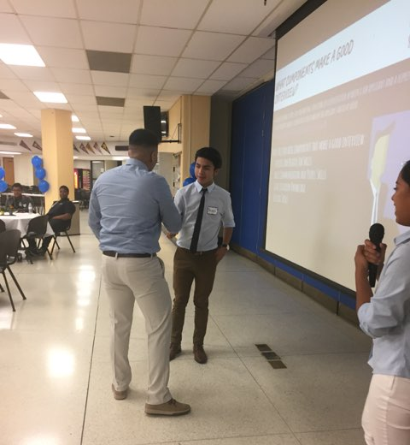
Personal Development Workshop
Student’s learned about various careers within J&J
What to wear to an interview
Prep, perform and the follow-up
Mock interviews
Career Mapping
Career ex. Beautician
College Knowledge Workshop
Value Sort Workshop
Students were given a list of common values which they had to sort and prioritize relevant to their careers. (ex. Caring, supportive, denpendable)
Toastmasters

Slide 7
Questions..

