Slide 1
Bridge to Employment
Aotearoa New Zealand

Slide 2
Snapshot James Cook High School
Decile index of 5 socio/cultural and economic indicators Decile 1 (lowest)
Students who identify as Maori 35%
Students who identify as Pasifika 33%
Students that move onto higher education 10%
Average attendance rate 75%

Slide 5
Te Whare Tapa Wha

Slide 6
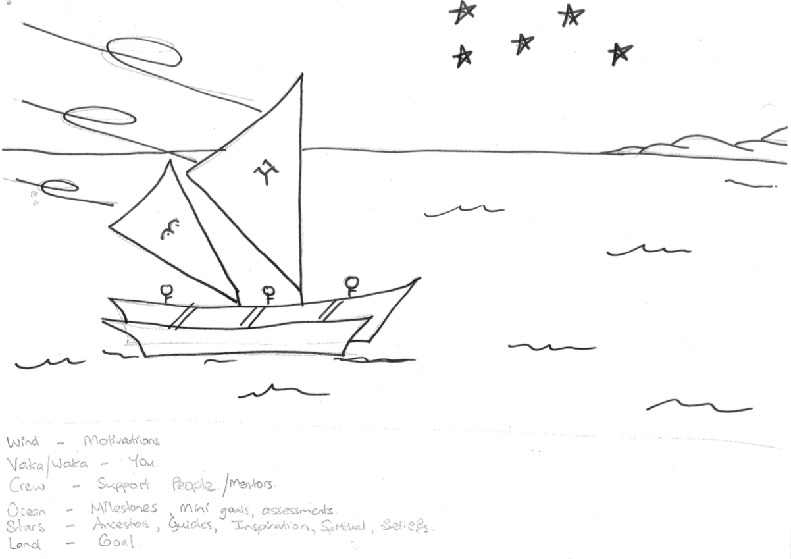
VAKA Model

