Slide 1
Digital Badging
ABTS 2018

Slide 2
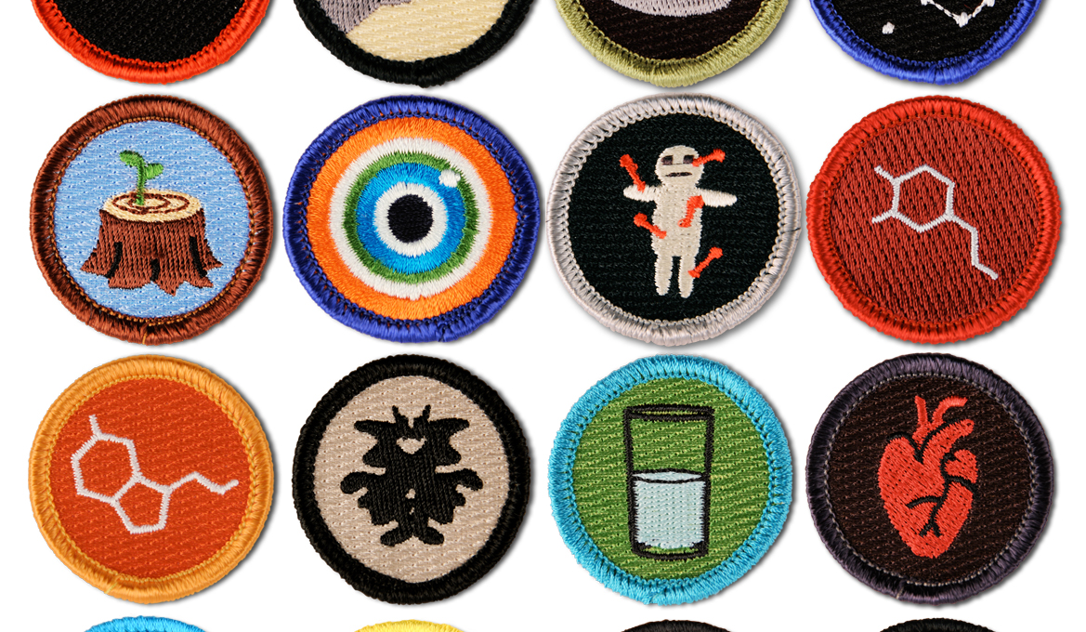
What are Digital Badges?
Part of a wave of online credentials
Initiative of Education Design Lab (21st Century Skills)
Live permanently on a “Learning Management System”—Stackable, searchable, linkable

Slide 3
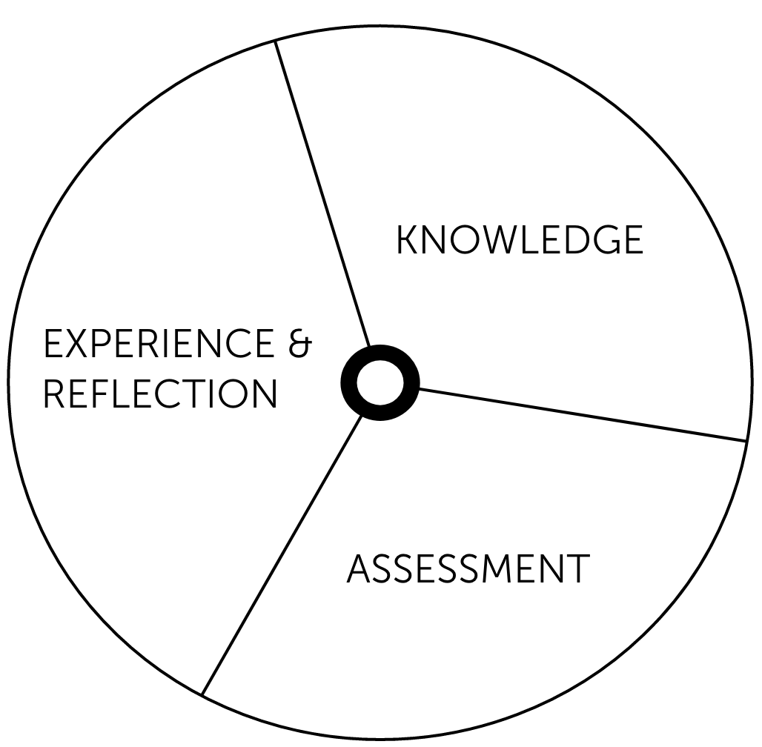
Structure of a 21st Century skills Digital Badge
4 Sub Competencies
360 Skills Assessment
15-20 hours of coursework
Knowledge | Experience & Reflection | Assessment
Key Thing: GROWTH

Slide 4
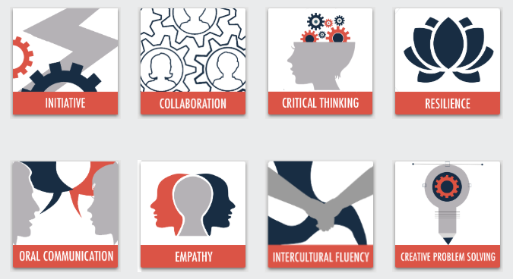
21st Century Skills:

Slide 5
ABTS Intercultural Fluency Model
Introduction: WHAT IS CULTURE
Definitions of Culture
Sub-Competency 1: SHOW CURIOSITY
Cultural Iceberg | Journals | Parking Lot | Cultural Experiences
Sub-Competency 2: IDENTIFY AND CHALLENGE ONE’S OWN CULTURAL BIAS
Intercultural Index | Axioms of Culture | Circles of Self
Sub-Competency 3: INCORPORATE DIVERSE PERSPECTIVES
Dark Room Exercise | The 4 Work Types | Appreciating Our Diverse Perspectives
Sub-Competency 4: DEMONSTRATE SELF AWARENESS
Self-Awareness Questions | Personal Coat of Arms

Slide 6
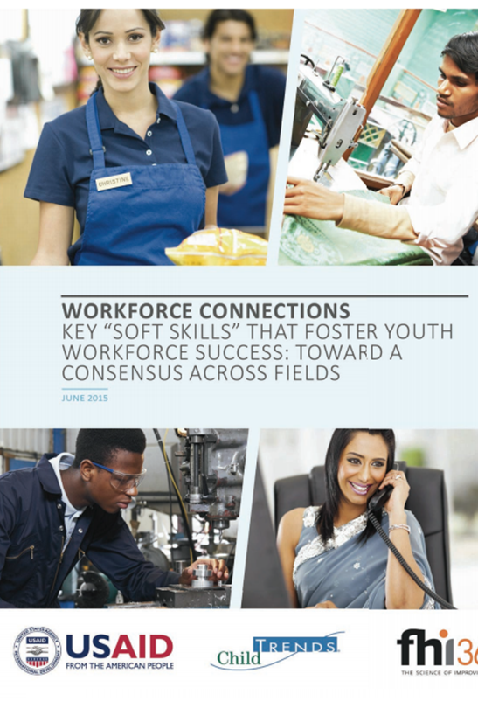
WHY?
Structures Activities
Gives students something to “hold”
Shows what they know and how they know it
“21st Century Skills” are “Soft Skills”
Social Skills
Communication Skills
Higher-order Thinking Skills
Self-Control
Positive Self-Concept

Slide 7
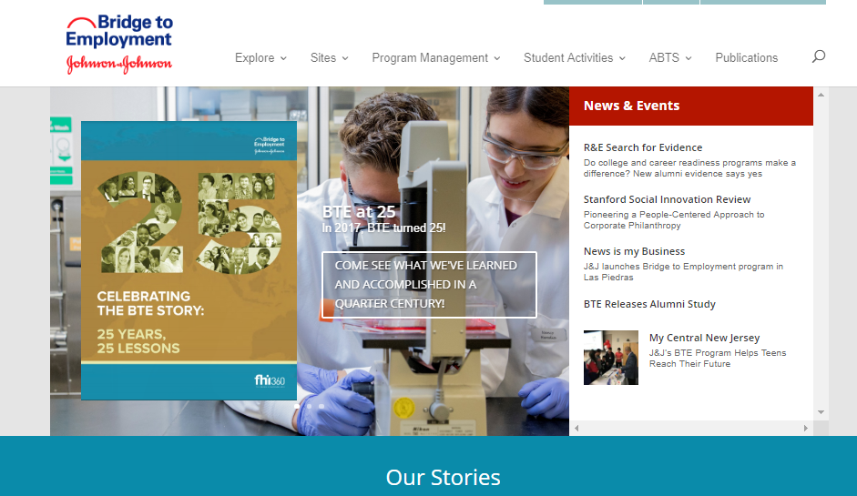
What’s NEXT
FHI 360 Develops Structured Curricula—Use for Individual Activities or Full Program
Sites implement and flesh out—Recommend Pairing with 360 Assessment & Other Project
Student Badges go online; linked to BTE Website
Find it NOW: Bridge2employment.org

Slide 8
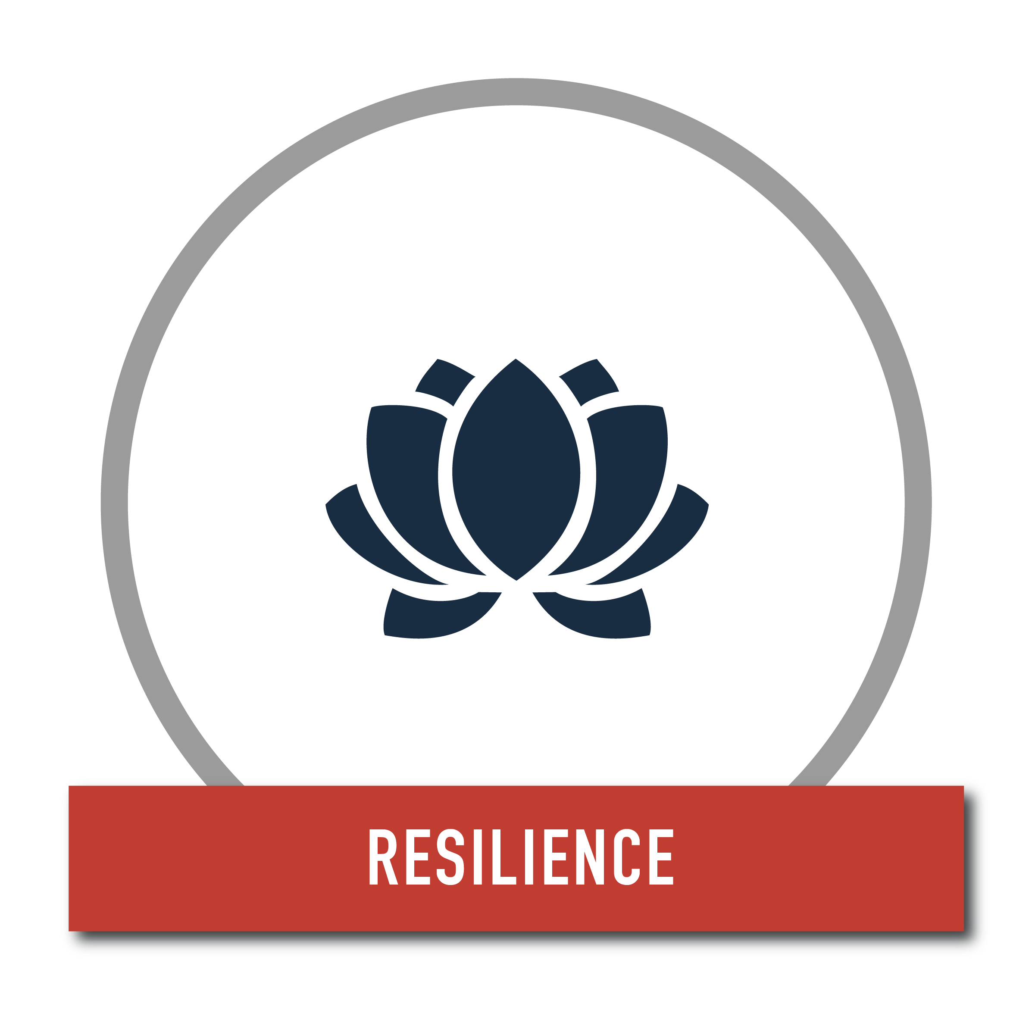
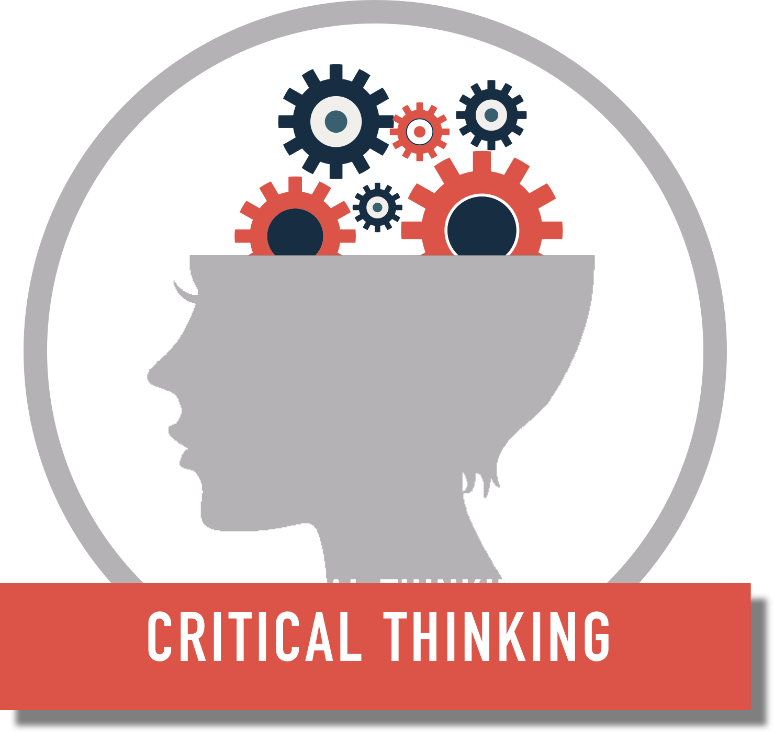
Tell us…
Strengthen Relationships
Listen Actively
Incorporate Diverse Perspectives
Focus on Solutions
Identify Patterns
Gather and Assess Relevant Information
Question Assumptions
Draw Conclusions
Demonstrate Self Awareness
Learn from Experience
Focus on Solutions
Exhibit Flexibility

Slide 9
Questions?

