Slide 2
Introduction to BTE Santa Ana
Partners:
CSS
UC Irvine Center for Educational Partnerships
Santa Ana High School
UCI
Santa Ana College
Cal State Fullerton
53 students

Slide 3
BTE Santa Ana—J&J structure
Steering Committee with partners—monthly meetings
Steering Committee at J&J—quarterly meetings
Subcommittees Structure for J&J led-activities:
Demos
Mentoring
Career Symposium Day
Job Shadow Day

Slide 4
Subcommittee Structure Provides Leadership
J&J Steering Committee comprised of J&J BTE co-leadership plus subcommittee heads
Co-leads for each subcommittee provides leadership development for employees in development programs
Structure allows focus on critical elements of our BTE program

Slide 5
Programmatic Development: Career Symposium
Career Symposium approach builds foundation for each year
Exposure to our multiple businesses
Exposure to our two California sites
Exposure to leadership
Hand-on learning on our products
Deepened knowledge on critical health issues such as atrial fibrillation
Exposure to manufacturing

Slide 6
Programmatic Development: Job Shadow
Job Shadow day adds depth on career opportunities
Career exploration through small group discussions with J&J employees
Exposure to leadership
Hand-on learning on our products
Exposure to manufacturing

Slide 7
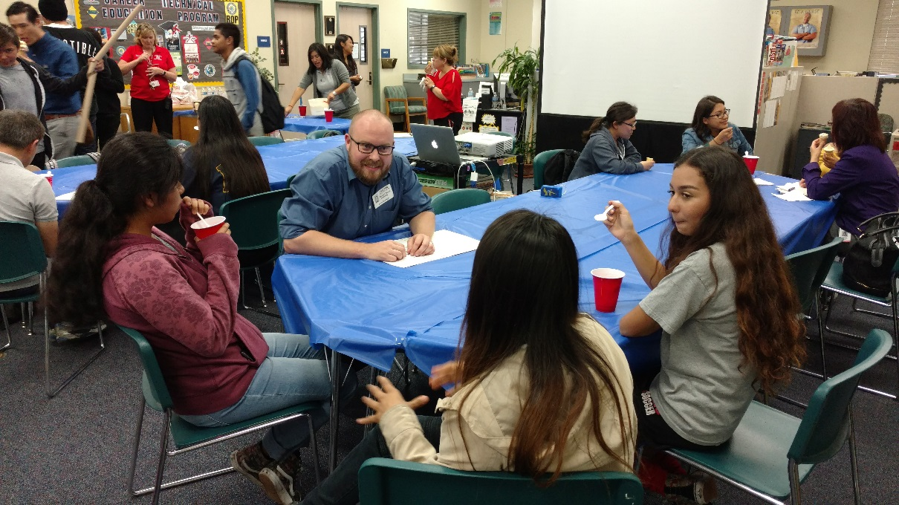
Mentoring Program
Builds on exposure to J&J employees during Job Shadow
Monthly after school programs at Santa Ana High School during Years 2 and 3
Small group structure: 3-5 students with 2 mentors

Slide 8
StrengthQuest
Half day exploration on personal strengths in Year 1
Building on StrengthQuest in Year 2 through review of strengths and building a personal plan

Slide 9
Hands-on Learning: Career Symposium
During Year 1 Career Symposium, workshops:
Build a Biological Indicator
Balloon Sinuplasty—using anatomical models
3D Printing—Applications in Healthcare, printed SAHS Medallions
Allows students to interact with our technology and hear about careers

Slide 10
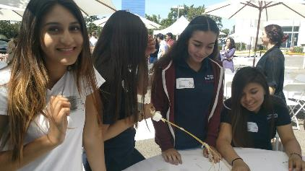
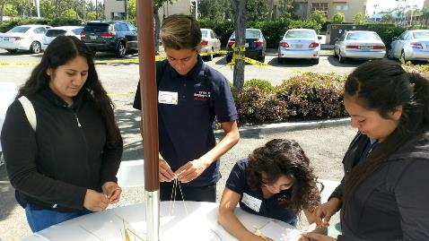
Hands-on Learning: Job Shadow
Introduction to WiSTEM2D curriculum
Used Marshmallow Challenge from Design module
Allows career exploration with J&J staff
Develops team work and problem solving skills

Slide 11
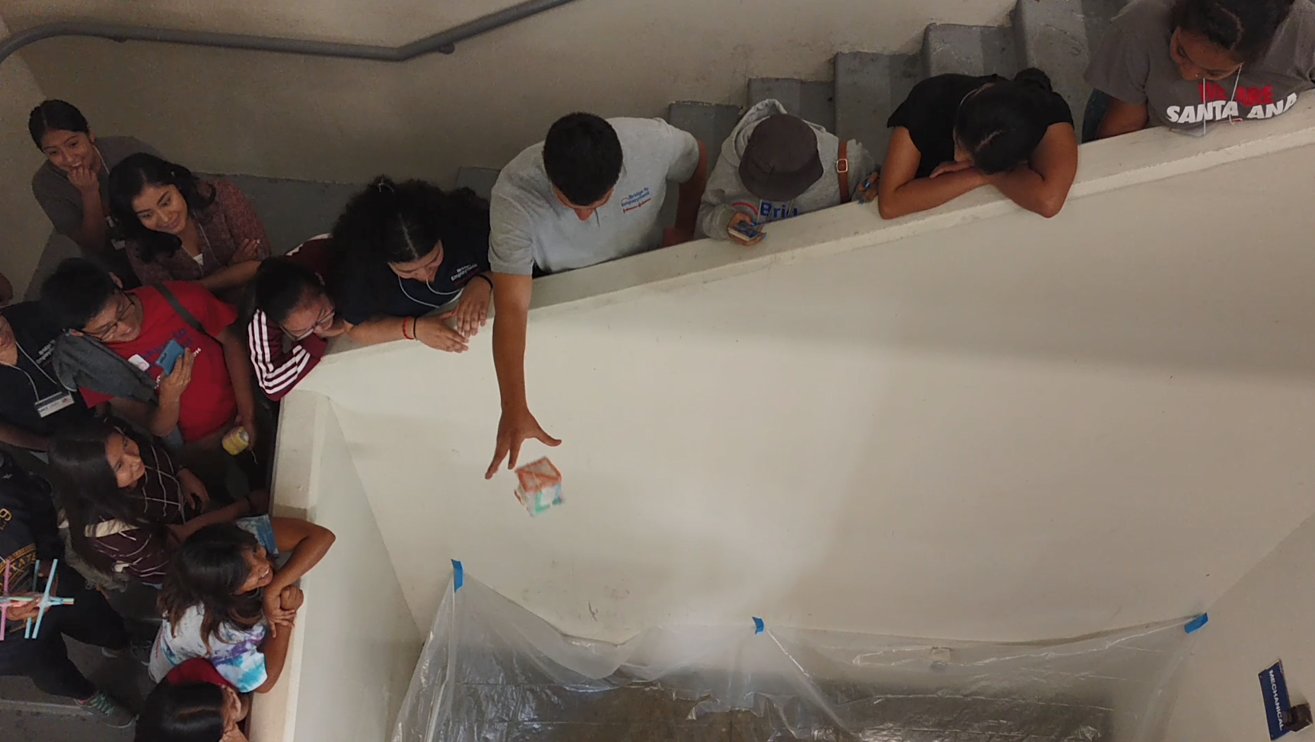
Hands-on Learning: Summer exploration
Two afternoon sessions at Santa Ana High School using WiSTEM2D modules
Session 1: Paper Plane Manufacturing
Session 2: Egg Drop Challenge with BTE San Diego

Slide 12
Hands-on Learning: Career Symposium 2017
Ablation demonstration with ST and STSF catheters and Ablation demo system: This workshop consists on showing the ablation process with a chicken breast and have students to volunteer to try to make an ablation. Also, we are including the Clinical setup demo that installed in the EP Lab and a tour will be provided to the students.

Slide 13
Hands-on Learning: Career Symposium 2017
Mapping demonstration with Pentaray Nav catheter and Carto demo system: This workshop consists on showing the mapping process with a Pentaray Nav catheter and explain how the doctor reads the catheter electrical signals in the Carto system. Also, the students will have the opportunity to do a mapping process.

Slide 14
Hands-on Learning: Career Symposium 2017
Manufacturing demonstration with Pentaray Nav and Octaray catheters: This workshop consists on showing the Octaray production line setup and process as well as the critical inspection process such as tip deflection, irrigation and ring spacing. The students will have the opportunity to perform the manufacturing inspections for a hands-on experience.

Slide 15
Questions?

