Slide 1
Developing Research Skills: The Effects of Waste on Our Environment & Health
Notes:
Read the title to students

Slide 2
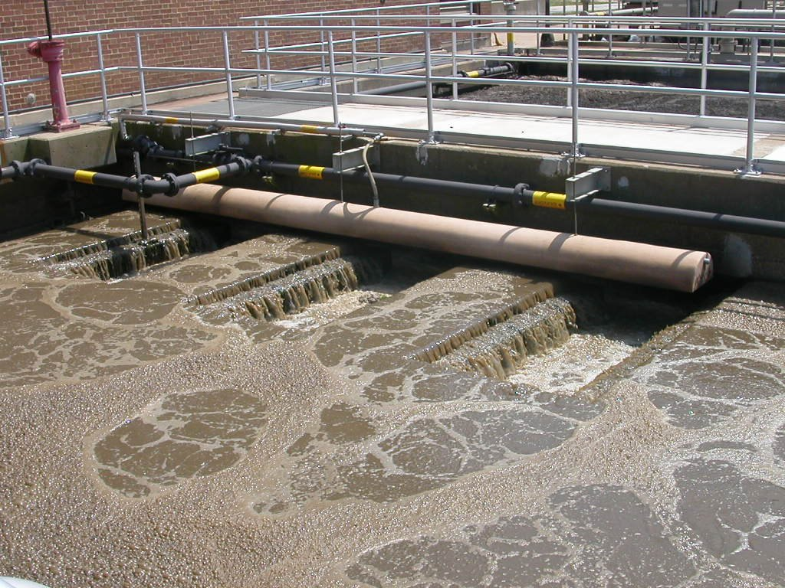
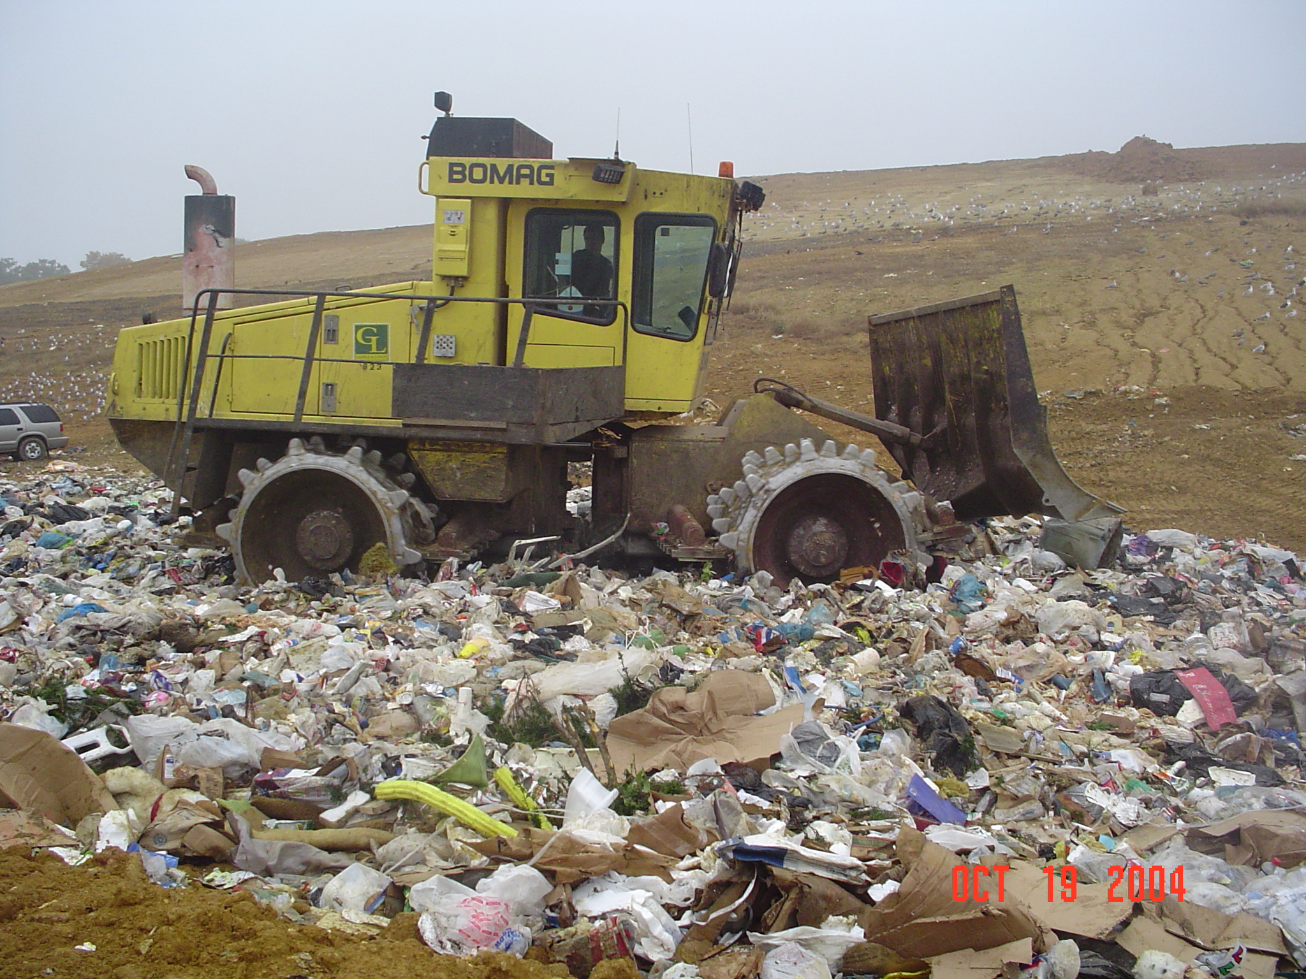
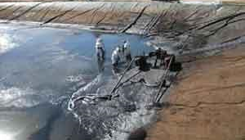
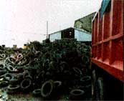
What do these pictures depict?
Notes:
Introduce the topic by having students take a minute to look at the pictures.
Ask them what they see and what they think they have in common. What are they all showing us?

Slide 3
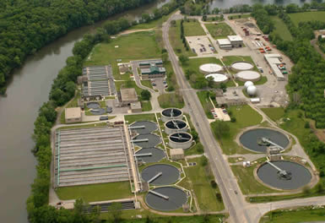
Answer: Solid Waste…Yuck!
Solid waste…
Is any garbage, refuse, or sludge from a wastewater treatment plant, water supply treatment plant, or air pollution control facility
Is discarded materials from industrial (factories), commercial, mining, agriculture, and/or community activities
Does NOT include household sewage or irrigation flows
Source: City of South Bend, Indiana
Notes:
Read the definition aloud to the students or have a student volunteer to read it.
Ask them what they think is in the picture. Ask them what they know about wastewater and treatment plants.

Slide 4
Simply put, solid waste…
Is any discarded material
Can be a solid, liquid, semi-solid, or a containerized gaseous material
Discuss:
Can you think of some examples of solid waste that you come in contact within your neighborhood?
Notes:
Simplify the concept to them with this definition.
Ask them to come up with several examples of different types of waste (newspapers, yard waste, old appliances, household garbage or used furniture).
See if they can give you an example of a solid waste, a liquid waste, and a gaseous waste (paper, liquid chemicals from plants exhaust from cars etc.…).

Slide 5
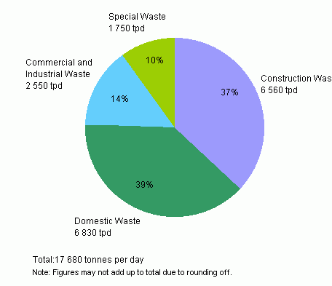
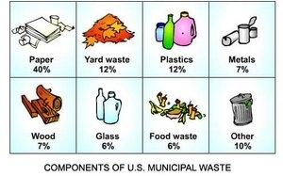
Examples:
A breakdown of the proportion of each type of waste in Hong Kong
A breakdown of U.S. Household Waste
Source: Hong Kong Waste Treatment and Disposal Statistics
Source: SOURCES AND TYPES OF SOLID WASTE
Notes:
Give them a minute to examine the graph/picture, then discuss.
Tell them that the pie chart depicts the proportion of the different types of waste in Hong Kong, for example 37% of their total waste comes from Construction and 39% comes from domestic waste.
Ask: Do you think the U.S would have similar proportions? Why or why not? Would cities and small towns have similar proportions? How might they be different?
Go through the U.S domestic waste proportions.
Ask students if they are surprised by the proportions, Did they expect paper to be such a high percentage of the total? Thinking of their own waste at home, do they have more of one type than another?

Slide 6
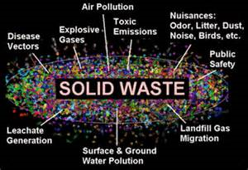
Why does it matter?
Source: The City of San Diego
Notes:
So by now, you know that we are discussing solid waste today. But why? Why is it important for you to know about? How does it affect you?
Looking at the picture, you can see solid waste takes on many forms and has the potential to affect us in many ways.
It can be smelly if it is not removed regularly or if it is burned.
It can be noisy, like in the case of air pollution caused by planes. It can also be noisy to remove, i.e garbage trucks collecting dumpsters.
It can pollute the water, land, and air as well as cause explosions if it is not stored and removed properly.
What happens when it comes into contact with humans?
It can make us sick (bacteria in our food or water, or it is absorbed through our skin)
It cause injury in the case of explosions or swimming in polluted waters

Slide 7
Think-Pair-Share-Discuss
What happens to solid waste in your community?
Where does it go and how does it get there?
Notes:
Read the questions aloud to the students
Then direct them to turn to a partner sitting next to them and discuss the questions. Give them about 5 minutes to discuss while you walk around ensuring they are discussing the topic
Re-group the students and ask what they discussed, what answers did they come up with to the questions?

Slide 8
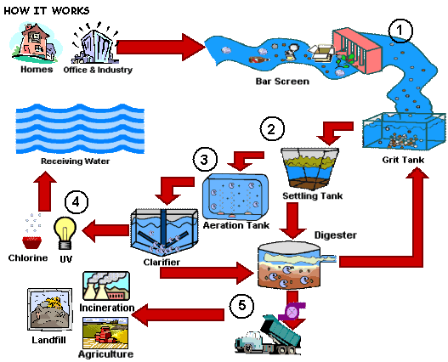
How wastewater treatment works:
Source: City of Dunbar, West Virginia
Notes:
Go through the chart with the students:
Waste begins in the home, in offices, or businesses
It leaves these places via the sewer or storm drains in the street (for solid waste it leaves via trash collection services in cities)
Then, it is allowed to settle in a tank so that solid waste sinks to the bottom, with the water on top. This allows it to be separated more easily.
Then, it goes through the process a second time in the settling tank.
Next, it is separated. The water is passed into an aeration tank and the solids are sent to a digester tank where bacteria consume the waste.
The water is then treated and cleaned using UV and Chorine technology, making it safe to use again. Then, it is passed into receiving water- back into our own water supply- rivers, lakes, streams, the ocean etc..
The solid waste is then transported via trucks and used in agriculture, burned in incinerators, or placed in landfills.
Point out that trash is usually sent straight to landfills and recycling is processed in separate plants as is food waste if it is composted.

Slide 9
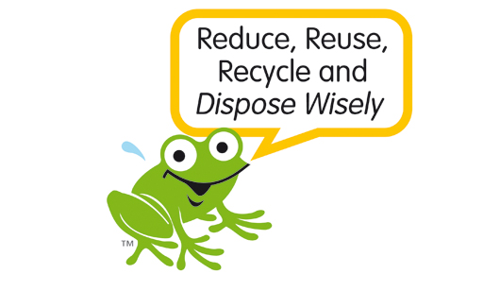
Now that you know…
What are appropriate places to dispose of solid waste?
What are some possible consequences if solid waste is not disposed of properly?
Source: City of Vincent : Reduce, Re-use, Recycle
Notes:
Places to dispose of waste: trash cans, dumpsters, and recycle bins
Places NOT to dispose them: on the ground, in rivers or other water supplies, and fires
Ask them to think about the consequences: if they don’t arrive at the conclusion- suggest to them that there are environmental consequences, as well as serious health consequences (diseases and infections) that result from poor solid waste management. See if they can brainstorm any they know.
See the next slide two slides for examples

Slide 10
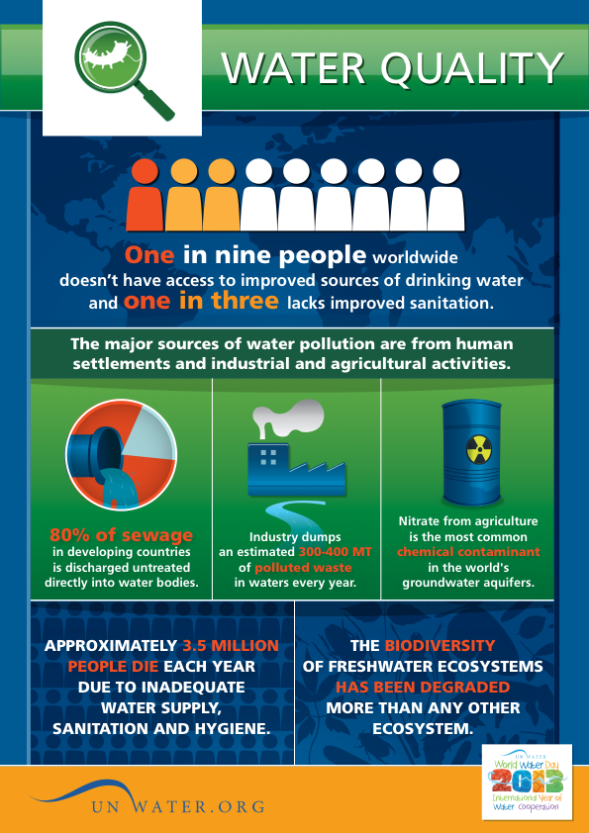
Environmental Consequences of Poor Waste Management
Source: UNWater.org
Notes:
One environmental and health consequence of poor solid waste management is poor water quality.
Distribute Handout 2
Review the flyer on Water Quality

Slide 11
Health Consequences of Poor Waste Management
Diseases and Infections
Respiratory Illnesses (Asthma)
Pneumonia
Influenza
Diarrhea
Gastroenteritis
Conjunctivitis
Otitis media
Parasites
Toxoplasmosis
Dengue fever
Typhoid fever
Colitis
Ascariasis
Notes:
Ask students if they are familiar with any of the diseases & infections listed. If needed, provide students with additional information, using the following:
Respiratory Illnesses (such as Asthma, pneumonia), as well as Influenza and Diarrhea … should be relatively familiar
Gastroenteritis is the “stomach flu;” diarrhea and vomiting are symptoms of this infection
Conjunctivitis is an infection in the eye
Otitis Media is an infection of the ear
Parasites are little organisms that enter the body and live inside you, worms are an example
Toxoplasmosis is an infection usually contracted from cats, especially in handling their stool.
Dengue Fever comes from being bitten by a mosquito, mosquitos live near waste water. Only usually is found in tropical places in developing countries.
Typhoid fever also usually is found in developing countries and is a virus that comes from unsafe water and food
Colitis is an infection in the intestines and stomach
Ascariasis is a type of worm that lives inside your intestines

Slide 12
What are communities doing?
Saving Lake Managua in Nicaragua
Kenya’s Green Project
Notes:
Explain that different communities are taking action to combat poor waste management.
If desired, watch one of the videos; alternatively, select your own video.
Ask students:
What is our community doing to combat this issue?

Slide 13
Assignment:
As a team:
Choose a health issue that results from poor waste management
Research the topic.
How is this disease/infection contracted and spread?
What are the symptoms and treatment?
Where is the disease/infection commonly found?
How does the disease/infection relate to our topic of waste management?
Create a factsheet (flyer) and PowerPoint, be sure to:
Include important facts, research, and background information
Make it visually appealing
Give recommendations (ideas) for community action
Present to your BTE peers for five to seven minutes
Notes:
After breaking the students into small groups or teams, give the assignment. Be sure to:
Help each team choose a disease/infection (see slide 11)
Ensure that no two teams are doing the same topic
Consider asking: “What will make the Factsheets and PowerPoints move visually appealing?” (Some answers may include: use of font, colors, pictures, diagrams, or maps)
Tell teams that Handout 2 serves as an example of a Factsheet or Flyer
Point teams to reputable sites for research (see next slide)
If needed, help teams brainstorm ways the community can take action

Slide 14
Good websites for research:
Center for Disease Control
http://www.cdc.gov/
WebMD
http://www.webmd.com/
World Health Organization
http://www.who.int/en/

