Slide 1
Learning for Change: Making Significant Impact
Nadra Franklin
October 5, 2015

Slide 2
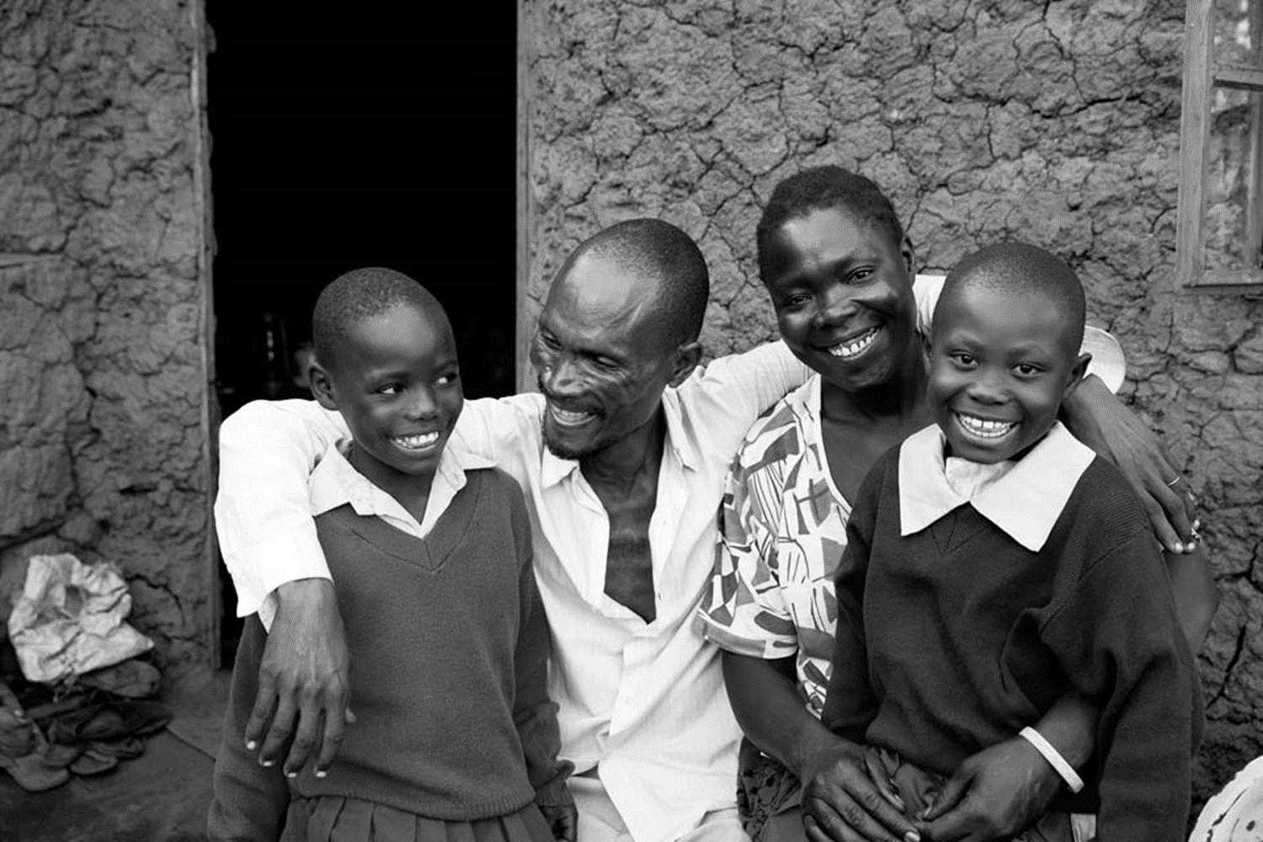
MISSION
To improve lives in lasting ways by advancing integrated, locally driven solutions for human development.
Jessica Scranton/FHI 360

Slide 3
Learning for Change and Impact

Slide 4
Start with your theory of change
OUR WORK

Slide 5
Our Work
Foster a culture of Proving and improving
Jessica Scranton/FHI 360

Slide 6
Our Work
Impact -> partnerships -> sustainability
Jessica Scranton/FHI 360

Slide 7
THANK YOU

