Slide 1
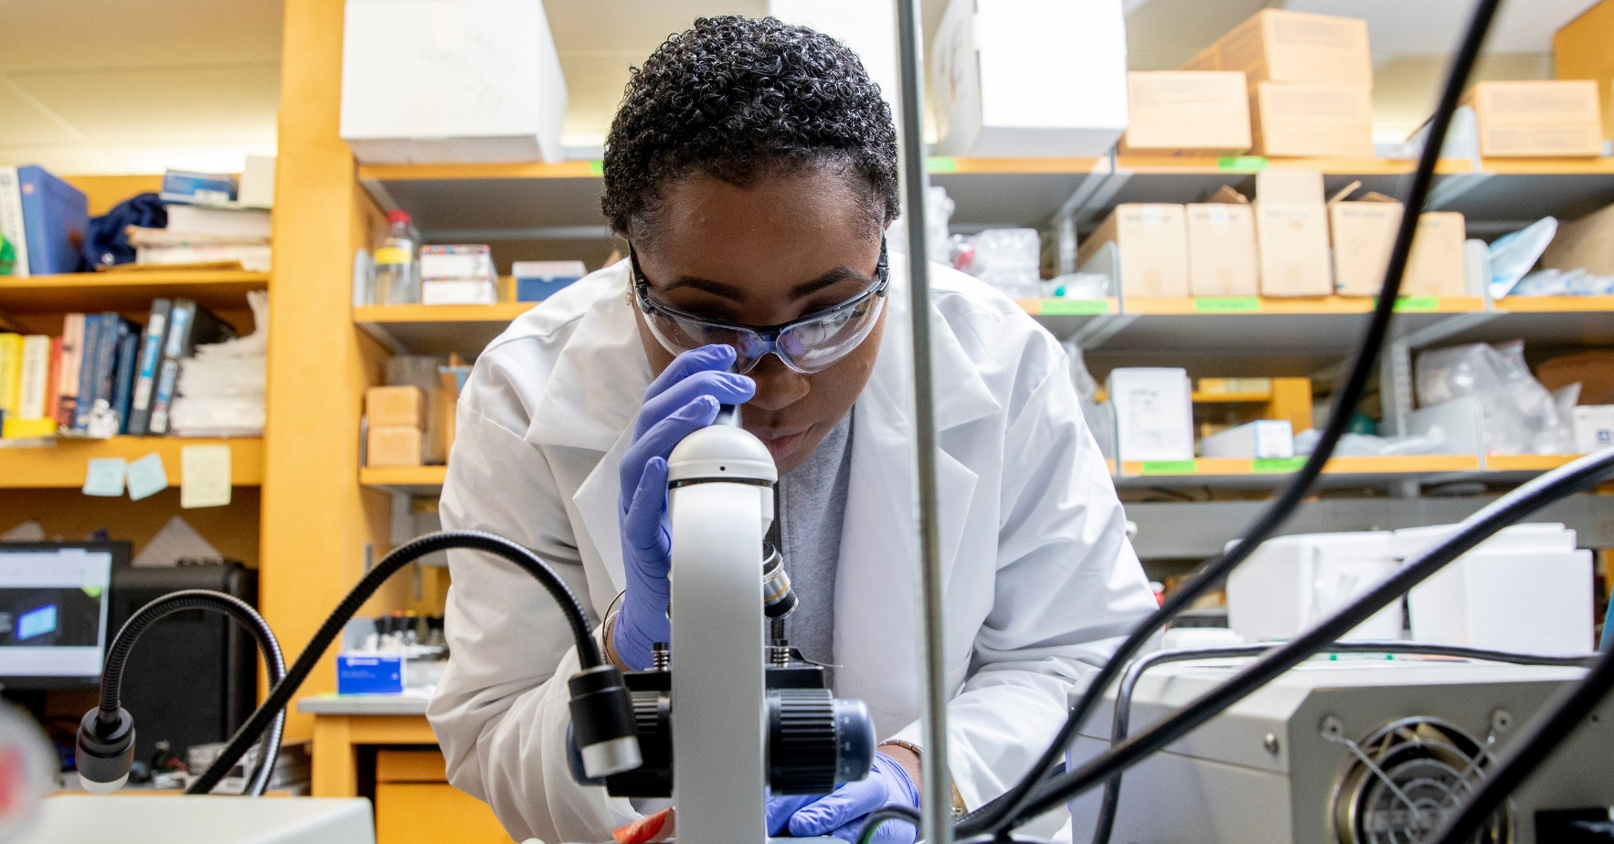
Exploring Johnson & Johnson’s Bridge to Employment (BTE) Program

Slide 2
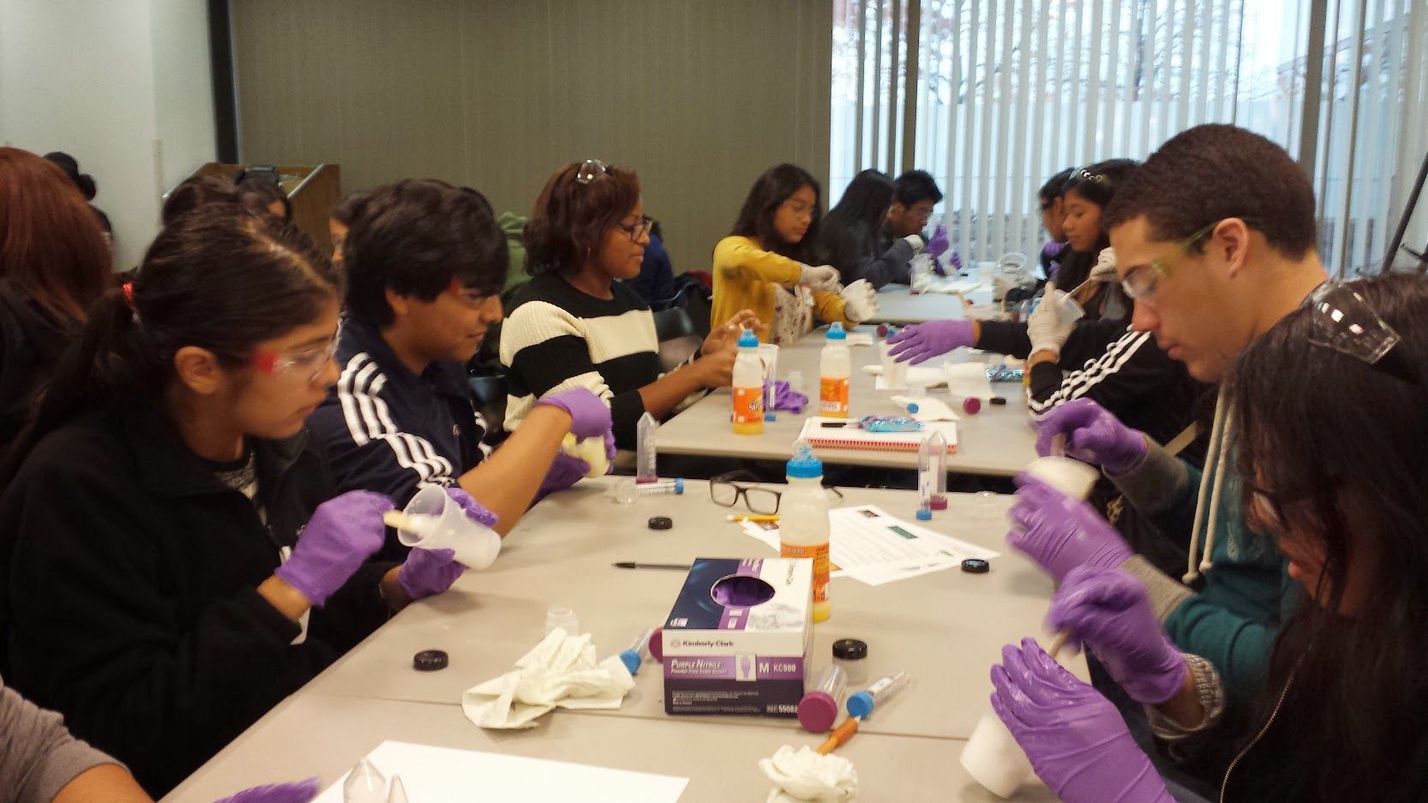
About BTE
The Credo in Action
“We are responsible to the communities in which we live and work.”
- excerpt from Johnson & Johnson’s Credo
Launched in 1992, this signature program is based on extensive research and school-to-career models.
BTE helps young people build solid futures by introducing them to a broad array of careers in health and by providing them with enhanced academic and real-world experiences.

Slide 3
About BTE
Program Design
Long-Term Outcomes
Increase the number of students who enroll in post-secondary education;
Increase the number of students pursuing a career in the STEM²D or healthcare sectors.
Program Strategies
To achieve these goals, all BTE sites target program activities in key areas:
Academic Achievement & Enrichment
Higher Education Awareness & Preparation
Career Exploration & Readiness
Community Engagement & Leadership
Management
Johnson & Johnson partners with FHI 360 to provide global program management, evaluation support, and technical assistance.
FHI 360 is a nonprofit human development organization dedicated to improving lives in lasting ways by advancing integrated, locally driven solutions.

Slide 4
Global BTE Reach
Fast Facts: 1992 – 2021
$9.4 million
invested by Johnson & Johnson
in BTE sites around the globe
between 1992-2021
74% of sites sustain
at least one program activity
post-Corporate funding
28% funded self-sustaining sites
receive funding from the local operating company to sustain programming efforts
102 sites
24 countries, 6 continents
Australia, Colombia, Czech Republic, Dominican Republic, England, India, Ireland, Israel, Italy, Kenya, Mexico,
The Netherlands, New Zealand, Panama, Philippines, Romania, Scotland, Singapore, South Africa, Spain, Sweden, Thailand, Taiwan, United States and Puerto Rico
67 U.S. sites
14 states & Puerto Rico
California, Delaware, Florida, Georgia, Indiana, Missouri, New Jersey, New Mexico, New York, Ohio, Pennsylvania, Massachusetts, Texas, Virginia, Puerto Rico
5,300 BTE students worldwide
44% of BTE students are enrolled
in a BTE site outside of the
United States or Puerto Rico
3,200⁺ J&J volunteers worldwide
60,000⁺ volunteer hours
provided between 2010-2021
(when tracking was initiated)
32%

Slide 5
About BTE
Geographic Area Served
Europe/Middle East
Helsingborg, Sweden Limerick, Ireland Prague, Czech Republic *
BTE Sites Funded by Johnson & Johnson Corporate by Region in 2022
North America
Athens, Georgia Atlanta, Georgia + Englewood, Florida Ewing, New Jersey Franklin Township, New Jersey Lancaster, Pennsylvania Palm Beach Gardens, Florida + Philadelphia, Pennsylvania Orange County, California Warsaw, Indiana
Asia-Pacific
Bangkok, Thailand * New Taipei City, Taiwan + Singapore Sydney, Australia Tokyo, Japan+
Latin/South America
Nigua, Dominican Republic Puebla, Mexico São José dos Campos, Brazil * Argentina +
Africa
Tswelopele, South Africa
* Four (4) sites will launch BTE programs in school year 2022 or school year 2022-2023.
+ Five (5) sites will initiate a Strategic Planning process in 2022, launching programs in school year 2023 or 2023-2024.

Slide 6
About BTE
Geographic Area Served
Selected communities must be within the “travel to work” time (30-minute commute) of a Johnson & Johnson local operating company and exhibit a strong community need (one or more of the following characteristics):
Economic Disadvantage
Designated high poverty community
Higher than average % of low-income families in community
Educational Disadvantage
Unsatisfactory school rating
Low student test scores
Low graduation rate
Few students proceeding to higher education
Few adults in the community w/a higher education degree
Barriers to Achievement
First generation college-bound
Geographic barriers (Isolated or rural location)
Language barriers
Social or cultural barriers

Slide 7
BTE Highlights 2020: Impacts & Outcomes
Analysis of BTE Graduates 2013-2020¹
academic
achievement
Higher Education
Awareness & Enrollment
STEM²D Career
Preparation & Interest
32%
72%
3-year Completion Rate
0.82 %
Increase in
overall grades (GPA) among BTE graduates from baseline to graduation (n=785)
(4.0% unpaired/independent sample)
98%³
graduation rate among students completing the 3-year program (n=736)
98.4%
of BTE graduates aware of higher education opportunities (n=672)
(vs. 88.9% of comparison group, n=481)
89.3%
of BTE graduates plan to attend an institute of higher education (n=650)
(vs. 79.5% of comparison group, n=453)
93.3%²
of BTE graduates possessed
key college- and
career-readiness skills (n=613)
(vs. 87.3% of comparison group, n=459)
49.5%
of BTE graduates’ plan
to pursue a career in the
STEM²D /health sectors (n=352)
(vs. 31.4% of comparison group, n=170)
¹ BTE Graduates are those students that participated in and completed the three-year BTE program between 2011 and 2020 (n=31:33 sites). Data based on the annual independent evaluations and reporting. ² Replicating 2018 method of five foundational skills, results are: BTE = 96.2% (n=626) and Comparison group = 92.3% (n=468) ³ Result is based on End of Grant Report data from 20:22 sites.
Notes:
BTE Graduates are those students that completed the three-year BTE program. FHI 360 calculates the completion rate using the initial enrollment indicated in the Quarterly Report submitted at baseline and the final enrollment indicated in the End-of-Grant Report submitted 30 days after graduation by the local site coordinator. The program completion rate for 2013-2030 is 72.7.% (31:34 sites reporting, including: Ambler, Pennsylvania; Auckland, New Zealand; Bound Brook, New Jersey; Bucharest, Romania; Cape Town, South Africa; East London, South Africa; Gurabo/Manati, Puerto Rico; High Wycombe, United Kingdom; Johannesburg, South Africa; Las Piedras, Puerto Rico; Leiden Netherlands; Mexico City, Mexico; Mumbai, India; Nairobi, Kenya; Naples, Italy; Norristown Area, Pennsylvania; New Brunswick, New Jersey (5); Newark, California; North Plainfield, New Jersey; Panama City, Panama; Phoenixville, Pennsylvania; Prague, Czech Republic; San Diego, California; San Lorenzo, Puerto Rico; Santa Ana, California; Sydney, Australia; Taunton, Massachusetts; Trenton, New Jersey (3); Wilmington, Delaware (2); Yokneam, Israel; and Yumbo, Colombia. Three-year completion rates are not applicable for three (3:34) sites, including Leeds, United Kingdom; Madrid, Spain; and Paranaque, Philippines, and were excluded from the analysis due to non-qualifying program model data.
Graduation Rate are those students that completed the three-year BTE program and graduated/completed secondary school between 2014-2020 (20:22 sites), including: Auckland, New Zealand; Bound Brook, New Jersey; Bucharest, Romania; Gurabo/Manati, Puerto Rico; High Wycombe, United Kingdom; Las Piedras, Puerto Rico; Leeds, UK; Mumbai, India; Nairobi, Kenya; Naples, Italy; Norristown Area, Pennsylvania; New Brunswick, New Jersey (5); North Plainfield, New Jersey; Phoenixville, Pennsylvania; San Diego, California; San Lorenzo, Puerto Rico; Santa Ana, California; Sydney, Australia; Taunton, Massachusetts; Trenton, New Jersey (3); Yokneam, Israel; and Yumbo, Colombia. At the time of this publication, two sites (2:22) did not have final graduation data, including: East London, South Africa; and Mexico City, Mexico.
Academic and Survey Data. FHI 360 analyzed the Academic and Survey data, as reported by the independent evaluators, of sites with students graduating and completing the BTE program between 2013-2020.
Between 2013-2019 this included data from 24:28 sites: Ambler, Pennsylvania; Auckland, New Zealand; Bucharest, Romania; Cape Town, South Africa; Gurabo/Manati, Puerto Rico; High Wycombe, United Kingdom; Johannesburg, South Africa; Leiden Netherlands; Mumbai, India; Nairobi, Kenya; Naples, Italy; New Brunswick, New Jersey (5); Newark, California; North Plainfield, New Jersey; Panama City, Panama; Phoenixville, Pennsylvania; Prague, Czech Republic; San Diego, California; San Lorenzo, Puerto Rico; Santa Ana, California; Sydney, Australia; Taunton, Massachusetts; Wilmington, Delaware (2); and Yumbo, Colombia. Four (4:28) sites, including Leeds, United Kingdom; Madrid, Spain; New Brunswick, NJ (4); and Paranaque, Philippines, were excluded from the analysis due to non-qualifying Academic and Survey data. “Work Readiness Skills” results are reported for 27:28 sites: Panama City, Panama survey data for these questions were not available for analysis.​
In 2020, Covid-19 resulted in limited Academic and Survey Data collection of the seven (7) BTE sites graduating, including: Bound Brook, New Jersey; East London, South Africa; Las Piedras, Puerto Rico; Mexico City, Mexico; Norristown, Pennsylvania; Trenton, New Jersey; and Yokneam, Israel.
See slide 6 for additional details on available data for analysis from these sites.

Slide 8
About BTE
Target Population
Number Served
35-50 students
Education Level
Last three years of secondary school
A “year” is defined as a full school year or calendar year (i.e., summer-only programs do not meet this definition)
Characteristics
Academic Potential
Barriers to Achievement

Slide 9
About BTE
Program Design & Program Activities
BTE program activities are customized to meet local needs
Key Focus Areas:
Academic Enrichment
Higher Education Preparation & Exploration
Community Engagement & Leadership
Career Exploration & Readiness
Program Activities (Students)
Duration (How long?)
Average: 8 hours per month (including some J&J employee involvement), totaling 80 hours/year
Frequency (How often?)
Average: 2 sessions per month
*BTE has a global attendance policy whereby students are to attend 80% of annual programming.

Slide 10
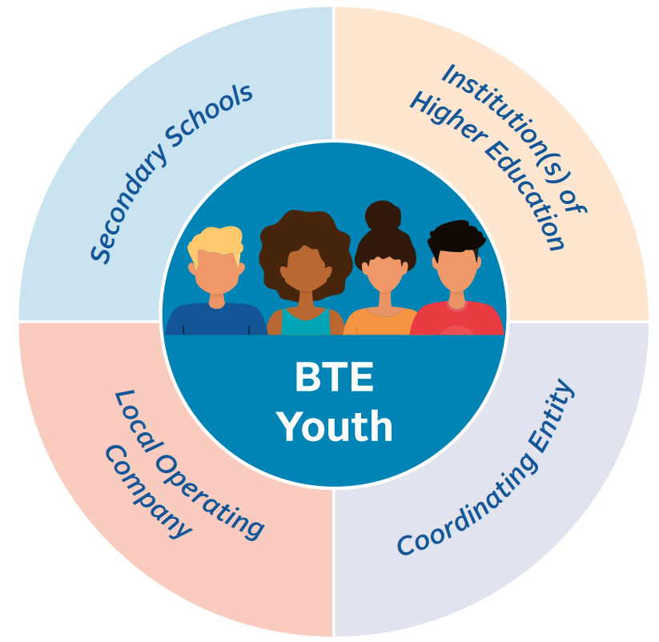
About BTE
Partners

Slide 11
About BTE: Management Roles & Responsibilities
Partner Roles & Responsibilities
Partner | Strategic Planning | Implementation | Graduation
Corporate | Recruit and select BTE locations Support BTE Executive Sponsor and champions, as needed Approve strategic planning grant application Provide strategic planning funding ($11,500 USD) Attend program launch, if possible, to welcome participants, family members, and community leaders to the BTE family | Support BTE Executive Sponsor and champions, as needed Host annual Alliance Building & Training Session (ABTS) with FHI 360 Approve implementation grant application Provide implementation funding on an annual basis ($90,000 USD total) Promote BTE globally | Attend graduation / culminating event, if possible, to congratulate BTE participants and site leaders Promote BTE globally
Local Operating Company | Decide to launch a local BTE program and submit a letter of commitment (Executive Sponsor) Select a BTE Volunteer Champion and a BTE Content Champion – the local operating company employees spearheading the BTE initiative. Participate in strategic planning Identify J&J activities Select additional team leads, as needed Recruit J&J employees for planned activities, as needed | Chair (Executive Sponsor) the advisory committee Serve on Management Team (BTE Volunteer Champion and BTE Content Champion) Run select activities (e.g., company tours or coaching) Provide/participate in four hours of activities for participants a month. Complete annual, online employee surveys on BTE experience Attend annual ABTS | Join with site coordinating entity to celebrate participants’ achievements Plan for future relationships with participants, schools, and site coordinating entity or end the program in a positive way Complete annual employee surveys on BTE experience

Slide 12
About BTE: Management Roles & Responsibilities
Partner Roles & Responsibilities
Partner | Strategic Planning | Implementation | Graduation
 | Global Program Management, Technical Assistance & Cross-Site Analysis
 | Facilitate Strategic Planning Workshop Support the site coordinating entity in development of the formal grant application Conduct initial volunteer trainings Collect start-up materials and ensure quality | Conduct annual site visits and quarterly check-In conversations Provide as-needed technical assistance Ensure quality of program is high Circulate best practices and make resources available Host annual ABTS Promote and market BTE globally | Receive final reports Collect and share lessons learned Update online resources and profiles
Independent Evaluator | Review program model and make any language changes required Customize student surveys Complete Evaluation Agreement | Collect student academic and survey data. Collect J&J employee data Conduct BTE participant focus groups Report on findings annually | Collect final information from schools, students, and J&J employees Release final evaluation report

Slide 13
About BTE: Management Roles & Responsibilities
Partner Roles & Responsibilities
Partner | Strategic Planning | Implementation | Graduation
Site Coordinator | Chair the Strategic Planning Committee Lead planning phase to set mutual priorities for participants and agree on target population, workplan and calendar of activities Finalize program model Develop a calendar of activities Submit BTE grant application Organize program kick-off event Spearhead participant recruitment efforts Oversee BTE participant application and selection process | Participate in the Advisory Committee Chair the Management Team; send invitations and prepare agendas and minutes Submit quarterly reports to FHI 360 Manage grant funds Participate in FHI 360 conference calls Develop an annual calendar of activities Provide eight hours of activities a month (including four hours of activities led by J&J employee) Manage day-to-day operations, including scheduling and making logistical arrangements for all BTE program activities (e.g., agendas, permission forms, participant transportation, food, and materials) Distribute participant surveys to BTE participants and arrange focus groups Support data collection and evaluation Attend ABTS / chaperone Student Ambassadors | Organize graduation ceremony to celebrate participants’ achievements Write end-of-grant report Plan for future relationships with participants and schools or end in a positive fashion Give feedback on experiences to FHI 360

Slide 14
About BTE: Management Roles & Responsibilities
Partner Roles & Responsibilities
Partner | Strategic Planning | Implementation | Graduation
Secondary School | Participate in strategic planning Serve on Strategic Planning Committee | Provide release time for participants to participate in BTE activities Provide academic data for BTE and comparison group cohorts to evaluation team Distribute surveys to comparison group students Link BTE to other programs Serve on BTE Advisory Committee Serve on Management Team Attend ABTS / chaperone Student Ambassadors (if funding permits) | Celebrate participants’ achievements Send final data to Site Evaluator Give feedback on experiences to FHI 360
Institution(s) of Higher Education | Participate in strategic planning Serve on Strategic Planning Committee Identify activities to support higher education exposure and preparation | Offer program activities that expose and prepare participants for higher education Offer peer mentors (optional) Serve on Advisory Committee Serve on Management Team | Celebrate participants’ achievements in final sessions or graduation ceremony Close out activities with participants in a positive manner Give feedback on experiences to FHI 360
BTE Youth | Submit BTE applications | Take part in BTE activities enthusiastically and fully Complete annual participant surveys Participate in annual focus groups – voicing suggestions and constructive criticism of program activities | Utilize the skills learned through BTE in future personal and professional endeavors Maintain contact, where appropriate, with BTE partners

Slide 15
BTE Partners
Secondary School Roles & Responsibilities
School Leadership (Director, Principal etc) | School Evaluation Contact |  | School Liaison (Teacher, Guidance Counselor etc) | Students
Supports Strategic Planning – helps design the BTE program Serves on the Advisory Committee – guides / advises overall program and linkages with other school programs. (once or twice a year meeting) Communicate with school leaders, teachers, parents and community about BTE Offers release time for BTE Participants to attend program activities (optional) | Supports Evaluation & Data Collection Selects BTE Participants & Comparison Group Provides Academic Data (BTE Participant & Comparison Group) Administers & Collects Comparison Group Survey | Supports Strategic Planning – helps design the BTE program Serves on Management Team (monthly) and offers implementation support – organize student release time, school/parent permissions, etc. |  | Participate in BTE Program Activities (BTE Participants) Complete Surveys (BTE Participants & Comparison Group)

Slide 16
BTE Partners
Secondary School Responsibilities con’t
Partner | Evaluation Responsibilities | Implementation
Secondary School | Assign a School Contact for Evaluation Develop Evaluation Agreement with Site Evaluator Select BTE Participants with BTE Partners Select Comparison Group Assign Unique BTE ID Number: BTE Participants Comparison Group Provide Academic Data Template (Excel Spreadsheet) to Site Evaluator BTE Participants & Comparison Group Baseline, Annual & Exit | Administer Comparison Group Surveys Entry, Annual & Exit Attend Annual Presentation of Evaluation Data BTE Advisory Committee Meeting Review & Use Evaluation Data Share BTE Impacts & Outcomes with school leaders, teachers, parents, community members, etc.

Slide 17
About BTE: Program Management
BTE Leadership Structure: Strategic Planning Phase
Strategic Planning Committee
Johnson & Johnson Local Operating Company
Coordinating Entity Chair
Secondary School(s)
Institution(s) of Higher Education
Other Community Partners
Technical Assistance

Slide 18
About BTE: Program Management
BTE Leadership Structure: Program Implementation (Year 1, Year 2, Year 3)
BTE Advisory Committee
Chaired by Johnson & Johnson Local Operating Company Executive Sponsor
Comprised of executive-level leadership from all BTE partner, as well as other community leaders .
Meets bi-annual/annual) to gain strategic advice and initiate sustainability efforts.
BTE Management Team
Chaired by BTE Site Coordinator / Coordinating Entity
Meets monthly to plan upcoming program activities, review and reflect on any program elements that need improvement, and determine each partner’s short-term role/responsibilities.
Employee Leadership Team
Site Coordinator
Secondary School(s) Liaison(s)
Institute(s) of Higher Education Liaison(s)
Technical Assistance
Program Evaluation
Independent Evaluator

Slide 19
About BTE
Learn More
For more information about Bridge to Employment (BTE), please visit: www.bridge2employment.org
For more information about FHI 360, please visit: www.fhi360.org
Important Contacts:
Amanda McMahon, BTE Program Director, FHI 360, amcmahon@fhi360.org
Tiffany Nesbey, BTE Program Manager, FHI 360, tnesbey@fhi360.org

Slide 20
Thank You!

