Slide 1
Bridge to Employment
Prague, Czech Republic
Kristýna Veinlichová, Tereza Aftanasová

Slide 2
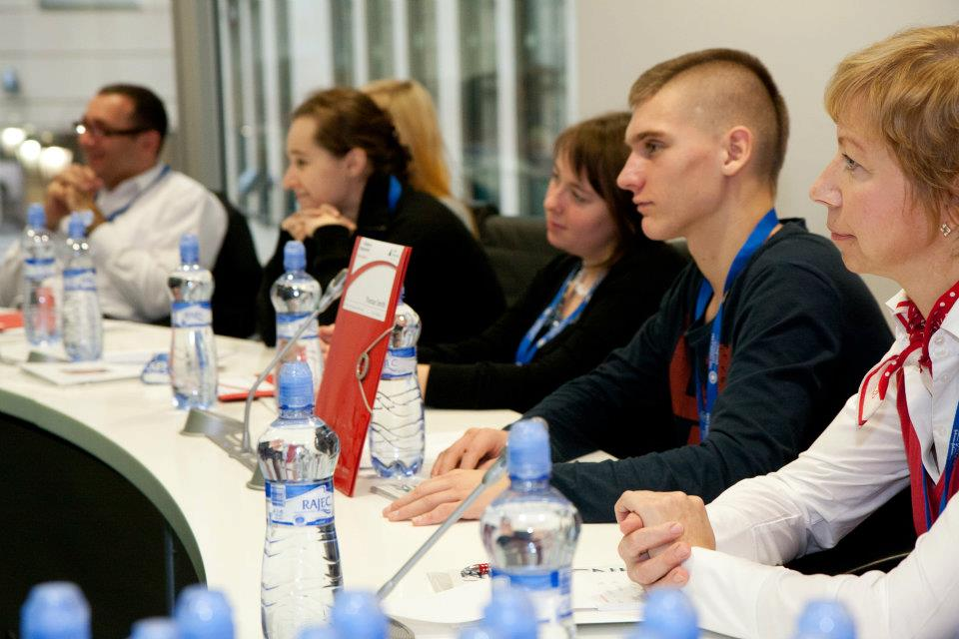
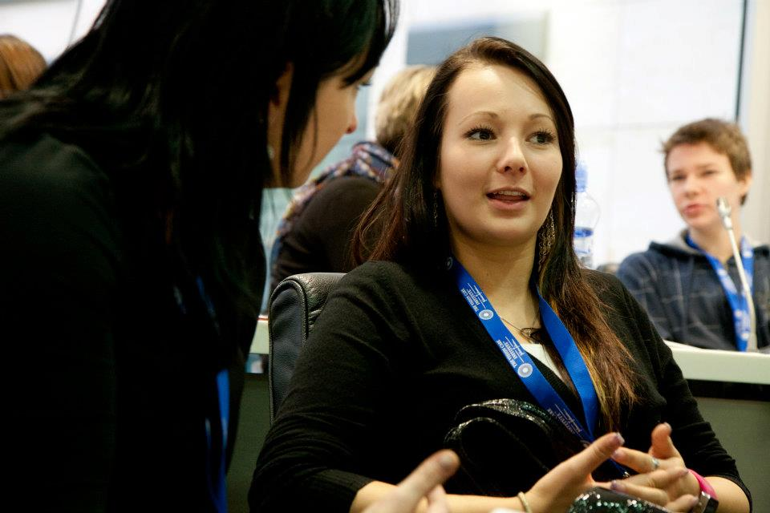
Johnson & Johnson Credo
23rd November 2011

Slide 3
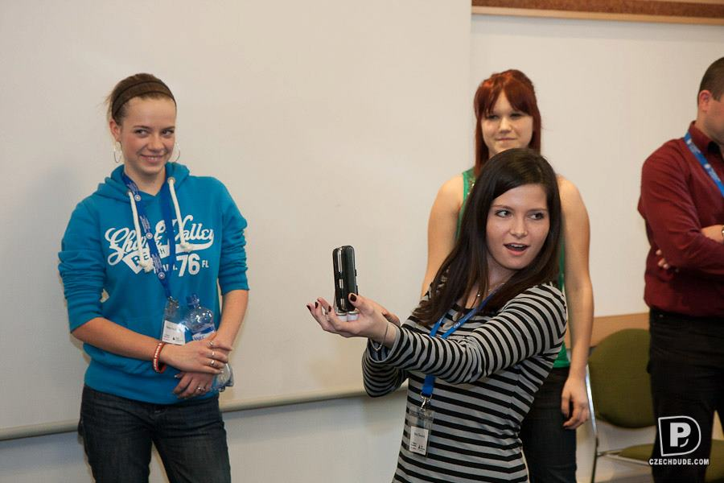
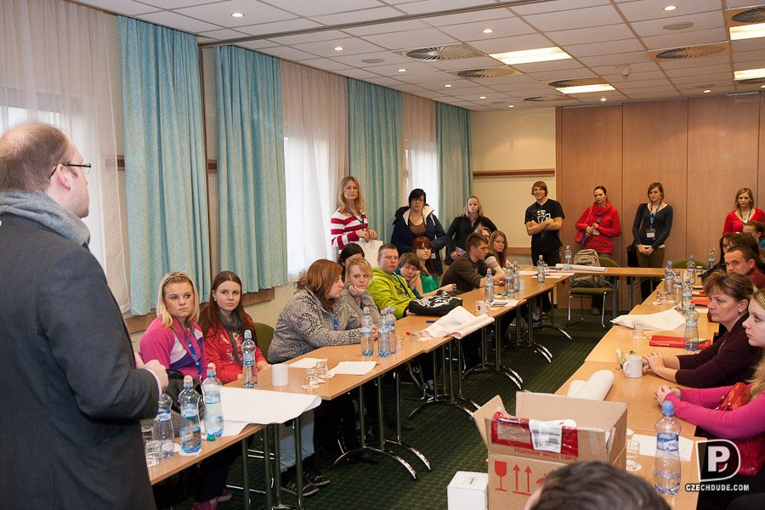
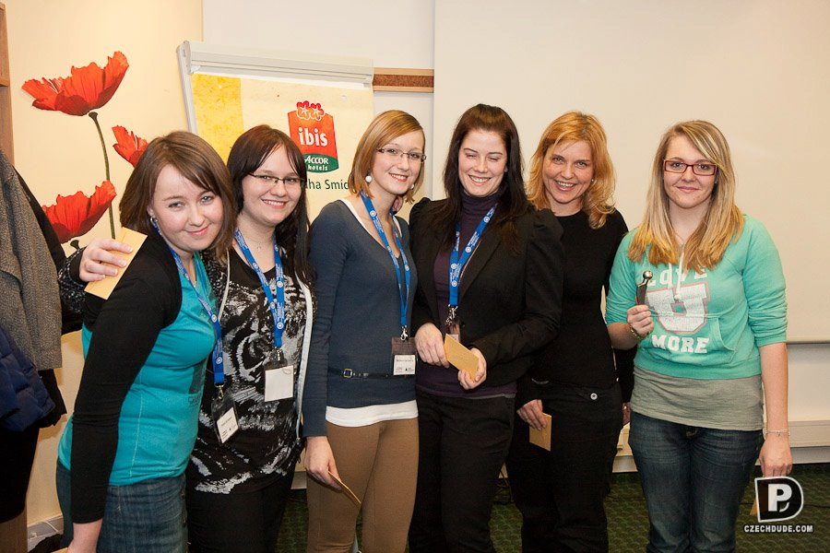
Prepairing for ABTS 2012 Application (CV, Cover Letter)
26th January 2012

Slide 4
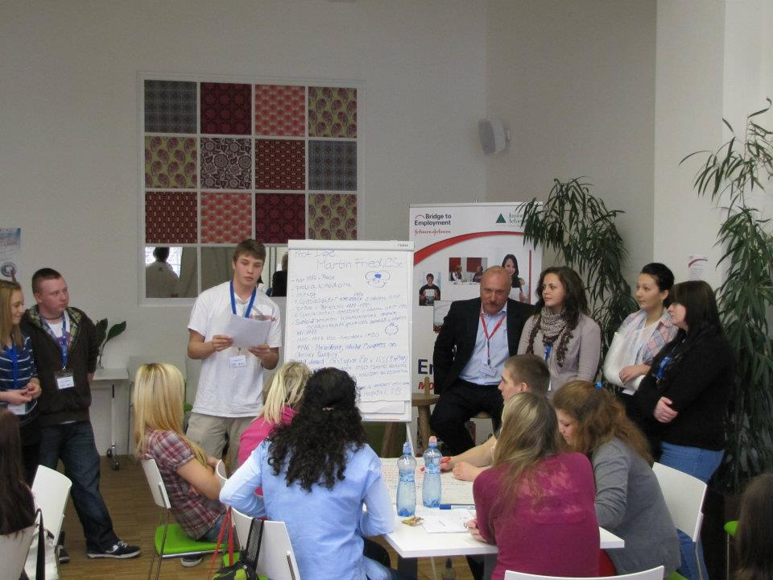
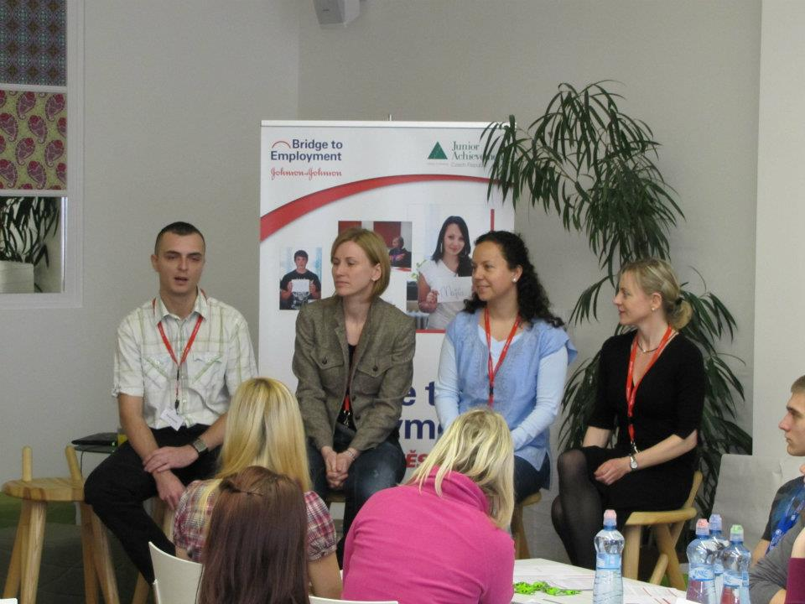
Meeting HCP with an International Experience
14th March 2012

Slide 5
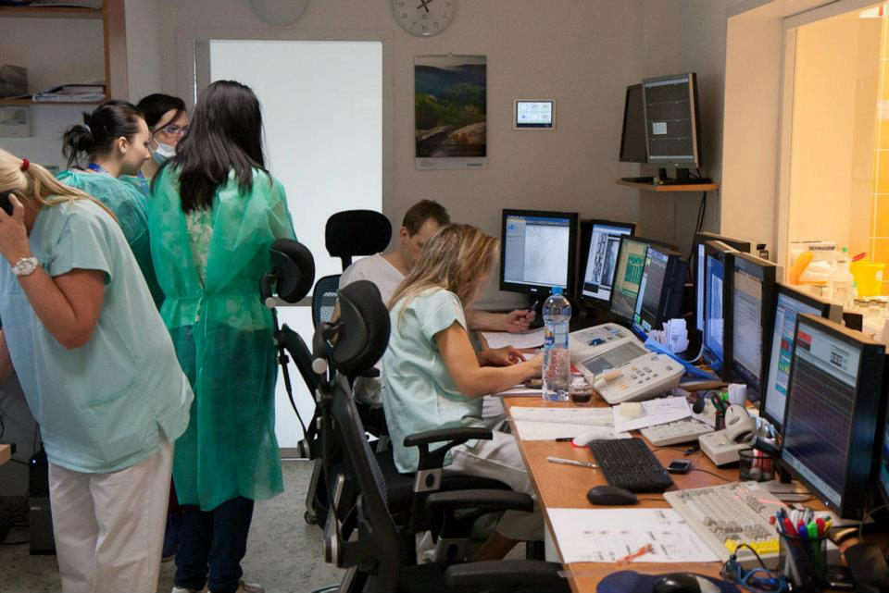
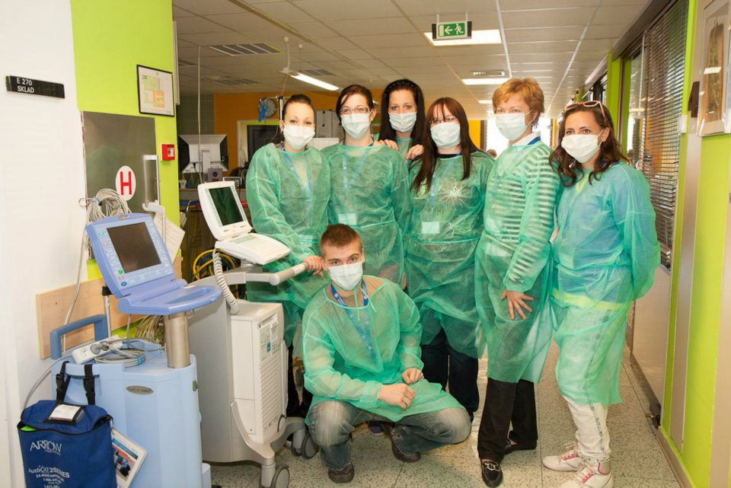
The Homolka Hospital Visit
18th April 2012

Slide 6
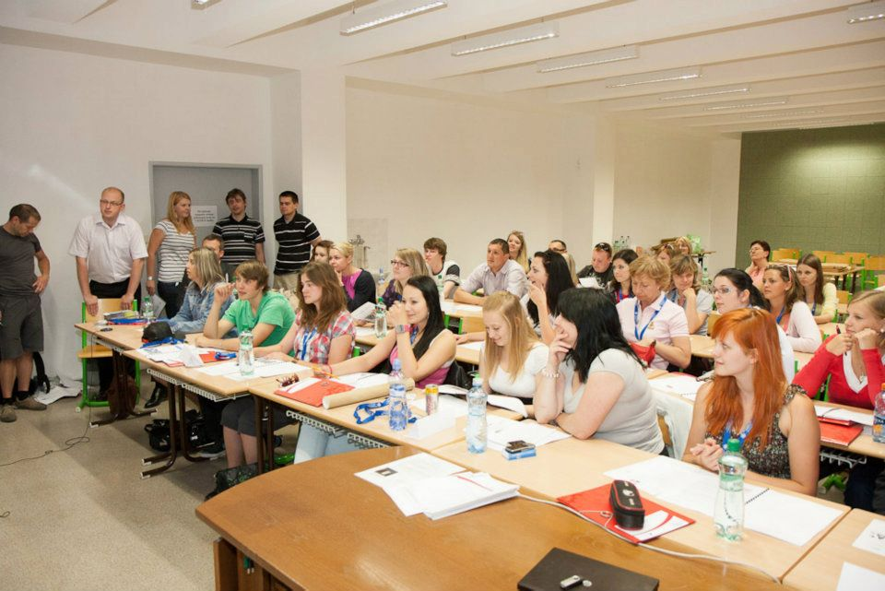
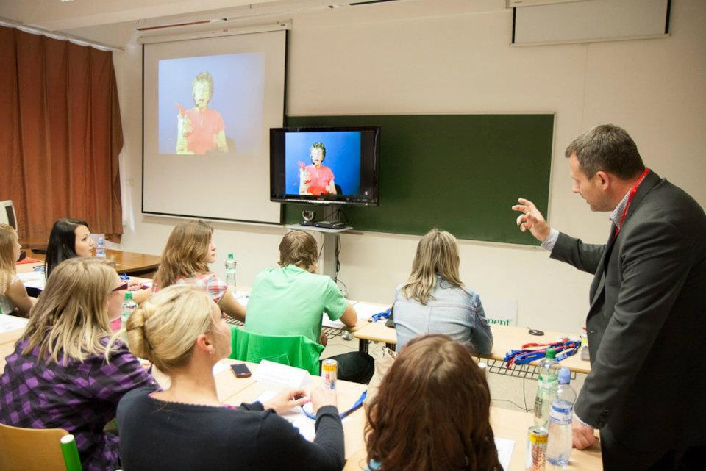
Operation Direct Link – Live from… Cardiac Classroom
31st May 2012

Slide 7
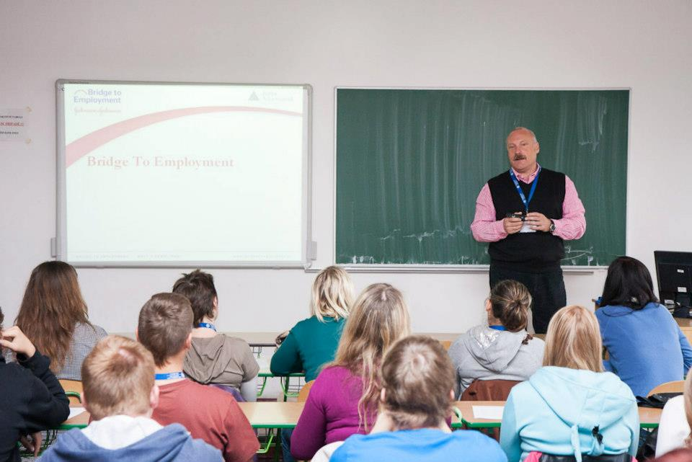
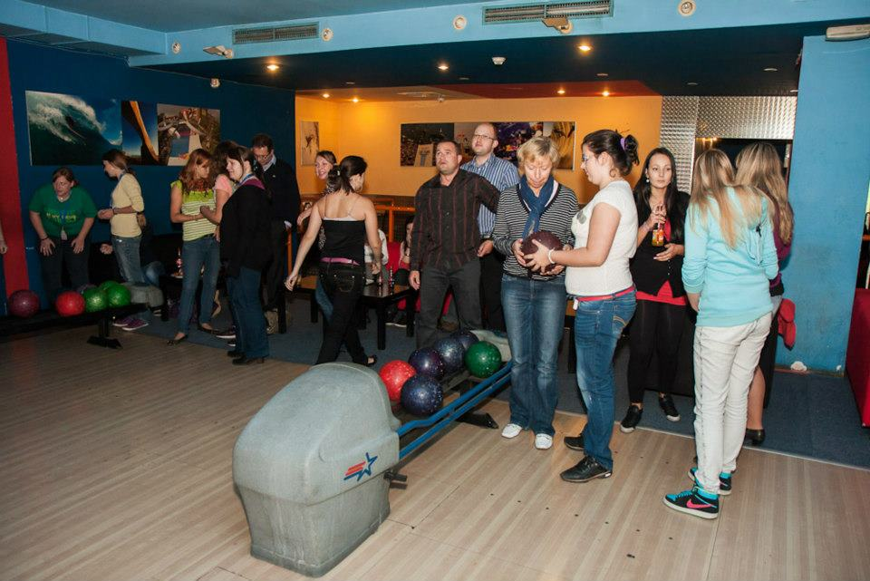
Start of BTE Year of Obesity
19th September 2012

Slide 8
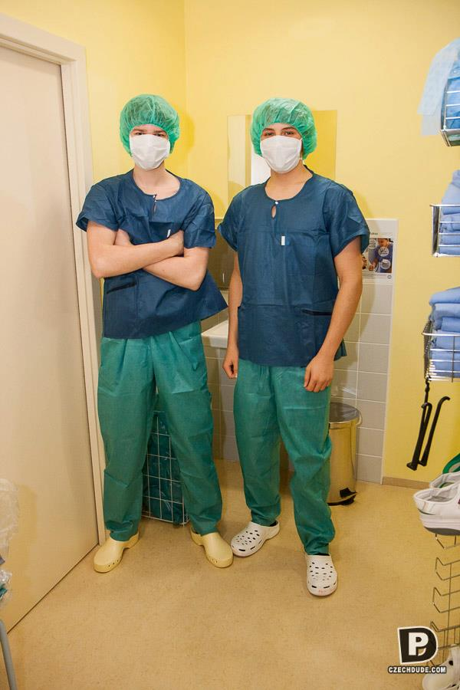
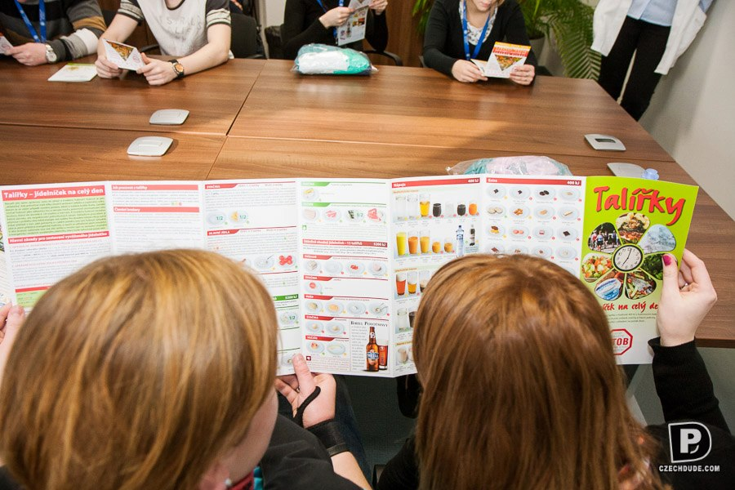
The OB Clinique Visit
14th November 2012

Slide 9
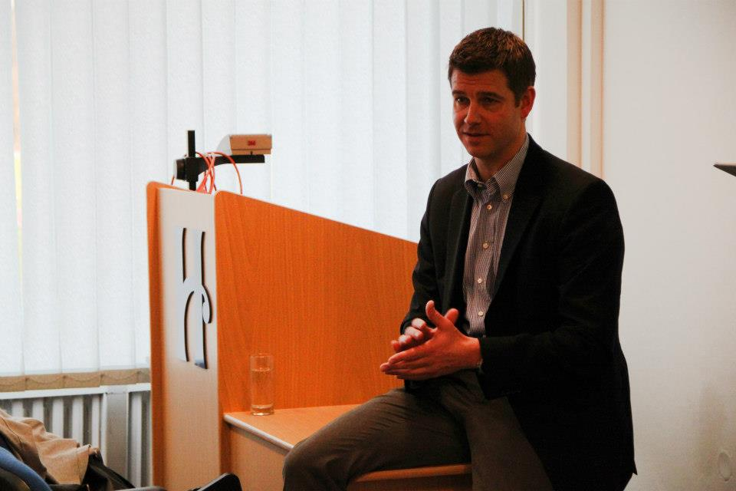
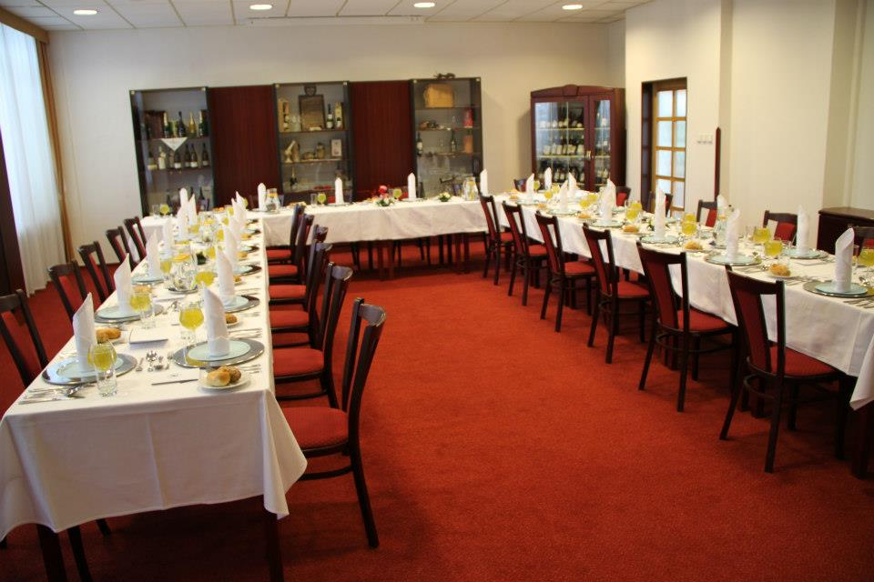
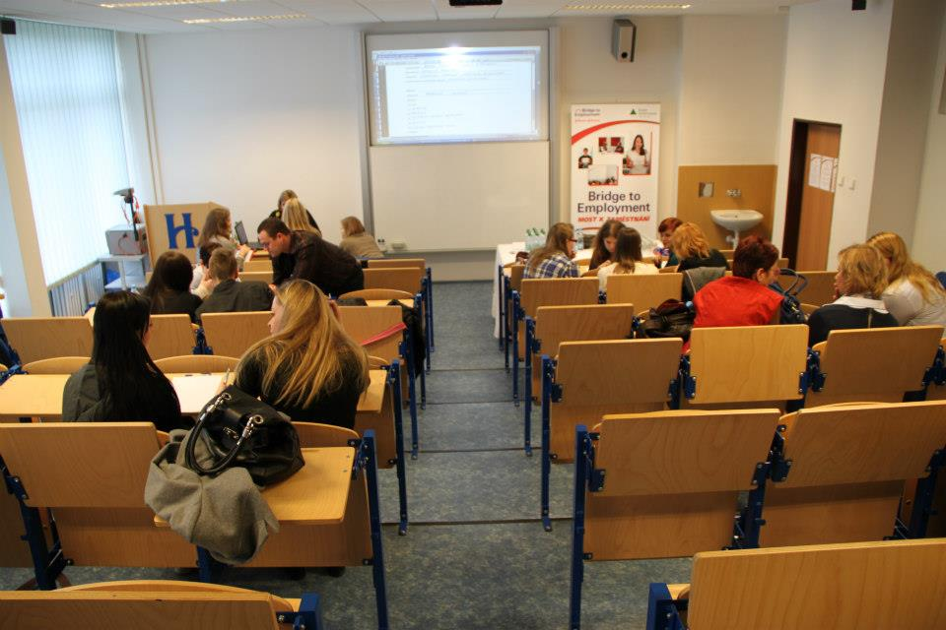
Ethics and Etiquette in Healthcare
30th January 2013

Slide 10
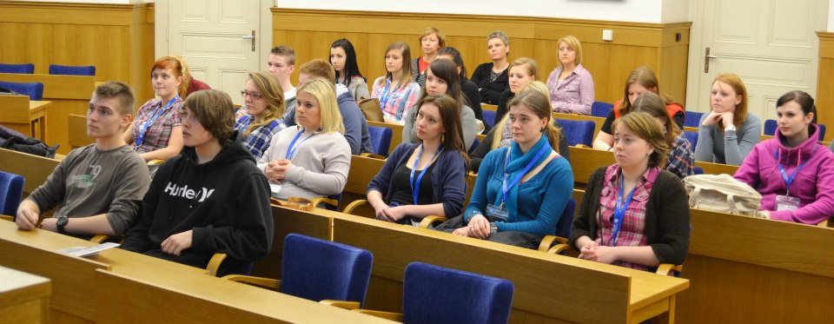
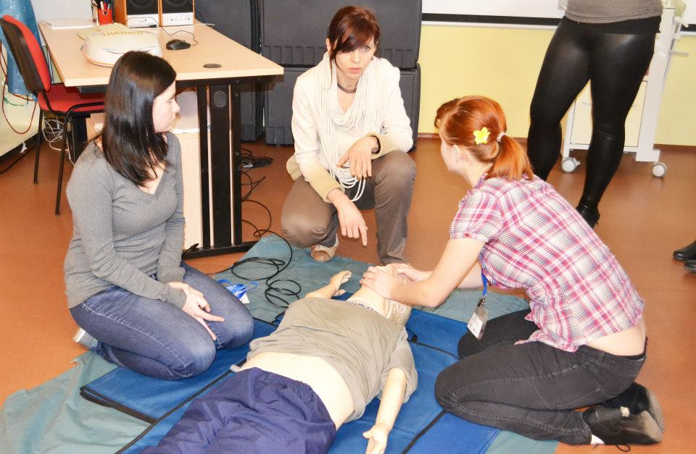
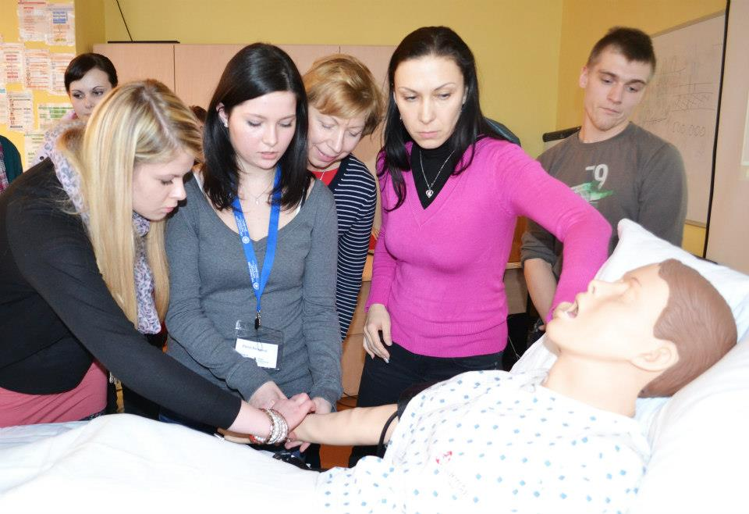
University Day
21st March 2013

Slide 11
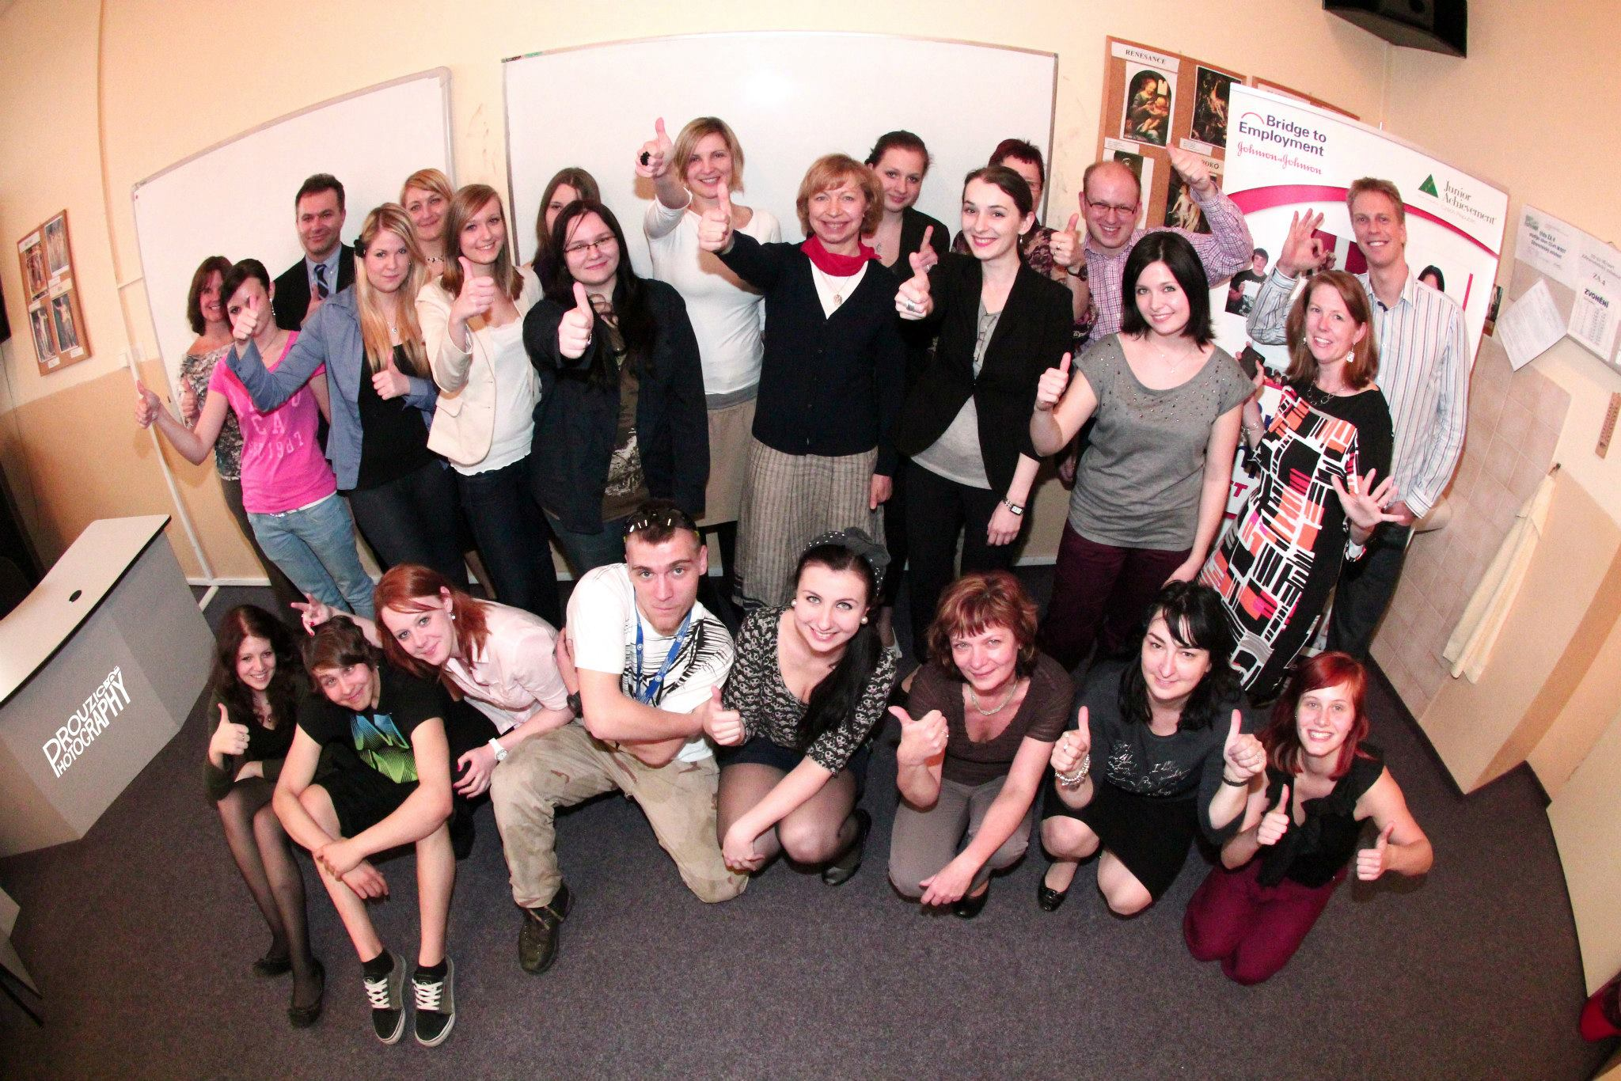
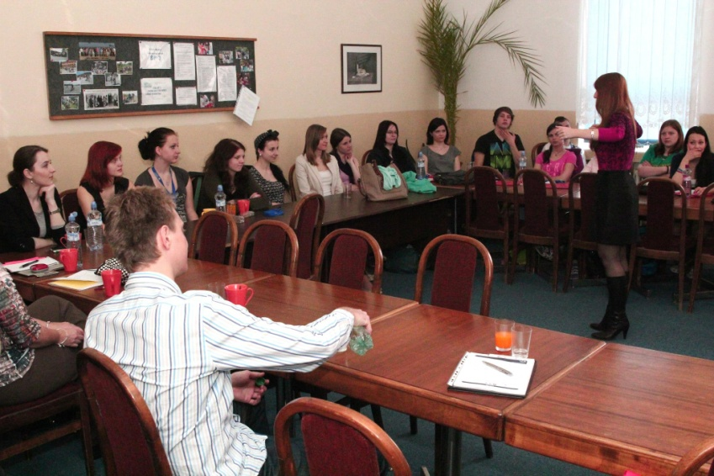
Project Day
18th April 2013

Slide 12
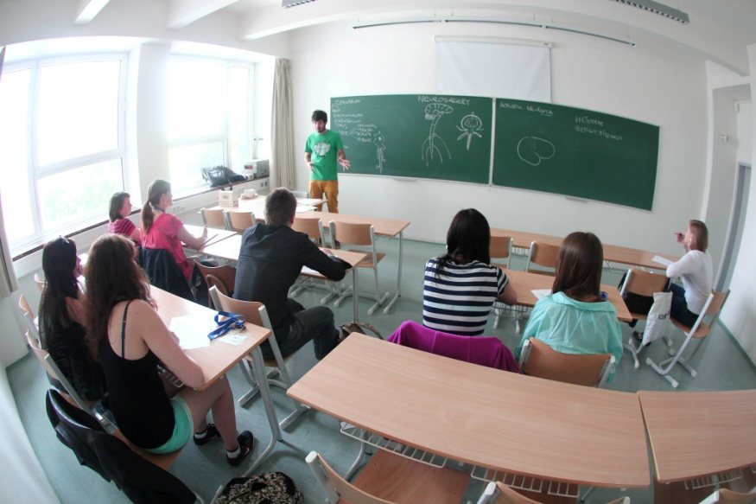
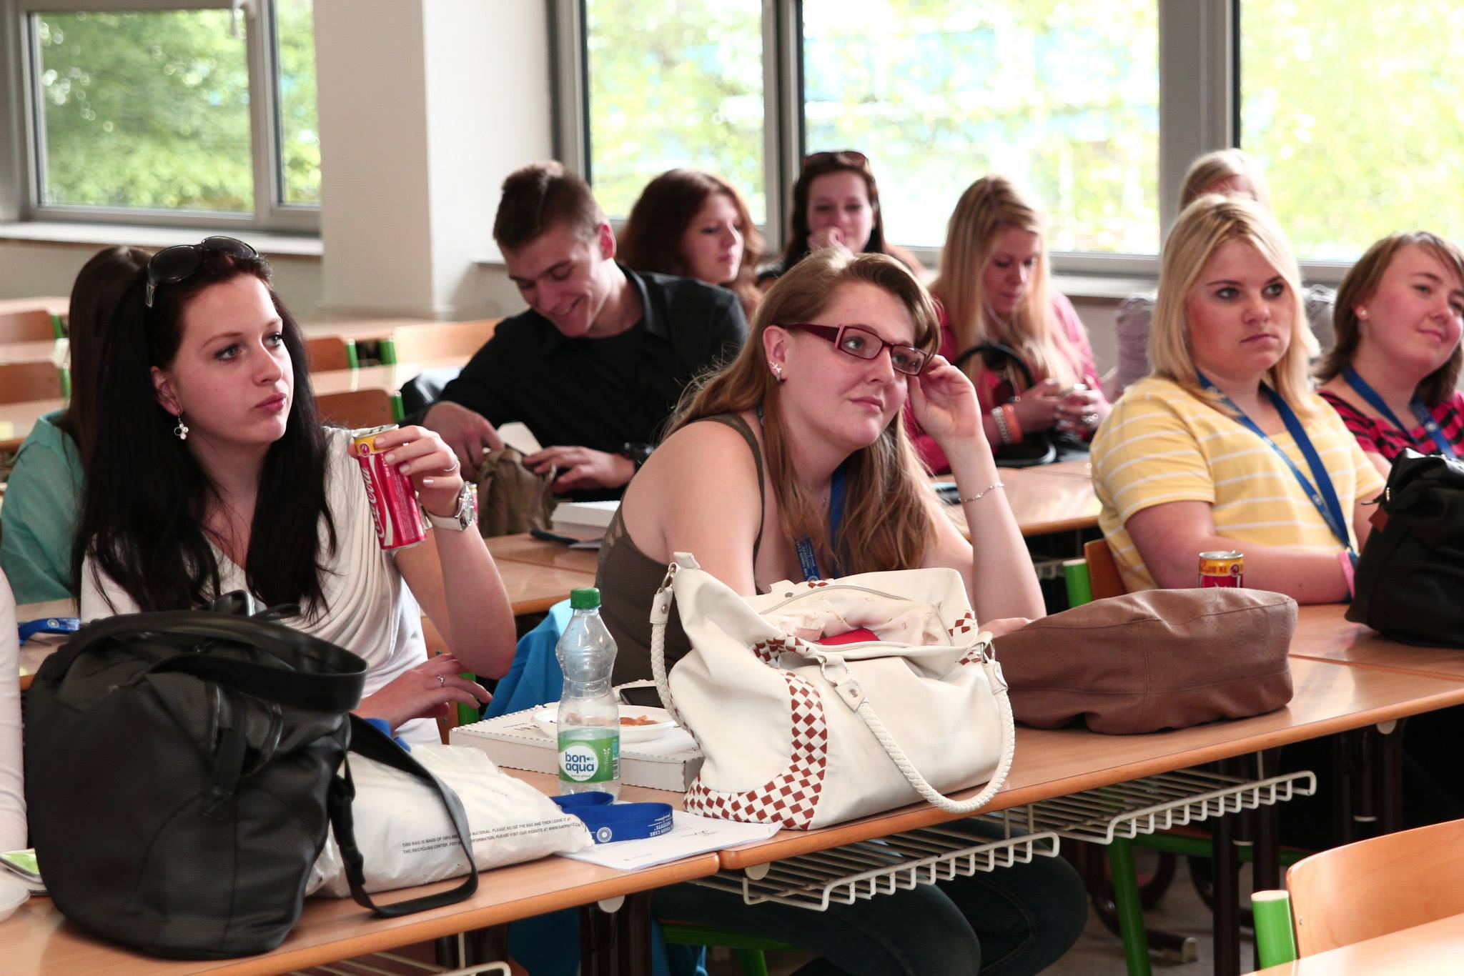
Operation Direct Link – Live from… Neurosurgery
16th May 2013

Slide 13
What are we going to do this year?
September 2013 – Breaking down first barriers
November 2013 – I want to be an university student
December 2013 – What comes after highschool? January 2013 –Working in Healthcare is a mission..
March 2013 – Bridge to employment
April 2013 – BTE Graduation Ceremony

