Slide 1
Bridge To Employment (BTE)
Dominic M.
(Nairobi BTE Coordinator)

Slide 2
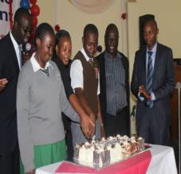
NBI BTE - Background
Launched in January 2014
- Working with 2 schools
St. Ann Gichocho – Girls’
Tala High School -Boys’

Slide 3
NBI BTE - Partners
Phillips Pharma Group –Local Operating Company
University of Nairobi (UoN)
Africa Nazarene University (ANU)
Kenya Medical Training Center (KMTC)
St. Ann Gichocho
Tala Boys’ High School
Kenya Education Fund – Local NGO.

Slide 4
Major Activities.
Health Clubs
Community Services
Job shadowing
Academic Enrichment
Higher Education Exposure
Life skills
Holiday Camps

Slide 5
The Holiday Camps
One week full board residential camps
All partners come together for planning
Usually agree on a theme guided by:
The evaluation report,
Feedback from previous camps and
Annual workplan.
Last camp focused on
Career Mapping/Coaching
Job shadowing
Community Service
Others issues covered included Leadership, effective communication among others
Fun.

Slide 6
Prog cont.

Slide 7
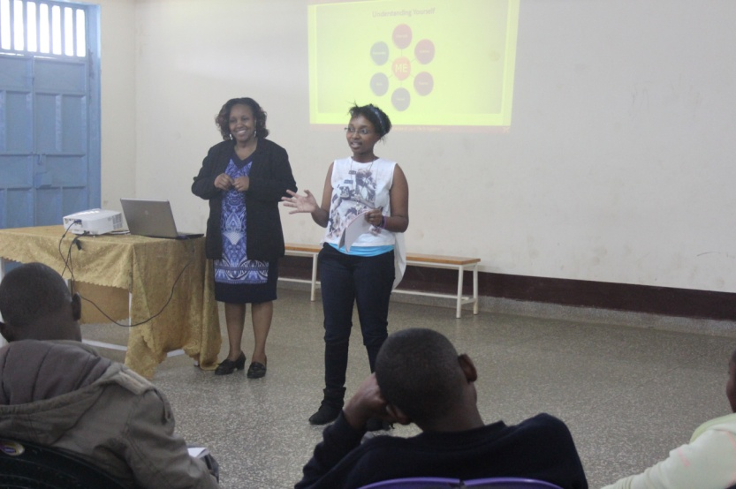
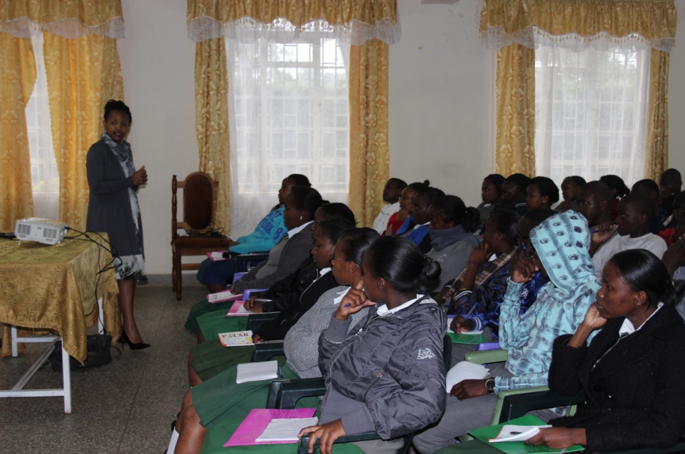
Career Mapping/Coaching
Achieved by inviting career and Human Resource experts
Had four 2-hour sessions
Presentations
Group activities
Scenarios
Talks by practioners

Slide 8
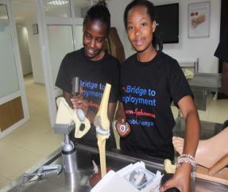
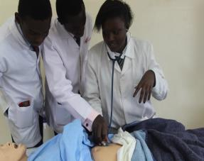
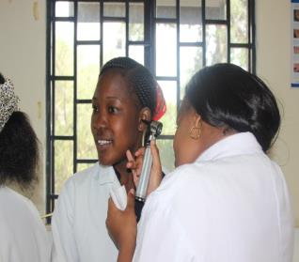
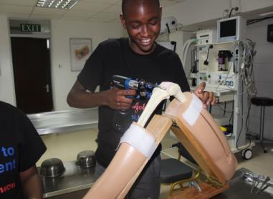
Job Shadowing
Visited two places this time – Nairobi Surgical Skills Centre
And Kenyatta National Hospital
KEF KEF

Slide 9
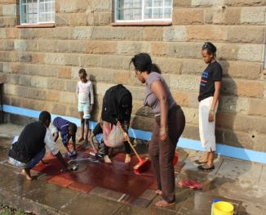
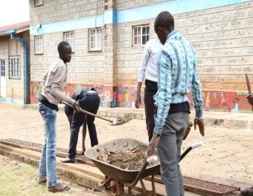
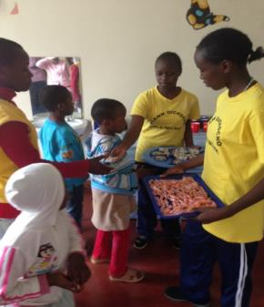
Community Service
To develop the sense of giving back and empower their communities and portray their schools as a good neighbour.
Visited two Orphanages : Nyumbani Childrens’ Home
St. Thomas Barnado
Helped with - Cleaning, Food Preparation, Playing,
Reading stories, Donations etc.

Slide 10
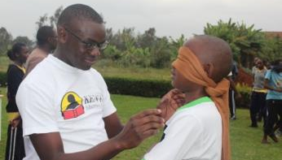
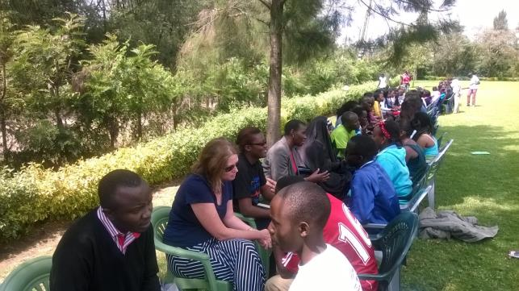
The Camps
Opportunities for Speed Coaching
Lots of life skills sessions.
Many interactions with university students.
Interactions with professionals & volunteers.
Important sessions covered during these camps.
Opportunities for
feedback after
tours and visits

Slide 11
END
Thank you

